Slide 1

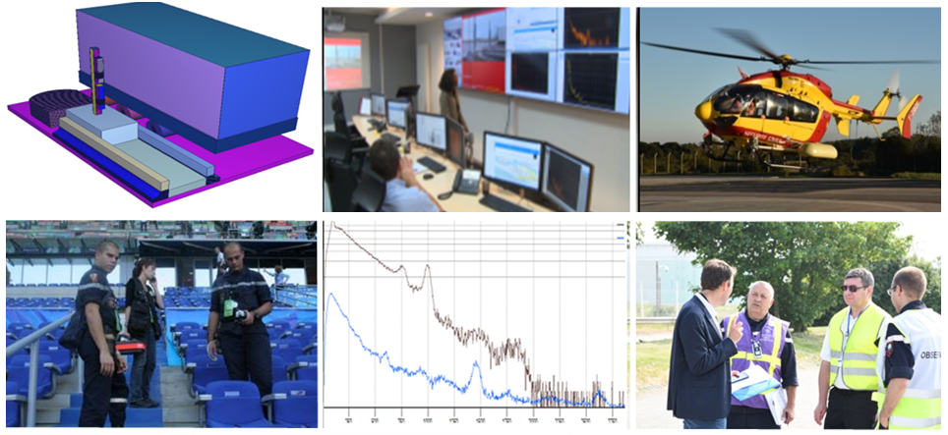
French advanced reachback capabilities in support to RN security
IAEA | International Conference on Nuclear Security | February 2020
CEA - France | Daniel Massé

Slide 2




CEA and Homeland Security:
R & D programs and operational unit
Nuclear non-proliferation
Supporting national and international authorities
Developing detection tools of proliferation activities
Nuclear test monitoring
Development, exploitation of CTBT stations
R&D for homeland security:
Detection and identification of CBRN-E agents,
cybersecurity, infrastructure security, …
Fight nuclear and radiological terrorism
Intervention in case of radiological accident or incident involving weapons or nuclear propellant

Slide 3
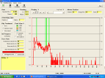

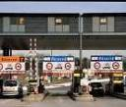

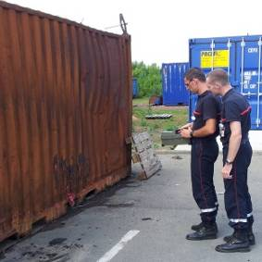
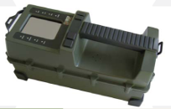
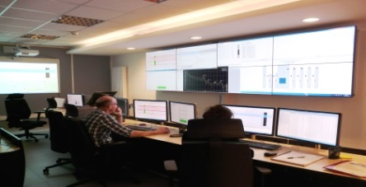
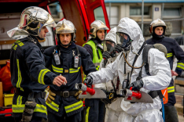
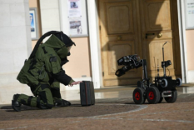
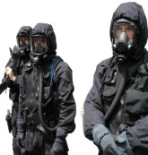
Advanced Reachback in CEA - Assistance to French authorities
Focus on a “TRIAGE” mission
Intelligence
Police, customs, …
CEA analysts
“TRIAGE unit” on duty 24/7
Technical information
First responders, CEA/DAM teams, monitoring systems, etc.
Threat evaluation
Data analysis
Assessment
and engagement of a
SUITABLE RESPONSE
Expertise, interpretation, numerical simulation, …
Notes:
Missions of CEA in the field of Homeland Security
As L. Olmedo presented yesterday, operational missions has been « assurées » and the whole architecture has evolved over the years.
Goal of that presentation: present several examples of expertises performed in different contexts to highlight the importance of all the components of the architecture required for outstanding reachback

Slide 4



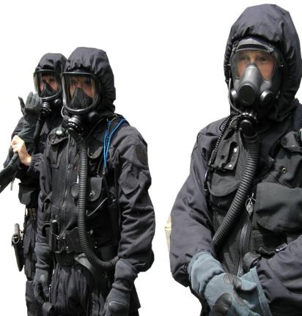
Who is supported by the CEA national reachback center?
First responders
    Fire brigades
    Civilian defence units
    EOD teams (bomb squad)
    Police SWAT (RAID)
    Customs
    Overseas military units
    …
    Specialized units
    CEA experts in operation
    CBRN Counterterrorism police unit (DCI_IT ➔ CEA is part of it)
    …
DCI-IT Missions:
    Intervention on improvised devices type CBRN
    Technical CBRN Assistance (police, gendarmerie, customs, …)
    Assistance for CBRN security of MPE
    RN TRIAGE surveys ➔ CEA National reachback center

Slide 5



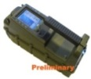

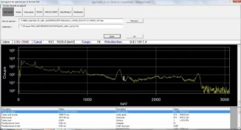
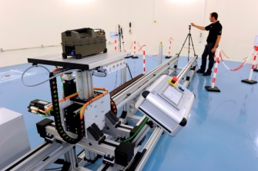

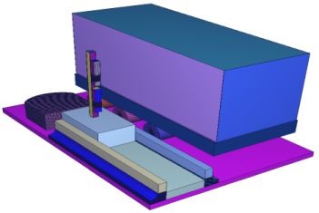
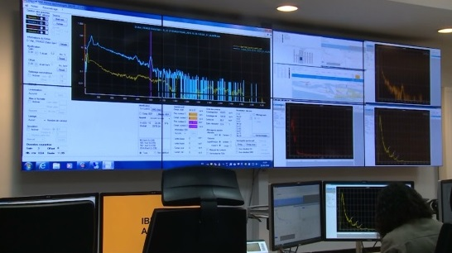
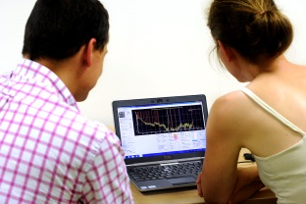
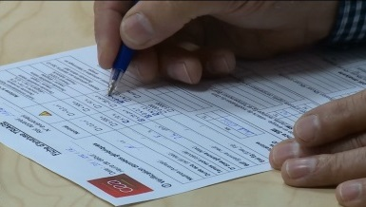
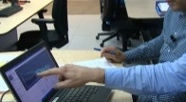
Reachback in CEA - Assistance to French authorities
A complete frame in the service of first responders
Interoperable detectors
Detector assessment and advices
Analysis and simulation tools
REACHBACK
  RN Experts on duty 24/7
  To support and expertise…
Course
Approved guidelines, operating mode
Adapted
Organisation
Training
  … for First Responders quick response < 1h
Notes:
Missions of CEA in the field of Homeland Security
As L. Olmedo presented yesterday, operational missions has been « assurées » and the whole architecture has evolved over the years.
Goal of that presentation: present several examples of expertises performed in different contexts to highlight the importance of all the components of the architecture required for outstanding reachback

Slide 6


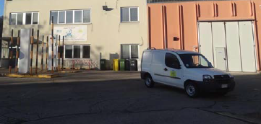
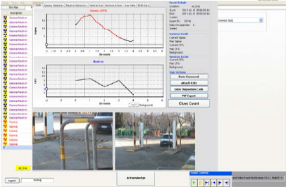
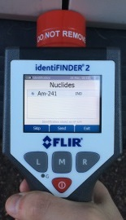
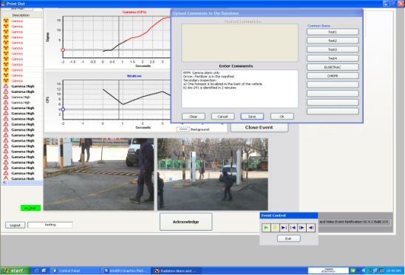
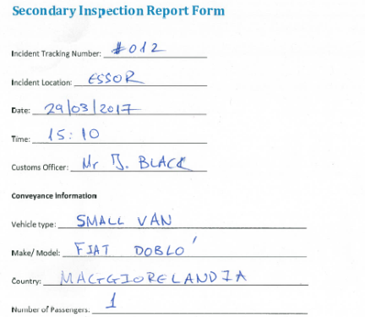
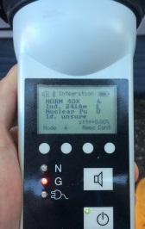
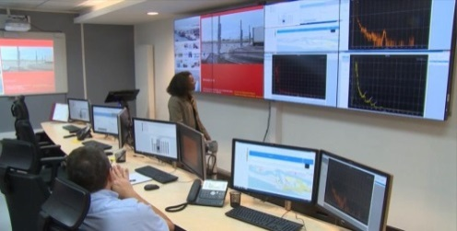
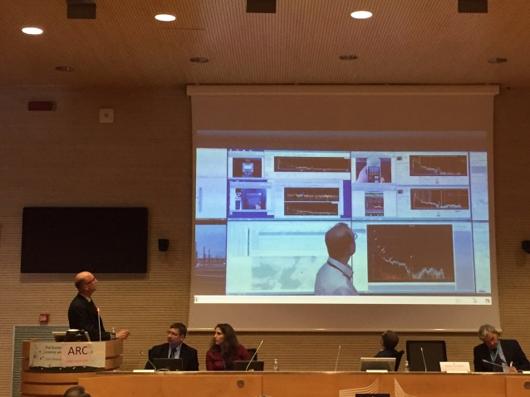
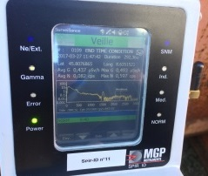
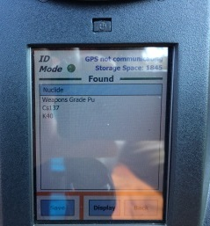
Magic Maggiore GICNT workshop – ISPRA 2017
Demonstration: Advanced Reachback Center
Boarder crossing
Detection & First level analysis
National
Reachback Center
Second level analysis
performance of :
- Technology,
- Analysis tools
- Expertise level
International/Advanced
Reachback Center
Third level analysis
Notes:
Rappel de notre rôle dans la démonstration faite à ISPRA en mars 2017 : Advanced Reachback Center
Pour cette démonstration, utilisation des moyens opérationnels du CEA dans le domaine de la lutte contre le trafic illicite et le terrorisme NRBC-E.
Reste de la présentation à pour objectifs de présenter ces outils à travers les missions et quelques exemples d’expertise réalisées ces dernières années.

Slide 7

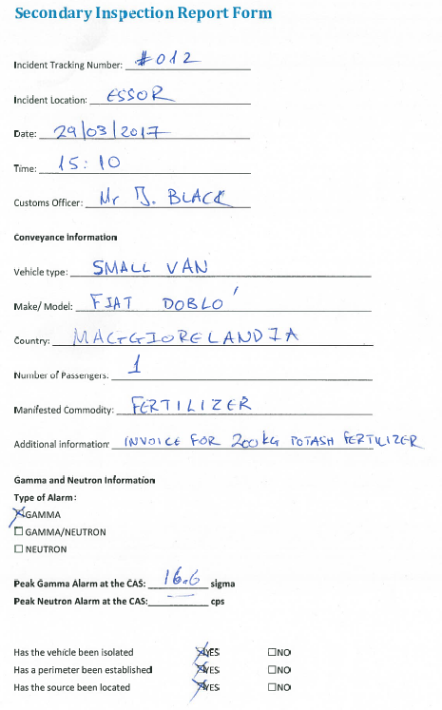
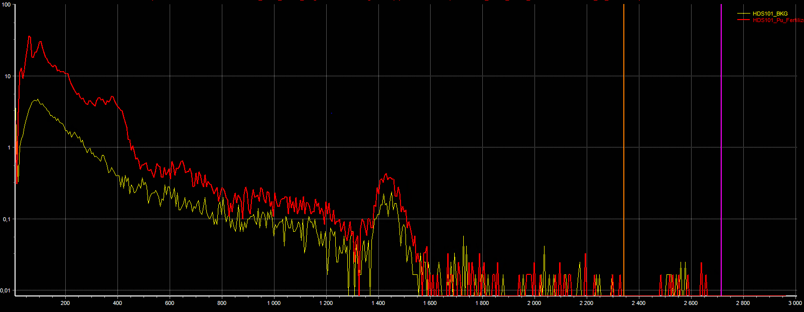
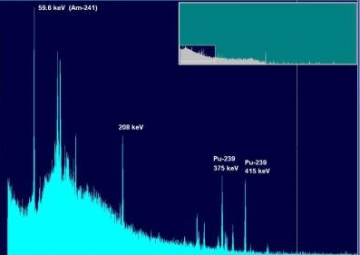
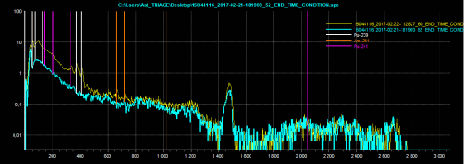
Magic Maggiore GICNT workshop – ISPRA 2017
Demonstration: Advanced Reachback Center – 3th level analysis
Transmission of all available information
RPMs profile
Secondary inspection report form
Low resolution gamma-ray spectra
Medium resolution gamma-ray spectra
High resolution gamma-ray spectra
Notes:
Rappel de notre rôle dans la démonstration faite à ISPRA en mars 2017 : Advanced Reachback Center
Pour cette démonstration, utilisation des moyens opérationnels du CEA dans le domaine de la lutte contre le trafic illicite et le terrorisme NRBC-E.
Reste de la présentation à pour objectifs de présenter ces outils à travers les missions et quelques exemples d’expertise réalisées ces dernières années.

Slide 8
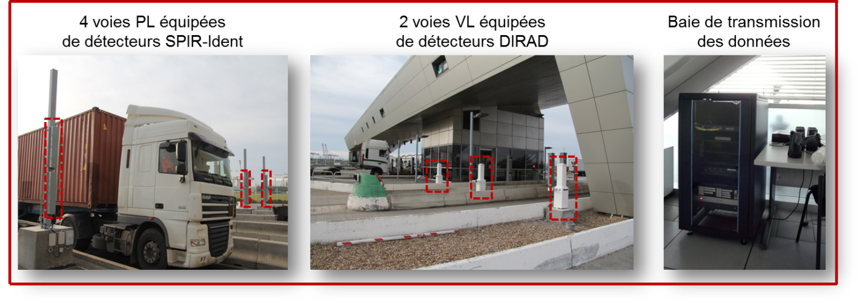
Reachback in CEA - Assistance to French authorities
Context: Monitoring of critical infrastructure
Port facility
Trucks lane equipped with
MIRION detectors
Light vehicules lane equipped
with BERTIN detectors
CEA command and transmission
Operational constraints
Minimum impact on monitored flow
Minimum specialized first responders manpower
Centralization of data and expertise
Around 4 000 vehicles / day
  ~ 15 events / day identified as NORM ➔ No alarm
  ± 1 event / week identified as in vivo medical ➔ No alarm
  Some alarms / year requiring confirmation and/or expertise
Totally automatic
No human decision
Transparent for harbor operator
Automatic sorting
  ➔ Adapted local organization and specific emergency plan (“ORSEC”)
Notes:
Plan ORSEC « CYCLAMEN » - Dispositif UK-France
Assistance to French authorities – Firemen
SDIS-62
SDIS-76
3) Monitored Harbor and associated plan ORSEC

Slide 9
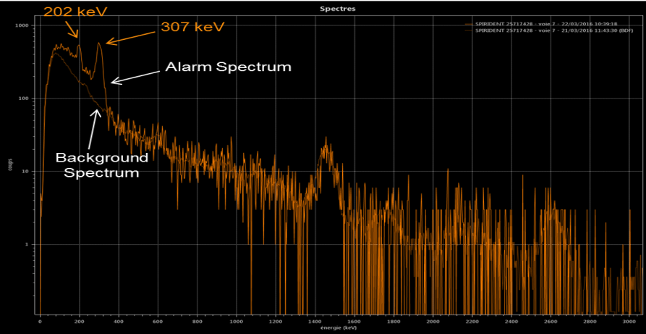

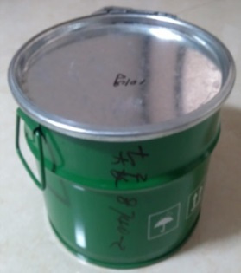

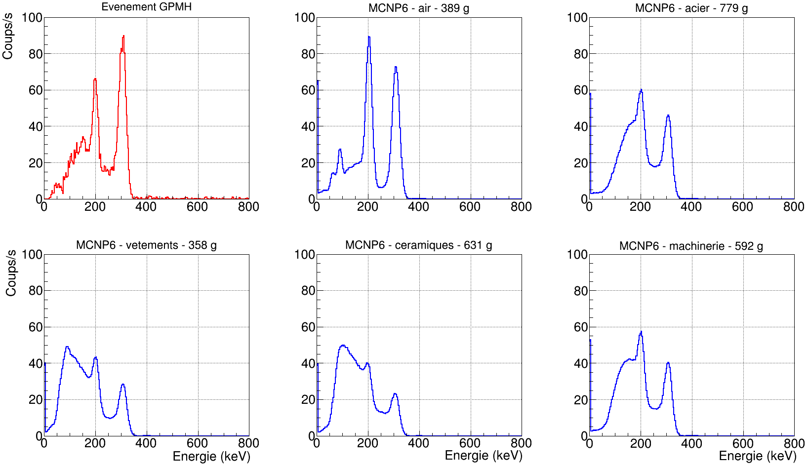
Reachback in CEA - Assistance to French authorities
Context: Monitoring of critical infrastructure
Example: Alarm with falls identification
Trucks lane
Light vehicules lane equipped
with BERTIN detectors
CEA command and transmission
Operational constraints
Minimum impact on monitored flow
Minimum specialized first responders manpower
Centralization of data and expertise
  Real-time expertise:
  Operational tools
  Lu-176 – Naturally radioactive isotope used in industry as catalyser
Lu-175 : 97,41 %
Lu-176 : 2,59 %
  Delayed expertise:
  Monte Carlo codes
  using validated detector model
  Confirmation of the mass
Notes:
Plan ORSEC « CYCLAMEN » - Dispositif UK-France
Assistance to French authorities – Firemen
SDIS-62
SDIS-76
3) Monitored Harbor and associated plan ORSEC

Slide 10
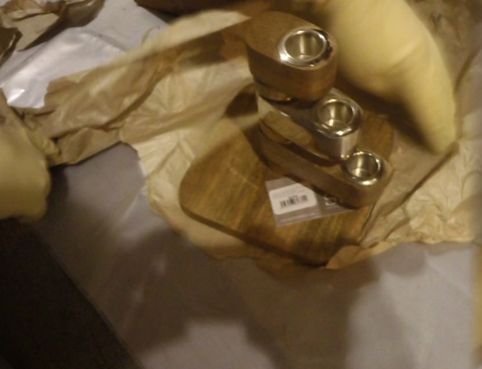
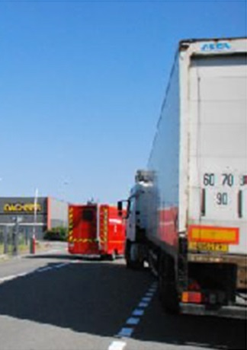
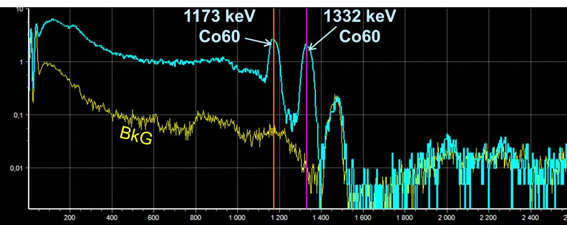
Reachback in CEA - Assistance to French authorities
Context: Expertise request from First responders and authorities
Example: Operation based on foreign custom information
  Reachback expertise requested by police unit in charge of CBRN terrorism
  Assistance to firemen intervening on a truck
  Truck contact dose rate: 2 to 6 µSv.h-1
  Truck load shipped from Asian country
  50 pallets of candlesticks (partly metallic)
  4 pallets "positive" : Co-60 identified
No threat but sanitary issue
Notes:
Plan ORSEC « CYCLAMEN » - Dispositif UK-France
Assistance to French authorities – Firemen
SDIS-62
SDIS-76
3) Monitored Harbor and associated plan ORSEC

Slide 11
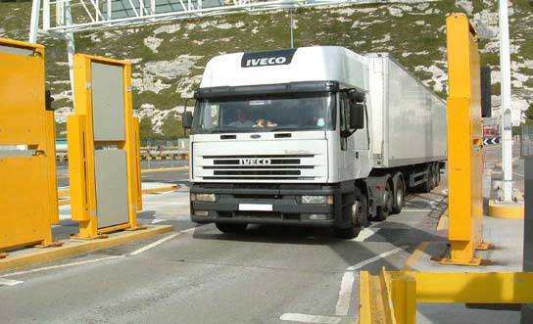
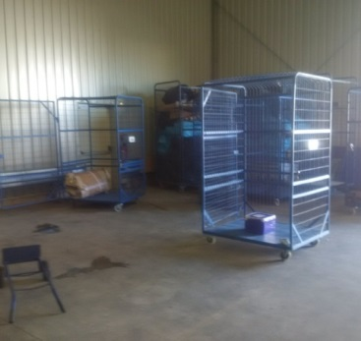
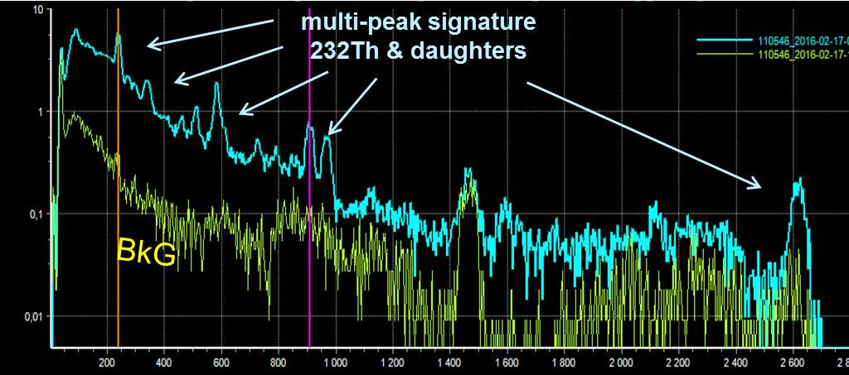
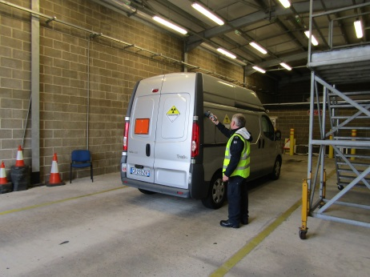
Reachback in CEA - Assistance to French authorities
Context: UK boarder Force at Channel Tunnel “Eurotunnel”
UK boarder Force
  CYCLAMEN detection
  UK BF inspection
French authorities
➔ emergency plan (“ORSEC”)
  Investigations:
  Customs and Police
  Radiological aspects:
  First responders = Fire brigade
Refused access to UK
Example: vehicle transferred to French authorities by UKBF
  Reachback expertise requested by police unit (PAF) and fire brigade (SDIS_62) ➔ Th-232 confirm
No threat but sanitary issue
Notes:
Plan ORSEC « CYCLAMEN » - Dispositif UK-France
Assistance to French authorities – Firemen
SDIS-62
SDIS-76
3) Monitored Harbor and associated plan ORSEC

Slide 12
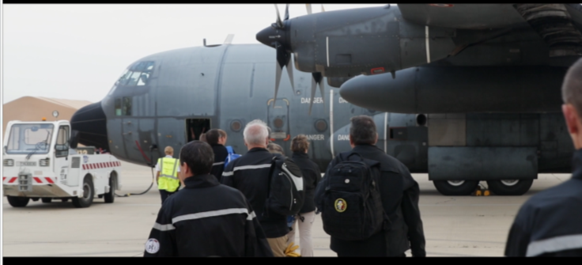
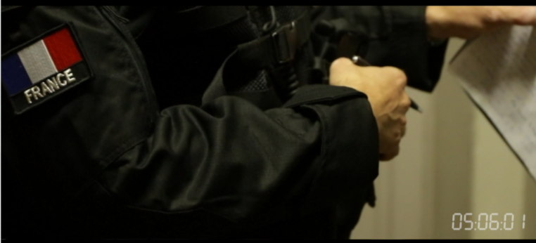

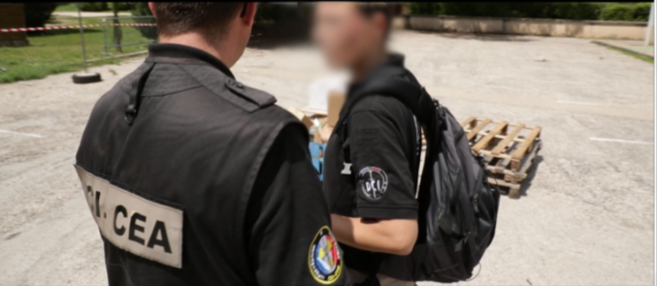
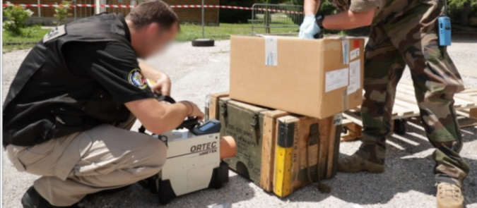
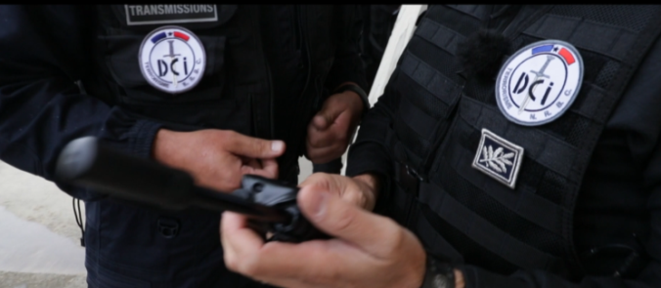
Contribution of the CEA advanced reachback center: supporting field operations
Context: Counterterrorism Police operation after expertise by the reachback center, the analysts :
    Know exactly what the initial technical situation is
    Are part of the field teams and are in their duty period
    Can deploy the most appropriate equipment and complementary measures on the field
    …

Slide 13
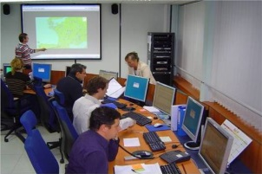


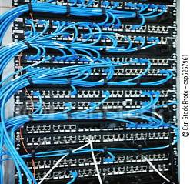















Conclusion
Towards the right balance …
… between detection technologies and reachback …
… to minimize infrastructure and manpower costs
24/7 REACHBACK - CNER
24/7 supervision
For guaranteed operational response
National Center for Radiological Expertise
Communication and routing system with star network
Mock-ups and metrology platform
(detector characterization, simulation models validation, hard/soft tests, …)
Detectors
Fixed
Hand held
First responders
requiring assistance
Training platform
(theory, tutorials, exercises, …)
Notes:
Plan ORSEC « CYCLAMEN » - Dispositif UK-France
Assistance to French authorities – Firemen
SDIS-62
SDIS-76
3) Monitored Harbor and associated plan ORSEC

Slide 14

Thank you for your attention
11th February 2020
daniel.masse@cea.fr
Centre DAM Île de France | DASE/SPR
Bruyères-le-Châtel – 91297 Arpajon CEDEX
T. +33 (0)1 69 26 44 59 | F. +33 (0)1 69 26 70 61
  Etablissement public à caractère industriel et commercial | RCS Paris B 775 685 019
Direction des Applications Militaires
Département Analyse, Surveillance, Environnement
Service de Protection contre les Rayonnements

