Slide 1
NUCLEAR SECURITY MEASURES
BEST PRACTICES ASSOCIATED WITH NUCLEAR / RADIOLOGICAL THREATS
MAJOR PUBLIC EVENTS
Unified Approach
N. Benson¹, S. Buntman², S.White^{3.} and R. Maurer⁴
¹ Panama Ministry of Health, Department of Radiation Health
² DOE/NNSA Office of Nuclear Incident Policy and Cooperation
³ Department of State, Embassy Panama City (DOS)
⁴DOE/NNSA Remote Sensing Laboratory, National Security Technologies

Slide 2
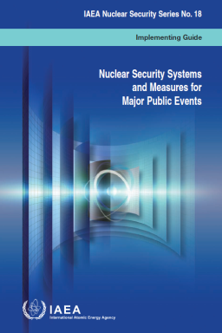
Nuclear Security Systems and Measures
The threat of nuclear terrorism is of great concern to countries hosting MPEs.
Major Public Events (MPEs) are challenging environments in which to conduct nuclear security measures
Many of these events are conducted at the national level and involve long lead time planning efforts and cooperation among a large number of local, state, and federal agencies
The intent is to not only protect the public from an incident or attack, but also to deter terrorists by displaying a strong readiness capability
A Nuclear Security Plan is developed to prevent, detect, interdict and respond to nuclear and radiological incidents and accidents
First Responders are trained and have proper instruments
Emergency Management Systems
Challenges with integration of Minsters, security forces and technical subject matter experts, security measures and command and control

Slide 3
Nuclear Security Systems and Measures
Panama – Unified Approach to CBRNE
The Panamanian response teams are derived on the basis on the April 2018, Decree 81
National Security Council of Panama, under orders from the Presidency, brings together an interagency team to manage CBRNE prevention and response.
CBRNE Unit: Task Force San Miguel Arcángel (FTC-SMA)
Included all of the security sections
Ministries are joined under one CNRNE Command
CBRNE Team
National Border Police, National Air and Naval Service, National Police Explosive Unit, National Customs Authority, Palace Guard, and Directorate of Public Health.
Enhanced coordination between civilian and military organizations
Sharing of knowledge and expertise, exchange of technological resources
Addressed Lesson Learned associated with:
Implementation of IAEA NSS-18, National Response Framework, coordination and information sharing, integration of mission requirements, clear chain of command and control.
Validated during the MPE associated with the 2019 World Youth Day

Slide 4
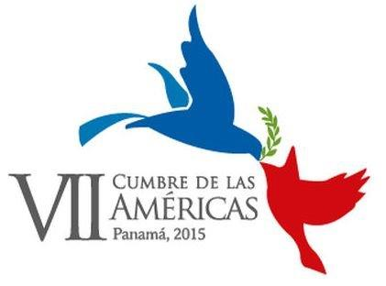
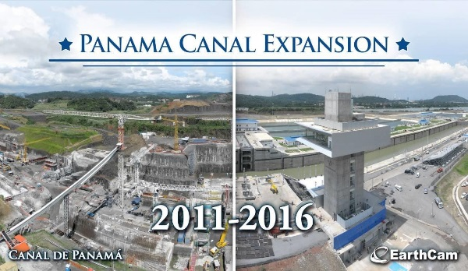
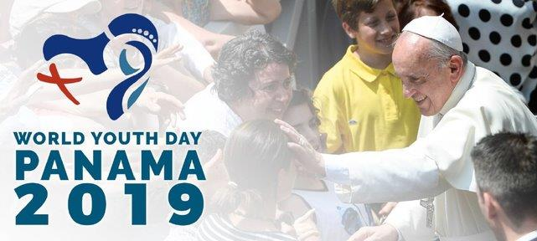
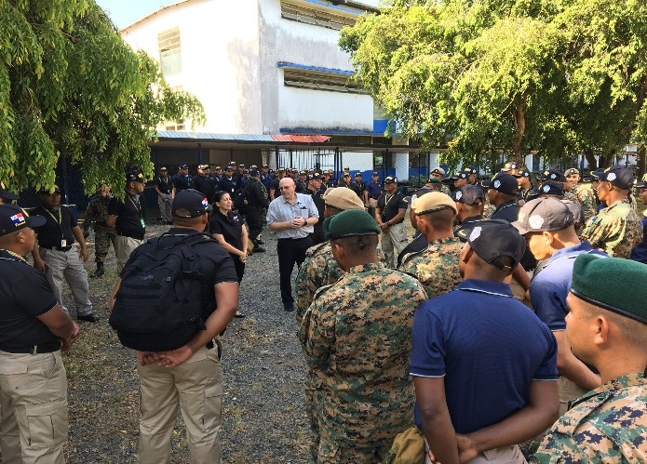
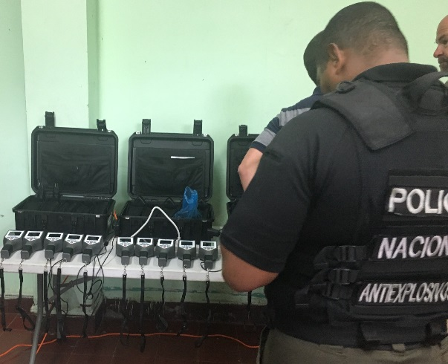
MPE Preparedness for Preventing a Terrorist Event
Panama Assistance
clear Incidents
DOE/NNSA - Nuclear Incident Policy and Cooperation
IAEA, Nuclear Security, Materials Out of Regulatory Control
DOS , Export Control and Related Border Security Program (EXBS)
Decree 81 Implemented
Supporting 12 venues
25 R/N Responders-
Trained - 2 Ministries
U.S. DOE in cooperation with IAEA, conducted a variety of courses, exercises and support to address nuclear security measures for Panama’s MPEs.
Major public event training
Training and exercises
Advisory support,
Radiological reach back support
Technical assistance
Operational support
20 R/N Responders-
Trained - 2 Ministries
120 CBRN Responders R/N Trained - 6 Ministries
R/N Equipment

Slide 5
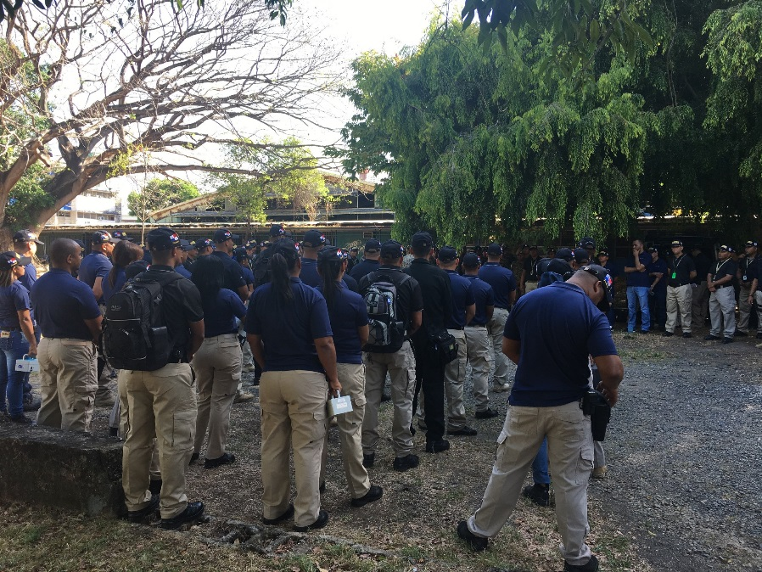
Questions ?
Panama New National Concept for
Emergency Preparedness and Response
Response Team’s
Ready To Respond To Chemical, Biological, and Nuclear/Radiological Incidents

