Slide 1
Radiological Risk Reduction through the Utilization of Low Energy Electron Beam
¹Jennifer Elster, Ph.D. & ²Suresh D. Pillai, Ph.D
¹Pacific Northwest National Laboratory , Richland, WA
²Texas A&M University, College Station, Texas
.

Slide 2
Presentation Outline
Motivation
Current activities
  Blood Irradiators
New opportunities and strategy
  Research irradiators & industrial sterilization
Low Energy electron Beam technology & applications
  Current commercial state of technology
  Current technology gaps
Future roadmap

Slide 3
Motivation
Cesium-137 based blood irradiators are high risk for a variety of factors
Cesium-137 –high on the NNSA ORS priorities for enhanced security and replacement
There is a need to replace these sources with machine-based (X-ray or electron beam) sources to prevent accidental or deliberate incidents
Many research irradiators and industrial panoramic irradiators in US and overseas rely on cobalt-60
  Many industrial cobalt-60 irradiators are high activity (> 2 million Curies)
Risks can be significantly reduced if research and panoramic industrial irradiators are replaced with machine sources

Slide 4
Replacing Blood Irradiators
US National Nuclear Security Administration (NNSA) is keen on replacing high-activity radioactive sources
CIRP program (Cesium Irradiator Replacement Program)
  NNSA currently focused on replacing Cs-137-based blood irradiators with x-ray technologies
  Site partners procure the X-ray equipment, NNSA funds Cs-137 removal and disposal (Offsite Source Recovery Project –OSRP)
Program has been very successful in the both the US and overseas
  As of Oct 1, 2019, 43,000 sources have been removed through OSRP

Slide 5
Challenges that still remain
Financial resources to remove all Cs-137 blood irradiators
Majority of panoramic irradiators around the world utilize cobalt-60
Lack of understanding of e-beam and x-ray technologies
Lack of publicly available comparative data between cobalt-60/e-beam/x-ray
Capital and operating costs associated with e-beam and x-ray technologies
Workforce shortages in personnel trained in e-beam and x-ray
Institutional lethargy to move away from traditionally utilized technologies

Slide 6
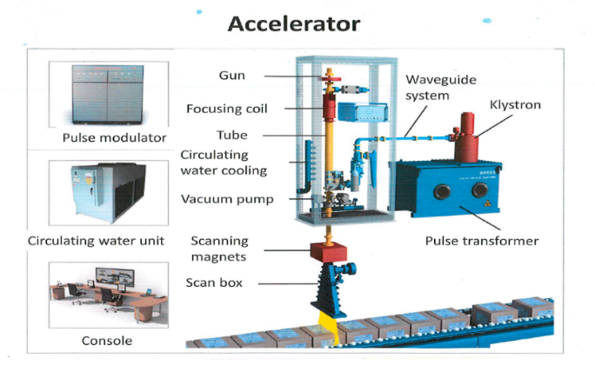
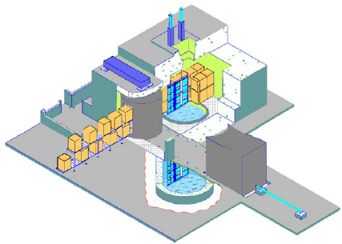
Ionizing Irradiation Technologies
Isotope based radiation
  Gamma radiation (cobalt-60 and cesium-137)
Ionizing Irradiation
Cobalt-60
eBeam
Machine generated (linear accelerators)
  Electron Beam (eBeam): electrons
  X-ray: photons
Cobalt-60
X-ray

Slide 7
Technologies to Generate Ionizing Radiation
Isotope based radiation
  Gamma radiation
  (cobalt-60 and cesium-137)
Machine generated (linear accelerators)
  Electron Beam (eBeam): electrons
  X-ray: photons
eBeam
X-ray
Cobalt-60
Cobalt-60
Ionizing Irradiation
Ionizing Irradiation
Ionizing Irradiation

Slide 8
Reality of Cobalt-60 today
X
Today, it is more expensive to build, maintain and replenish a cobalt-60 facility compared to an eBeam facility of similar production capability
Cobalt-60 is not available easily
Cobalt-60 cannot be transported easily
Cobalt-60 has major environmental and security issues
Cobalt-60 facilities will be economically unsustainable
Therefore,
Cobalt -60 technology is on its last legs

Slide 9
eBeam and X-ray Technologies
High voltage
E-Beam
E-Gun
Accelerating structure
Magnetic
scanner
E-beam particles
X-Ray
High voltage
Tantallum shield
X-Ray photons
E-Gun
Accelerating structure
Magnetic
scanner

Slide 10

Panoramic Irradiation using High Energy E-Beam

Slide 11
Not All E-Beam Technologies are the same

Slide 12
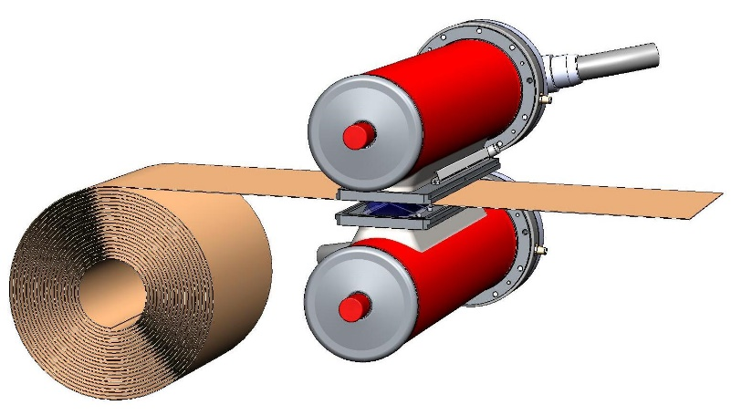
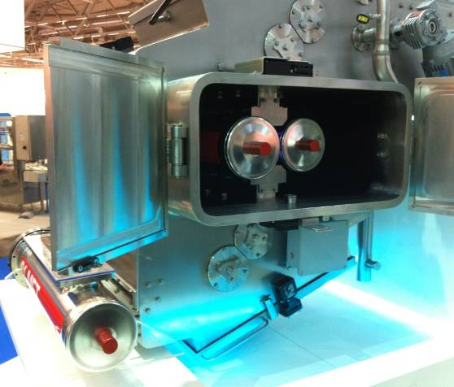
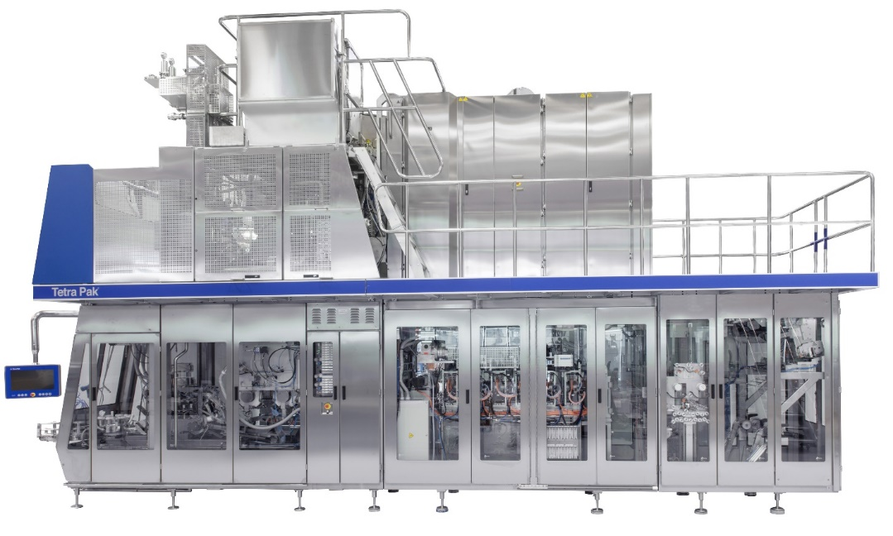
Low Energy E-Beam for aseptic packaging a Green Solution – Tetra Pak in-line eBeam application
  Substitutes H₂O₂, the gold standard for > 30 years
75% less energy than H₂O₂ for the sterilization process
40% lower CO₂ footprint
33% less power draw from the mains
> 1 billion aseptic packages produced and sold around the world
Courtesy : Tetra-Pak

Slide 13
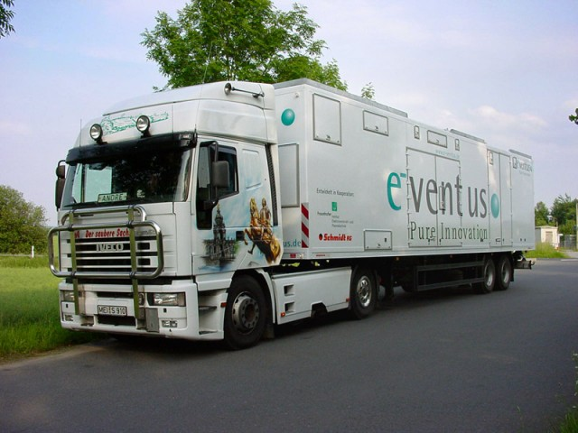
Commercial seed disinfection by low energy e-beam technology
Chemical-free treatment of seeds:
30 tons / hour
90 – 100% efficiency
Courtesy : Ian Bland,

Slide 14
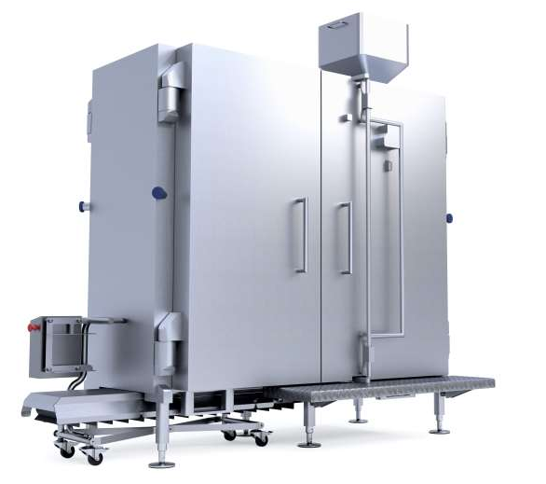
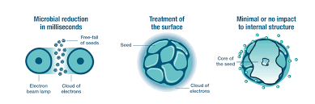
Buhler’s -Laatu™ Low Energy E-Beam for Spice Surface Sterilization
Figures courtesy: Buhler
PNNL-SA-150254

