Slide 1
Preparedness and Implementation of Nuclear Security Plan for MPEs in Viet Nam
International Conference on Nuclear Security: Sustaining and Strengthening Efforts
10-14 February 2020, Vienna, Austria
Than Thi Ngoc Mai
International Cooperation Division
Viet Nam Agency for Radiation and Nuclear Safety

Slide 2
Content
1. National Structure for response to nuclear security events
2. Implementation of Nuclear security for major public events in Viet Nam
2.1. Nuclear Security Plan for Hung King Temple Festival
2.2. Nuclear Security Plan for APEC Summit 2017
2.3. Nuclear Security Plan for DPRK – US Summit 2019
3. Advantages and Challenges
4. Conclusion

Slide 3
1. National Structure for response to nuclear security events
Prime Minister
Ministry of Science and Technology
Ministry of Finance
Ministry of Public Security
Ministry of National Defence
Local Government
VARANS
General Department of Vietnam Customs
Vietnam Coast Guard
Vietnam Border Defence Force
Department of Public Security
Department of Science and Technology
General Department of Security
Other
Vietnam Leaders Security Command (K10)
Department of Health

Slide 4
1. National Structure for response to nuclear security events
As defined in the Prime Minister Decision No. 884/QD-TTg dated 16 June 2017 on approving National Radiological and Nuclear Emergency Response Plan, the following Ministries are responsible for response to nuclear security events, including major public events:
Under Ministry of Public Security (MPS):
General Department of Security: Assist the Minister in managing and administering on Foreign Security
Vietnam Leaders Security Command (K10): protect senior officials of the Party and State of Vietnam, protect work areas, activities and conferences when they are attending.
Vietnam Agency for Radiation and Nuclear Safety (VARANS): assist the in performing safety, security and safeguards in atomic energy field.

Slide 5
1. National Structure for response to nuclear security events
The Local Police, Provincial Departments of Science and Technology, and Local Fire brigade, Medical, Military Units: ensuring general security in the local area.
General Department of Vietnam Customs: control of import, export, exit, entry and transit activities of Vietnam, combating against smuggling or illegal transportation of goods, including nuclear and other radioactive material.
Ministry of National Defence: manages, coordinates and supervises military affairs, including all military units, paramilitary units, and similar agencies in the country.
Other ministries: Ministry of Health, Ministry of Transportation, etc.

Slide 6
2. Implementation of Nuclear security for major public events in Viet Nam
2.1. Nuclear Security Plan for Hung King Temple Festival
2.2. Nuclear Security Plan for Asia-Pacific Economic Cooperation (APEC) Summit 2017
2.3. Nuclear Security Plan for Democratic People’s Republic of Korea (DPRK) – the United States of America Hanoi Summit 2019

Slide 7
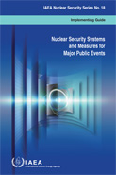
2.1. Nuclear Security Plan for Hung King Temple Festival
Joint Nuclear Security Action Plan for Hung King Temple Festival
- Hung King Temple Festival event was the first major event that Viet Nam applied measures to ensure nuclear security under the guidance of the IAEA Nuclear Security Series publications No.18 "Nuclear Security Systems and Measures for Major Public Events"
After consultations with the IAEA, the Vietnam Leader Security Command requested support for the implementation of nuclear security measures for the event.
A Joint Nuclear Security Action Plan between IAEA and K10 was established to define the tasks to be jointly implemented by the Vietnamese authorities and IAEA Division of Nuclear Security to enhance Viet Nam capacity for carrying out nuclear security measures in the framework of the festival

Slide 8
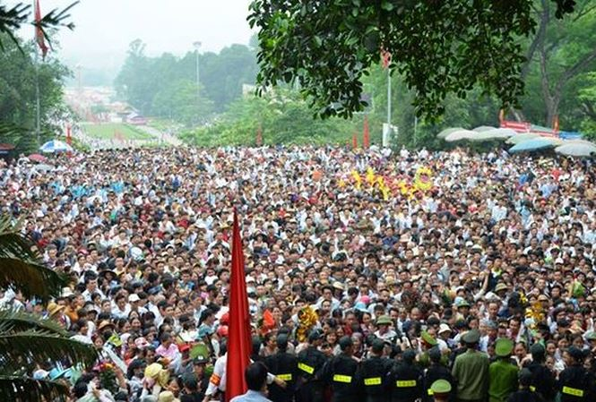
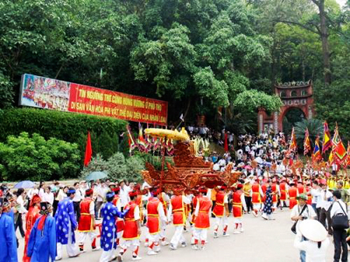
2.1. Nuclear Security Plan for Hung Temple Festival
The main relevant agencies involved in organization of the Hung King Temple Festival Security Plan:
Hung King Temple Festival
K10
Phu Tho Provincial Agencies
U.S. DOE/NNSA
VARANS
IAEA’s Nuclear Security Division

Slide 9
2.1. Nuclear Security Plan for Hung Temple Festival
Nuclear security response preparedness
03 Coordination Meetings with the IAEA and US. NRC (March 2015, August 2015 and April 2016) to discuss on threat assessment, international assistance and nuclear security arrangements for the festival
01 workshop and 04 training courses:
Nuclear Security Systems and Measures for Major Public Events,
Information Exchange in Incidents of Nuclear and Other Radioactive Material out of Regulatory Control,
Responding to Nuclear Security Events at Venus and other Strategy Locations, and
Radioactive Sources Searching
04 Technical Visits in Brazil and United States to study and exchange experience on nuclear security for major public events.

Slide 10
2.1. Nuclear Security Plan for Hung Temple Festival
Nuclear security response preparedness
Vietnam Authorities also organized some training courses on radiation safety and emergency response for Vietnam Leaders Security Command and local police and involved organizations.
Vietnam Leaders Security Command developed nuclear security scenarios and carried out exercises to enhance prevention, detection and response capability.
Vietnam Leaders Security Command and VARANS deployed instruments to Hung King Temple area in order to carry out some tasks such as selecting sites where radiation detection instruments will to be installed, perform:
acceptance testing,
develop and test detection and response procedures,
performed pre-event radiological surveys and background mapping and designed physical protection systems for nuclear and other radioactive material.

Slide 11
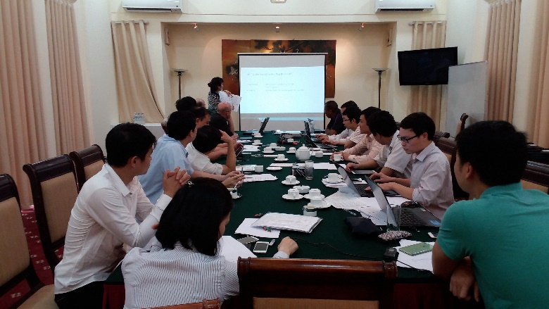
2.1. Nuclear Security Plan for Hung Temple Festival
Nuclear security response preparedness
After comprehensive preparedness process, Vietnam Leaders Security Command developed nuclear security response plan and arrangements for implementing the developed plan for the Hung Temple Festival and submitted to Ministry of Public Security for approval.

Slide 12
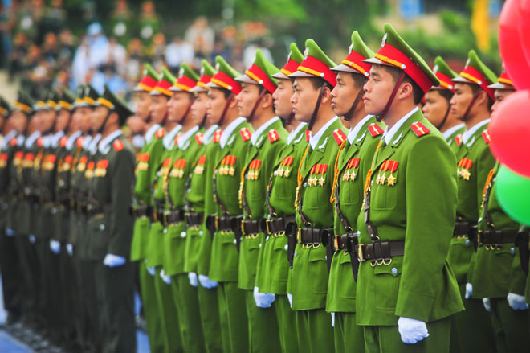
2.1. Nuclear Security Plan for Hung Temple Festival
Implementation of NS response plan
No | Organization | Number of staffs
1 | Vietnam Leaders Security Command | 25
2 | Vietnam Agency for Radiation and Nuclear Safety | 9
3 | Phu Tho Police | 200
4 | U.S.DOE/NNSA | 4

Slide 13
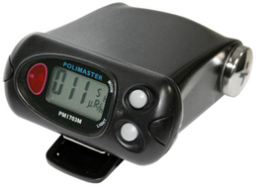
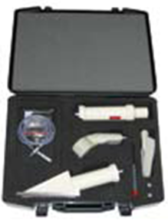
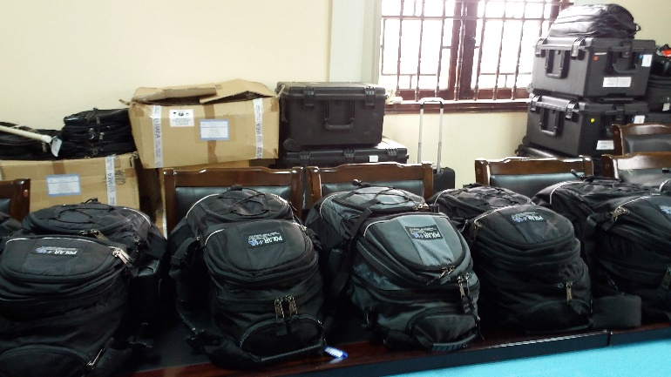
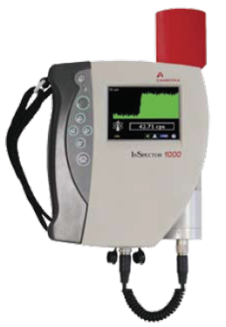
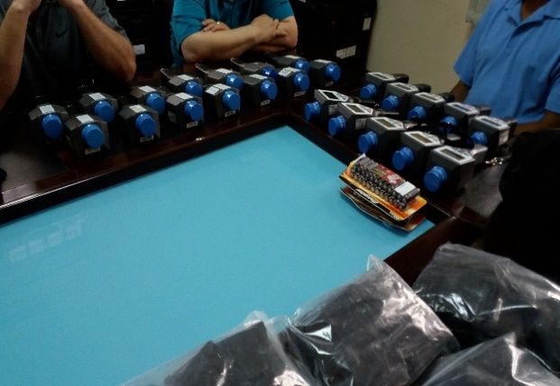
2.1. Nuclear Security Plan for Hung Temple Festival
Implementation of NS response plan
No | Equipment | Quantity (units)
1 | Personal radiation detectors (PRDs) | 210
2 | Portable radiation scanners (Backpacks) | 20
3 | Radioactive Isotope Identifier Device (RIIDs) | 26
4 | SPARCs | 6
5 | Linear Detectors | 2
6 | HPGe Detectors | 2
7 | Contamination Detectors | 2
8 | Radiation Alert Inspector | 5

Slide 14
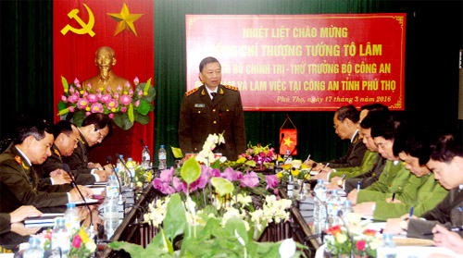
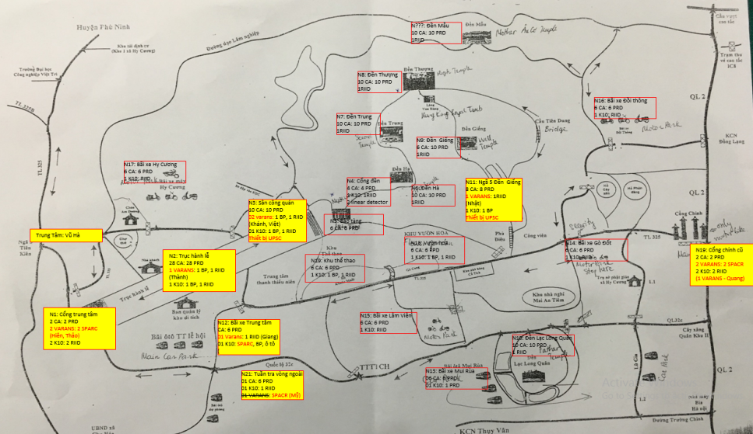
2.1. Nuclear Security Plan for Hung Temple Festival
Implementation of NS response plan, 3 Levels as follows:
Level 1: using RPDs, SPACRCs, Backpacks and Linear Detectors to primary checking in order to detect radiation and coordinate with Level 2 to zoning, identify suspect objects.
Level 2: using RIIDs, Backpacks and Inspectors to secondary checking after receiving radiation information from Level 1, cooperate with Level 3 to deal with radiation events.
Level 3: using HPGe(s), Contamination detectors, emergency response equipment and protective equipment to respond to radiation incidents.

Slide 15
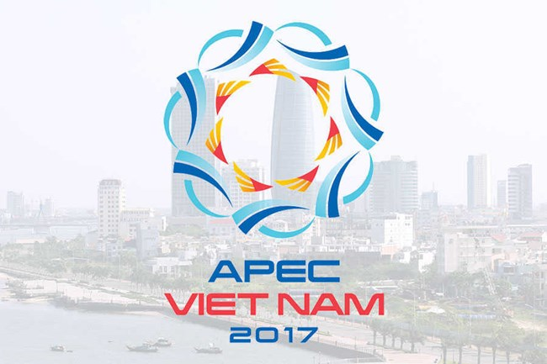
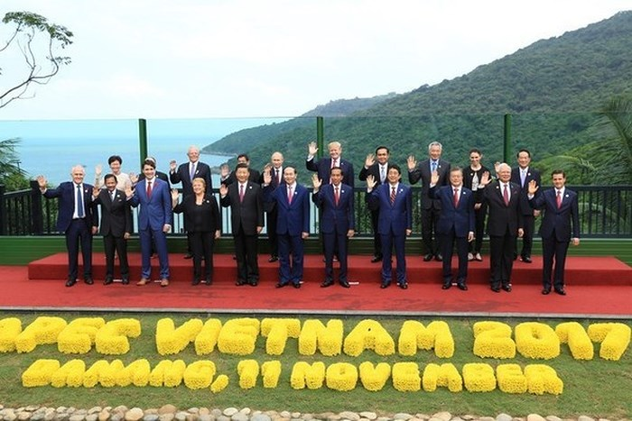
2.2. Nuclear Security Plan for APEC 2017
- Da Nang City in 2017, second time Viet Nam hosted the Summit.
- Main organizations involving in the Summit:
APEC 2017
Ministry of Public Security
Da Nang, Quang Nam Provincial Agencies
Customs
VARANS
Ministry of National Defence
Other
IAEA

Slide 16
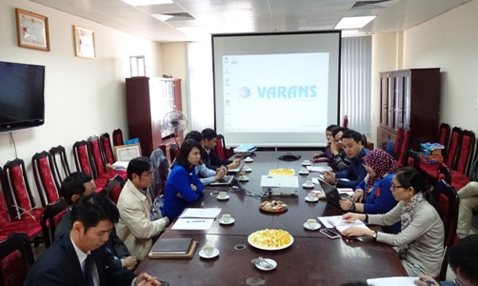
2.2. Nuclear Security Plan for APEC 2017
Nuclear security response preparedness
01 Coordination Meetings with the IAEA and (March 2017) to discuss on:
threat assessment;
international assistance
nuclear security arrangements for APEC 2017;

Slide 17
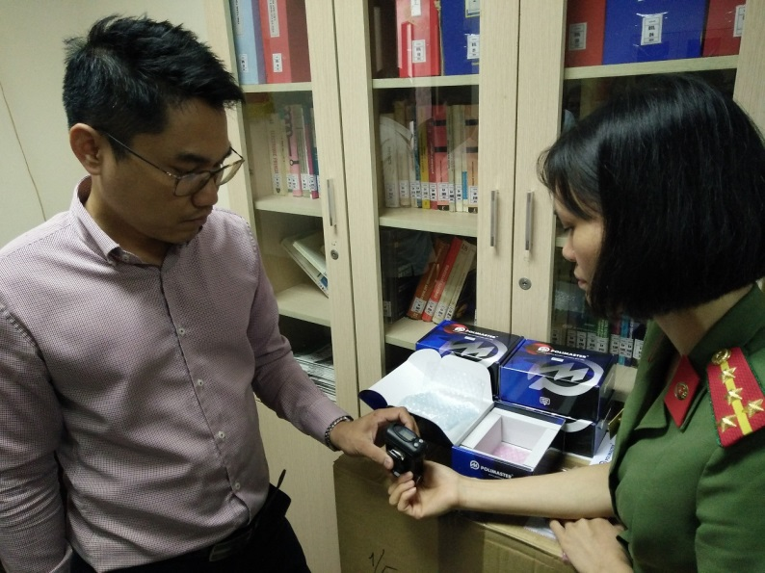
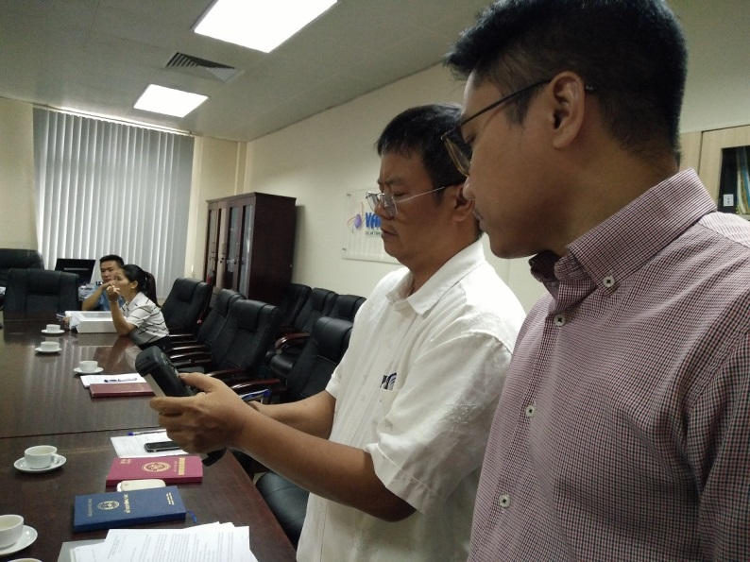
2.2. Nuclear Security Plan for APEC 2017
Nuclear security response preparedness
25/9/2017, VARANS handed over the equipment for Customs (Da Nang customs) and K10;
10/2017, VARANS provided training for Customs (Da Nang customs ) and K10 on:
Nuclear Security Systems and Measures for Major Public Events,
Information Exchange in Incidents of Nuclear and Other Radioactive Material out of Regulatory Control,
Responding to Nuclear Security Events at Venus and other Strategy Locations, and
Radioactive Sources Searching

Slide 18
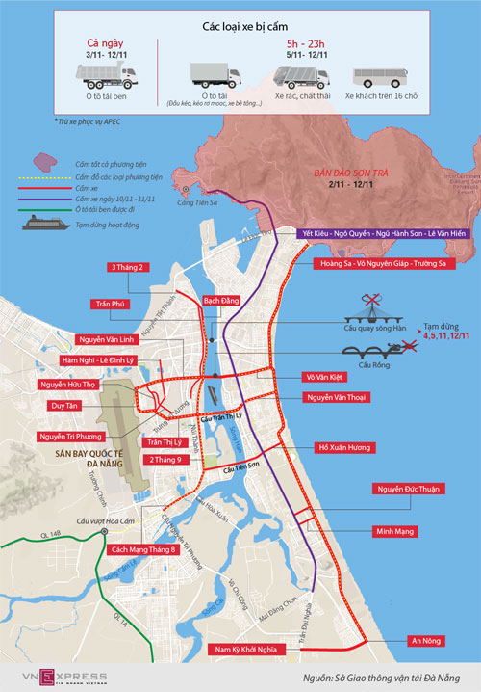
2.2. Nuclear Security Plan for APEC 2017
Nuclear security response preparedness
VARANS has temporarily ceased the authorization for transportation of nuclear materials, radioactive sources through Da Nang, Quang Nam and neighboring provinces.
Da Nang, Quang Nam and neighboring provinces established strict control the routes in the area
Danang Customs established radioactive control posts at Da Nang International Airport and Da nang seaport.

Slide 19
2.2. Nuclear Security Plan for APEC 2017
Nuclear security response preparedness
01 Coordination Meetings with the IAEA and (March 2017) to discuss on:
threat assessment;
international assistance
nuclear security arrangements for APEC 2017;

Slide 20
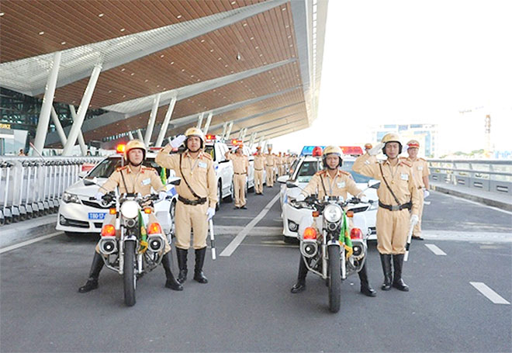
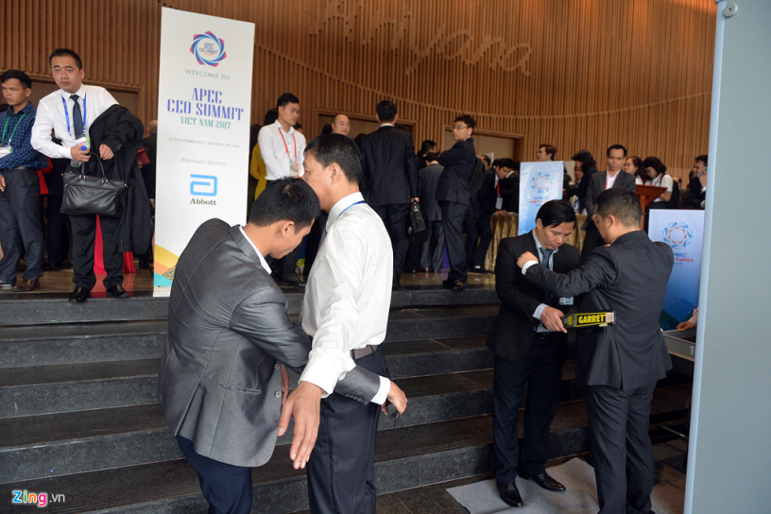
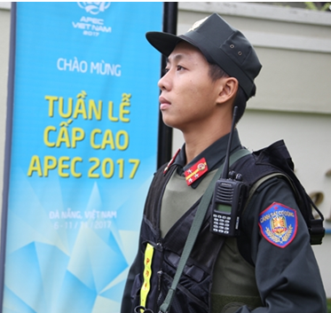
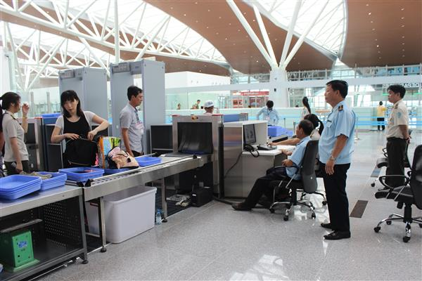
2.2. Nuclear Security Plan for APEC 2017
Implementation of NS response plan
No | Organization | Number of staffs
1 | Vietnam Leaders Security Command | N/A
2 | Vietnam Agency for Radiation and Nuclear Safety | 2
3 | Da Nang Police | N/A
4 | Quang Nam Police | N/A
5 | Customs | N/A
6 | Ministry of National Defence | N/A

Slide 21
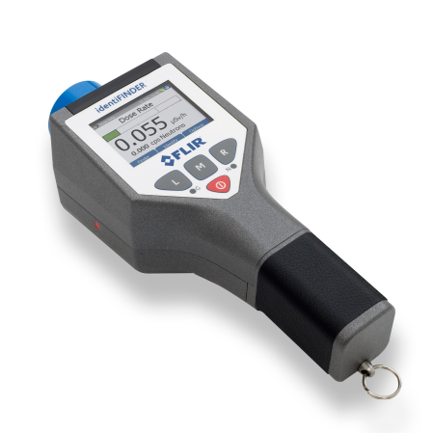
2.2. Nuclear Security Plan for APEC 2017
Implementation of NS response plan
No | Equipment | Quantity (units)
1 | Personal radiation detectors (PRDs) | 10
2 | Portable radiation scanners (Backpacks) | 4
3 | Radioactive Isotope Identifier Device (RIIDs) | 3
4 | SPARCs | 6
5 | HPGe Detectors | 2
6 | Contamination Detectors | 2

Slide 22
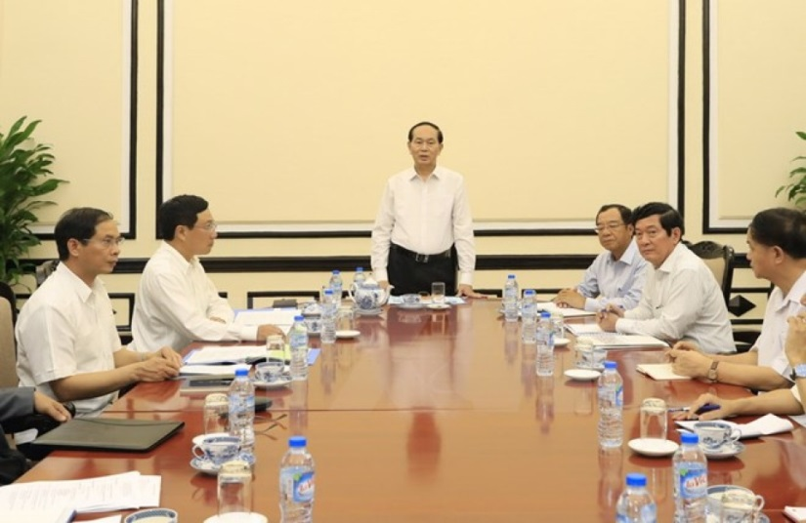
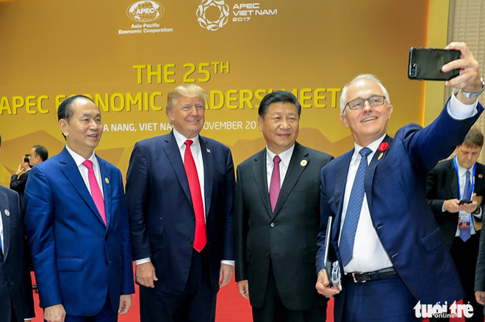
2.2. Nuclear Security Plan for APEC 2017
Implementation of NS response plan
Level 1: using RPDs and Backpacks to primary checking in order to detect radiation and coordinate with Level 2 to zoning, identify suspect objects.
Level 2: using RIIDs, Backpacks and Inspectors to secondary checking after receiving radiation information from Level 1, cooperate with Level 3 to deal with radiation events.
Level 3: using HPGe(s), Contamination detectors, emergency response equipment and protective equipment to respond to radiation incidents.
As such, the implementation of nuclear security as part of the general security has contributed to the success off the summit

Slide 23
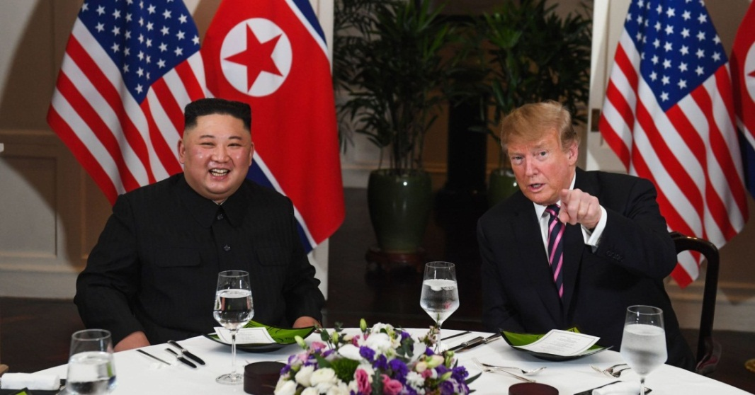
2.3. Nuclear Security plan for DPRK – US Hanoi Summit 2019
DPRK-US Hanoi Summit 2019 held in February 2019
Time for preparation was limited
During this event, the MPS and other agencies were responsible for ensuring security protection of the event, especially ensuring security at the border in Lang Son and other strategic locations in Hanoi.
VARANS collaborated with security agencies in providing training for police officers and supporting their activities relating to nuclear security

Slide 24
3. Advantages and Challenges
Advantages
The interest and support from the Government, Ministry of Public Security and competent authorities in conducting thorough and comprehensive preparedness activities.
Valuable support from the IAEA and the US regarding the provision of experts, equipment and training.
.
Challenges
The site/facility characteristics are complicated with substantial large space;
The agencies involved in implementing nuclear security measures at the event were inexperienced (especially the local police force);
Coordination mechanism among the participating agencies needed to be improved.

Slide 25
4. Conclusions
Involvement of the Government, the Ministry of Public Security and relevant Ministries is very important;
Support from the IAEA and the US on providing experts, equipment, training and material is greatly valuable;
The security of MPEs needs a comprehensive planning, systematic preparation and effective implementation;
The nuclear security plan at the MPE had to address many difficulties and challenges.
Conducting such nuclear security activities is an important step in improving the capacity and providing experience for organizations and individuals involved in planning and implementing nuclear security measures at other major public events in the future.

Slide 26
Thank you for your attention!

