Slide 1
APPLICATION OF MATURITY MODELS FOR EVALUATING CYBERSECURITY PROGRAMS AT NUCLEAR AND RADIOLOGICAL FACILITIES Cliff Glantz Pacific Northwest National Laboratory
IAEA International Conference on Nuclear Security, February 2020
PNNL-SA-150172 / INDICO 537

Slide 2
The Approach: Maturity Model
Maturity Model
An organized way to convey a path of experience, wisdom, perfection, or acculturation.
The subject of a maturity model can be an object or things, ways of doing something, characteristics of practices or processes.
PNNL-SA-150172 / INDICO 537
2

Slide 3
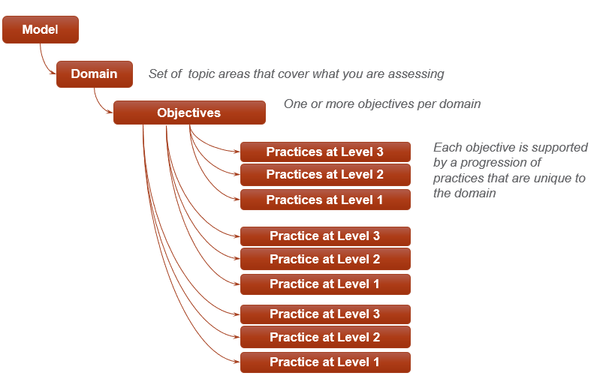
PNNL-SA-150172 / INDICO 537

Slide 4
PNNL-SA-150172 / INDICO 537

Slide 5
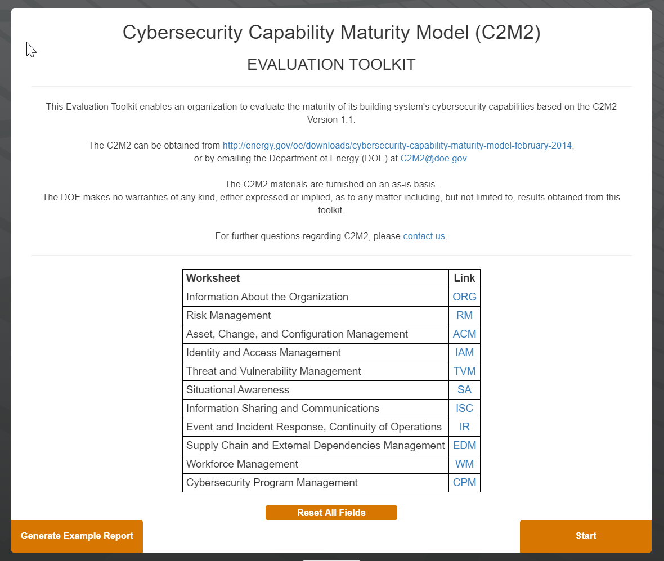
PNNL-SA-150172 / INDICO 537

Slide 6
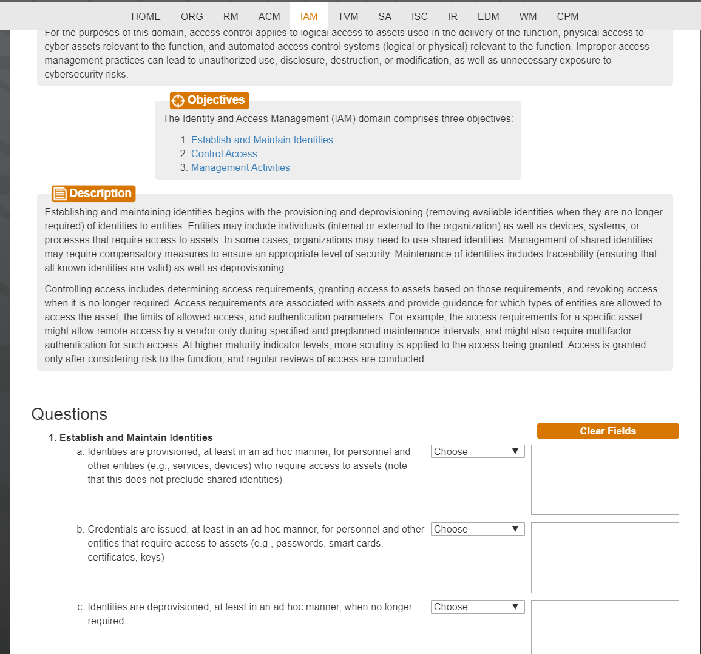
PNNL-SA-150172 / INDICO 537

Slide 7
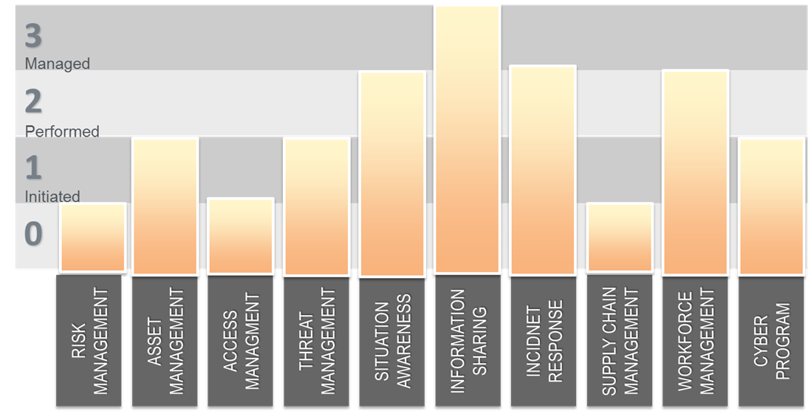
Evaluating Cybersecurity Maturity
Each cell contains the defining practices by goal for domain for that maturity indicator level. If performing those practices, you earn this maturity level.
Defined progression of goals
Maturity Indicator Levels
The example shows high maturity level for “Info Sharing” and low for “Supply Chain Management.” May indicate more attention should be paid to this.
Alternatively, if cybersecurity risk small, low maturity level may be perfectly acceptable from cost-benefit perspective.
PNNL-SA-150172 / INDICO 537

Slide 8
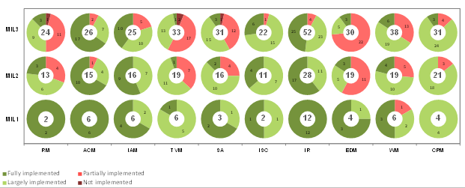
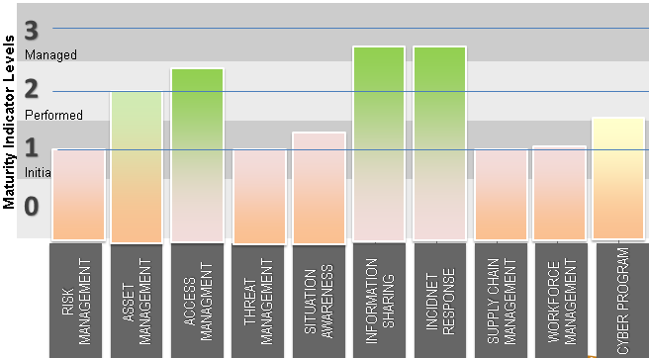
PNNL-SA-150172 / INDICO 537

Slide 9
Thank You!
PNNL-SA-150172 / INDICO 537
9

