Slide 1

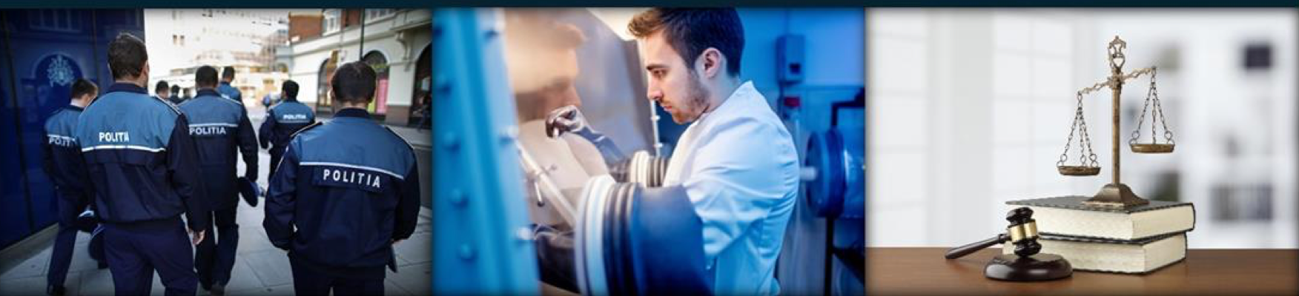
Study on the Implementation of nuclear forensics in various legal systems
Dr. Andrei I. Apostol,
Head Prosecutor Elena Dinu

Slide 2
Goal and Objectives
Goal
To understand legal aspects which have to be considered for the implementation of nuclear forensics capabilities and similarities and differences of an investigation, prosecution and trial within various legal systems
Objective
  Provide an overview of various legal systems and describe a successful Implementation case study
Notes:
Nuclear Security Solutions: Introduction to the IAEA
Notes:

Slide 3
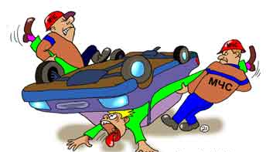


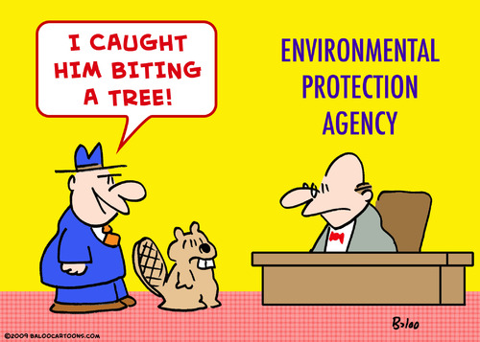
Implementing Nuclear Foreniscs
Even if the specific field of forensics refers to the “nuclear physics” realm, from a legal point of view it is not different from any other traditional forensics’ domains and has to be implemented in accordance with the national legal framework of the specific country, following the same legal procedures.
Notes:
In practice, many states and international organizations, primarily associate the response to illicit activities involving nuclear or other radioactive materials with main national authorities competent to regulate, control or authorize activities in the nuclear field like Regulatory Bodies, Emergency Services, Intelligence or in some cases even Environmental agencies. This confusion leads to lack of awareness on nuclear security related issues among judicial entities like prosecutors, judges and judicial police which results in failure of opening criminal cases when appropriate and impedes conducting proper investigations.

Slide 4
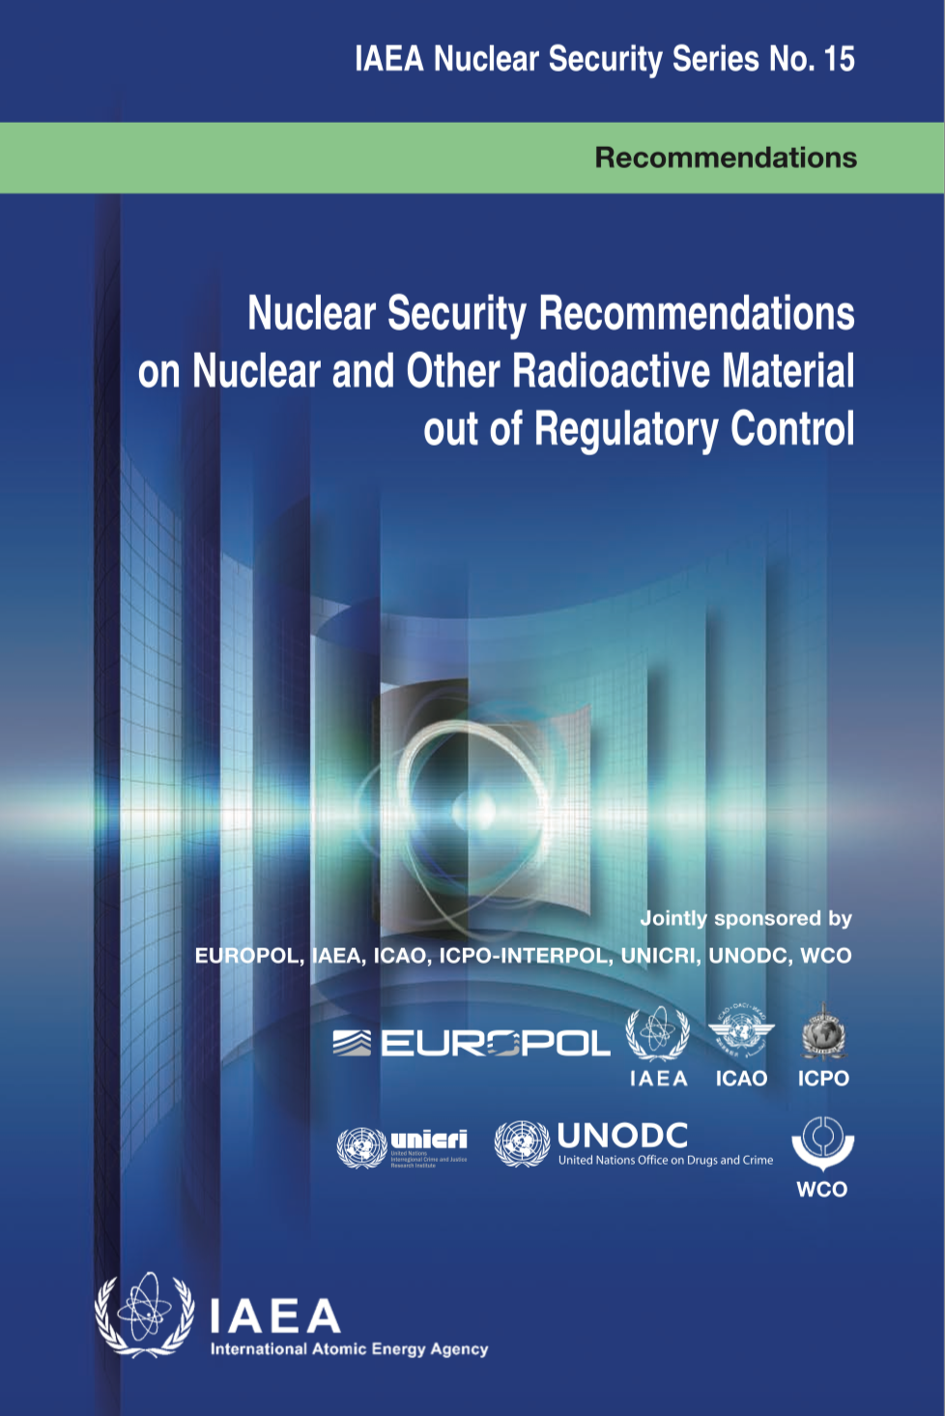
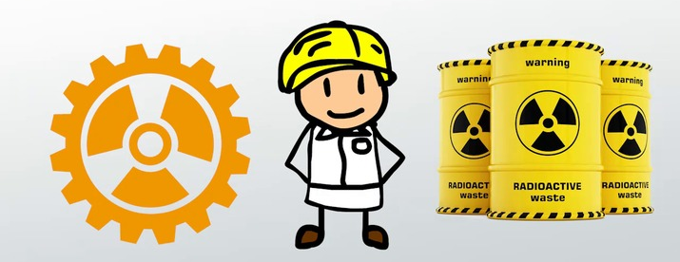
NSS15 recommends that member states develop nuclear forensics capabilities according to their nuclear security related needs
During the implementation of new scientific tools like those offered by Nuclear Forensics within the scope of the criminal investigation, the peculiarities of various legal systems have to be taken into consideration.

Slide 5
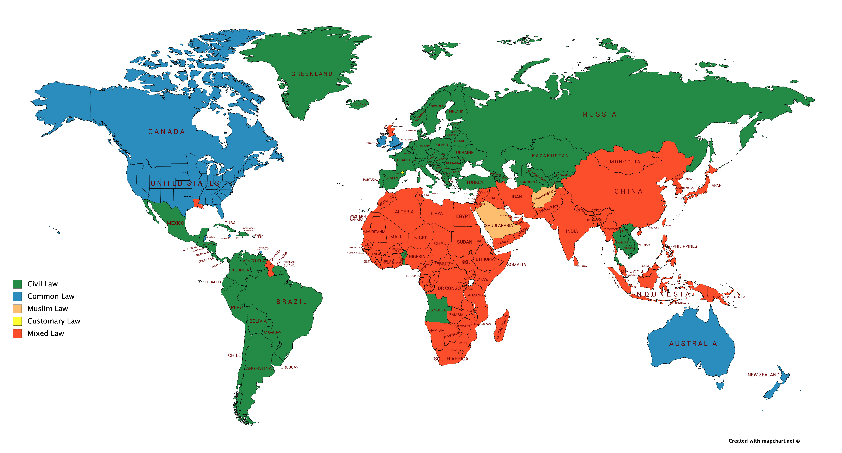
Legal Systems
Sharia Law
Most law systems in the world belong to either Civil Law or Common Law, or are a mixture of any possible combination between Civil Law, Common Law, Sharia Law and Customary Law
Notes:
Most law systems in the world belong to either Civil Law or Common Law category, or are a mixture of the two/three (+any other). The Common Law system is prevalent in the UK and the Commonwealth, as well as the USA, while Civil Law System (Roman system) is represented in the vast majority of countries including the European Union , Russian Federation, South America (except Guyana). In some countries in Africa and Asia a mixture of the two systems, or Islamic Law exists. Therefore, when implementing new scientific tools like those offered by Nuclear Forensics within the scope of the criminal investigation, the peculiarities of various legal systems have to be taken into consideration.
While many of the same fundamental principles stemming from Roman Law are at the basis of both Civil and Common Law, they evolved separately and have their own legal structures and rules of procedure, even though throughout history the two systems obviously influenced one another. Convergence drivers are for example the modern European integration supported by free movement of people and goods, as well as the globalization and the international cooperation instruments promoted by international bodies. However, divergence factors include historical traditions, political and economic specificities, the Western focus on decentralization and cultural differentiation

Slide 6



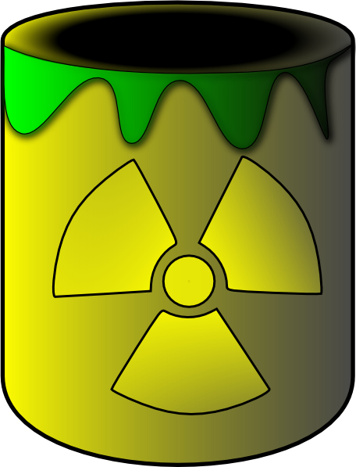



Civil vs Common Law
Civil Law
Common Law
Reliable Evidence?
Reliable Evidence?
Yes
No
No
Yes
Case is sub-judice
Notes:
In what concerns the decision to prosecute in a criminal case, that generally pertains to the prosecutor in Civil law systems. In some continental law systems i.e. France, unlike the Common law ones, both judges and prosecutors are magistrates and are subordinated at institutional level to the Justice minister. In many other European legal systems the two professional categories receive the same training, are subject to the same professional examinations and their careers are interchangeable. the prosecutorial function varies widely within common law systems and sometimes can be exerted by certain agencies or even by an interested party. for example, in England and Wales, while the Crown Prosecution Service has an independent position from both the executive and the judiciary, it has no power to direct the investigation or to be involved in the hearing of witnesses. The Police is entitled to charge with an offence and the role of CPS only starts after the police investigation is finalised and a decision on the prosecution has been made [4] (Ashworth A., 2000). At the same time, in common law, in principle, the prosecutor has much more discretion in deciding to initiate criminal proceedings (the opportunity principle as opposed to the legality principle in civil law), after assessing the evidence and establishing that the case falls within the scope of the law.
In the USA, where the prosecutor’s office was traditionally linked to the local community which in some states elects the head of the office, the trend has been for more serious crimes to empower the General Attorneys to take up prosecutions concerning higher profile cases with statewide implications [5] (Walther S., 2000). Law enforcement agencies are part of the Executive. They enjoy investigative powers and are independent from the Prosecutor’s Office. The Police decide at what stage the investigation gets referred for prosecution or legal advice. Unlike the UK however, the public prosecutor is invested with the power to bring charges for more serious offences.

Slide 7


Civil vs Common Law
Common Law
Civil Law
Notes:
Penalty

Slide 8




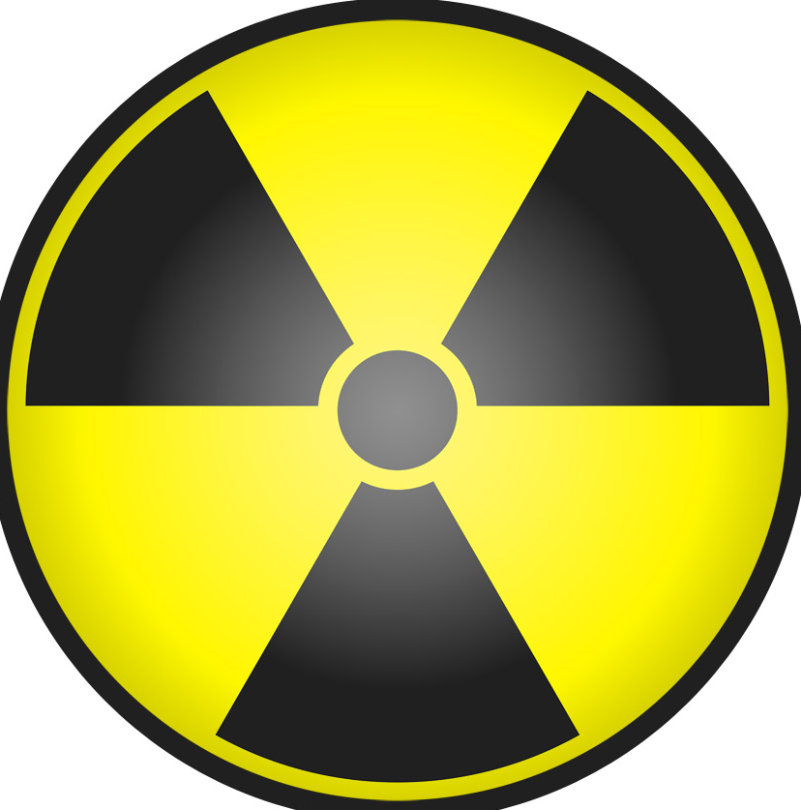
Nuclear Forensics Experts within Criminal Investigation
Approved by Court or authorized by an Entity (ex. Ministry of Justice)
Notes:
For the purpose of this report it shall be noted that in Civil Law systems, while the experts can also be proposed by the parties (subject to availability), they are usually selected from a list approved by the court or are certified or authorized by an entity i.e. the Ministry of Justice following a prescribed procedure, to ensure they are impartial and not biased by the interests of the party they represent, and to verify their professional training. In such cases the experts provide written reports though they could also be heard as witnesses if the judicial authority deems appropriate. Scientific expert opinion enjoys a certain extent of discretion in Civil Law, especially in regard to findings which cannot be checked by the judicial actors, though experts are sometimes asked to supplement their reports or reports could be assessed by counterparts when any doubt about the findings remain.

Slide 9
Case Study: Romania

Slide 10
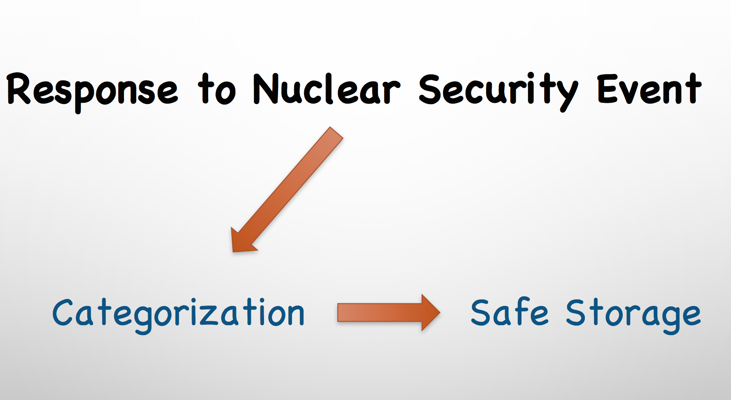
I
Since 1993 around 40 cases reported to the ITDB
Zero Criminal Cases Opened
Notes:
This despite legal provisions into force that require various non-judicial, executive agencies that gain knowledge about suspicious activities amounting to a criminal offence to report such incidents to the appropriate criminal investigation or prosecution bodies.
Many factors could be behind this situation. The most important of which was “the unsureness about the entity entitled to make a decision on opening proceedings” (opening a criminal case).
Another common confusion was related to the evidence itself, which is regarded by some agencies with competencies i.e. in control or emergency interventions as mere samples of material, overlooking the fact that evidence is de facto and de jure any factual element which serves to establish the existence of an offence, identifying the perpetrators, finding the truth and establishing the facts of the case as to achieve a just resolution of the proceeding (art.97 of the Criminal Procedure Code).

Slide 11
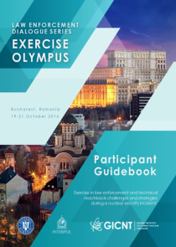
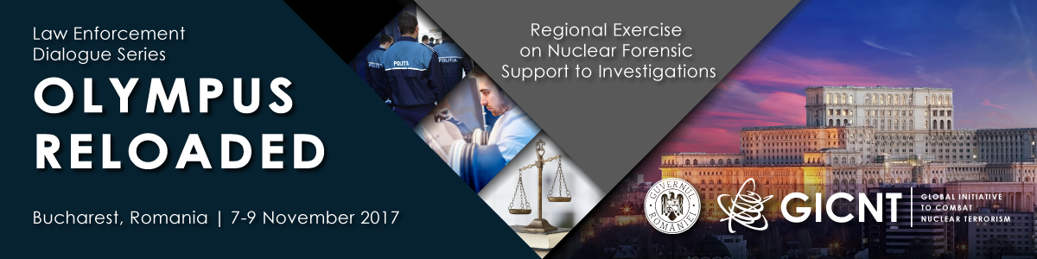
GICNT Activities Hosted by Romania
Olympus – for testing National Response System to Nuclear Security Events
Olympus Reloaded – to address the missing component (Judicial Investigations and Nuclear Forensics)
Self Assessment Tool – to address the national need and finding solutions to the identified gaps

Slide 12


II
Response to Nuclear Security Event
Criminal Case
Radiological Crime Scene
Crime Scene Investigation
Evidence Collection
Chain of Custody
Nuclear Forensics Analysis/Interpretation/Findings
Advancing the Investigation
Prosecution and Trial
PREVENTION
Notes:
Asa a inceput sa arate sistemul nostru dupa testarea SAT

Slide 13
Results of National Efforts (2018-2019)
Five Criminal cases were opened by Judicial Authorities
Five Nuclear Forensics Reports were provided for the Judicial Authorities (lead investigators) by IFIN-HH’s Nuclear Forensics Lab.
Investigations contributed to the prevention of future Nuclear Security Events
Notes:
Putina statistica

Slide 14
Conclusions
The implementation of nuclear forensics as a component of forensics science on the national level should be done in strict accordance with the state’s Criminal Code.
In civil law systems, every seizure of MORC insofar as it represents an illicit activity sanctionable by the criminal law, has to be followed by opening a criminal investigation and prosecution, given the principle of legality, as opposed to Common law jurisdictions, where prosecution can be dropped based on opportunity assessment;
Nuclear forensics international information exchange and other cooperation responsibilities should be established with channels primarily responsible for criminal investigations such as judicial authorities in civil law countries, police in common law countries or other investigative bodies.

Slide 15
Questions or Comments?

