Slide 1
IMPLEMENTING A TABLE TOP EXERCISE (TTX) FOR ASSESSING PHYSICAL PROTECTION SYSTEM’S EFFICIENCY AT NATIONAL CENTRE FOR SCIENTIFIC RESEARCH “DEMOKRITOS”
I. TSOUROUNAKIS, A. SFETSOS, K. KOVATSOS, I.XINTAVELONIS

Slide 2
Objectives
The objectives of the TTX were 3-fold:
Evaluate the performance of the PPS and the Security Emergency Procedures of the facility, under a specific threat, and determine its Weak Points and Vulnerabilities.
Evaluate the implementation of Security Procedures and the Response Tactics by Security Personnel during an Emergency Scenario that included external threats.
Contribute to the Continuous Training of Security Personnel at N.C.S.R. Demokritos.

Slide 3
Scope
Participants were exclusively members of N.C.S.R. “Demokritos” Security Personnel.
The organizing team decided so, thus security personnel :
Feel comfortable implementing security procedures during an emergency event, without the presence of off-site responders.
Comment and criticize, unbiased, the outcome and the procedures of the exercise

Slide 4
TTX Preparation
Sandia National Laboratories Methodology, as described in NUSAM CRP, was selected.
Data and documentations concerning: PPS Performance Tests, Barrier Delay times, Assessment and Communication times, Guards and External Response Forces times, Design Basis Threat (DBT) scenarios, Contingency Plans, were gathered.
Also, various site maps with different scales, tokens with appropriate colors for Adversary and Response Teams, 10sided dices for the determination of engagements outcome, white boards and flipcharts for scribing adversaries’ and response’s teams movements and time frames, were used.

Slide 5
Roles and Responsibilities
Facilitator, facilitated the exercise.
Protective Force Team (Blue Team). Determined initial positions and all response actions according to contingency plans, training, and tactics.
Adversary Team (Red Team). Provided threat characteristics. Determined initial positions and all actions according the original attack plan.
Evaluation Team (Green Team). Served as an unbiased referee.
Protective Force Team Coordinator. Observed Blue Team’s actions. Communicated team’s decisions to Facilitator.
Adversary Team Coordinator. Observed Red Team’s actions. Communicated team’s decisions to Facilitator.

Slide 6
TTX Conditions
The TTX took place in 2 daily workshops, so security personnel working at night shifts had the ability to attend.
One scenario per day was executed:
Sabotage in Reactor pool
Theft of Radiological Source stored in Reactor ground level
TTX duration per day: 5 hours

Slide 7
Setting up the TTX
Prior the beginning of the TTX, a Power Point presentation briefing was given with all necessary clarifications.
After briefing, Security Personnel was divided in Red and Blue teams. They were removed to different rooms.
Sequence of moves per round begun with Adversaries announcing their first move to Facilitator. In succession, Protective Forces announced their move. And so forth.

Slide 8
Scenario Parameters (common for both days)
February
02:30 a.m.
Rain
Temperature 3⁰C
North Wind 5 Bfs
Police Responders arrival time 6 min after duress button activation

Slide 9
TTX Considerations
Initially, each team was allocated 20 min to decide attack scenario and defensive positions
5 min time allocated between rounds, so Teams prepare their next move
Passive Insider considered
Two teams were kept in separate rooms until the first engagement

Slide 10
End Conditions of TTX
Completion of scenario
Red team achieved their goal
Red team cannot achieve their goal due to :
Not enough members to complete task
Loss of essential equipment (Explosives, tools, vehicles)
When Police Responders arrive on site

Slide 11
1st Scenario: Sabotage in Reactor pool
Red Team (Adversaries)
4 Persons, military skills, Radio communications
1 Passive Insider
AK-47, 9mm Pistol, Sniper Rifle (7.62), Hook gun, 10kg TNT explosives, Oxygen cutting torch, 50m rope
4X4 vehicle
Time increments per round played at 10 sec intervals

Slide 12
1st Scenario: Sabotage in Reactor pool
Blue Team (Guards)
5 Persons (Guards, Patrol men)
No arms. Standard equipment (Radios, torches) Everyday procedures
Patrol vehicle
Realistic approach (no heroes) was fostered

Slide 13
Result
Red Team succeeded in their purpose within 7 min. real time.
They were identified by the Guards in 3 min and 20 sec real time.
Police responders estimated arrival time after 2 min and 20 sec the Red Team achieved their goal.

Slide 14
2nd Scenario: Theft of Radiological Source stored in Reactor ground level
Red Team (Adversaries)
5 Persons, military skills, Radio communications
1 Passive Insider
AK-47, 9mm pistol, Sniper Rifle (7.62), 10kg TNT explosives, RPG
Van, motorcycle
Time increments per round played at 15 sec intervals

Slide 15
2nd Scenario: Theft of Radiological Source stored in Reactor ground level
Blue Team (Guards)
6 Persons (Guards, Patrol men)
No arms. Standard equipment (Radios, torches)
Enhanced Security Level (Upon Intelligence Information)
Patrol vehicle

Slide 16
Result
Red Team aborted their plan due to an early identification by Patrol men
They were identified in 30 sec time
Police was informed at 45 sec TTX real time
Excellent dispersion of the Blue Team is the main reason for the timely identification

Slide 17
ΤΤΧ’s ‘Hot’ Evaluation
Very positive feedback from participants.
They found it a very useful practice over emergency procedures and tactics, recognizing PPS’s vulnerable points and thus to pay enhanced attention to them.
They proposed compensatory actions, to eliminate those vulnerabilities, focusing in procedures, equipment and sensors.
They underlined the importance of an early detection in the overall PPS performance, and its significance to prevent malicious acts.
TTX is a great tool to build up ‘team spirit’ between Security Personnel.

Slide 18
Lessons Learned
Facilitator has a vital role for the smooth evolution of the exercise.
Team coordinators have an equally important role for controlling two teams.
Coordinators should remain neutral and not interfere sentimentally with their teams.
Evaluation Team should have the knowledge and the experience to consult Facilitator, upon disputes.
Look up Tables are absolutely essential for properly conducting a TTX.
Look up Tables should be advised in accordance with Site’s PPS specific Performance Test Data, otherwise analysis would be difficult.
TTX is very useful instrument for validating future upgrades.

Slide 19
Thank for your attention

Slide 20
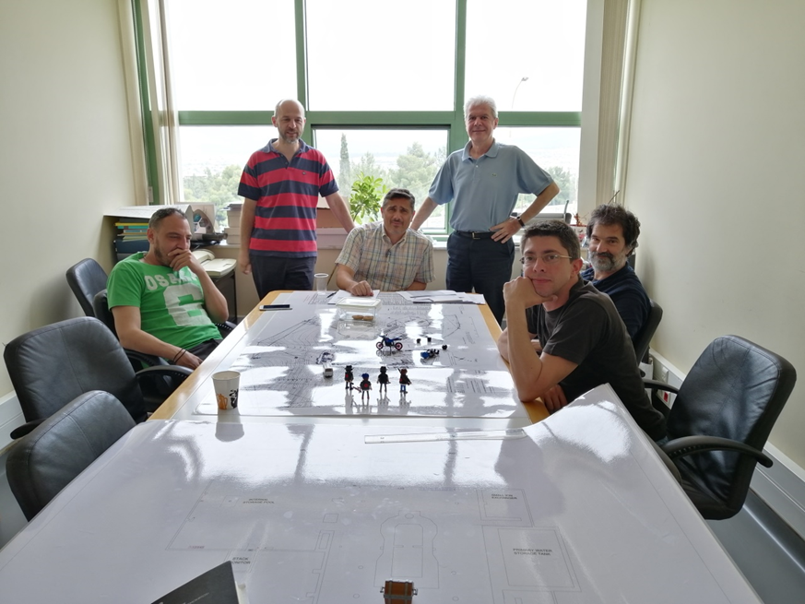
Questions at the end of the session
email: johnt@ipta.demokritos.gr

Slide 21
Step 1 | Find base PH by cross-referencing weapon type and range to target (rounds down range)
Weapons PH table
Weapon Type |  | RANGE -> | 10m | 20m | 30m | 40m | 50m | 60m | 70m | Max eff
 |  | Rate of fire in 10 Seconds
 |  | # rds. fired
Pistol (9mm) |  | 2 | 7 | 5 | 3 | 1 | x | x | x | 50m
Assault Rifle (9mm) |  | 2 | 7 | 5 | 3 | 3 | 2 | 1 | 1 | 100m
Weapon Type |  | RANGE -> | 100m | 300m | 500m | 700m | 900m | 1100m | 1300m | Max eff
Rate of fire in 10 sec.
# rds. fired
Assault Rifle (5.56) | 2 | 7 | 5 | 3 | 1 | x | x | x | 600m
Light Machine Gun (5.56) | 3 | 6 | 4 | 2 | 1 | x | x | x | 600m
Heavy Machine Gun (7.62) | 3 | 6 | 4 | 2 | 2 | 1 | 1 | x | 1000m
Heavy Machine Gun (50 cal) | 3 | 5 | 5 | 5 | 3 | 3 | 3 | 1 | 1800m
Sniper Rifle (7.62) | 2 | 7 | 7 | 5 | 3 | 1 | 1 | x | 1000m
Sniper Rifle (50 cal) | 1 | 7 | 7 | 5 | 3 | 3 | 3 | 1 | 1800m
RPG-7 | 1 | 6 | 3 | 1 | x | x | x | x | 500m
40 mm | 1 | 6 | 3 | x | x | x | x | x | 350m
40 mm belted | 3 | 6 | 4 | 4 | 3 | 3 | 2 | 2 | 1600m
Spotting only | n/a | 5 | 3 | 1 | 0 | 0 | 0 | 0 | 0
Modify spotting PH +1 for target firing, +1 for target moving, +1 for large target, +1 for pos rep from friendly unit; all modifiers are cumulative. Example: PH to spot a moving vehicle at 700 Meters is 0 + 1 +1 = 2

Slide 22
Die roll: | Vs. armor* | 5.56mm | 7.62mm | .50cal | 40mm HEDP | RPG
1 | Vk | Vk | Vk 1 KIA | Vk 2 KIA | Vk 2 KIA | Vk all KIA
2-3 | 1 KIA | 1 KIA | Vk | Vk 1 KIA | Vk 2 KIA | Vk 2 KIA
4-5 | No effect | 1 KIA | Vk | Vk 1 KIA | Vk 1 KIA | Vk 2 KIA
6-7 | No effect | 1 KIA | 1 KIA | Vk 1 KIA | Vk 1 KIA | Vk 1 KIA
8-9 | No effect | No effect | 1 KIA | Vk | Vk | Vk 1 KIA
10 | No effect | No effect | 1 KIA | 1 KIA | 1 KIA | Vk 0 KIA
Αν πρόκειται για θωρακισμένο όχημα γίνεται μετακίνηση 2 στήλες αριστερά. Όταν χρησιμοποιείται RPG η στήλη παραμένει αμετάβλητη.
Vk = Το όχημα ακινητοποιείται
KIA = Τίθεται εκτός παιχνιδιού ο αντίστοιχος αριθμός επιβαινόντων στο όχημα

