Slide 1
International Conference on Nuclear Security 2020
Vienna - Austria
Implementing Blockchain Technology in NMAC system
Verónica Venturini
Argentine National Atomic Energy Commission (CNEA)
Information Security Department
veronicaventurini@cnea.gob.ar

Slide 2
Introduction
Motivation
Emerging technologies have focused on blockchain technologies.
Review of possible applications in the nuclear industries.
Objectives
Ensure transparency transactions in control of nuclear and radioactive material movements.
Contribution
The implementation of the NMAC system using blockchain.

Slide 3
Introduction
Art of State
Cryptocurrencies
Energy distribution from smart grids
Finances and property rights
Organizations such as DARPA (United State) or Rosatom (Russia) invest in R&D on blockchain to safeguard military assets and in nuclear energy respectively.
Notes:
Cryptocurrencies, energy distribution from smart grids, finances and property rights are examples of these technologies. Organizations such as DARPA (United State) or Rosatom (Russia) invest in R&D on blockchain to safeguard military assets and in nuclear energy respectively.

Slide 4
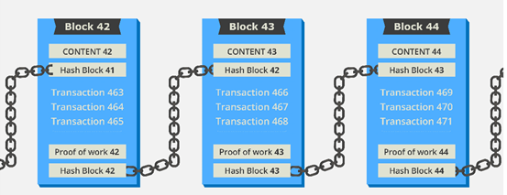
Blockchain
Blockchain characteristics
Blockchain constructs a chronological chain of blocks, hence the name "block-chain".
Each block is an immutable information unit.
Blockchain consists of timestamping of transactions, Peer-to-Peer networks, cryptography, and shared computational power.
Components: data model, transaction language, consensus algorithm.
Smart Contracts: automatic execution code.

Slide 5
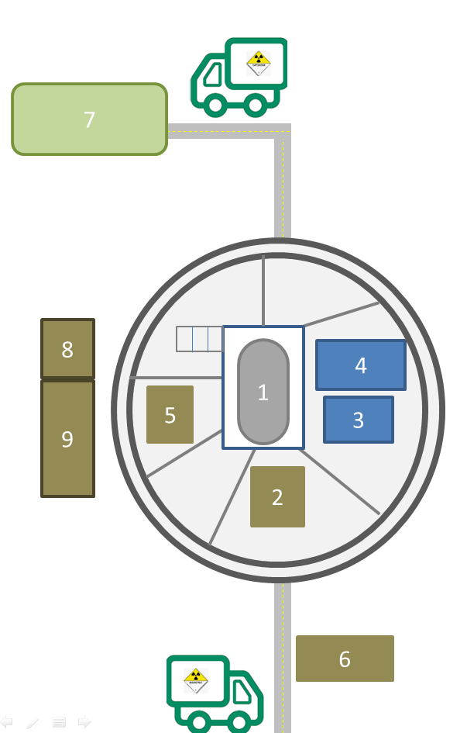
Use case: NMAC System
Scenario
“A new set of fuel rods arrives to the facility. A custodian named John Muller receives the set of material.
He must login in a web page that allows him to specify the type of source transaction. In this case, the transaction is record new sources.
These transactions are registered in the nmac-blockchain with a timestamp specification.
Then, at the moment when the fuel rod replacement occurs, Muller has to write this new transaction in the nmac-blockchain.”
Movements:
Shipment
Receipt
Transfer
Relocation
Nuclear Reactor Core
Storage Enclosure
Maneuvering Pool
Waste Disposal Pool
Laboratory 1
Reception
Waste Disposal Facility
Enclosure 1
Enclosure 2
Notes:
In this case, Muller has to add each new material in the nmac-blockchain with the transport specification that came to the facility and the characteristics of each material: identification, custodian, radiation (dose rate and activity), amount of material, material status, number of tamper indicating device (TID), manufacturer, and date and time of transaction, among others.

Slide 6
Use case: NMAC System
Constrains by design
Separation of duties should be maintained to ensure that the same person cannot both transfer and receive the nuclear material.
Radiation should be measured before and after each movement: the present architecture eludes that verification.

Slide 7
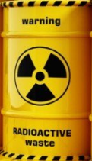
NMAC System: Design
Participants
Regulator: Monitoring source movements, audit the blockchain.
Nuclear Material Custodian: Source/Nuclear Material Check in, Source/Nuclear Material Check out, Relocation of nuclear source, Adding source to the blockchain and Adding new location.
Assets
Nuclear Material
Transactions
1) Add sources, 2) return a list of sources, 3) request information about a particular source, and 4) modify the source’s custodian.
Channels
Are the communication buses between participants.

Slide 8
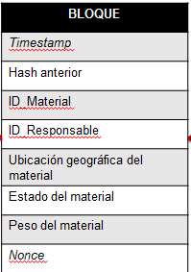
NMAC System: Design
A block structure in the nmac-blockchain
BLOQUE
Timestamp
Hash anterior
ID_Material
ID_Responsable
Ubicación geográfica del material
Estado del material
Peso del material
Nonce
Custodio 1
Regulador ARN
Custodio 3
Custodio 2
Verificador Secretaría de
Energía
Notes:
Nonce: se refiere a la semilla de un generador de números aleatorios.

Slide 9
NMAC System: Design
Representation of a previous hash.
BLOQUE 00
Timestamp
Hash anterior
ID_Material
ID_Responsable
Ubicación geográfica del material
Estado del material
Peso del material
Nonce
BLOQUE 01
Timestamp
Hash anterior (Bloque 00)
ID_Material
ID_Responsable
Ubicación geográfica del material
Estado del material
Peso del material
Nonce
Notes:
Nonce: se refiere a la semilla de un generador de números aleatorios.

Slide 10
NMAC Blockchain Architecture
Notes:
Hyperledger Fabric.
Allows Private Blockchain: PERMISSIONED networks place restrictions on who is allowed to participate in the network and in what transactions.

Slide 11
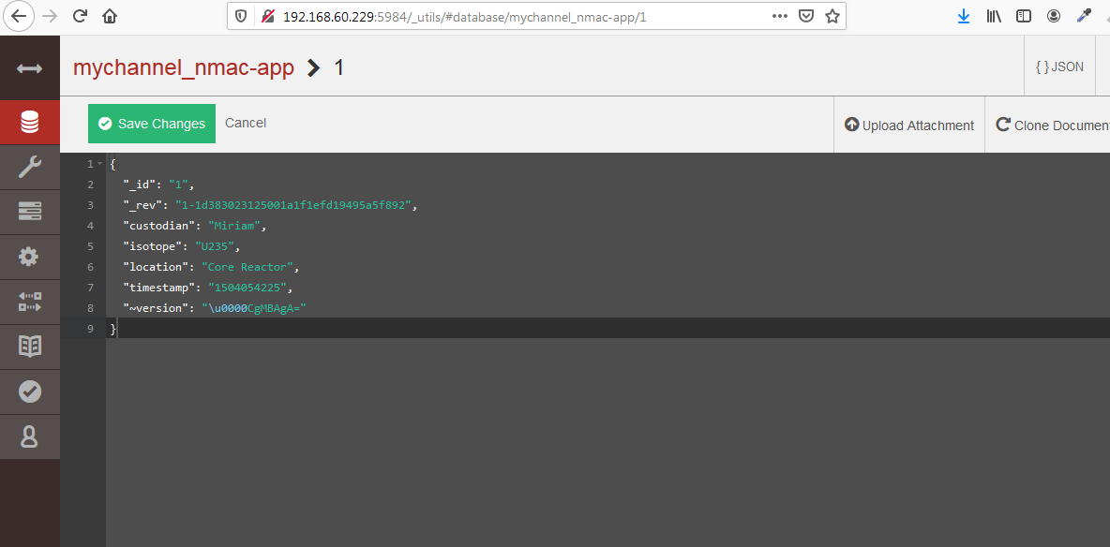
NMAC Blockchain: Proof of Concepts
CoachDB

Slide 12
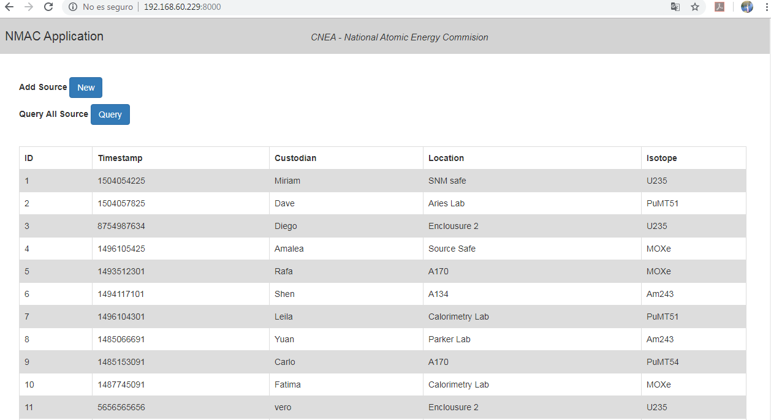
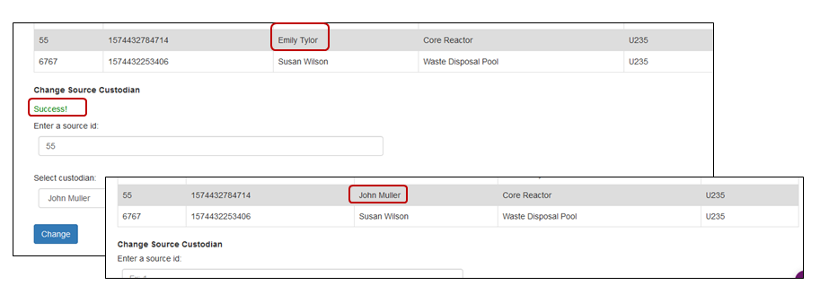
NMAC Blockchain: Proof of Concepts
Nmac-app

Slide 13
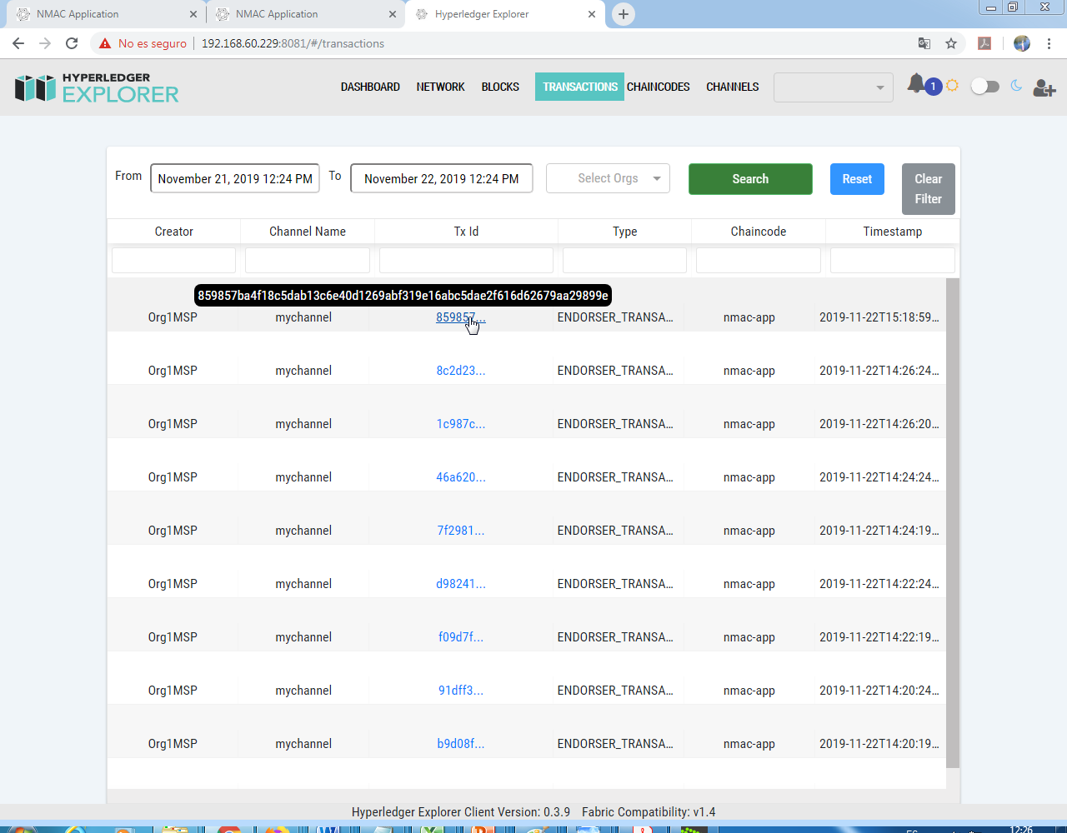
NMAC Blockchain: Proof of Concepts
Hyperledger Explorer

Slide 14
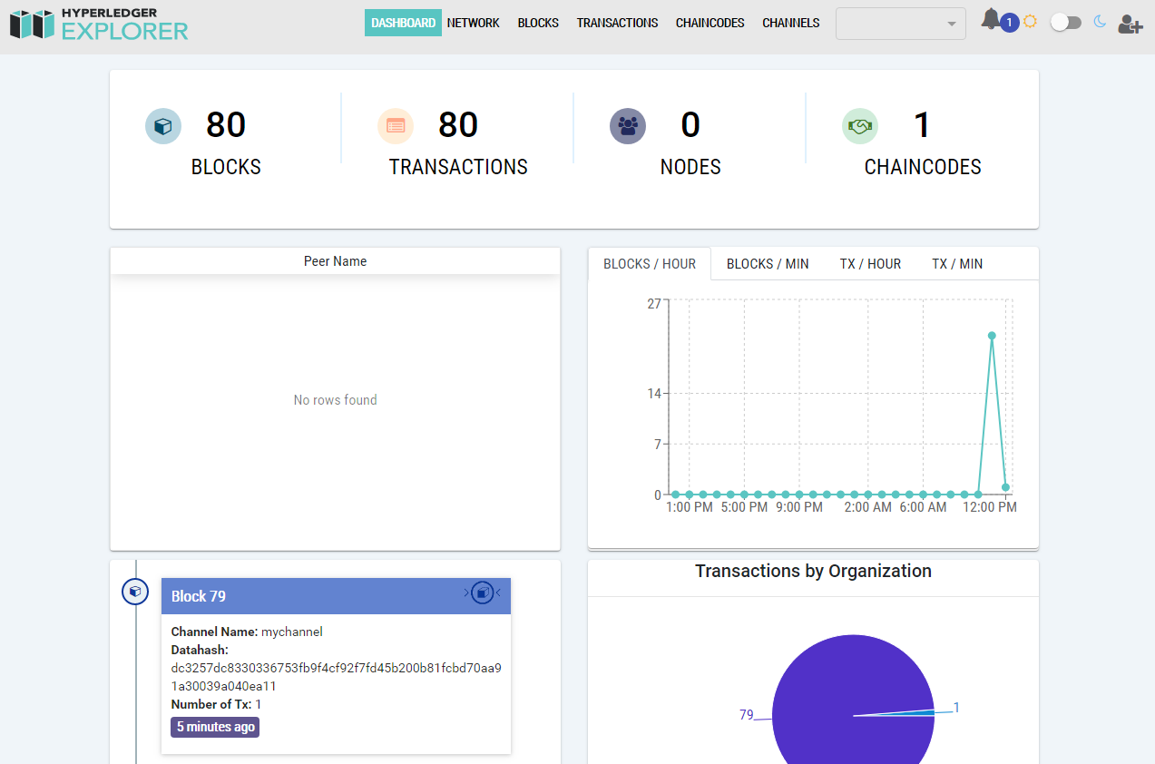
NMAC Blockchain: Proof of Concepts
Hyperledger Explorer

Slide 15
Conclusions and Future Works
Conclusions
Nmac-blockchain could improve the current NMAC system.
This technology bring transparency to nuclear material movements between facilities and different countries.
Nmac-blockchain reduces costs and delays in the regulator’s processes and enhances the security of the information assets helping avoid possible sabotages.
Futures works
We are going to implements more blockchain peers and evaluate the behaviour and performance of the nmac-blockchain with a large number of concurrent transactions.
Improve the user experience.

Slide 16
References
IAEA Nuclear Security Series N° 32-T. Establishing a System for Control of Nuclear Material for Nuclear Security Purposes at a Facility during Use, Storage and Movement. Technical Guidance. International Atomic Energy Agency, Vienna (2019).
AR 10.16.1, Rev. 3. Transporte de Materiales Radiactivos. Autoridad Regulatoria Nuclear, Argentina (2016).
Análisis del Ciclo de Combustible Nuclear Argentino. Furlano L., Marino A. C., Comisión Nacional de Energía Atómica.
Aspectos básicos de blockchain: Hyperledger Fabric e Hyperleger Composer. Maheshwari S. IBM, developerWorks (2018).
Blockchain for dummies, 2nd IBM Limited Edition. Brand W. (2018).
Blockchain for Business - An Introduction to Hyperledger Technologies. EdX curses (April, 2019).

Slide 17
Implementing Blockchain Technology in NMAC system
Questions?
Thanks for your attention.-
veronicaventurini@cnea.gob.ar

