Slide 1
Computer and information Security Training and Awareness ProgramMES for Nuclear Facilities
Nelson K. Agbemava
IT and Computer Security Section
Instrumentation & ICT Department
Radiological & Non Ionizing Installations Directorate
International Conference on Nuclear Security: Vienna, Austria, from 10 to 14 February 2020.

Slide 2
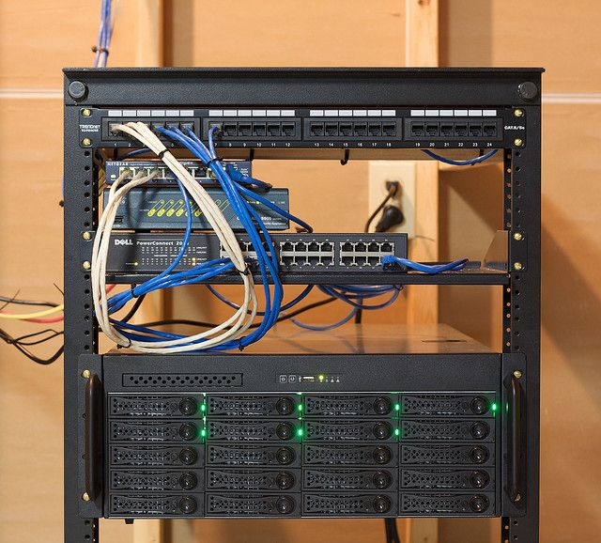
Open Question

Slide 3
INTRODUCTION
Notes:
Cyber-attacks are proving an effective means by which adversaries can target organizations, employees, and their critical assets and information. This requires organizations to adopt defensive strategies and implement preventive and protective measures. One significant measure is a comprehensive cyber security training programme to provide the necessary knowledge, skills, and abilities for personnel to identify, manage, and mitigate risks associated with cyber-attacks .
Does your business have employees? If so, cyber security (and cyber security awareness) are critical to your survival in an industry dominated by growing virtual crime. Certainly, most people know about costly identity theft and reputation-destroying network hacks, which seem to be on the news almost every day. Organizations implement firewalls, comprehensive cyber security defense systems, and sophisticated IT protocols to keep themselves safe from online threats.
The problem? Without an embedded culture of cyber security awareness and enforcement, all of those fancy and expensive systems aren’t going to do you much good.
In the end, your employees are your organization’s weakest link in the cyber security field. It’s called “the human factor.” Criminals know the easiest way to access secure networks or steal data is to target people who already have access and steal their login credentials and other critical info.
Why is cyber security awareness important?
Did you know that 95% of cybersecurity breaches are due to human error? On top of that, only 38% of global organizations state that they’re prepared to handle a sophisticated cyber attack. And worse, as much as 54% of companies say they have experienced one or more attacks in the last 12 months—this number rises every month.
Social engineering is a current favorite tactic among cyber criminals—the psychological manipulation of victims to convince them to willingly or unwittingly surrender private data that is then subverted for nefarious purposes. Another prominent technique is phishing, where phony emails or links are spread to employees who then have their login credentials mined. In fact, 95% of cyber attacks are a result of phishing scams so phishing awareness training is essential.
Alongside these two, malware is also a constant threat, with people downloading apps or software that is designed to compromise their devices or provide network access to hackers.

Slide 4
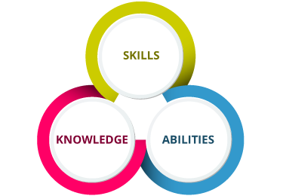
CYBER SECURITY TRAINING
These roles demand specific knowledge, skills, and abilities (KSAs) which the NICE framework defines as follows:
Knowledge is “a body of information applied directly to the performance of a function.”
Skills “… Skills needed for cybersecurity rely … on applying tools, frameworks, processes, and controls that have an impact on the cybersecurity posture of an organization or individual.”
Ability is “competence to perform an observable behaviour or a behaviour that results in an observable product.”
Notes:
Nuclear facilities and the organizations that operate, regulate, and supply them require nuclear security. Nuclear security is defined by the IAEA as “The prevention of, detection of, and response to, criminal or intentional unauthorized acts involving or directed at nuclear material, other radioactive material, associated facilities, or associated activities .Cyber security is a critical and integral part of nuclear security.
Cyber security is necessary to ensure that information and digital systems continue to provide significant functions necessary for the safe and secure operation of nuclear facilities. Since these systems may be targeted by adversaries using cyber-attacks, a formal programme is required to provide Cyber security awareness and training to all personnel having a role in the safety and security of the facility.

Slide 5
CYBER SECURITY TRAINING AND TRAINEES
Cyber Security competence is increased through an overall comprehensive Cyber Security Training Programme
This is structured in four tiers – Awareness, Topical, Professional, Specialized
Type of cyber security training | Applicable Personnel
Awareness Training | All employees and contractors
Topical Training | All employees and contractors
Professional Training | Technical and Security Staff (e.g. system administrators, software developers, network administrators, security guards, system engineers)
Specialized Cyber Security Training | Cyber Security Team (CST), cyber security incident response team (CSIRT), Cyber Security Officer, Chief Information Security Officer (CISO), Risk Acceptance Roles)

Slide 6
RESOURCES
Resources available to African Member States does not provide sufficient coverage of critical KSAs for needed work tasks
International Support and collaboration is necessary to ensure that Nuclear security regimes in these countries can deliver the necessary cyber security.
Education and Training of Cybersecurity Workforce Members: The identification of tasks in work roles allows educators to prepare learners with the specific KSAs from which they can demonstrate the ability to perform cybersecurity tasks.
Collaboration among public and private entities, such as through
IAEA courses,
US Department of Energy (DOE)
Cyber Security training courses, online courses (eLearning),
University and Professional Development
GNRA internal training program, would enable such institutions to determine common knowledge and abilities that are needed.

Slide 7
RESOURCES Cont.
For specialized training, there are several offerings, but these are largely out of the reach of countries and organizations with limited resources.
These are listed in as
SANS ICS cyber security training courses and ISA cyber security training courses.
The Black Hat Conference training programs
Infosec Institute SCADA/ICS Security Boot Camp
Cybati Control System Cybersecurity Course and
Training Kit (CybatiWorks™) can also be considered as candidates.

Slide 8
CONCLUSION
Cyber security awareness and training programs need to be based upon the KSAs necessary for personnel to competently perform work tasks and activities necessary to provide nuclear security and specifically protection against compromise (i.e. cyber-attack).
Once these work tasks are assigned, the NICE Specialty Areas and Work Role matrix can be used to link the necessary KSAs that are required to be delivered by the training programme.
The analysis also revealed that free or publicly available resources that can be leveraged for the training programme are mostly limited to use in awareness training. This places a significant strain on training programmes with very limited resources to provide the necessary professional and/or technical training. It is imperative that international cooperation and support be engaged to fill this gap to ensure global nuclear security needs are addressed.

