Slide 1
The past and potential role of civil society in nuclear security
Matthew Bunn and Nickolas Roth
Professor of Practice, Harvard Kennedy School
IAEA International Nuclear Security Conference, February 14, 2019
belfercenter.org/managingtheatom

Slide 2
Civil society groups have played a major role in strengthening nuclear security
Civil society includes
Advocacy groups
Think-tanks
Academia
The press
More…
From suggesting ideas to fostering dialogue, civil society has played a wide range of roles in strengthening nuclear security for decades
Civil society is far more than protesters against nuclear energy
Source: Fissile Materials Working Group

Slide 3
Highlighting the dangers of nuclear terrorism
Non-government analyses have often been key in highlighting the dangers nuclear security should address
1973 book, The Curve of Binding Energy had major impact on early U.S. nuclear security rules
Graham Allison’s Nuclear Terrorism: The Ultimate Preventable Catastrophe influenced President Obama’s concern about the issue
Joint U.S.-Russian non-government assessment briefed to Sherpas before the 2014 nuclear security summit
Source: Latin American Leadership Network

Slide 4
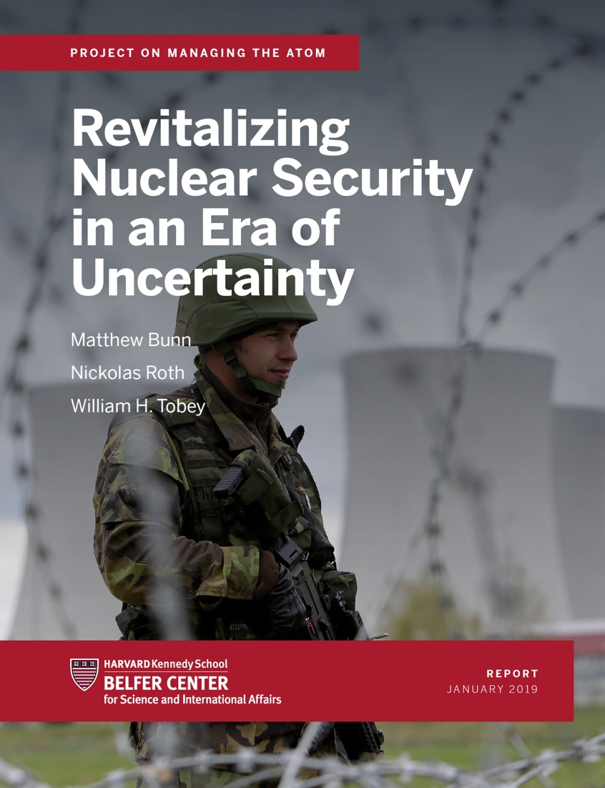
Providing research and ideas
Non-government analyses have provided research to better understand problems and solutions
More freedom to draw back to the big picture, more time to examine analogies, learn lessons from the past
Non-government analyses often suggest new ideas for action
Nunn-Lugar cooperative threat reduction
The IAEA Nuclear Security Fund
Summit “four-year effort”
Summit gift baskets on HEU minimization, training…
Many more…
Source: Managing the Atom, Belfer Center

Slide 5
Nudging governments to act, and holding them accountable
Civil society groups press for action using a variety of tools
Reports, articles, briefings, meetings with policymakers
Exposés in the media
More…
Civil society groups track progress, hold governments and industry accountable
E.g., NTI “Nuclear Security Index,” PGS-ACA-FMWG progress reports
More freedom to be candid about countries’ performance in fulfilling their commitments
Monitoring progress often leads to action to overcome obstacles
Governments and industry often see civil-society groups as a problem, and sometimes disagree with their ideas – but there is little doubt nuclear security around the world is stronger than it would have been without civil society attention

Slide 6
Providing education, building dialogue
Civil society actors help educate the public and other nuclear security stakeholders
E.g., International Nuclear Security Education Network (INSEN)
WINS Academy
More…
Civil society groups organize dialogues, partnerships, networks that might not otherwise occur
E.g., NTI “Global Dialogue” on nuclear security – government, industry, non-government experts from around the world
WINS best practice exchanges
Institute for Nuclear Materials Management – professional society
Track 2 or Track 1.5 dialogues – less constrained by government positions, can sometimes open up areas for government-to-government cooperation
More…

Slide 7
Helping with implementation, funding initial steps
Civil society groups have often helped implement nuclear security programs
WINS peer reviews of nuclear security governance
Center for Nonproliferation Studies help to several countries in finding rad sources out of regulatory control (in part using social media)
University of Georgia work with Indonesia on developing, implementing, nuclear security culture self-assessment
More…
Civil society groups can even provide funding for initial steps
NTI funding for HEU removal in “Project Vinca”
NTI founding gift of IAEA Nuclear Security Fund

Slide 8
Limitations, prospects for the future
Limitations constrain civil society’s role
Hostility or lack of interest from governments, industry
No access to sensitive information – may not be fully informed; often limited expertise
Limited resources and staffing, especially if the public is not interested
But civil society has played a very important role, and could play a larger role in the future
Expanded dialogues, networks
Expanded funding for nuclear security work from foundations, governments, industry
Establish, sustain civil-society groups monitoring nuclear security in additional countries
Centers of Excellence may be able to play a role in tracking progress, identifying gaps to be filled

