Slide 1
IAEA International Conference on Nuclear Security: Sustaining and Strengthening Efforts
The Intricate Security Culture Issue: Some Considerations about the Role of Managers
Carsten Speicher,
Ministry of the Environment, Climate Protection and the Energy Sector,
Baden-Württemberg, Germany
Vienna, 10 - 14 February 2020
Notes:
Titel des Vortrags (Menü Ansicht / Kopf- und Fußzeile / Notizblätter und Handzettel)
Vortragender, Anlass, 27.04.13
Seite 1

Slide 2
Talking points
security culture, what is it and what is it good for?
some considerations about managers and their role
what can be done to foster a positive culture

Slide 3
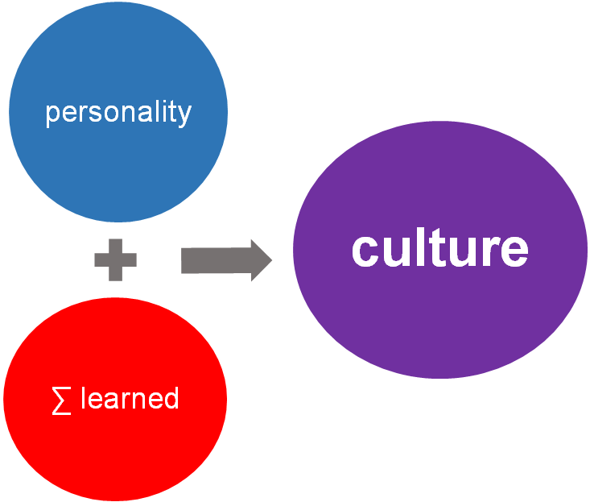
Culture...a question of definition?

Slide 4
Radiological Terrorists – what are they up to
Radiological dispersal device (RDD) disperses radioactive material into the environment, resulting in radioactive contamination.
Radiation emission device (RED) utilizes a radioactive source to expose potential victims to radiation.
Nuclear plant infrastructure and particularly spent fuel pools, if intentionally damaged, can release radiation, contaminating the immediate surroundings or beyond.
Improvised nuclear device (IND) is built from components of a stolen weapon or from scratch using nuclear material that could produce nuclear explosions and/or radioactive contamination.

Slide 5
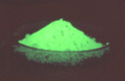
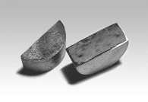
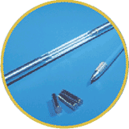
Radiological Terrorists – what may they look for
Cesium-137 Chloride
Strontium-90
Americium-242 Source
Cobalt-60 “Pencils”
Iridium-192 “Seeds”
Californium-252 Sources
Source: CITS, USA

Slide 6
Damage: Cost Estimate
Total economic loss from the act of terrorism against the World Trade Center in 2001
Over 190 billion US$
Cost to the British economy of the July 2005 bombing of the London metro system
Between 4 and 6 billion US$
Estimate of potential ensured losses from a medium size radiological attack in Washington DC
About 107 billion US$
Source: American Academy of Actuaries quoted from CITS/USA

Slide 7
Some indicators for bad patterns of behaviour
Unskilled and/or unaware staff, e.g. guards
“Lame“(weak) managers (Peter Principle?)
Failing technology (too complex or not sophisticated enough, KISS principle or ”complexity is the enemy of security“)
Unmotivated staff (mushroom-/crocodile-management?)
Complacent management (Dunning-Kruger-Effect?)
Poor external or internal working conditions („bad luck“…really?)

Slide 8
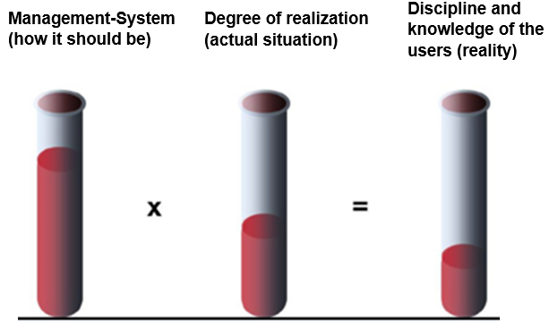
Is it good enough to have a well structured management system?

Slide 9
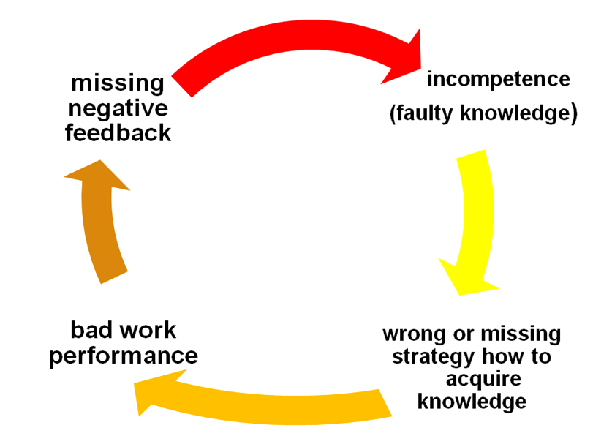
The vicious circle of incompetence

Slide 10
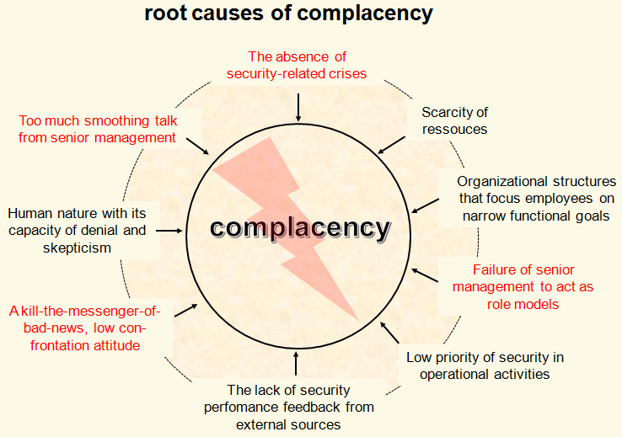

Slide 11
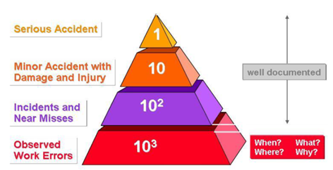
Helmreich’s error pyramid

Slide 12
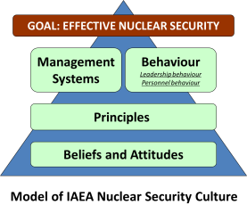
easy to see:
behaviours
habits
appearance
10%
90%
difficult to see:
values
priorities
assumptions
beliefs
expectations
our national experience:
most of the observed and analysed security related events (also low-level) are highly influenced by “weak spots“ of the security culture in pratice!:
the cultural iceberg

Slide 13
Guiding questions for any manager (I)
How do I guarantee to be regularly and often approachable for my staff?
How do I take responsibility for the needs of my staff?
How can I make sure to visibly act as role model when it comes to security related issues (and e.g. not claiming “special rights” and exceptions for myself)?
What can I do to clearly and regularly communicate the security goals of our company to the staff?
How do I contribute to improve the motivation of the staff?
How do I make decisions in practice and do I properly explain them to the staff?

Slide 14
Guiding questions for any manager (II)
How do I use authority and if so, every time if necessary and or just limited to sanction the staff?
How can I clearly communicate the “red line” problem (the absolute “no-go” for our company when it comes to security related misbehaviour) and the obligatory consequences if crossing or violating this line?
Do I regularly perform walkthroughs, make them visible for the staff and document them in a careful and respectful manner?
How do I motivate and actively support the (self-)assessment of our own security culture?
How do I contribute to implement the resulting action plan and monitor its progress?

Slide 15
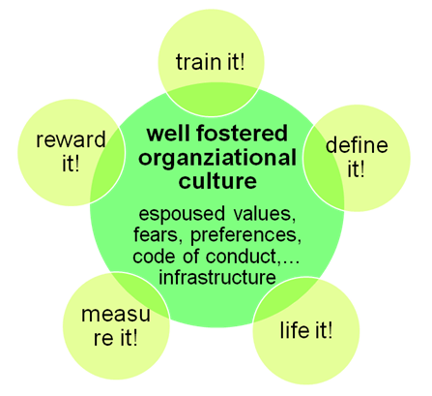
The ultimate goal!

Slide 16
Thank you for your attention!
“Organizational culture means to the organization the same thing as the oil in the gearbox: It supports the long-term effectiveness and functionality“
(A. Hagemann, former member of the German TSO “GRS“)
Any questions?
Please contact:
Carsten Speicher
carsten.speicher@um.bwl.de
Tel.:+49-711-1262613
...and I‘d like to add:
“Look at the oilcan at times and the state of its content is the duty of and the task for every regulator!“

