Slide 1


Making THE Australian Nuclear
Security Regime Fit for Purpose
International Conference on Nuclear Security
11 FEBRUARY 2020
Prepared by Michal Botha, Nuclear Security Section
Australian Safeguards and Non-Proliferation Office
D20/73251

Slide 2
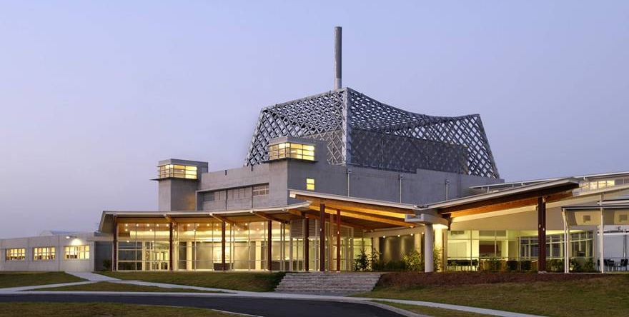
Regulated Nuclear Industry and Facilities
  UOC Industry
    3 operating uranium mines
    14 Road, Rail and Sea transport
  ~ 100 Universities, Hospitals, Radiographers, etc. holding nuclear material
  ANSTO
    OPAL Research Reactor (LEU Fuel - Category II)
    nuclear material stores
    production of ⁹⁹Mo and other medical isotopes
  Technology holders
    e.g. Silex Systems Ltd enrichment research

Slide 3
Permit holder distribution by industry type
~ 150 Permit Holders

Slide 4
INTERNATIONAL and NATIONAL Nuclear Security regimeS
International
Treaties
Amended CPPNM
Nuclear Terrorism Convention
UNSCR 1540
Orgs
IAEA
GICNT
United Nations
INTERPOL
WINS
Less-than-treaty
Instruments
Nuclear Security Series
Code of Conduct
National
Laws, Regulation & Competent Authorities
Nuclear Non-Proliferation (Safeguards) Act 1987
Australian Radiation Protection and Nuclear Safety Act 1998
ASIO
ACSC
Regulations
Regulations
ASNO
AGs
Permits
ARPANSA
Licences
AFP
Facility Operator
Security Systems
“Guns, Guards and Gates”
Security Plans and Arrangements

Slide 5
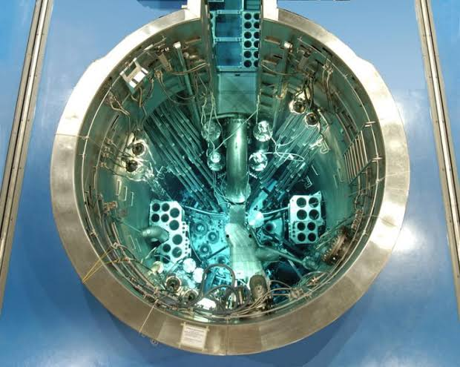
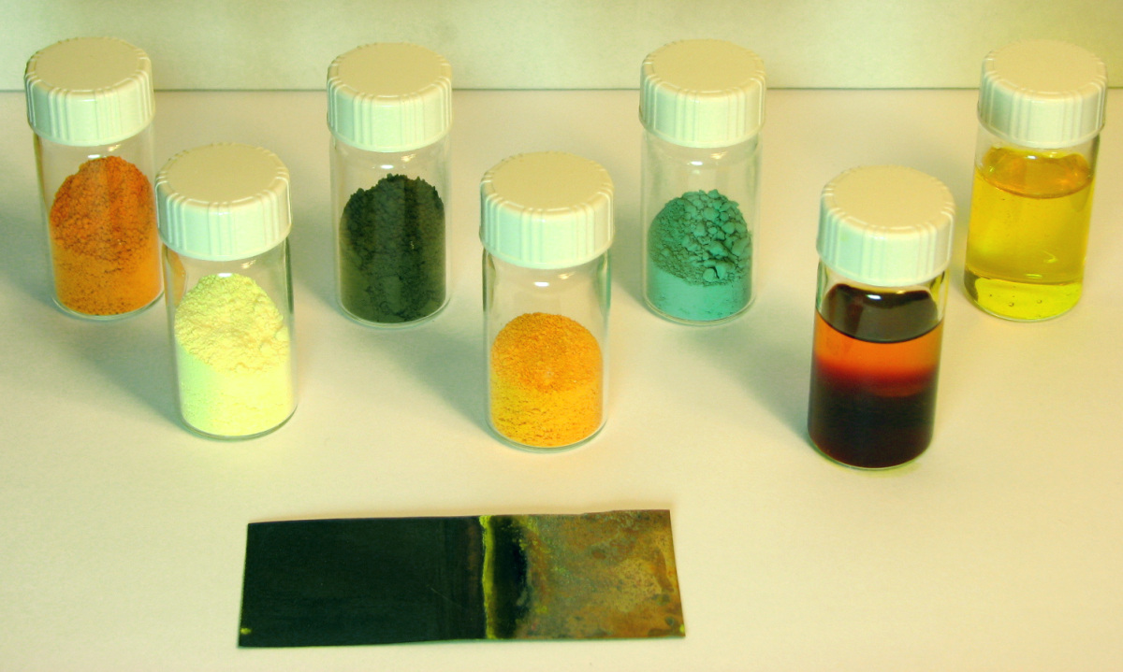
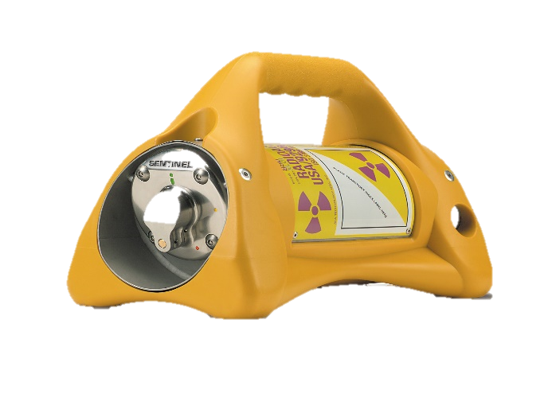
PERMITS HOLDER SECURITY CATGORISATION

Slide 6
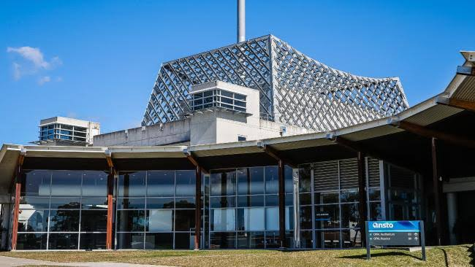
Australian Categorisation of Nuclear Material
IAEA Categorisation According to NSS-13 (INFCIRC/225/Rev.5) (CPPNM Annex II)
Material |  |  |  | Category
 | Form |  |  | I | II | III
Special Fissionable Material | Unirradiated | Pu |  | ≥2kg | >500g <2kg | >15g ≤500g
 |  | U²³⁵ | ≥ 20% U²³⁵ | ≥5kg | >1kg <5kg | >15g ≤1kg
 |  |  | > 10% U²³⁵ < 20% U²³⁵ |  | ≥10kg | >1kg <10kg
 |  |  | < 10% U²³⁵ |  |  | ≥10kg
 |  | U²³³ |  | ≥2kg | >500g <2kg | >15g ≤500g
 | Irradiated Fuel |  |  |  | DU, NU, Th or LEF <10% fissile content

Slide 7
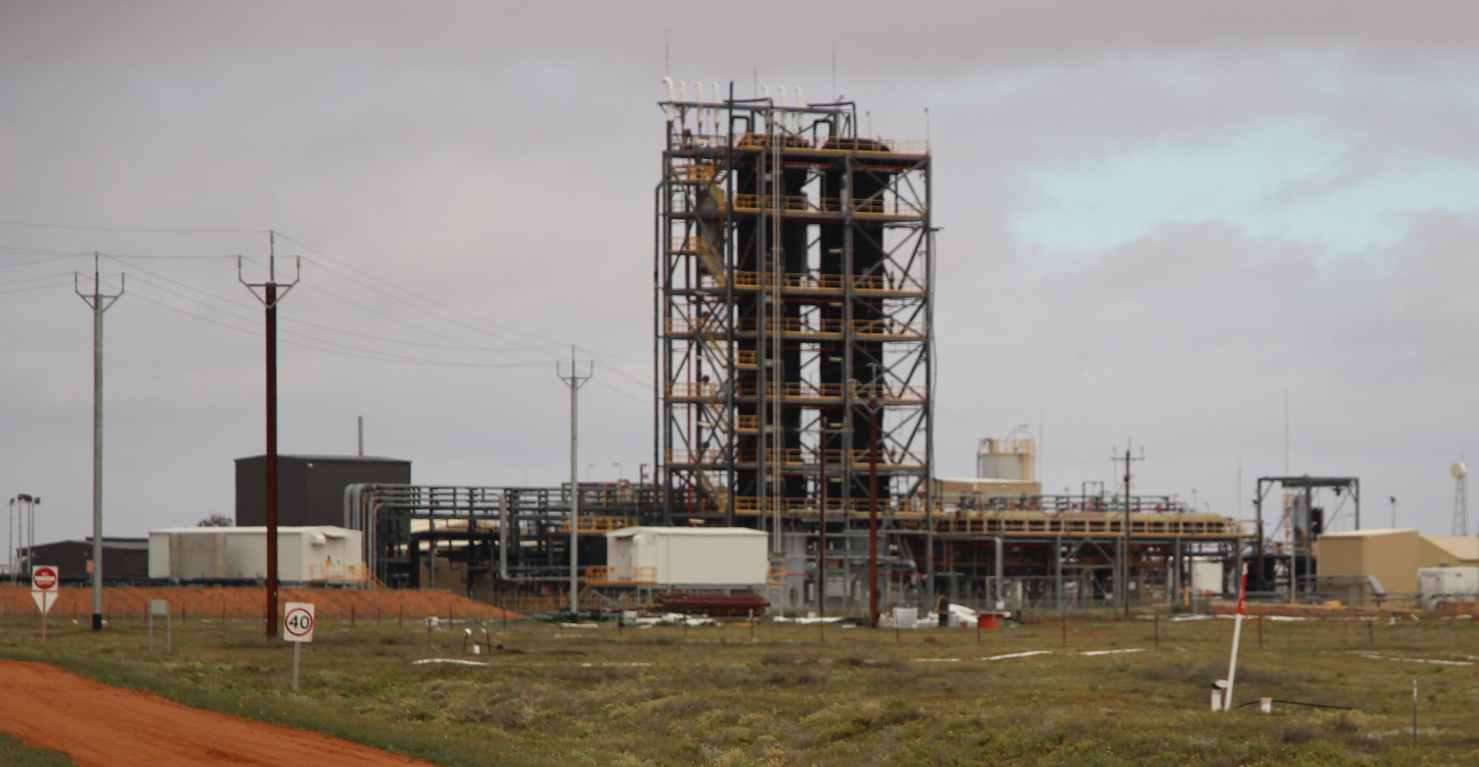
Australian Categorisation of Nuclear Material
IAEA Categorisation According to NSS-13 (INFCIRC/225/Rev.5) (CPPNM Annex II)
Material |  |  |  |  | Category
 | Form |  |  |  | I | II | III |  |  |  | LOF
Special Fissionable Material | Unirradiated | Pu |  |  | ≥2kg | >500g <2kg | >15g ≤500g |  |  |  | ≤10g
 |  | U²³⁵ | ≥ 20% U²³⁵ |  | ≥5kg | >1kg <5kg | >15g ≤1kg |  |  |  | ≤10g Total U²³⁵
 |  |  | > 10% U²³⁵ < 20% U²³⁵ |  |  | ≥10kg | >1kg <10kg
 |  |  | < 10% U²³⁵ |  |  |  | ≥10kg
 |  | U²³³ |  |  | ≥2kg | >500g <2kg | >15g ≤500g |  |  |  | ≤ 10g
 | Irradiated Fuel |  |  |  |  | DU, NU, Th or LEF <10% fissile content
Source Material | Unirradiated | Natural Uranium |  |  |  |  |  |  |  |  | Unlimited
 |  | Depleted Uranium |  |  |  |  |  |  |  |  | ≤5000kg
 |  | Thorium |  |  |  |  |  |  |  |  | ≤5000kg

Slide 8
Australian Categorisation of Nuclear Material
IAEA Categorisation According to NSS-13 (INFCIRC/225/Rev.5) (CPPNM Annex II) |  |  |  |  |  |  |  |  | ASNO Categorisation Prudent Management Practice
Material |  |  |  |  | Category |  |  |  | Category |  | Location Outside Facility (LOF) |  |  | UOC |  | Radiographers
 | Form |  |  |  | I | II | III |  | IV |  | L3 | L2 | L1 | U1 | U2 | R2 | R1
Special Fissionable Material | Unirradiated | Pu |  |  | ≥2kg | >500g <2kg | >15g ≤500g |  | >10g ≤15g |  | ≤10g | ≤5g | ≤1g
 |  | U²³⁵ | ≥ 20% U²³⁵ |  | ≥5kg | >1kg <5kg | >15g ≤1kg |  | >10g ≤15g Total U²³⁵ |  | ≤10g Total U²³⁵ | ≤5g Total U²³⁵ | ≤1g Total U²³⁵
 |  |  | > 10% U²³⁵ < 20% U²³⁵ |  |  | ≥10kg | >1kg <10kg |  | >10g ≤1kg Total U²³⁵
 |  |  | < 10% U²³⁵ |  |  |  | ≥10kg
 |  |  |  |  |  |  |  |  | >10g <10kg Total U²³⁵
 |  | U²³³ |  |  | ≥2kg | >500g <2kg | >15g ≤500g |  | >10g ≤15g |  | ≤ 10g | ≤ 5g | ≤1g
 | Irradiated Fuel |  |  |  |  | DU, NU, Th or LEF <10% fissile content
Source Material | Unirradiated | Natural Uranium |  |  |  |  |  |  | ≤5000kg |  | ≤5000kg | ≤500kg | ≤10kg | Unlimited | 1x10⁶kg
 |  | Depleted Uranium |  |  |  |  |  |  | ≤5000kg |  | ≤5000kg | ≤500kg | ≤10kg |  |  | ≤5000kg | ≤500kg
 |  | Thorium |  |  |  |  |  |  | ≤5000kg |  | ≤5000kg | ≤500kg | ≤10kg

Slide 9
ASSOCIATED ITEMS
ASSOCIATED ITEMS
ASSOCIATED MATERIAL (AM)
Material specially suited for use in nuclear activities
ASSOCIATED TECHNOLOGY (AT)
Information applicable primarily for enrichment,
reprocessing or heavy water production
ASSOCIATED EQUIPMENT (AE)
Equipment or plant specially for use in nuclear activities
Document
containing
information
Photograph, model or other thing from which such information may be obtained or deduced
Reactors
Reactor internals, pressure vessels etc.
Nuclear Grade Graphite
Electronic Media (e.g. CDs, USB, Hard-drive, Smart Device, Networks)
Equipment or plant (AE) from which information (AT) can be obtained or deduced
Computer or physical model
Heavy Water
Heavy Water Plant
Centrifuge Design
Enrichment, reprocessing or heavy water plant and equipment

Slide 10
PERMITS AND AUTHORITIES
Section 16
Section 13
Permit to Transport Nuclear Material
Permit to Possess Nuclear Material
Section 18
T1 - NM General
Authority to Communicate Information
R1 - Radiographer Small Quantity
T2 – NM
Air transport
T9 - NM Single Transport
R2 - Radiographer Medium Quantity
S1 - Facilities
U1 - UOC Concentration Plant
P1 - Patent Attorneys
U2 - UOC Transport Road/Rail
L1 - Very Low Quantity
S2 - Research Associated Technology
U3 - UOC Transport Sea
P2 – Government Archives
U4 - UOC Stevedores /Ports
L2 - Low Quantity
S3 - Research
Nuclear Material
U5 - UOC Broker / Trader
Section 16A
L3 - Moderate Quantity
Permit to Establish Facility
S4 - Waste Repository
U6 - UOC Laboratory
U7 - Establish UOC Plant
L4 - Category IV
Permit to Decommission Facility
Section 16B
U8 – Decommission UOC Plant

Slide 11
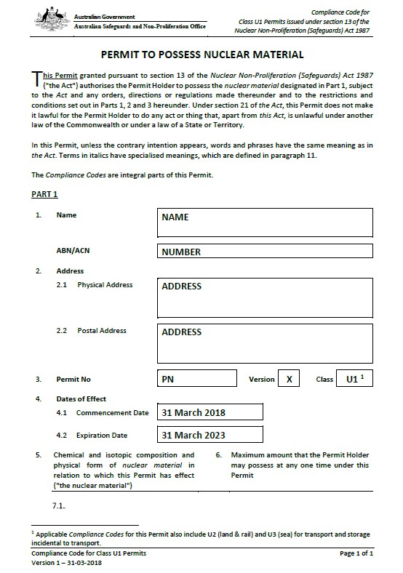
Permit Content - UOC
RISK
ASSESSMENT
GOVERNANCE
PERMIT SECTION
MAXIMUM
NUCLEAR
MATERIAL
HOLDINGS
PERMIT
HOLDER
PARTICULARS
CONTROL
REQUIREMENTS
COMPLIANCE CODE
INSPECTION
REQUIREMENTS
ASNO / IAEA
NUCLEAR SECURITY
REQUIREMENTS
EXECUTIVE LEVEL
PERMIT PRICIPLES
ACCOUNTANCY
REQUIREMENTS
SECURITY PLAN
SCALABLE
THREAT
MODEL
APPLICATIONS
NOTIFICATIONS
REPORTING

Slide 12
Permit Content – UOC TRANSPORT
RISK
ASSESSMENT
GOVERNANCE
PERMIT SECTION
MAXIMUM
MATERIAL
TRANSPORT
LIMIT
PERMIT
HOLDER
PARTICULARS
PRE-
TRANSPORT
COMPLIANCE CODE
INSPECTION
REQUIREMENTS
ASNO / IAEA
EXECUTIVE LEVEL
PERMIT PRICIPLES
STORAGE
INCIDENTAL TO
TRANSPORT
DURING
TRANSPORT
TRANSPORT PLAN
SCALABLE
THREAT
MODEL
EMERGENCY
PROCEDURES

Slide 13
L1, L2, L3 PRUDENT MANAGEMENT PRACTICE – GRADED APPROACH
The Permit Holder shall maintain security measures for preventing the theft, loss or unauthorised handling of nuclear material including:
  [L1] restricting access to nuclear material to persons who need to access such material;
  [L1] securing the inventory in a lockable room or container; and
  [L1] maintaining documentary records associated with the Permit conditions
  (access list, log in/out sheet)
  [L2] maintaining written procedures for access, use and storage
  [L3] maintaining adequate levels of appropriately qualified staff to ensure systems of physical protection and security are fully implemented and operational

Slide 14
NEXT STEPS
  Glossary
  Harmonisation
  New Permit Classes
  Production of Guidance Documents
  Model Security Plans

Slide 16
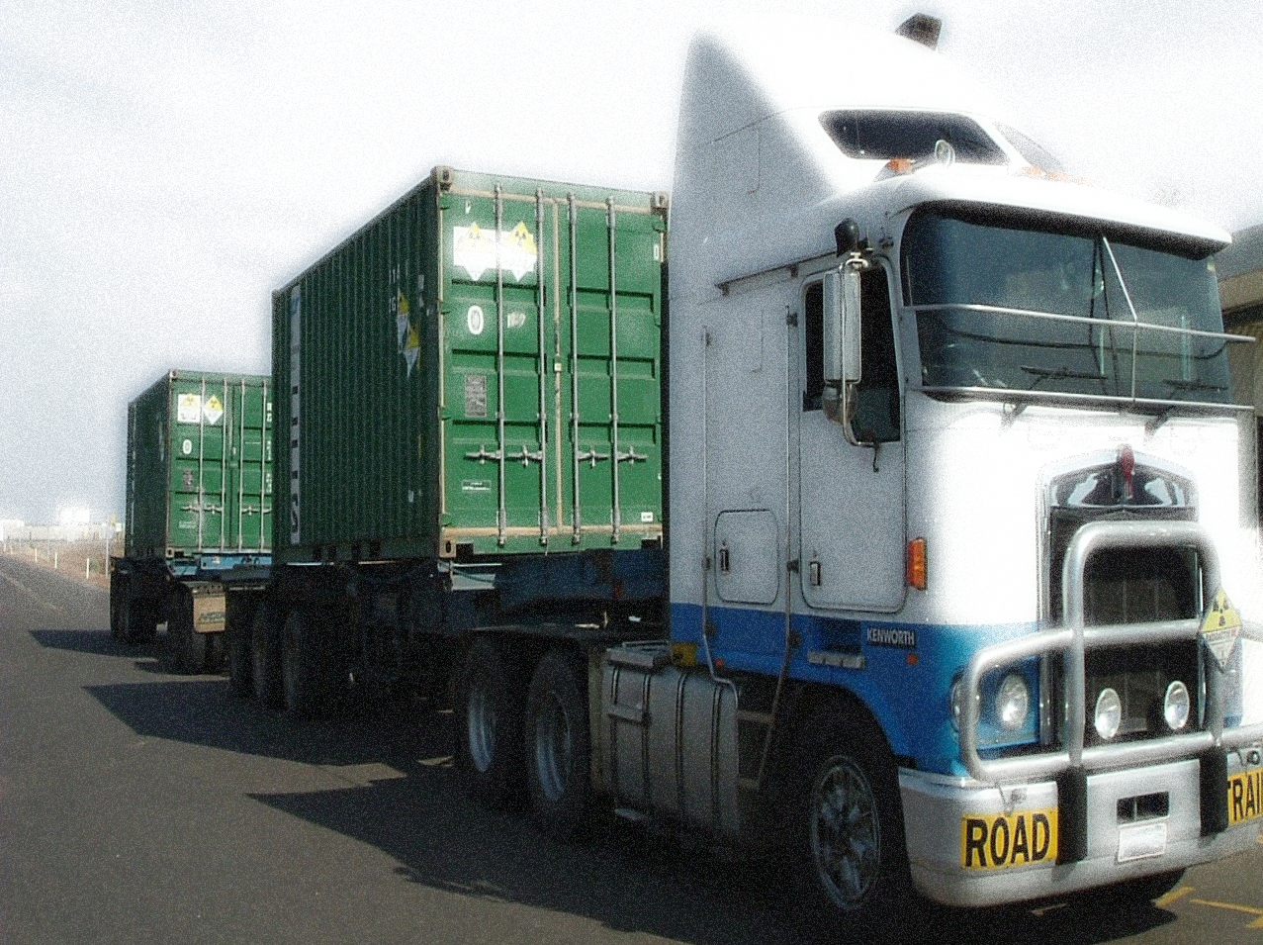
Additional Slides

Slide 17
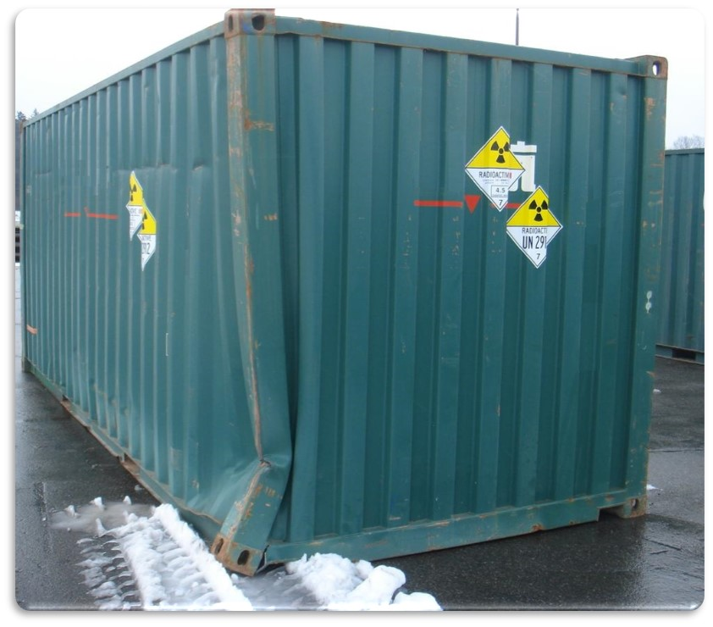
Permit Functional Format
Route
Pre –
Transport
Container / Seal Inspection
Transport Briefing
Communications Operational Test
During
Transport
Convoy Communication
Predetermined stops
Security and Situational Awareness
Interim
Storage
Interim Security Arrangements
Approved Secure Compounds
Container storage to be door-to-door
Emergency
Response
Restoring Communications
Maintaining Security
Training
Escalated
Threat

Slide 18
Scalable Threat Model for the Transport of UOC
ASNO utilizes a threat scale based on the
Australian National Terrorism Threat
Advisory System³
CERTAIN
Attack/activities is imminent or occurring
EXPECTED
Movements of UOC are to cease
PROBABLE
Attack/activities is assessed as likely
POSSIBLE
Attack/activities is feasible and could occur
Mining Industry
NOT EXPECTED
Baseline nuclear security measures to be applied for the transport of UOC
Australian Maritime Transport and Offshore Facilities Security Act 2003 in keeping with ISPS⁴ requires the application of maritime security levels
MARSEC 3
Security incident is probable or imminent
MARSEC 2
Heightened risk of a security incident
MARSEC 1
Normal business operations
³www.nationalsecurity.gov.au
⁴International Ship and Port Facility Security Code 2003

Slide 19
Australian Nuclear Security Regime
NPT
Australian / IAEA Comprehensive Safeguards Agreement – 10 July 1974
International Convention for the Suppression of Acts of Nuclear Terrorism
Additional Protocol to the Comprehensive Safeguards Agreement – 12 December 1997
Amended Convention on the Physical Protection of Nuclear Materials
Australian Legislation
Administered
by ASNO
Nuclear Non-Proliferation
(Safeguards) Act 1987
ARPANS Act 1998 Regulations 1999 – Part 3
Weapons of Mass Destruction
(Prevention of Proliferation) Act 1995
Associated
Equipment
Nuclear &
Associated Material
Associated
Technology
Patents Act 1990
- Article 147
Customs (Prohibited Exports) Regulations 1958 - Reg 13E
Customs (Prohibited Exports) Regulations 1958 - Reg 9

Slide 20




Australian Security LANDSCAPE
Radioactive Material
Nuclear Security-Related
Information
Associated
Other Sensitive Government Information/Assets
Nuclear Material
Material
Equipment
Technology
ICSANT
Amended CPPNM
ASNO (Safeguards Act) - [Physical Security]
ARPANSA + State Authorities
IAEA NSS 20 –
Nuclear Security
Protective Security Policy Framework
IAEA NSS 14
[Nuclear Security]
IAEA NSS 13
[Physical Protection]
Physical Security
Information/Cyber Security
Personal Security

Slide 21
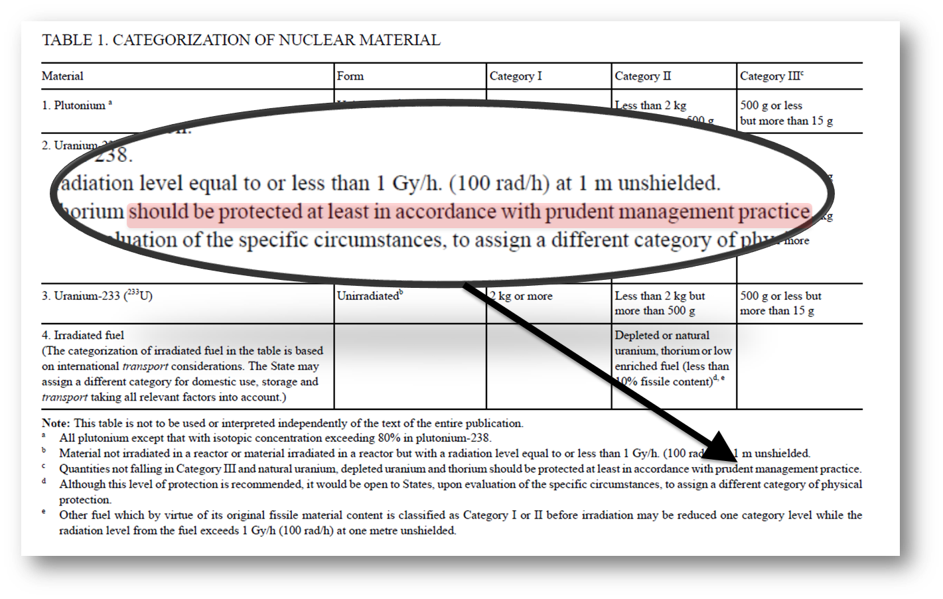
CATEGORISATION OF NUCLEAR MATERIAL – INFCIRC/225
Australia has
- 1 research reactor facility that has Class III and Class II nuclear material in storage.
Approximately 140 operators that have nuclear material requiring prudent management practice
99% of Australian Operators are required to have prudent management practice

