Slide 1
International standards for the performance of radiation detection instruments used in the global nuclear security framework International Conference on Nuclear Security ICONS2020, 10-14 February 2020, IAEA (Vienna)
Radiation protection instrumentation
Miroslav VOYTCHEV, IRSN (France), Secretary of IEC/SC45B
Radoslav RADEV, LLNL (US), Chairman of IEC/SC 45B
LLNL-PRES-799397
This work performed under the auspices of the U.S. Department of Energy by Lawrence Livermore National Laboratory under Contract DE-AC52-07NA27344

Slide 2
IEC - International Electrotechnical Commission
Founded in 1906
Prepares and publishes international standards for all electrical, electronic and related technologies
National Committees (NC)
62 member countries
23 associated member countries
Technical Committees (TC) and Sub-committees (SC)
207 TCs and SCs
more than 560 WGs

Slide 3
IEC/SC 45B Radiation protection instrumentation
Prepare standards that address instrumentation used for:
the measurement of ionizing radiation in the workplace, to the public and in the environment for radiation protection purposes
illicit trafficking detection and identification of radionuclides
radiation-based security screening
Country membership
Participating countries (P-members): 20, Observer countries (O-members): 15
More than 100 experts
Testing laboratories
Governmental agencies
Manufacturers
Users
Standards and technical documents
Published: 57, In development: 10
Liaisons with ISO, IAEA, ICRP, ICRU…
7 Working Groups (WGs)
WG 15: Illicit Trafficking Control Instrumentation using spectrometry, personal electronic dosimeter and portable dose rate instrumentation

Slide 4
Standards on instrumentation used for detection of illicit trafficking of radioactive material
11 international standards published since 2003
Revisions undertaken since 2014
Harmonization
Taking into account the feedback from different testing programs and international projects as ITRAP+10
Types of instruments
Body-worn
Portable or hand-held
Portal
Vehicle-mounted
Data output format standard
IEC 62755 (2012)

Slide 5
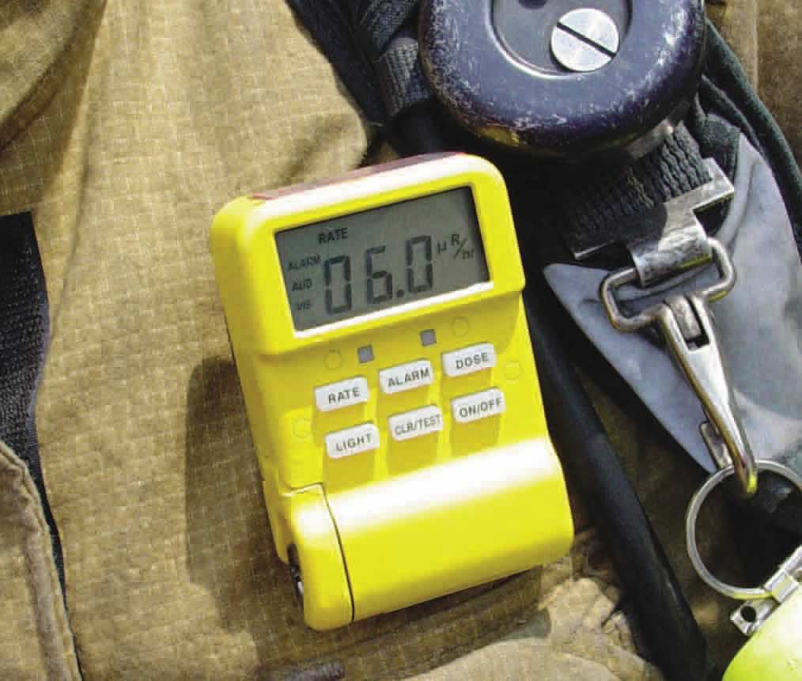
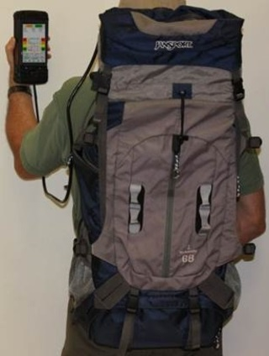
Body-worn
IEC 62401 Ed. 2 (2017) Alarming Personal Radiation Devices (PRD)
IEC 62618 Ed. 2 (in progress) Spectroscopy-Based Alarming Personal Radiation Devices (SPRD)
IEC 62694 Ed.2 (in progress) Backpack Based Radiation Detector (BRD)

Slide 6
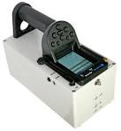
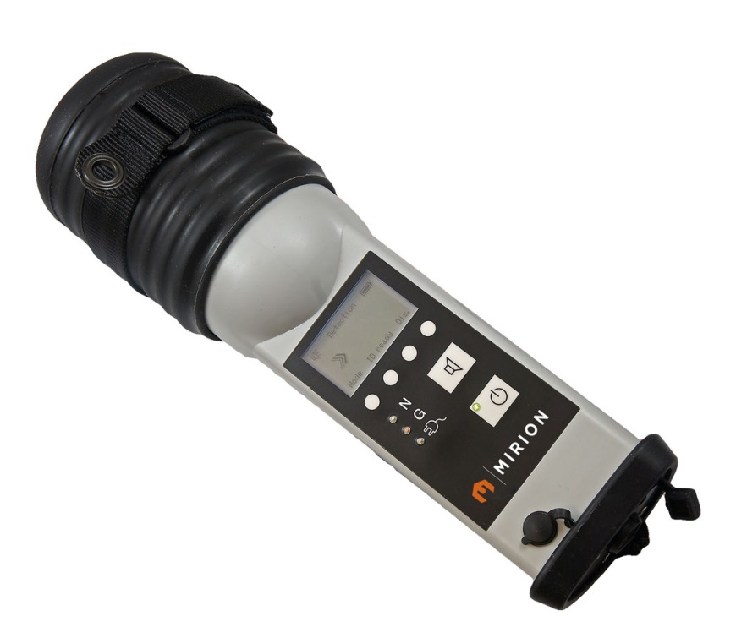
Portable or hand-held
IEC 62327 Ed. 2 (2017) Hand-held Radionuclide Identification Devices (RID)
IEC 62533 (2010) Hand-held highly sensitive Photon Devices (GSD)
IEC 62534 (2010) Hand-held highly sensitive Neutron Devices (NSD)

Slide 7
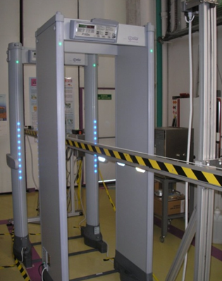
Portal
IEC 62244 Ed. 2 (2019) Portal Monitors (RPM)
IEC 62484 Ed. 2 (in progress) Spectroscopy-Based Portal Monitors (SPRM)

Slide 8
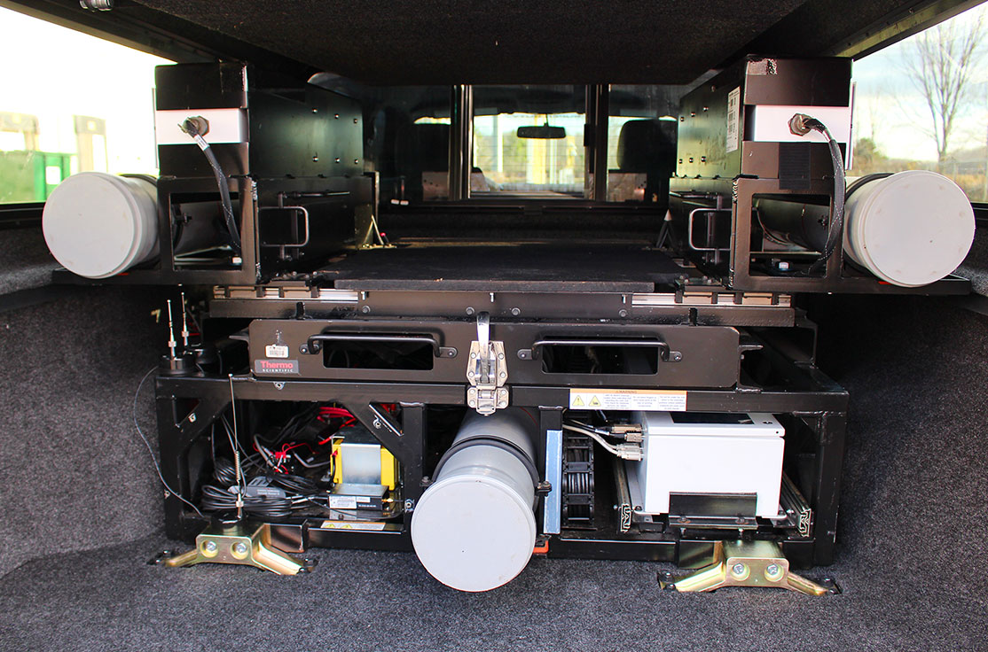
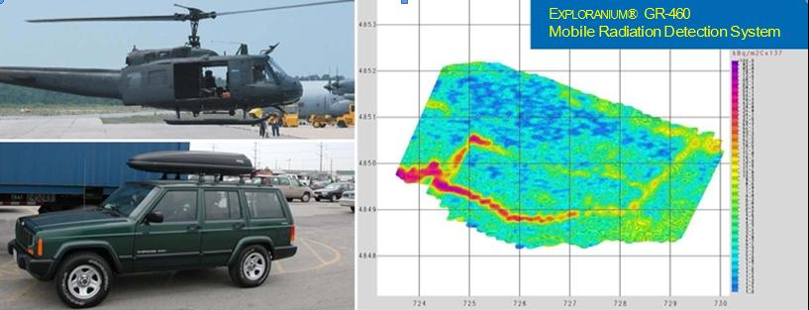
Vehicle-mounted
IEC 63121 (in progress) Vehicle-mounted mobile systems (VMS)

Slide 9
Basic radiation detection requirements
 | Max rate of false alarm | Gamma or neutron alarm | Gamma dose rate indication error | Gamma dose rate over-range | Additional tests
PRD | 1 alarm in 1 h | ≤ 2 s at increase of 0.5 µSv∙h^{–1} above background | ≤ ±50 % | At 2 times max range
SPRD | 3 alarms in 8 h | ≤ 3 s at increase of 0,5 µSv∙h^{–1} above background | ≤ ±50 % | At 2-10 times max range or 1 mSv∙h^{–1}
BRD | 1 alarm in 1 h | ≤ 2 s with gamma fluence rate of 4 s⁻¹·cm | ≤ ±30 % | At 1.5 times max range | Angular dependence
RID | - | ≤ 1 s at increase of 0.5 µSv∙h^{–1} above background | ≤ ±30 % | At 1.5 times max range | Gamma source localization
GSD | 1 alarm in 1 h | ≤ 3 s at increase of 0,05 µSv∙h^{–1} above background | ≤ ±30 % | At 10 times max range or 1 mSv∙h^{–1}
NSD | 1 alarm in 1 h | ≤ 2 s at exposure from ²⁵²Cf to 0.1 n∙s^{–1}.cm^{–2} | - | At 10 times max range
RPM | 2 alarms in 10 h | At radiation level greater than a threshold | - | At 1.5 times max range | Warning when backgr. change
SRPM | 1 alarm in 10 h | Alarm at radionuclide identification | - | At 1.5 times max range | Warning when backgr. Change
VMS | 1 alarm in 2 h | At radiation level greater than a threshold | - | At 1.5 times max range | Background effects

Slide 10
Other radiation tests
Detection of gradually increasing radiation
Neutron detection alarm (if applicable)
Personal protection alarm
Radionuclide identification (RID)
Single: ²⁴¹Am, ¹³³Ba, ⁶⁰Co, ¹³⁷Cs, ⁶⁷Ga, ¹³¹I, ^{99m}Tc, ⁴⁰K (KCl or KOH), ²⁰¹Tl, ²²⁶Ra, ²³²Th, ²³⁸U (DU), ²³⁵U (HEU) and ²³⁹Pu (WGPu)
Mixed: ¹³¹I + WGPu, NORM+HEU, NORM+WGPu

Slide 11
Climatic, mechanical and EMC requirements and tests
Climatic: ambient temperature, temperature shock, low/high temperature start-up, relative humidity, moisture and dust protection
Mechanical: drop, vibrations, microphonics/impact and mechanical shock
Electromagnetic: electrostatic discharge, radio frequency (RF) immunity, radiated emissions, magnetic fields and AC line powered equipment requirements
Electrical: battery lifetime and power requirements
Documentation

Slide 12
Conclusion
Criteria and compliance test methods in the standards
Optimization
Compromise
Consensus
Objects of the standards
Describe the performance requirements and functional criteria
Develop testing methods for evaluating the performance of the applicable instrumentation
Specify general characteristics, general test procedures, radiation characteristics, climatic, mechanical, electromagnetic and electric characteristics
Compliance with standard requirements provides
Manufacturers with internationally acceptable specifications
Device users with assurance of the rigorous quality and accuracy of the measurements
International use
CENELEC transposition as EN standards
Harmonization with US ANSI standards by the Accredited Standards Committee “Radiation Detection”

Slide 13
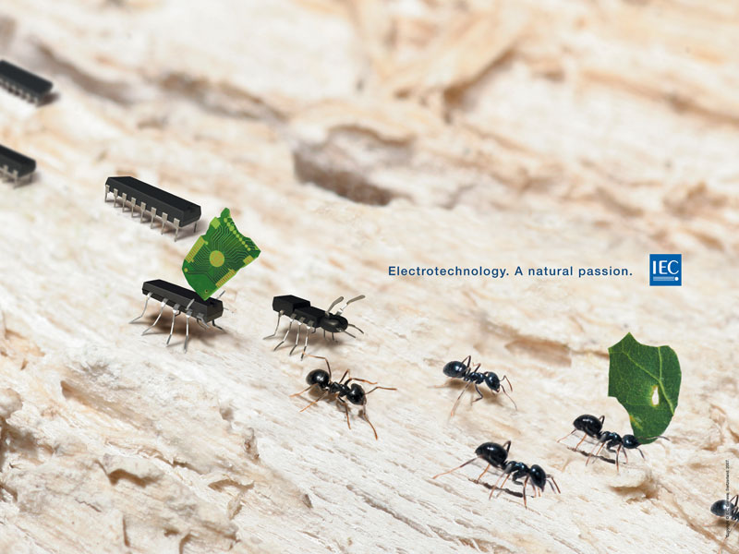
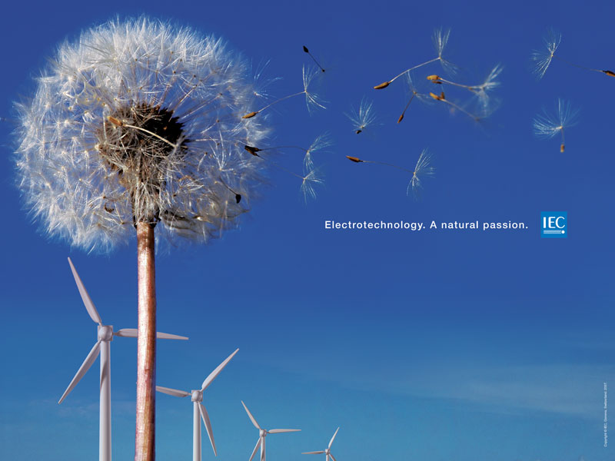
Thank you for your attention. Any questions?
For contacts:
miroslav.voytchev@irsn.fr
radev1@llnl.gov

