Slide 1
Evaluation of the Appropriateness of Trust Models to specify Defensive Computer Security Architectures for Physical Protection Systems
Presented By: John Sladek (CNSC)
Primary Author: Michael T. Rowland (Sandia)

Slide 2
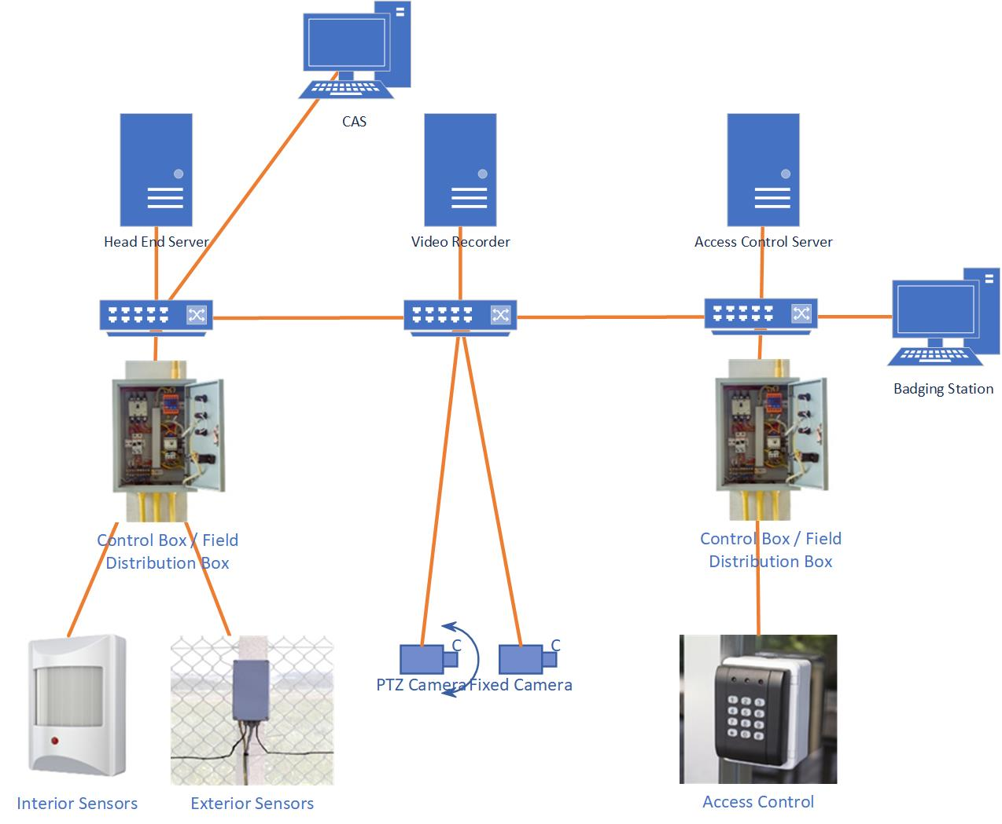
Generic PPS Design

Slide 3
Graded Approach
Graded Approach
Demands increasingly stringent requirements based on severity of consequence.
Ensures that level of effort to provide security is commensurate with the severity of consequence.
Highest
protection
Generic Requirements
Level 1 Requirements
Level 2 Requirements
Significance of Facility Function
Level 3 Requirements
Level 4 Requirements
Level 5 Requirements
Lowest
protection
Security Level – Strength of Requirements

Slide 4
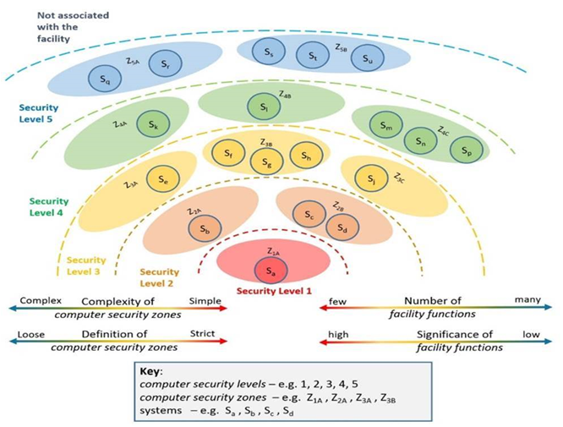
Defence in Depth
Defence in Depth
Defensive Computer Security Architecture (DCSA) increases the difficulty of the adversary accessing or having the opportunity to:
  sabotage vital equipment, resulting in safety consequence)
  gain unauthorized access to attractive material (theft of material), resulting in a security consequence.
The figure shows a DCSA based on safety goals.

Slide 5
Confidentiality, Integrity & Availability Requirements for PPS
Confidentiality (Example)
Example linked to PPS ‘prevent’ function
The prevent function is supported by restricting site access to authorized individuals
Supported by information flows from the head-end system and the badging office, where the authentication information (e.g., biometrics, PIN, card number) are recorded.
Authentication information is used to verify the identity of the person (or entity) requesting access to protected areas at the edge devices (using PIN, biometrics, card number).
Information used for authentication is PII and its confidentiality needs to be protected.
Integrity (Accuracy & Completeness)
Example taken from the ‘detect’ function.
Alarm signals generated by sensors need to be accurate and complete.
If integrity not provided, may result in:
  Alarm not received (failure to detect)
  Alarm received but not valid (spurious or nuisance alarm)
  Alarm received but modified (change in time or location)
  Modification of video signals used for assessment (e.g., security officer is presented old video data)

Slide 6
CIA Requirements for PPS - Continued
Availability
Loss of availability of PPS components will have impact on provision of security functions:
  Access control will typically fail-secure (preventing any access) but places burden on the security staff as manual checks will need to put into place.
  Complete loss of perimeter monitoring will be a significant challenging since security staff will be required to monitor the perimeter.
  If insufficient staff is available, this could result in gaps in monitoring which would result in serious degradation of overall performance of the PPS.
CIA Priority (highest to lowest)
Integrity – without complete and accurate alarms, the adversary has increased likelihood of successfully evading detection before reaching the critical detection point.
Compromise of integrity can be accomplished through ‘stealth’ and therefore not identified by security staff without specific computer security measures in place.
Confidentiality – disclosure of PII can lead to an adversary using the PII (e.g. copy access card, crack passwords) to modify PII (changing biometric data) or to use cracked passwords add new credentials.
Can be done through ‘stealth’ or even exfiltrated and done offline (cracking passwords)
Availability – failures are immediately detectable and typically procedures and processes are put into place. Many PPS designs will fail-secure.

Slide 7
Necessity of Security Levels and Security Zones
Graded Approach
  Typical approach is to place PPS in the highest and/or second highest (most stringent) level.
  Key computer security measure - isolation using a “prevent access” paradigm
Defence-in-Depth Approach
  Typical approach is to place a PPS into a single zone (or multiple isolated zones)
  Line supervision to ensure no tapping, disruption, or ‘cutting’ of communication lines
  Encrypted communication (e.g., 3DES or AES)
  ‘data in use’ is vulnerable to authorized insiders and adversaries able to exploit ’unknowing’ insiders.
  Head-end systems are vulnerable.
Example Vulnerability
  Implantation of unauthorized attacker technology that can circumvent controls
  Created covert, remotely accessible, communications channel to access control server.
  John Clem, Sandia National Laboratories, IAEA-CN-254-298, ‘Potential Weaknesses in the Cyber Systems of High-Security Physical Protection Systems’

Slide 8
NSS 13 and NSS 27-G Requirements
Integrated (dictionary.com definition)
  organized or structured so that constituent units function cooperatively
Physical Protection System (NSS 13 definition)
  An integrated set of physical protection measures intended to prevent the completion of a malicious act.
Integration of PPS:
  mentioned 8 times within NSS 13
  Section 4 of NSS 27-G – “Developing, Implementing, and Maintaining an Integrated PPS”
Cyber-security impact of ‘integration’
  PPS designs have an expectation of absolute and complete trust between devices
  This trust can be abused without formalized access control policies being implemented
  Requires a trust model to analyze system design to verify that CIA of PPS is protected from adversaries according to priority (e.g., I > C > A).

Slide 9
Functions of PPS – Demanded for Graded Approach
Physical Protection Functions are ‘detect’, ‘delay’, and ‘response’
These function descriptions do not allow for easy gradation and assignment to security levels.
IAEA NST047 states that ‘Facility Functions’ are:
  A coordinated set of actions and processes that needs to be performed at a nuclear facility.
  Each function is associated with specific purpose or goal that must be accomplished
Detect, delay and response lacks the completeness required for assessment
Potential descriptions of PPS functions that can be assessed are:
  Detection of intruder at a Critical Detection Point
  Control of access at the protected area perimeter
  Detection of contraband entering protected area
  Visual assessment of potential security events at protected area boundary
  Detection of radioactive material in vehicles leaving the facility

Slide 10
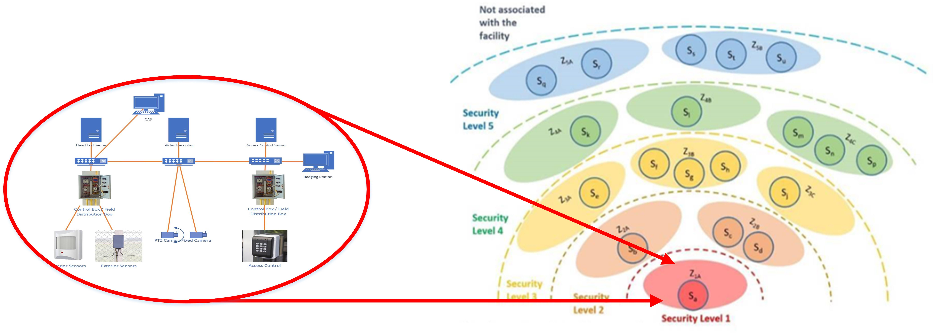
PPS Architecture – Single Level/Single Zone
Physical protection functions of ‘detect’, ‘delay’, and ‘response’ do not allow for assignment to security levels (no graded approach).
Lack of grading (and focus on integration) does not support creation of security zones (no computer security defense-in-depth)
May result in strategic vulnerabilities in architecture (e.g., all devices within PPS trust each other)
Trust models cannot be used to verify protection

Slide 11
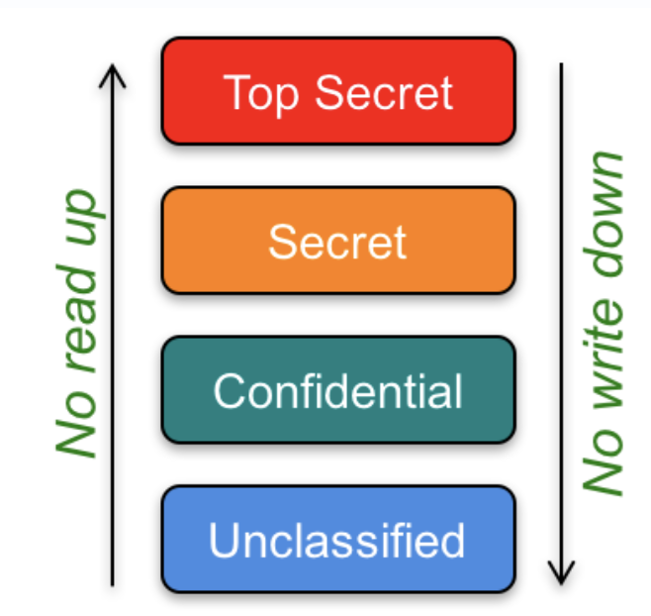
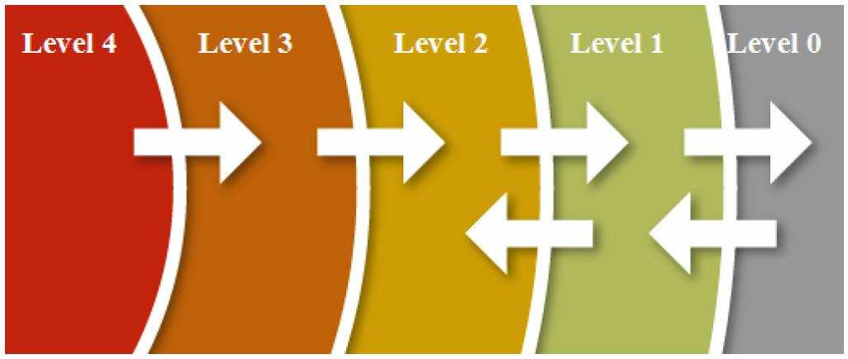
Biba and Bell-LaPadula
Biba Integrity Model
  Prioritizes the protection of Integrity
  Nuclear Safety systems – DCSA are built based upon or informed by this model.
  NEI 08-09 Rev 6 implementation
Bell-LaPadula
  Prioritizes the protection of Confidentiality
  Protection of Classified Information is informed by this model
  Inverse of Biba Integrity Model
References – Biba (NEI 08-09); Bell-LaPadula https://www.cs.rutgers.edu/~pxk/419/notes/access.html

Slide 12
Clark-Wilson
  Not a single specific policy, but a framework to specify ‘class’ of policies
  Addresses security requirements of commercial applications
    Reference: David D. Clark and David R. Wilson, A Comparison of Commercial and Military Computer Security Policies, 1987 IEEE Symposium on Security and Privacy
  Enforces Integrity:
    Only authorized users are allowed to make changes to the system.
    Authorized users can’t make unauthorized changes
    Internal and external consistency are maintained
  Integrity requirements consist of two parts:
    Internal consistency – properties of internal system state; enforced by the computer system (integrity verification procedures)
    External consistency – relation of the internal system state system to real world; enforced by ‘auditing’
  Mechanisms
    Well-formed transactions – data can only be manipulated by a specific set of programs (transaction processes); users have access to programs and not data.
    Supports separation of duties (no single user can manipulate data or circumvent the security system)

Slide 13
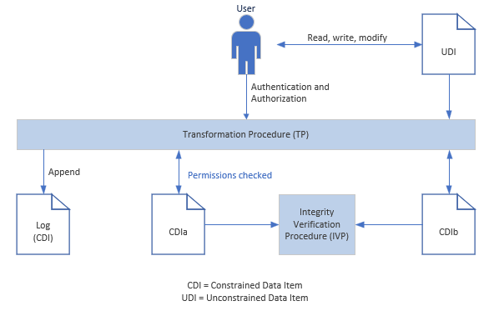
Clark Wilson
Figure based on: Dieter Gollman, Computer Security (3rd Edition), John Wiley and Sons, 2011

Slide 14
Conclusion
PPS systems rely heavily on ‘prevent’ paradigm for computer security; increasing difficulty for a application of a graded approach or implementation of defence-in-depth for computer security.
Trust Models are useful to evaluate the design of systems and potentially inform new designs to implement nuclear security principles.
PPS systems need to prioritize Integrity; but Confidentiality shares almost equal priority.
Biba and Bell-LaPadula do not provide for near-equal prioritization
Clark-Wilson potentially allows for both; but more research is required to determine whether existing designs are or can be structured to generally comply with a framework of access control policies.

Slide 15
Thank you!

