Slide 1
EFFECTIVE OPPORTUNITIES FOR GENDER EQUALITY, CAREER ADVANCEMENT, AND KNOWLEDGE BUILDING: SERVING AS A CHIEF SCIENTIFIC INVESTIGATOR
P. N. G. RatHnaweera^{1*}
¹ Radiation Protection & Technical Services Division, Sri Lanka Atomic Energy Board, Colombo, Sri Lanka
^{1*}nirasha@aeb.gov.lk
Presented by: P.N.G. RATHNAWEERA

Slide 2
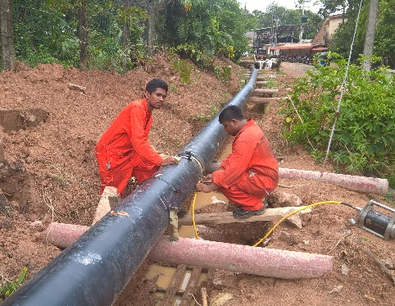
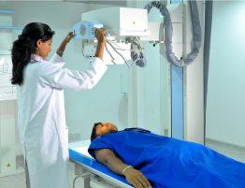
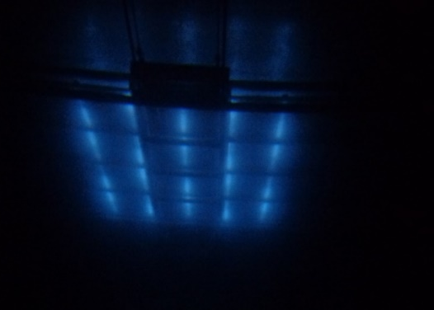
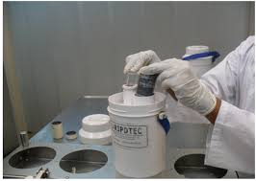
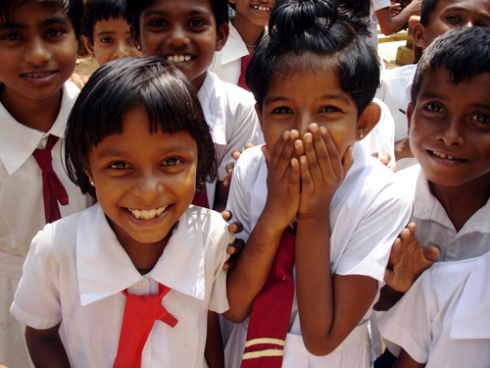
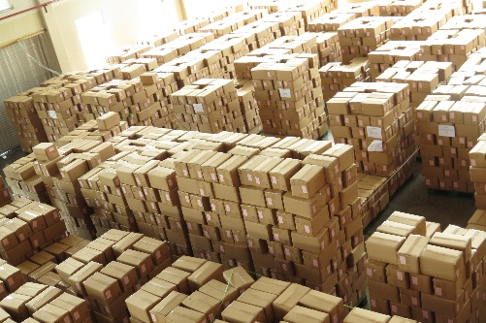
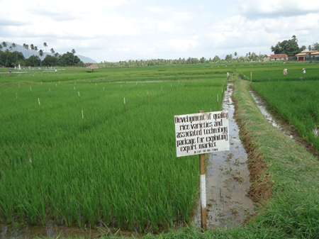
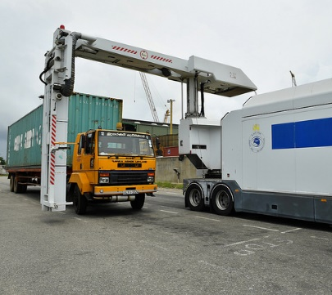
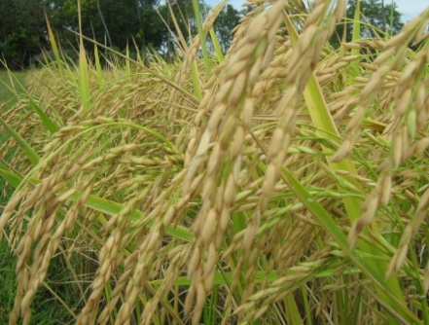
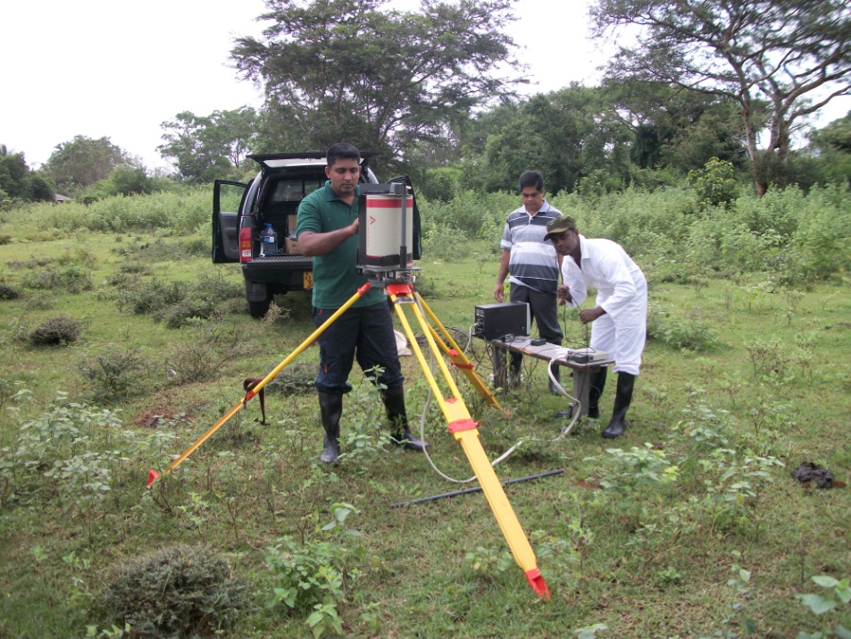
Nuclear Applications in Sri Lanka
Medical
Industrial Radiography
Irradiation
Environmental Conservation
Security
Agricultural Research

Slide 3
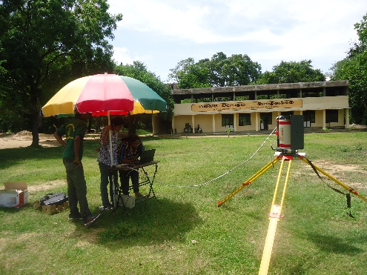
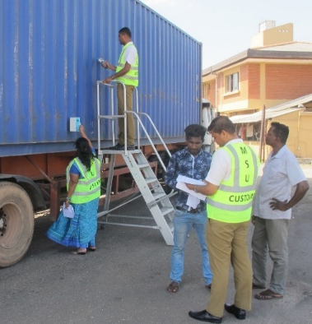
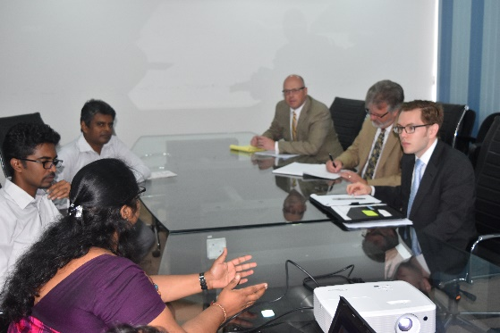
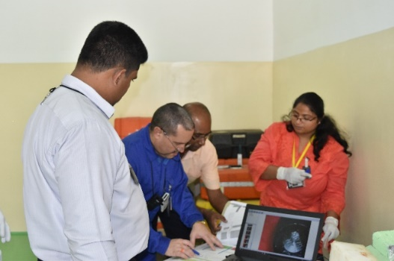
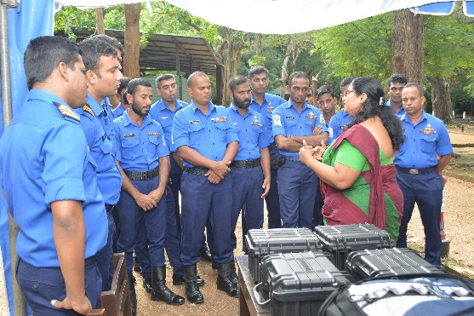
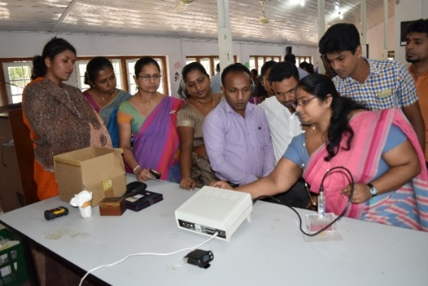
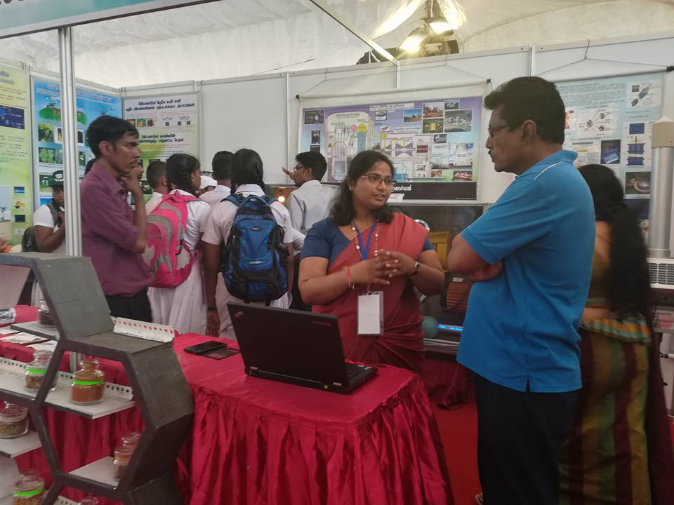
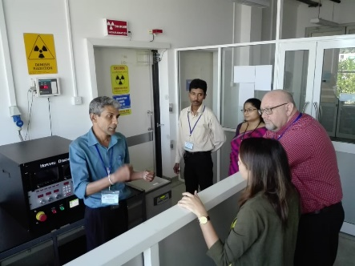
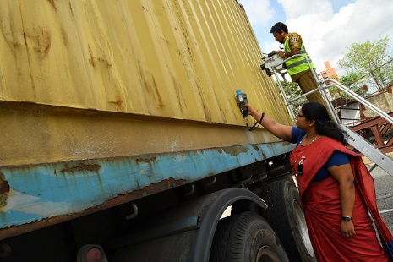
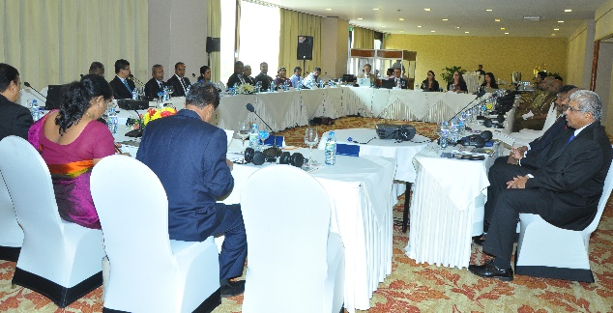
Nuclear Security
Environmental Monitoring
International Collaboration
Radioactive Waste Management
Expert Support
My Role
Nuclear Safety
FLO Training
HRD and Education
CBRN Training
Public Awareness
Quality Management
Detection Support
SOP Development

Slide 4
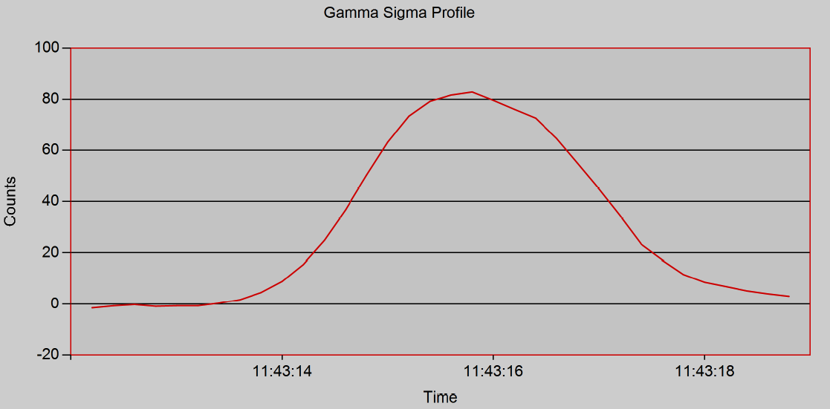
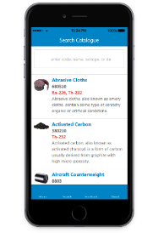
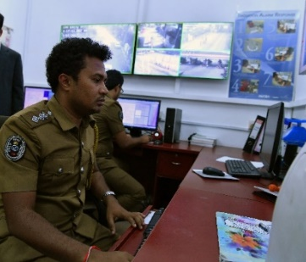
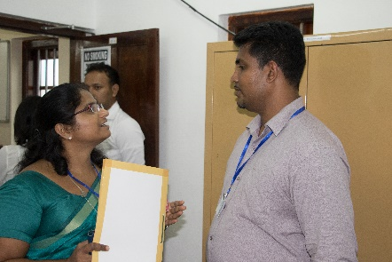
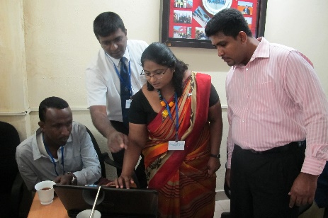
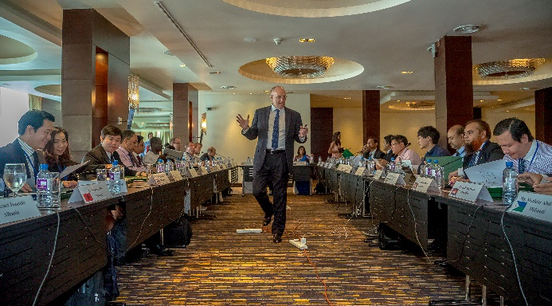
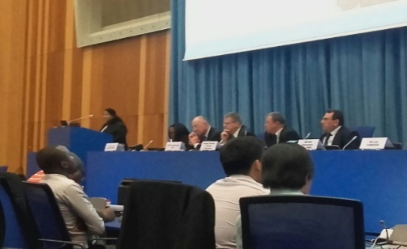
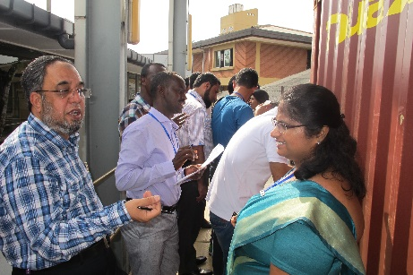
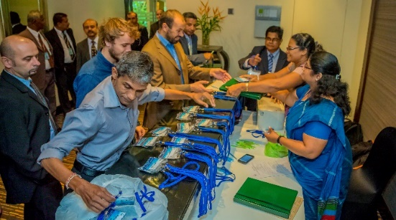
Coordinated Research Project (J02005) on Alarm Assessment
J02005 project is to provide common technical tools to evaluate the alarms from Radiation Detection instruments (Radiation Portal Monitors/RPM) mostly coming from the Naturally Occurring Radioactive Materials (NORMs).
Better Opportunity to develop …,
Project or team management leadership
Build important networks
expand and demonstrate technical skills

Slide 5
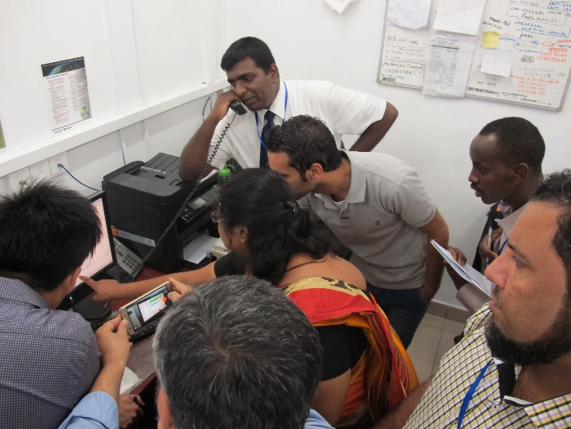
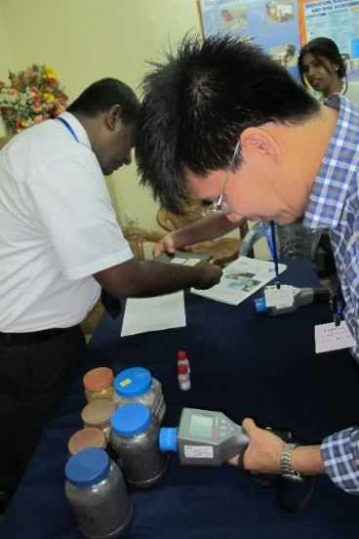
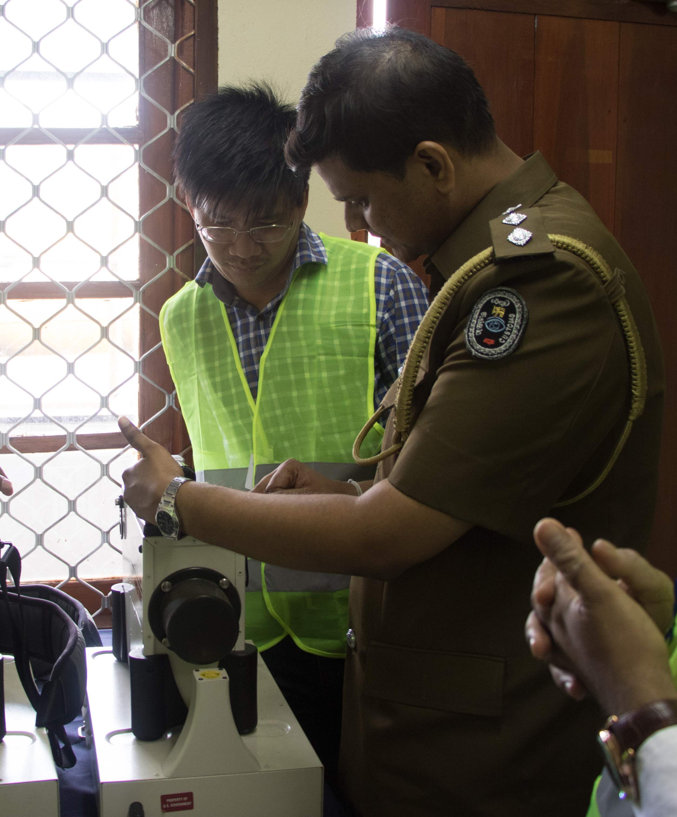
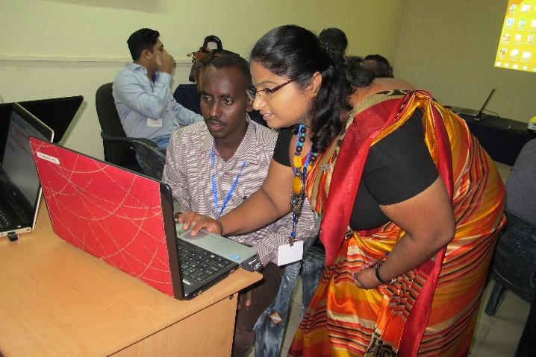
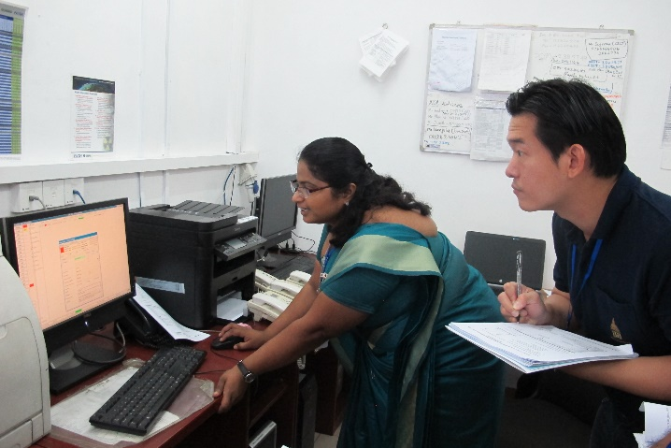
Additional Activities related to CRP
Knowledge Sharing – Technical Visit to Colombo Port
Period : 2016.04.25 - 2016.04.28
Location: Port of Colombo
No of Participants : 09
Countries:
Pakistan
Thailand
Jordan
Cambodia
Djibouti

Slide 6
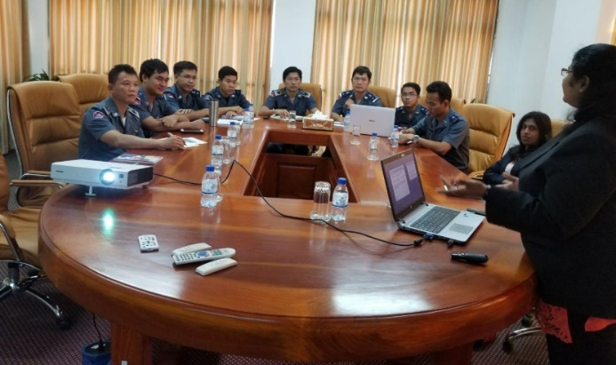
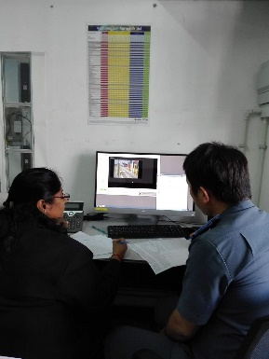
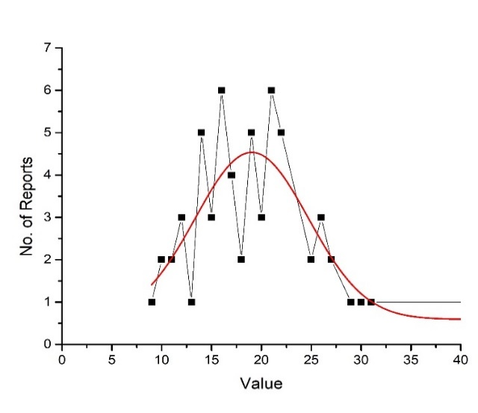
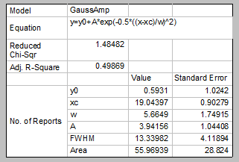
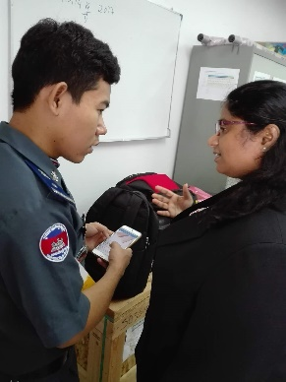
Knowledge Sharing - Technical Visit to Cambodia
Period : 2017.12.11 -2017.12.14
Location: Phnom Penh Autonomous Port
No of Participants : 07
Activities:
• Introduction about CRP & TRACE of IAEA.
• Site visit and collecting necessary site measurements.
• Alarming data & empty container data was collected & analyzed.
Existing problems in the system were discussed
Effect of lanes
Distribution Function for Ceramic Tiles

Slide 7
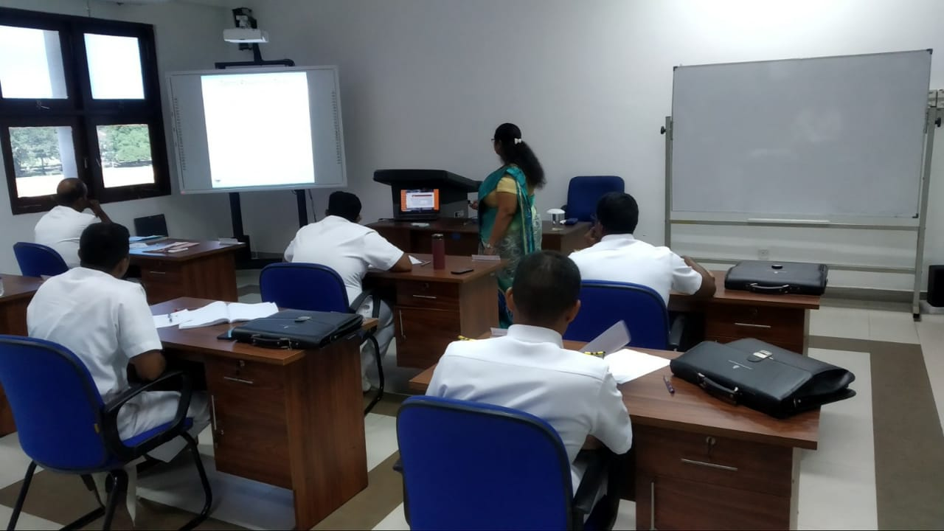
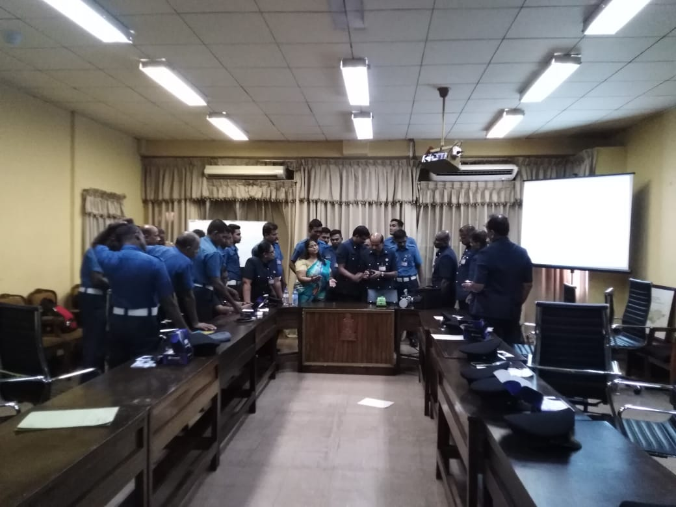
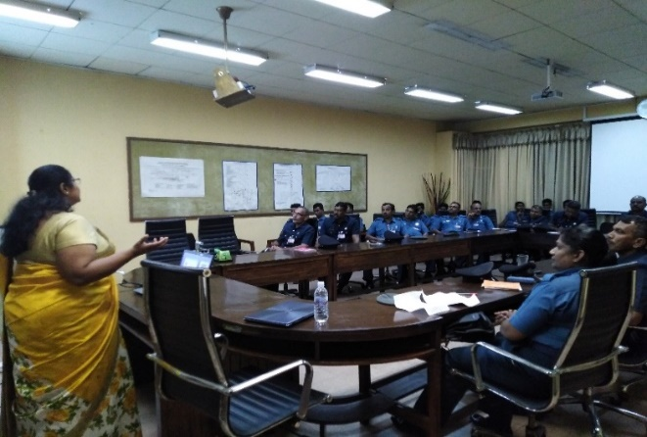
Challenges
Most of the officers in nuclear security field are male officers and they are mostly equipped with heavy radiation detection instruments for the border monitoring operations.
Electronic and computer based technical knowledge is essential to understand the operations in the field.
Some radiation detection instruments such as Backpack radiation detectors, Radio-isotopes Identification Devices (RID) are relatively heavy, making them difficult to handle in the field.
The outstation time is significant; need to travel long distance from the workplace. Especially, with unknown officers, facility operators and new environments to work with.
Some of the people easily underestimate the knowledge of a female trainer in the field

Slide 8
Opportunities
If you look around, there are lots of solutions available to overcome these challenges
IAEA supports you to make up your carrier development through,
Trainings
Workshops
Technical Meetings
Consultant Meetings
Research Projects
to be a lead professional in Nuclear Security field without discrimination of the GENDER!

Slide 9
THANK YOU…

