Slide 1
Enhancing Sustainable Nuclear Security Operations Through Participation In The Coordinated Research Project On Improved Assessment Of Initial Alarms
P. N. G. RatHnaweera^{1*}, P. D. MAHAKUMARA ¹, R. A. N. C. RANASINGHE ¹,
I. U. W. LIYANAGE ², C. MASSEY ³ ,C. IAMSUMANG ³
¹ Radiation Protection & Technical Services Division, Sri Lanka Atomic Energy Board, Colombo, Sri Lanka
² Megaport Surveillance Unit, Sri Lanka Customs, Colombo, Sri Lanka
³ Division of Nuclear Safety and Security, International Atomic Energy Agency
^{1*}nirasha@aeb.gov.lk
Presented by: P.N.G. RATHNAWEERA

Slide 2
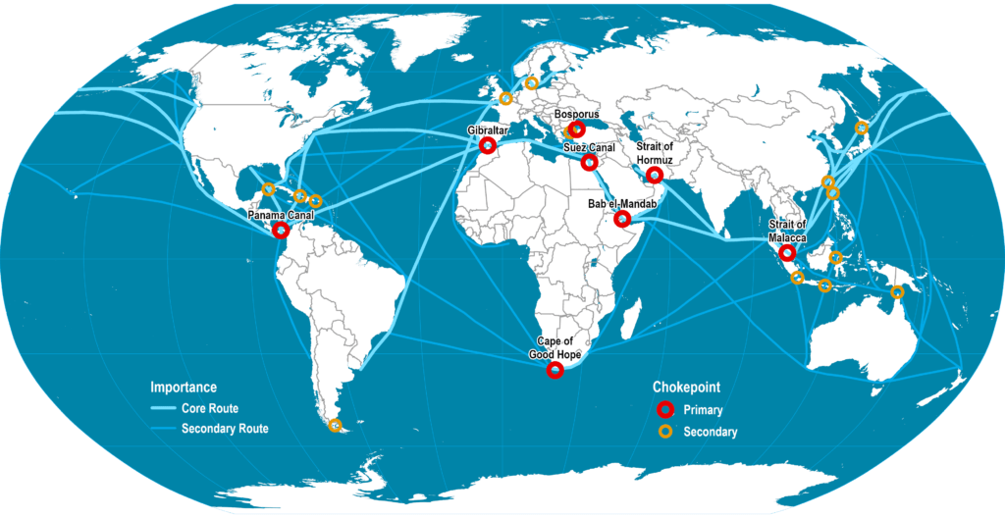
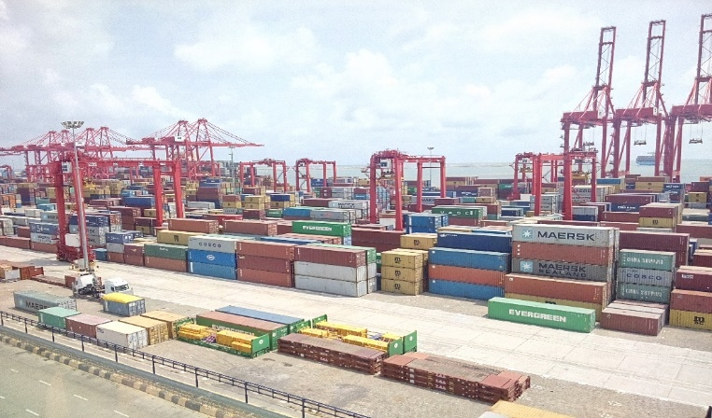
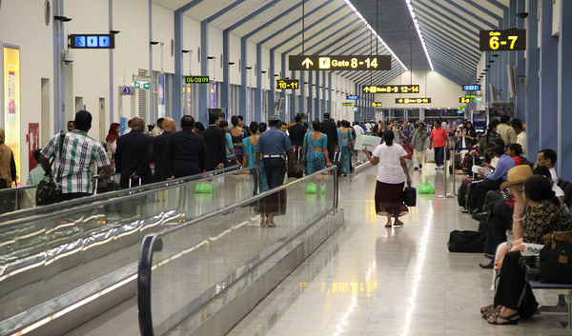
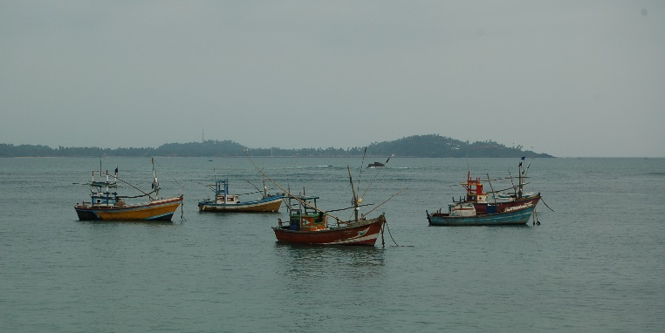
Challenges faced by Sri Lanka in controlling illicit trafficking
Located as a maritime hub in world’s main shipping routes
A lot of transshipments are going through the Colombo sea port, making it one of the busiest ports in the region. 5.1 million TEU containerized cargo was handled during the year 2015
Handling the Nuclear Security at the Katunayake Airport
400 connected cities worldwide
10,883,904 Passenger movements in year 2018
67,308 Aircraft movements with 279,560 Cargo movements in year 2018
A lot of undesignated ports are available due to the geological location as an island in Indian ocean, closer to Indian peninsula.

Slide 3
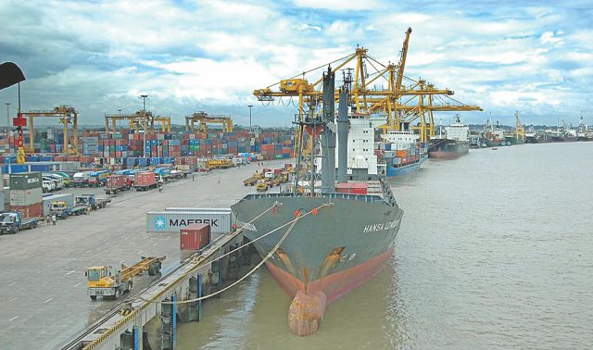
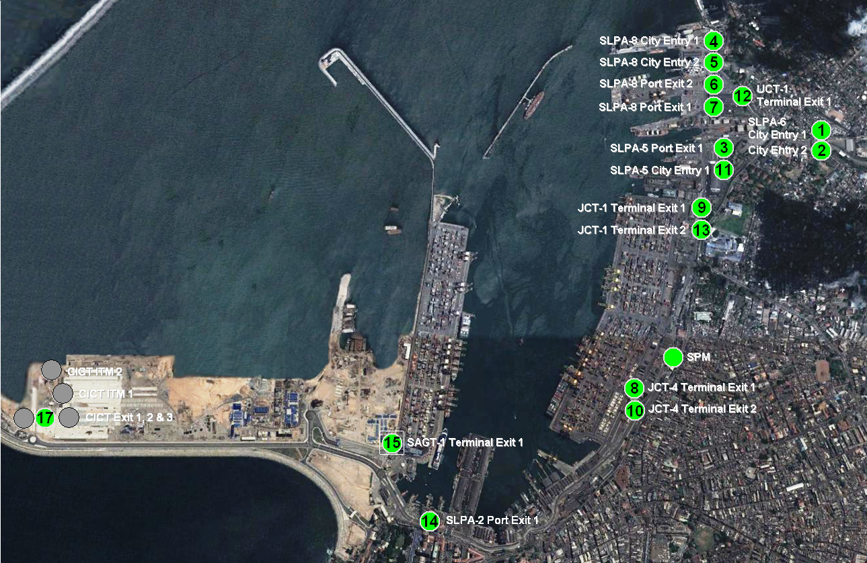
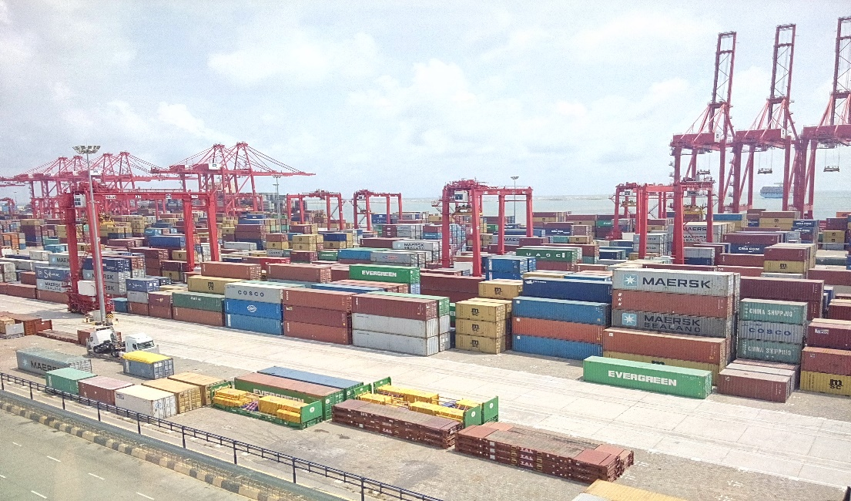
Radiation Monitoring at Colombo Sea port

Slide 4
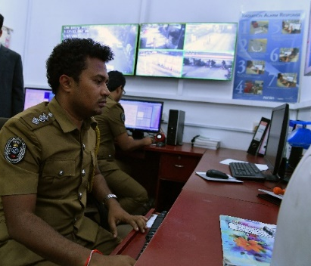
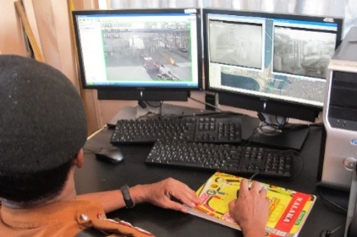
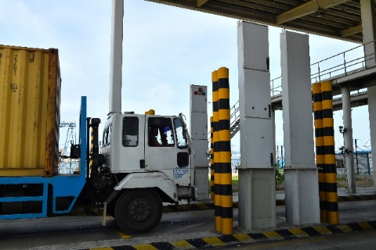
Radiation Monitoring at Colombo Sea port
Challenges
Training
Based on the frequency of internal transfers of the officers
Lack scientific knowledge in the field
Quick guide for Alarm assessment
SOP Development
Equipment sustainability
(Maintenance/ Expert knowledge)
Proper networking (Internal & External)
Knowledge Sharing & Best Practices
Up to date knowledge in the field
SL Customs (Megaport)
CAS operations
Investigations
Coordination among other counterparts
Central Alarm Station (CAS)
SL Ports Authority
Provide security for port operations
LAS operations & Maintenance
LAS
LAS
Local Alarm Station (LAS)
RPM
RPM
Radiation Portal Monitor (RPM)
SL Atomic Energy Board & SL Atomic Energy Regulatory Council
As a technical reach back, provide technical & legal assistance to manage the Radioactive Materials

Slide 5
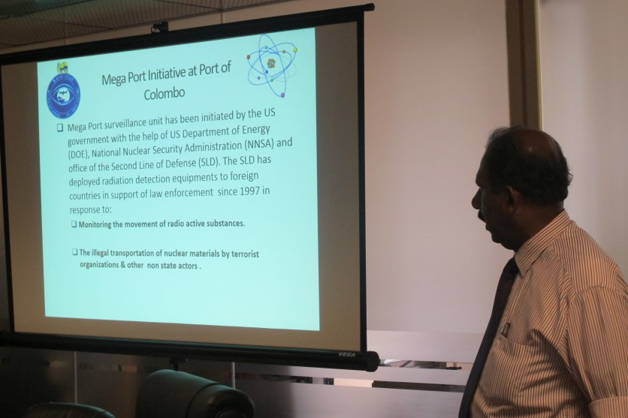
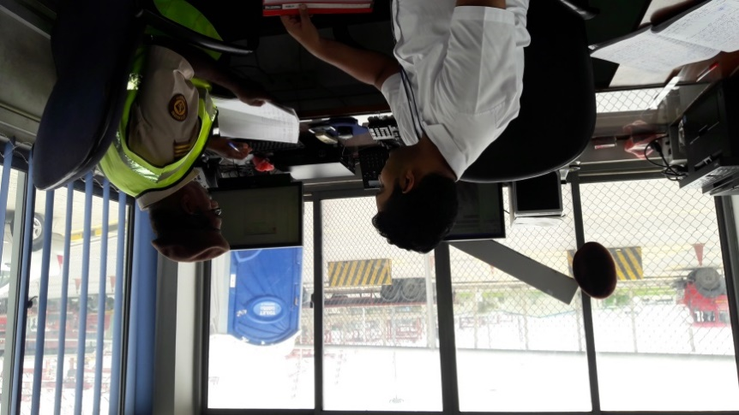
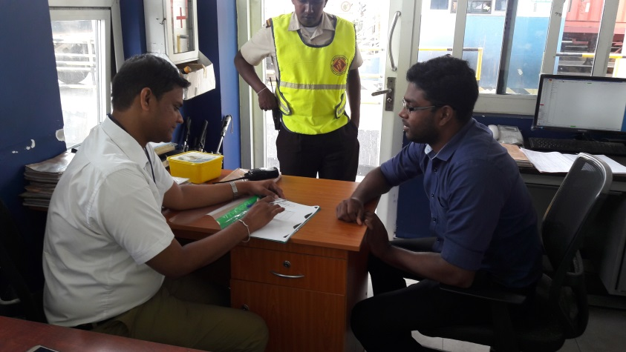
Time study of Alarmed Cargo Release
Management of SL Customs
CAS Operators
360 degree feedback about Alarmed Cargo Release
LAS Operators
Consignees

Slide 6
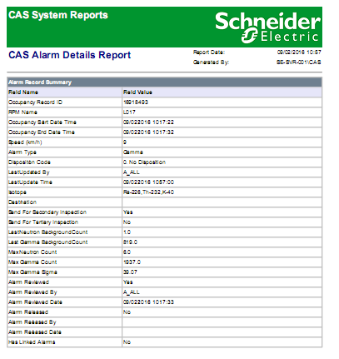
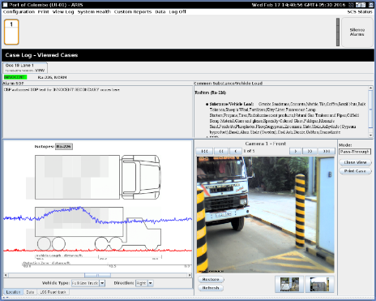
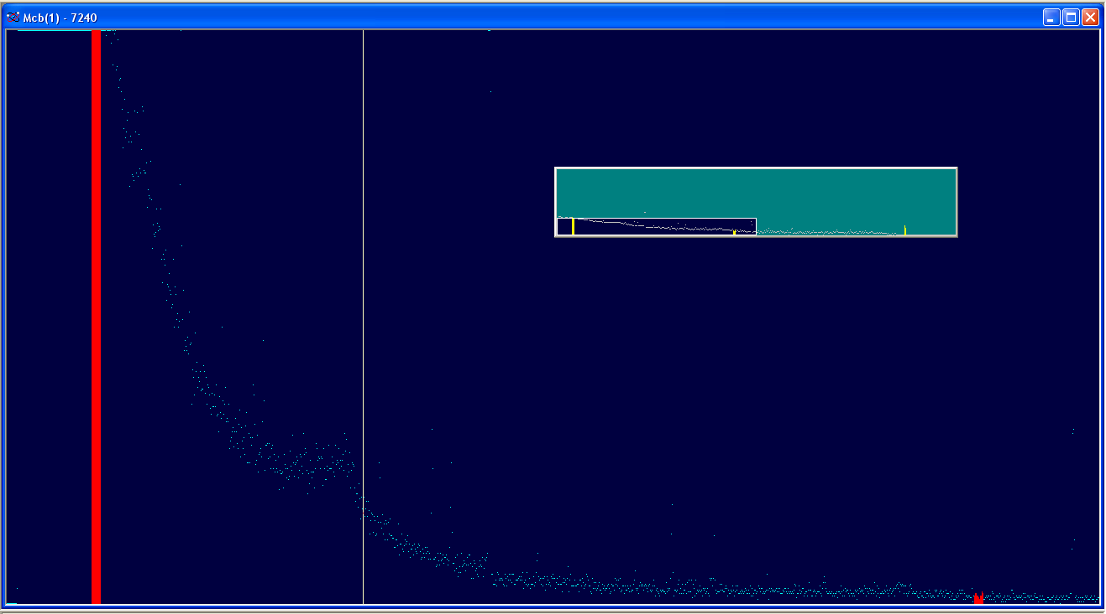
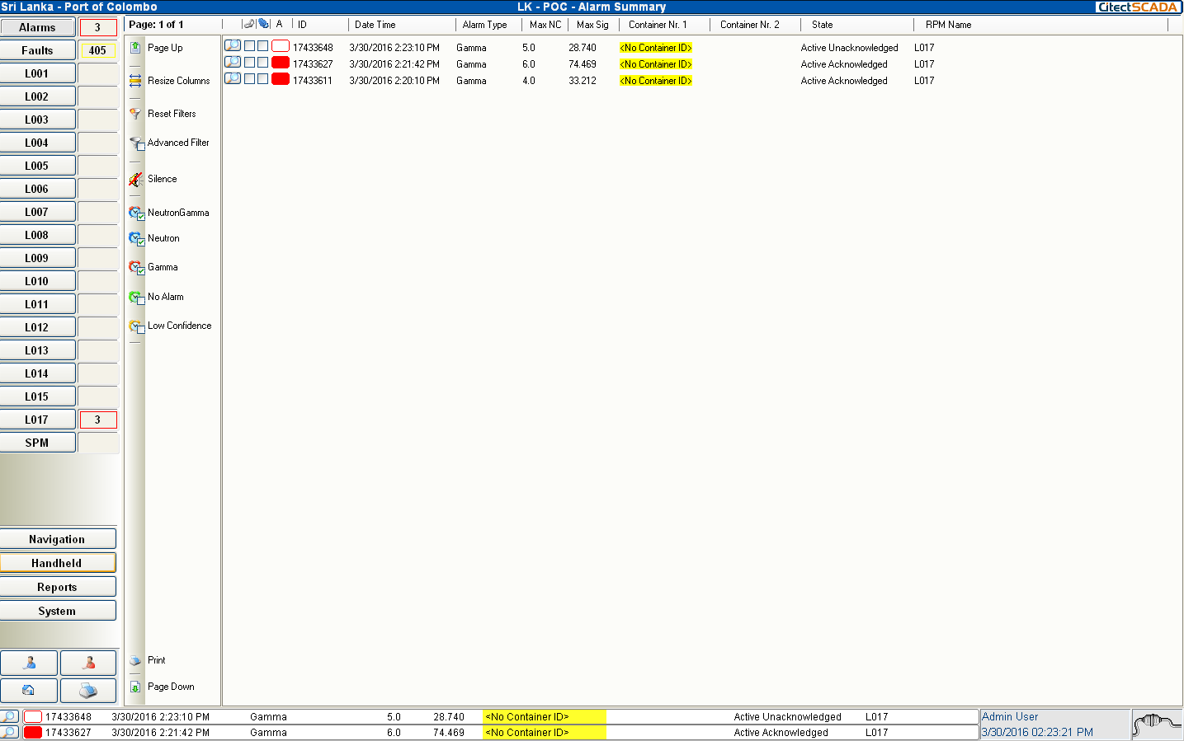
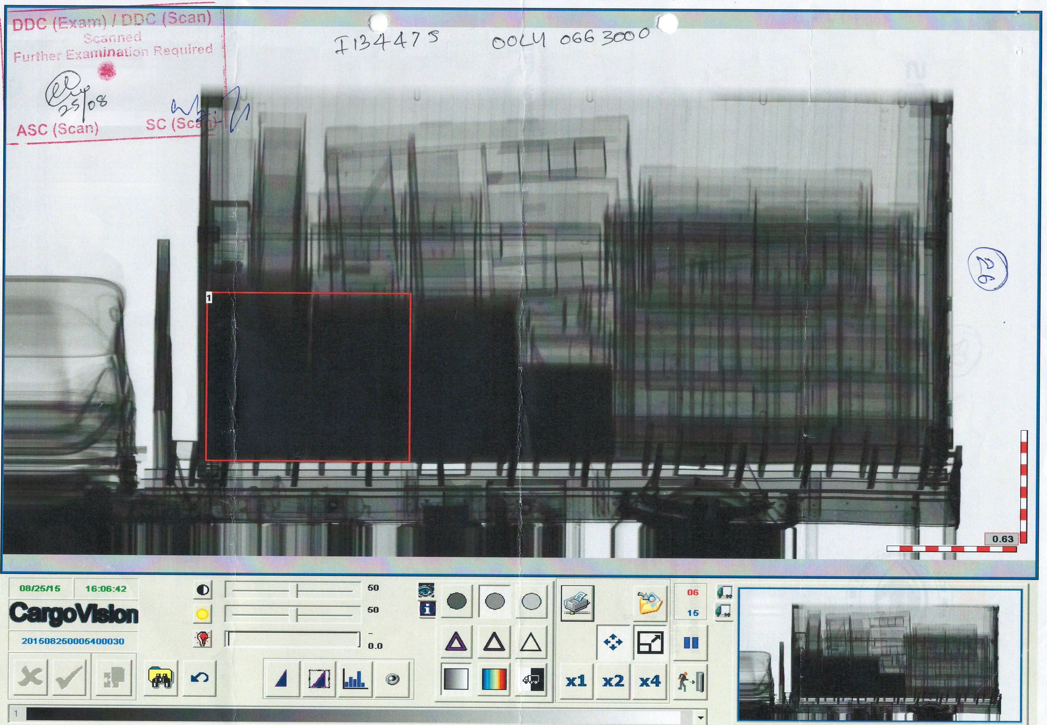
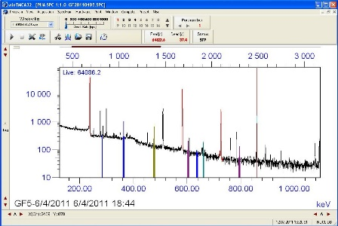
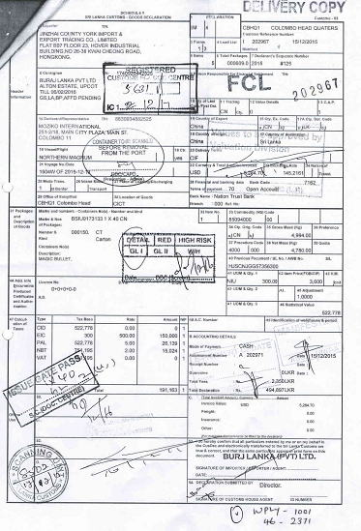
Involvement to the IAEA Coordinated Research Project J02005
Joined the CRP No. J02005 in Year 2015 as a collaborative work between SL Customs and the SL Atomic Energy Board
Actively participated to,
The pilot study of the project
Initial data collection to formulate the NORM catalog
Additional testing for,
Radiation profile of Empty Container
Speed test with NORM commodities
Effect of background for small vehicles
Effect of Elevated / Non elevated RPM setups
Testing results of TRACE App
Knowledge Sharing with the CRP members

Slide 7
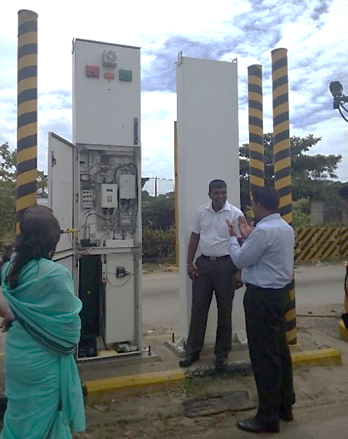
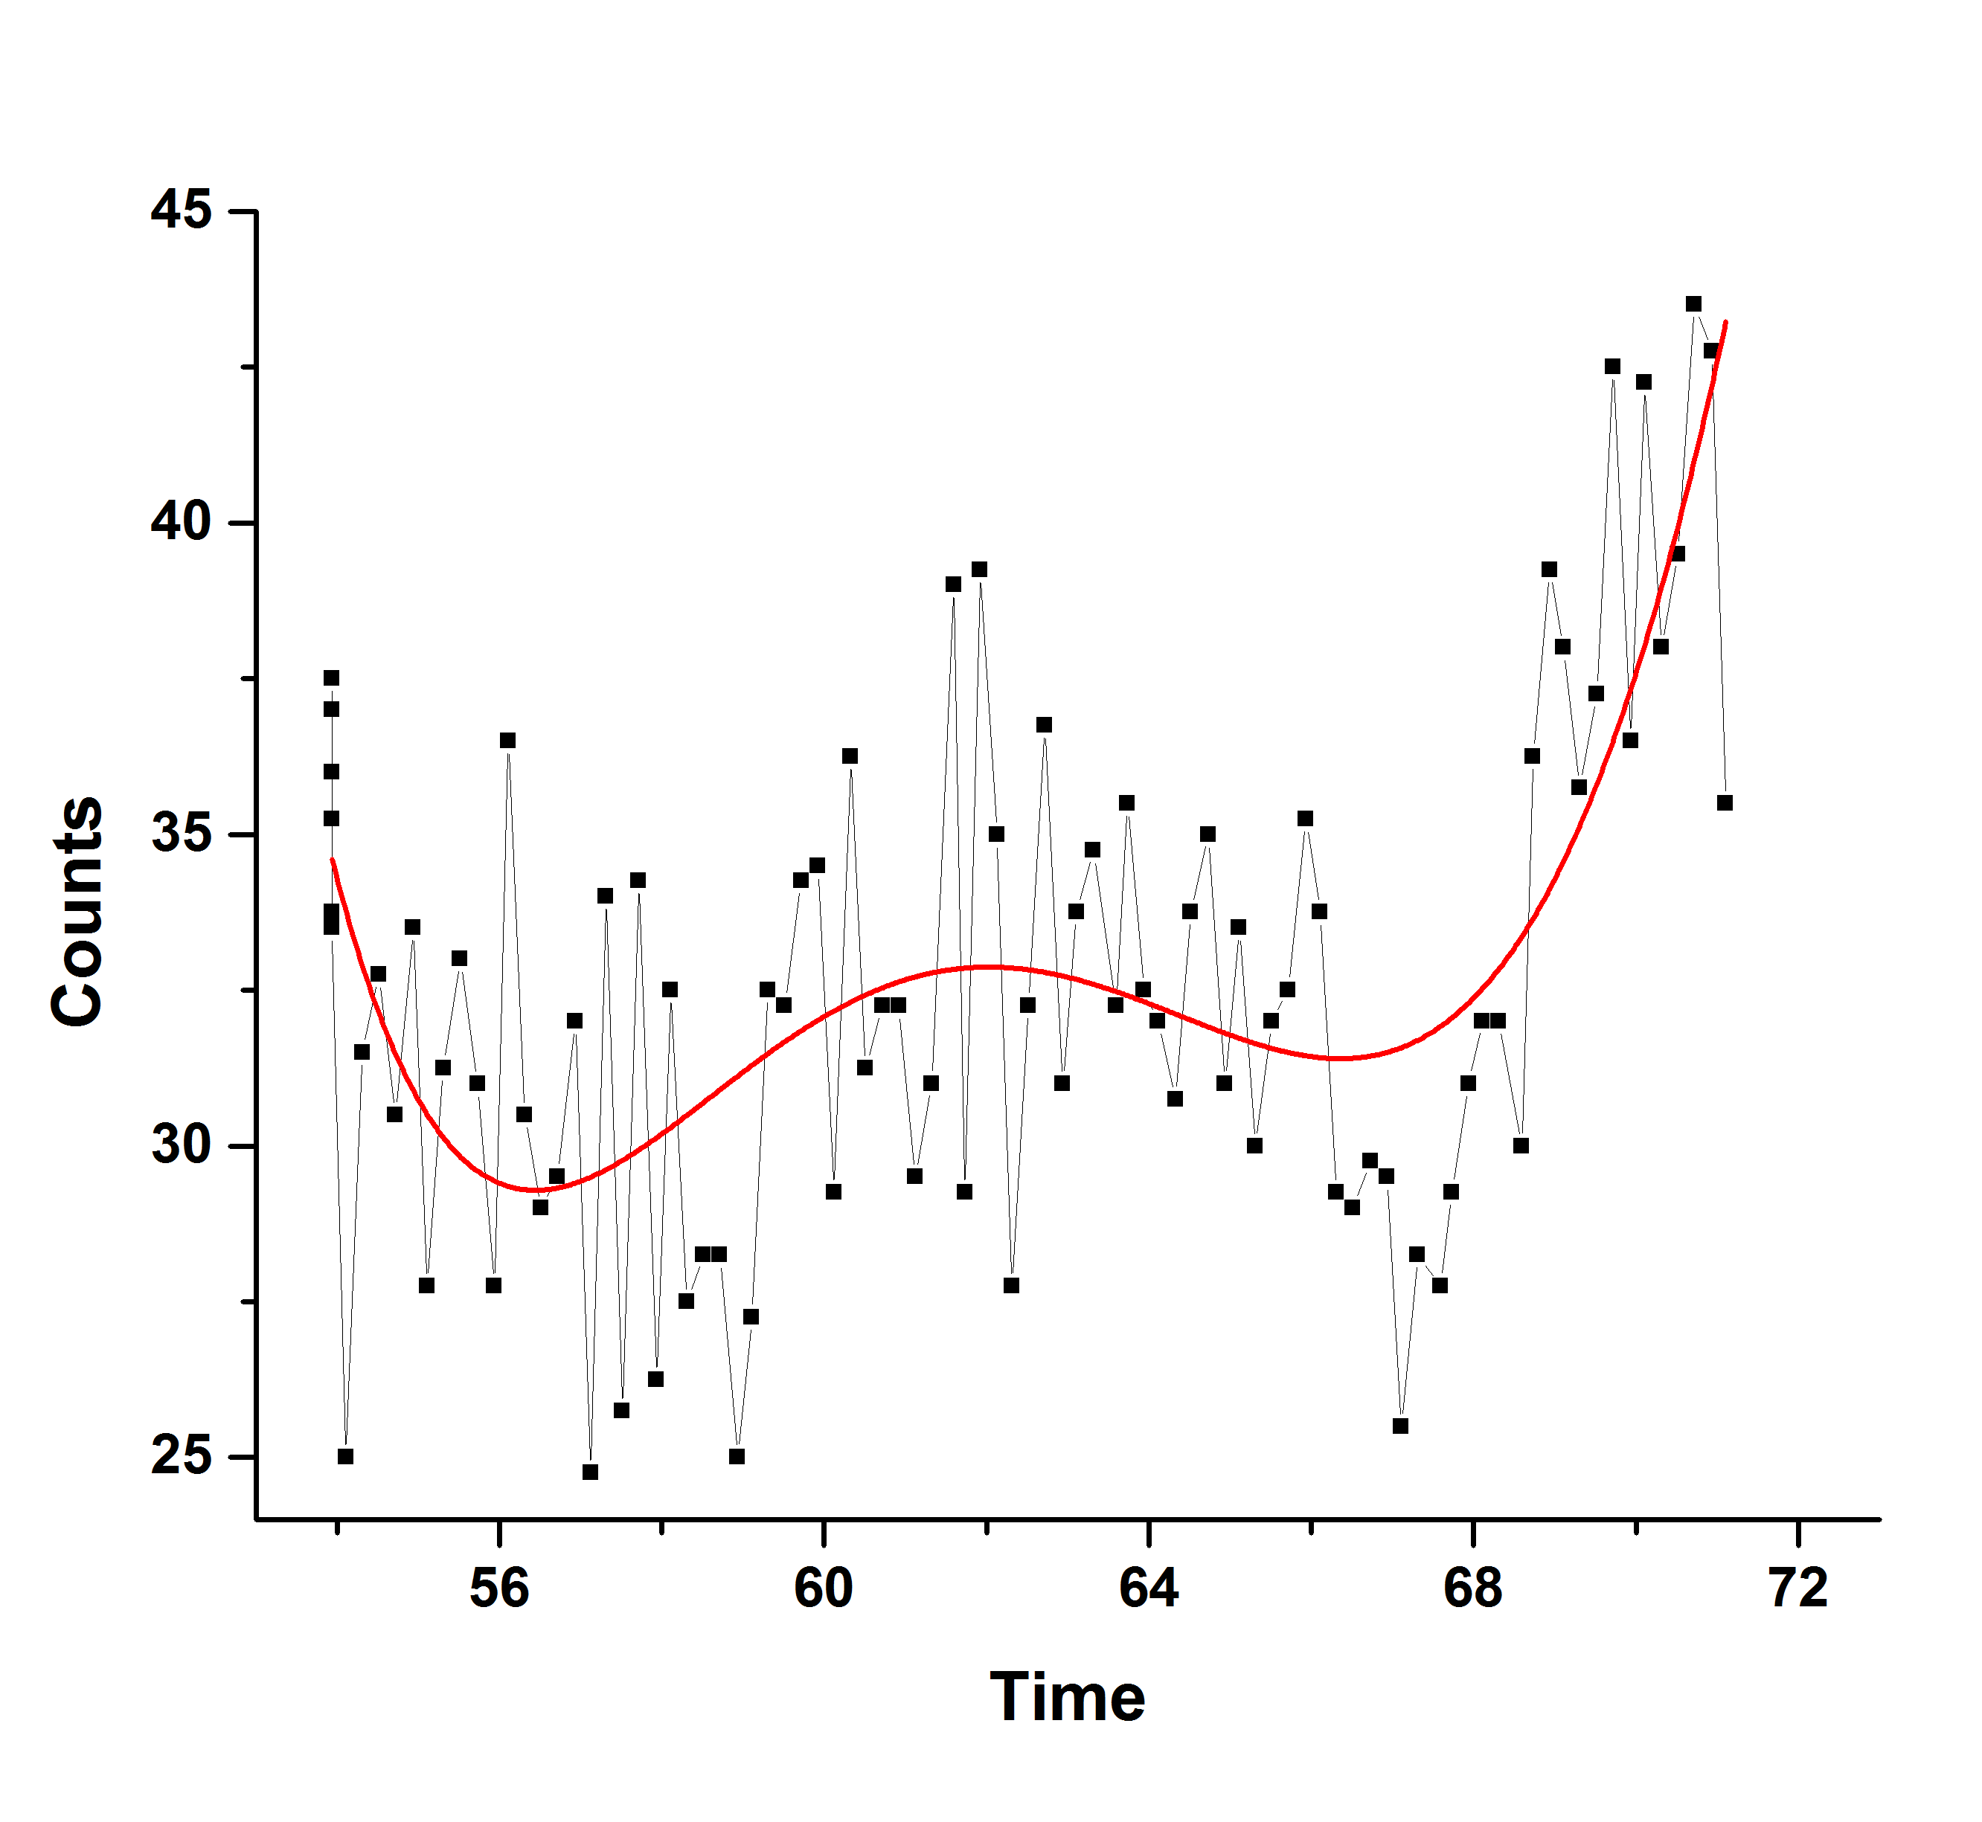
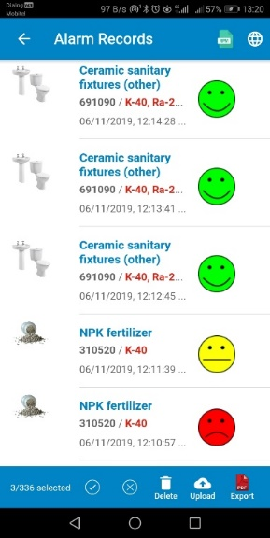
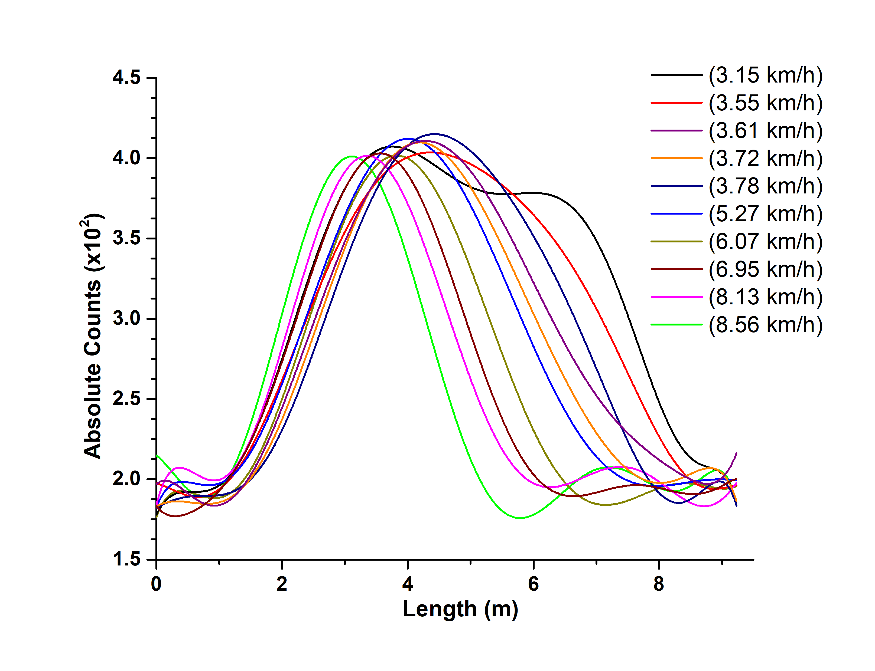
Pilot Study
Additional Tests
TRACE Testing
Profile of
Empty Container
Effect of
Elevated /Non elevated of RPM
COMBINATION | NO OF CONTAINERS
SPM | 68
NaI | 1
HPGe | 1
SPM+NaI | 5
SPM+HPGe | 5
SPM+HPGe+X-ray | 1
NaI+X-ray | 1
SPM+NaI+HPGe | 17
SPM+NaI+HPGe+X-ray | 1
Total | 100
Speed test

Slide 8
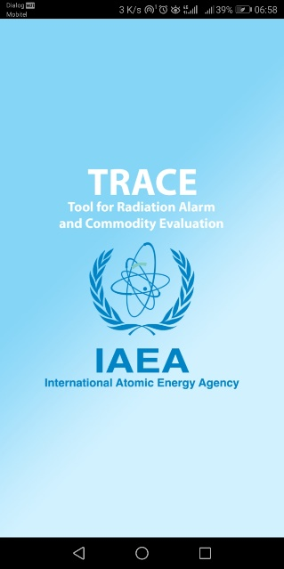
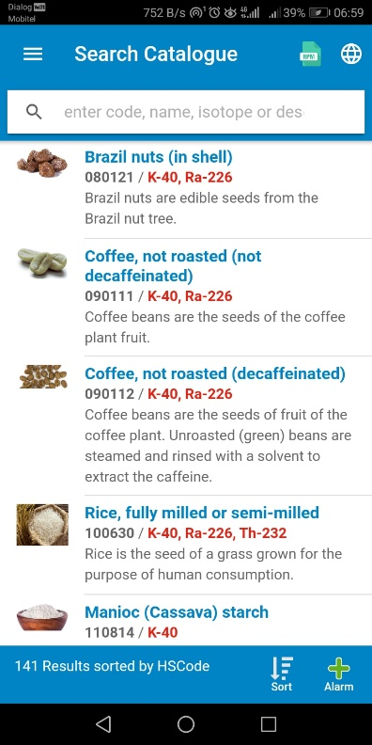
Outcomes & Benefits
The participation in the CRP has also enhanced collaboration and expert knowledge among the stakeholders of national nuclear security regime through:
Sharing the technical knowledge and onsite experience (FLO/ Experts)
Introduce TRACE among the other related parties such as Consignees, Ports Authority,
Military and Police etc. through existing awareness programs
Implementation of trainings
Development of methodologies - Update the SOP by including IAEA TRACE APP
Improvement of detection capabilities
The sustainability of the nuclear security culture in Sri Lanka has been enhanced through:
Improved utilization and understanding of detection instruments and how to repair, maintain, and calibrate the instruments for optimum performance,
Improved and focused training through need analysis and a systematic approach to training (SAT)
Improved Standard Operation Procedures (SOPs) that take advantage of the TRACE tool and have ensured to be used as a consistent and reliable source of information,
Development of new approaches to implementing effective nuclear security detection operations.

Slide 9
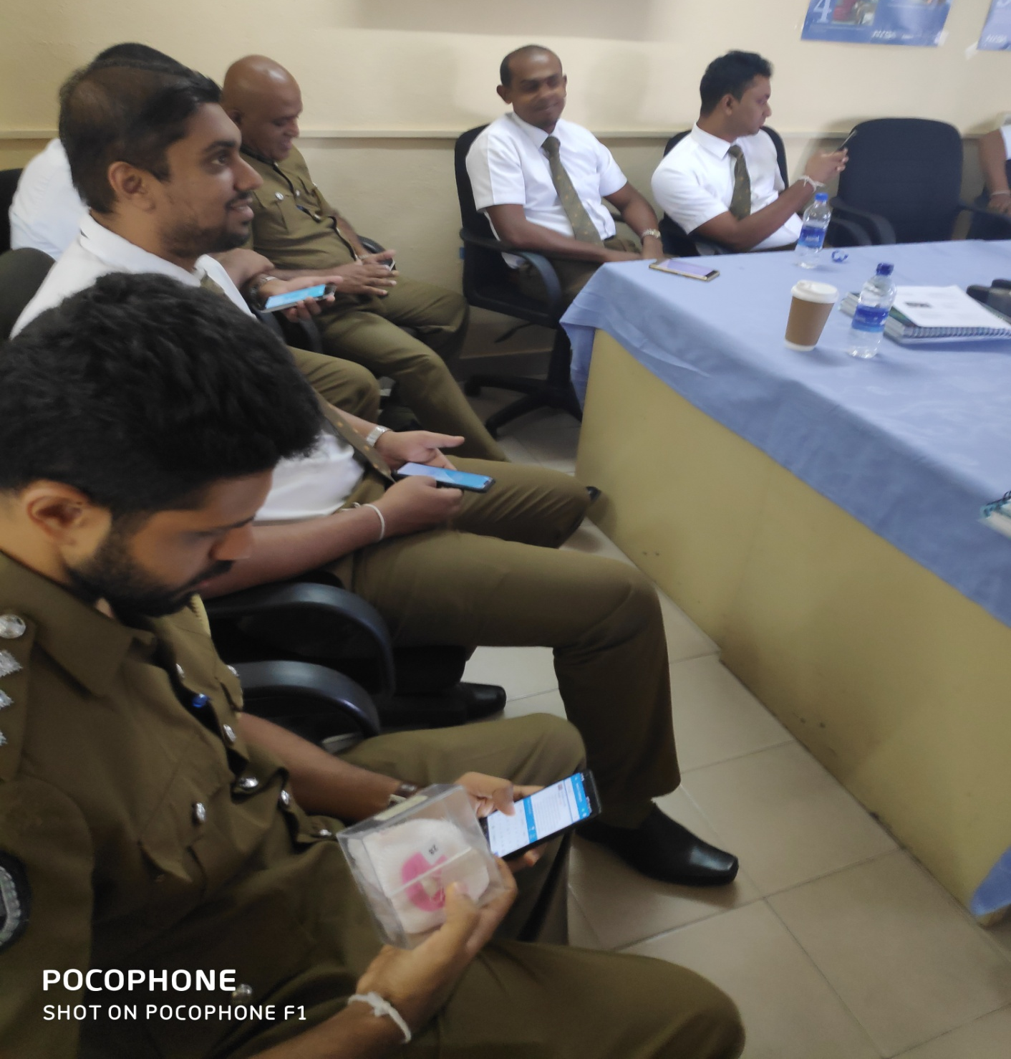
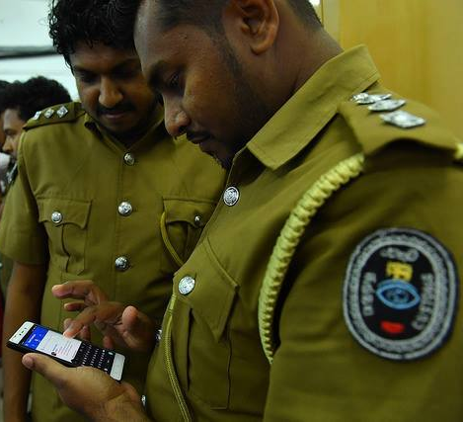
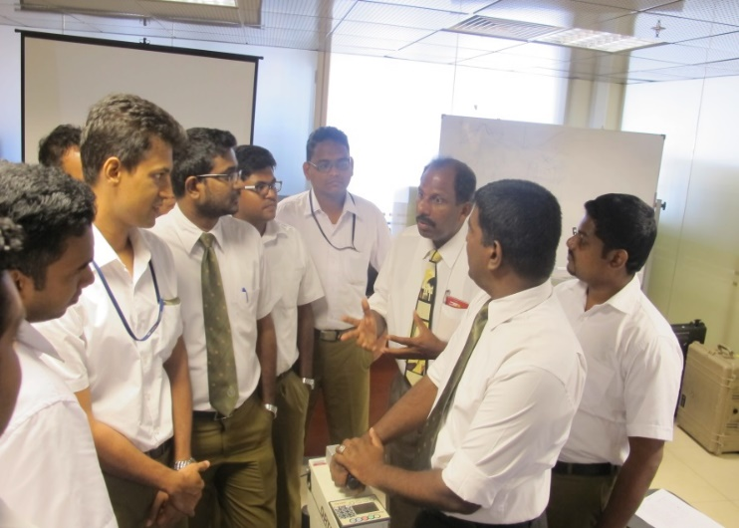
TRACE User Training for FLOs
30 minutes topic (English) - Front Line Officer operator training curricular (NSDD) in 2019 March
Have conducted several training sessions so far,
Introducing the system to all Customs officers during general training programmes (ASC/ SC / Appraisers)
Structure of Training
Introduction
How to Install
Content of the app
Working with app - General & Specific
Activities
Training Materials
IAEA TRACE Presentation
Video clip

Slide 10
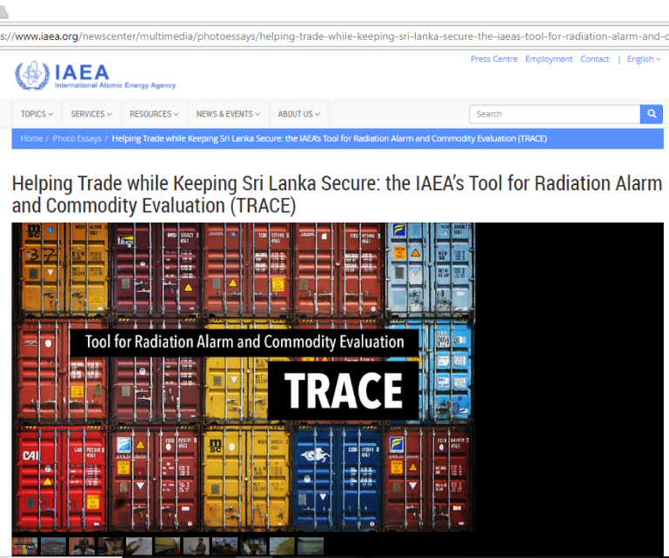
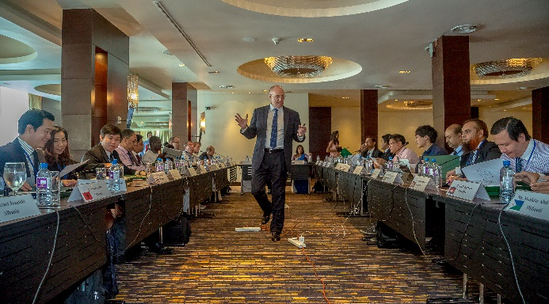
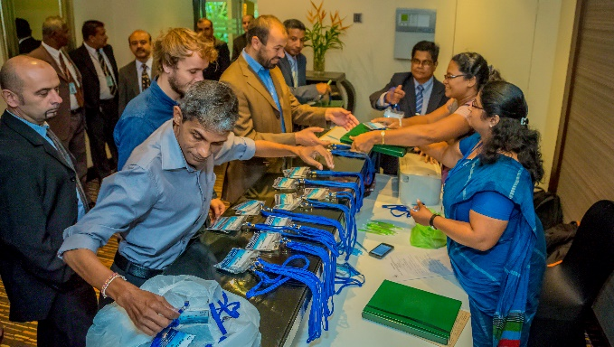
International Cooperation
The CRP has provided an excellent pathway for the following:
Sharing knowledge, experience and best practices through:
Technical & Scientific Visits among the CRP members
Technical workshops to share enhanced alarm and data analysis capabilities
Interactions with technical experts and equipment manufacturers
Take part in professional and other global nuclear security networks
(IAEA- FLO, IAEA-NSSC, World Custom)

Slide 11
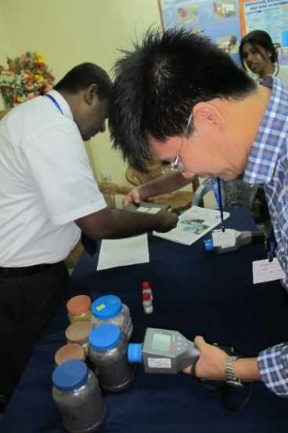
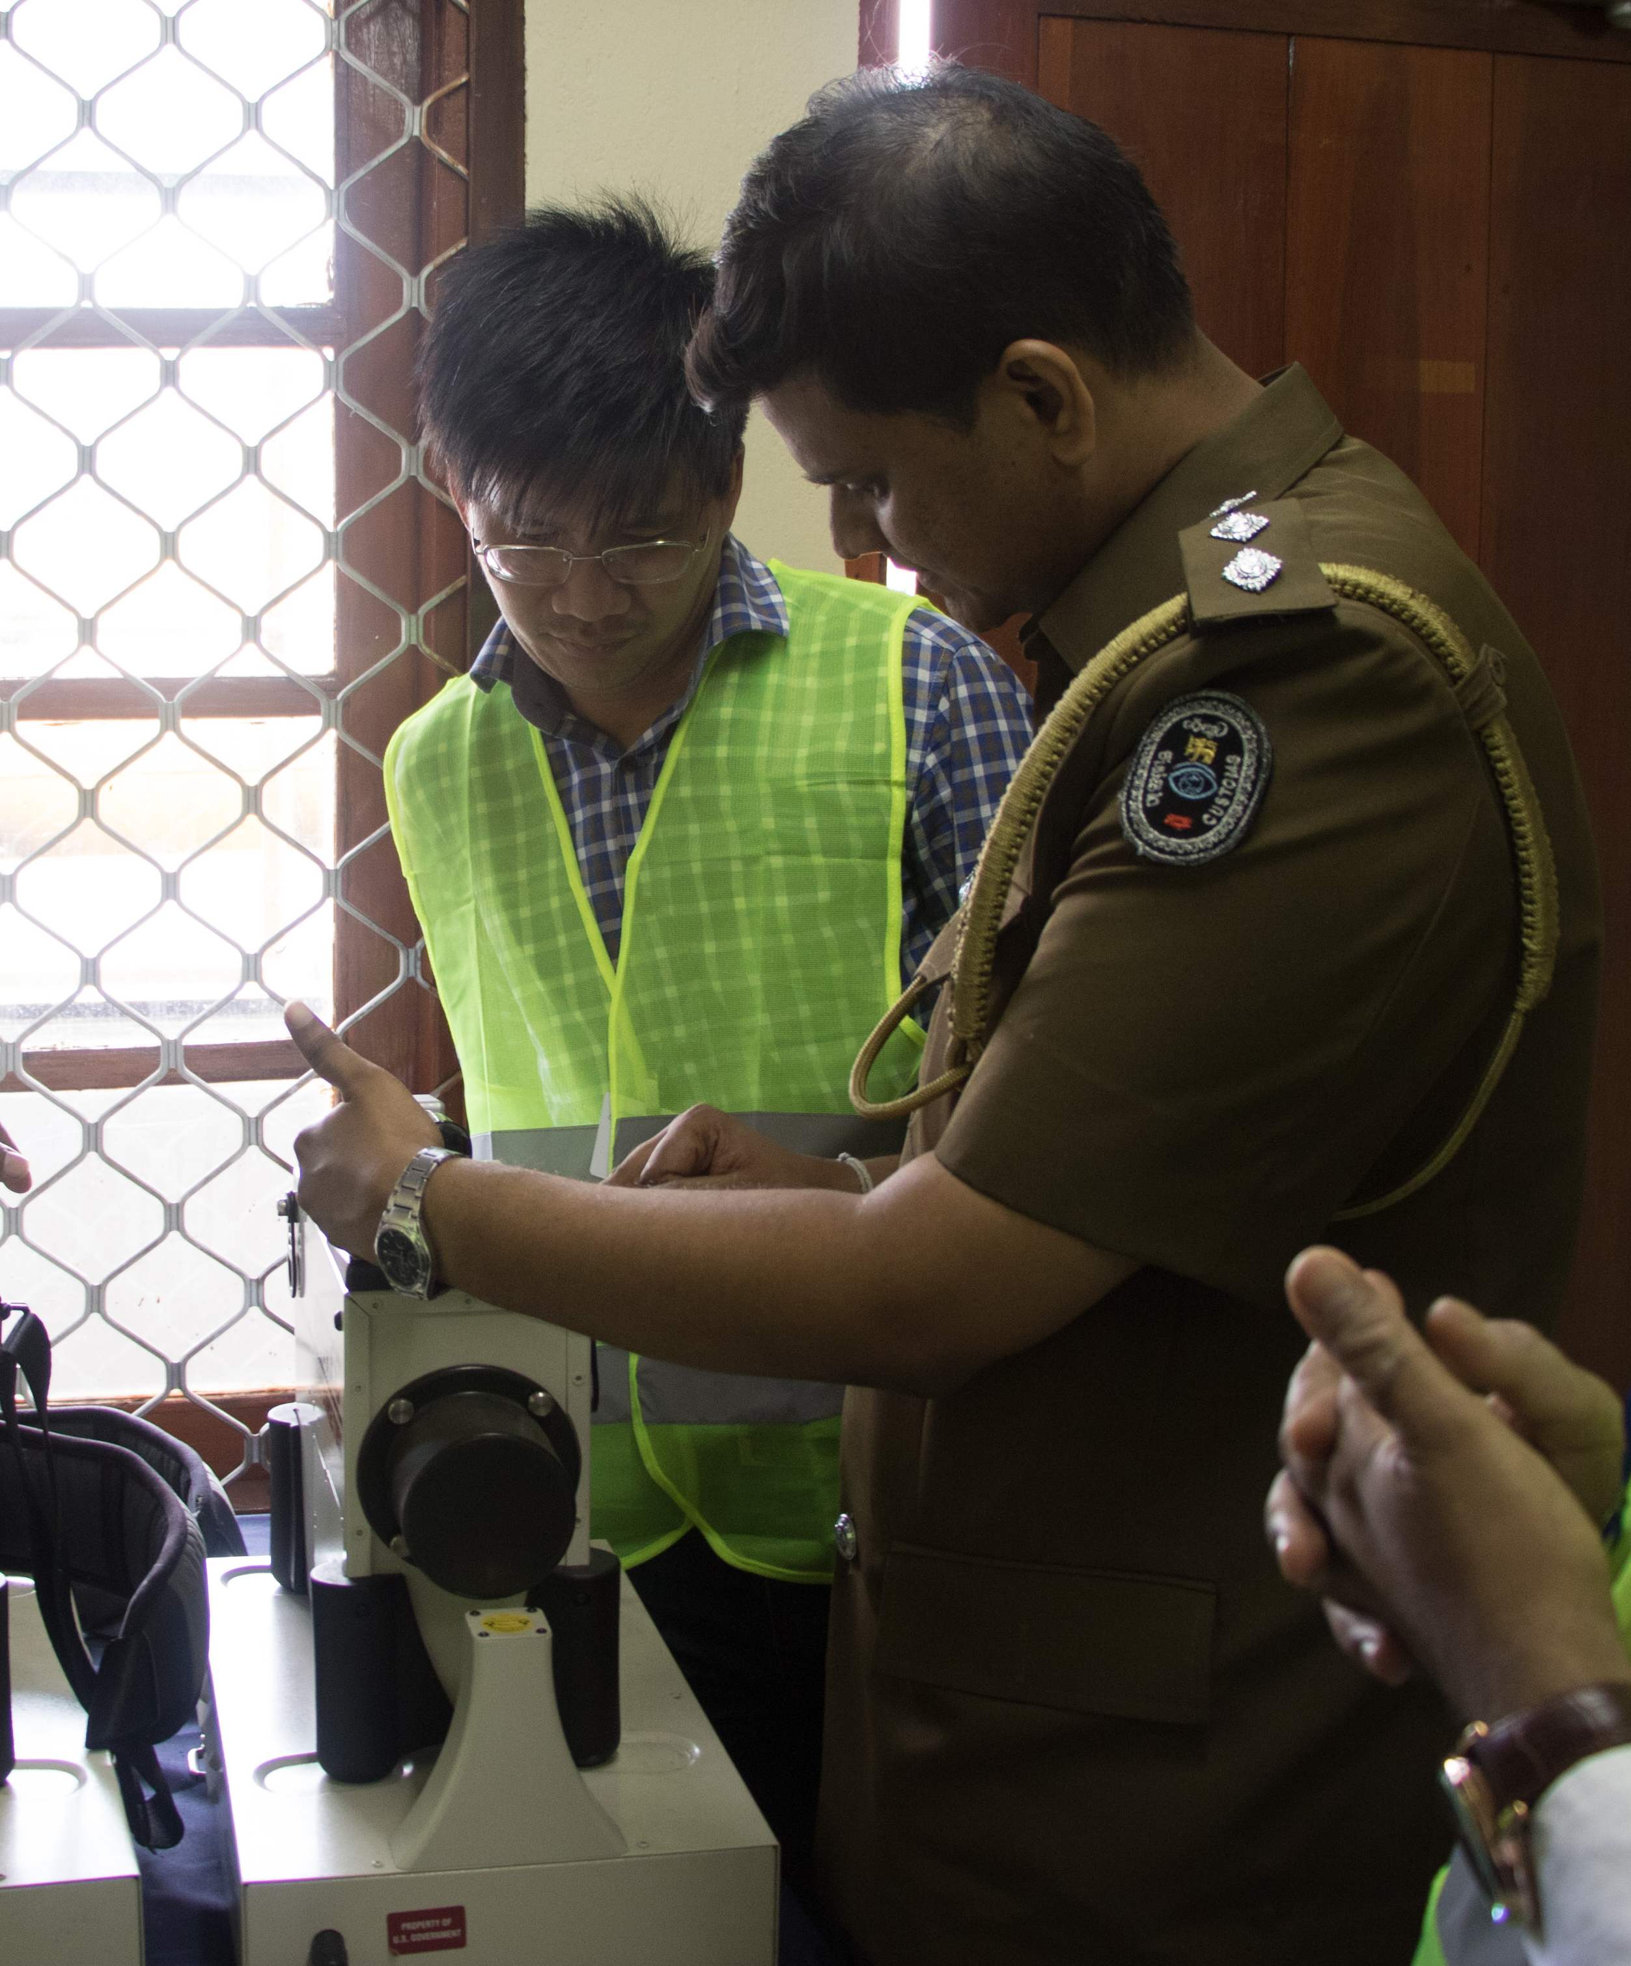
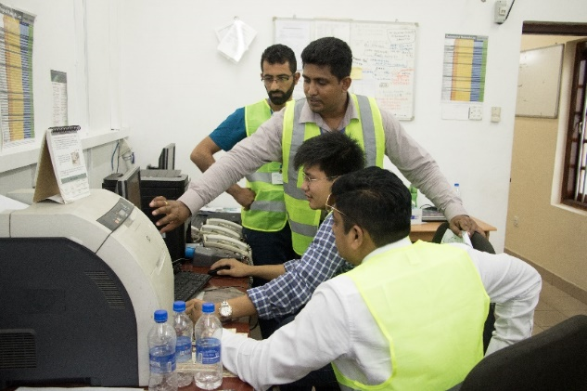
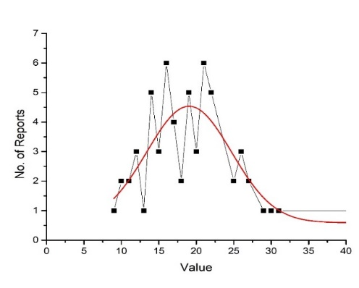
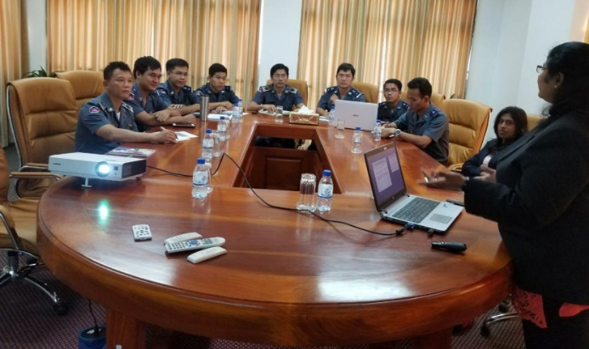
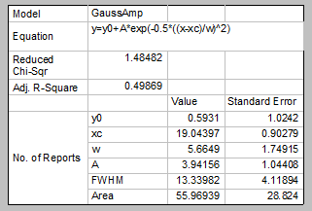
Technical Visits
Technical Visit to Colombo Port, Sri Lanka
Technical Visit to Phnom Penh Autonomous Port, Cambodia
Period : 2016.04.25 - 2016.04.28
Location: Port of Colombo
No of Participants : 09
Countries:
Pakistan
Thailand
Jordan
Cambodia
Djibouti
Period : 2017.12.11 -2017.12.14
Location: Phnom Penh Autonomous Port
No of Participants : 07
Activities:
• Introduction about CRP & TRACE of IAEA.
• Site visit and collecting necessary site measurements.
• Alarming data & empty container data was collected & analyzed.
Existing problems in the system were discussed
Distribution Function for Ceramic Tiles

Slide 12
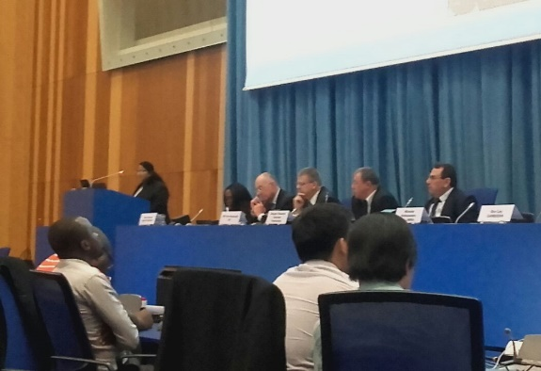
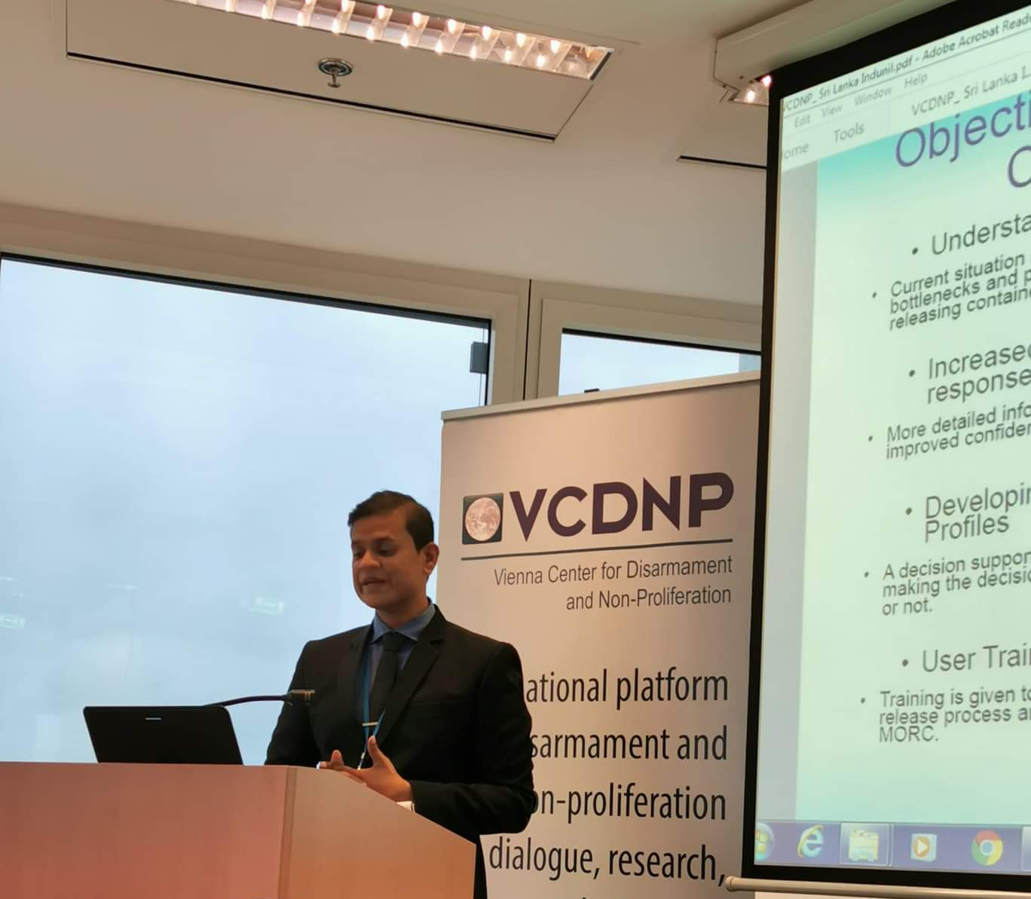
Publications in International Meetings
Programme | Dates | Place | Title of Presentation
Second Technical Meeting on Radiation Detection Instruments for Nuclear Security: Trends, Challenges and Opportunities | 16-20 April,2018 | VIC, Vienna, Austria | Involvement of Sri Lanka for CRP on Improved Assessment of Initial Alarms From Radiation Detection Instruments (J02005)
International Conference on the Security of Radioactive Material | 03-07 December,2018 | VIC, Vienna, Austria | Identification of effective parameters and their relations for normalization of radiation profiles from radiation portal monitors for initial alarm assessment at the ports of entry
The Ninth International Symposium on Naturally Occurring Radioactive Material | 23-27 September,2019 | Denver, Colorado | Challenges in applying safety and security measures in NORM alarm assessments in Colombo, Sri Lanka seaport
Panel Discussion on Facilitating Trade While Preventing Nuclear Smuggling | 13 November 2019 | VIC, Vienna, Austria | Facilitating Trade While Preventing Nuclear Smuggling Sri Lanka

Slide 13
Acknowledgement
Management of Sri Lanka Customs and
Mega Port Surveillance Unit
Management of Sri Lanka Atomic Energy Board
International Atomic Energy Agency

Slide 14
Thank You ! ….

