Slide 1
THREE IPPAS Experiences
International Conference on Nuclear Security
10-14 FEBRUARY 2020
Dr Stephan Bayer, Director Nuclear Security Australian Safeguards and Non-Proliferation Office
Notes:
Slide 1: Good morning and thank-you for your attendance - I hope you are enjoying this session on safeguards & security. I will continue now on the theme of nuclear security

Slide 2
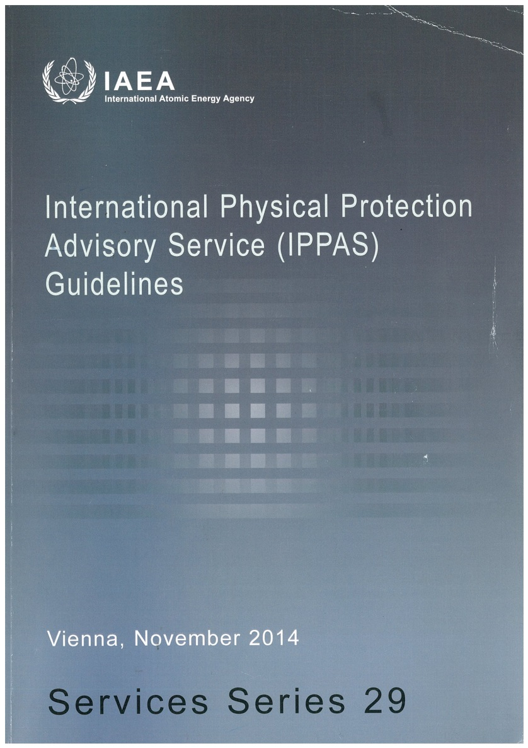
IPPAS MISSIONS – Three Experiences
Team member (3)
Host country (2)
Team leader (2)

Slide 3
Notes:
This morning Rob Floyd eloquently explained the world of nuclear non-proliferation and nuclear security and why it is import to you. As you can see ASNO is responsible for a range of international non-proliferation and security treaties. I will concentrate today on nuclear security, and in particular one important activity that supports that regime.

Slide 4
TYPICAL IPPAS schedule
Date | Activity
Sunday | IPPAS team meets for first time
Monday | Meeting opening, State presentations
Tuesday | State presentations
Wednesday | Facility presentations | Facility tours
Thursday | Facility tours
Friday | Briefings + Q&A | Report writing
Saturday | Report writing
Sunday | Report writing/Free time
Monday | Report writing
Tuesday | Report writing/ 1st Draft
Wednesday | State reviewing 1st Draft
Thursday | Interactive reviewing
Friday | Presentation of Final Report, Media release

Slide 5
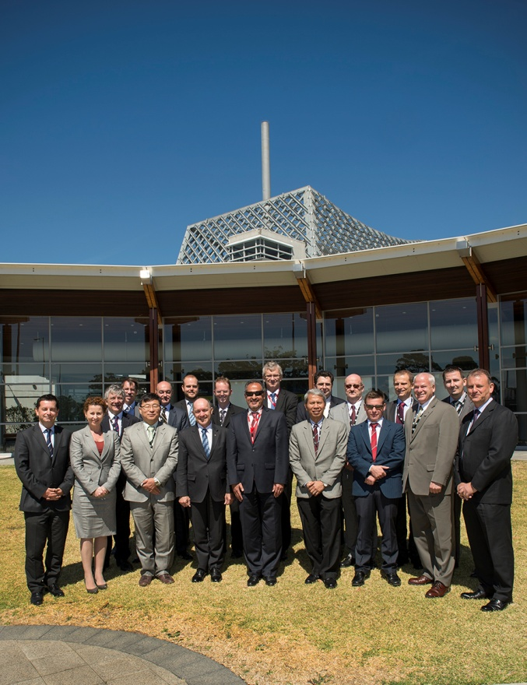
Team member – Lessons
Steep learning curve
Each mission has a familiar pattern but is different
Understand your assigned task
Be prepared - read the AIP and more
Take good notes
Help each other
2nd week is tough
Sometimes you need to let it go….
Much to learn from the experience

Slide 6
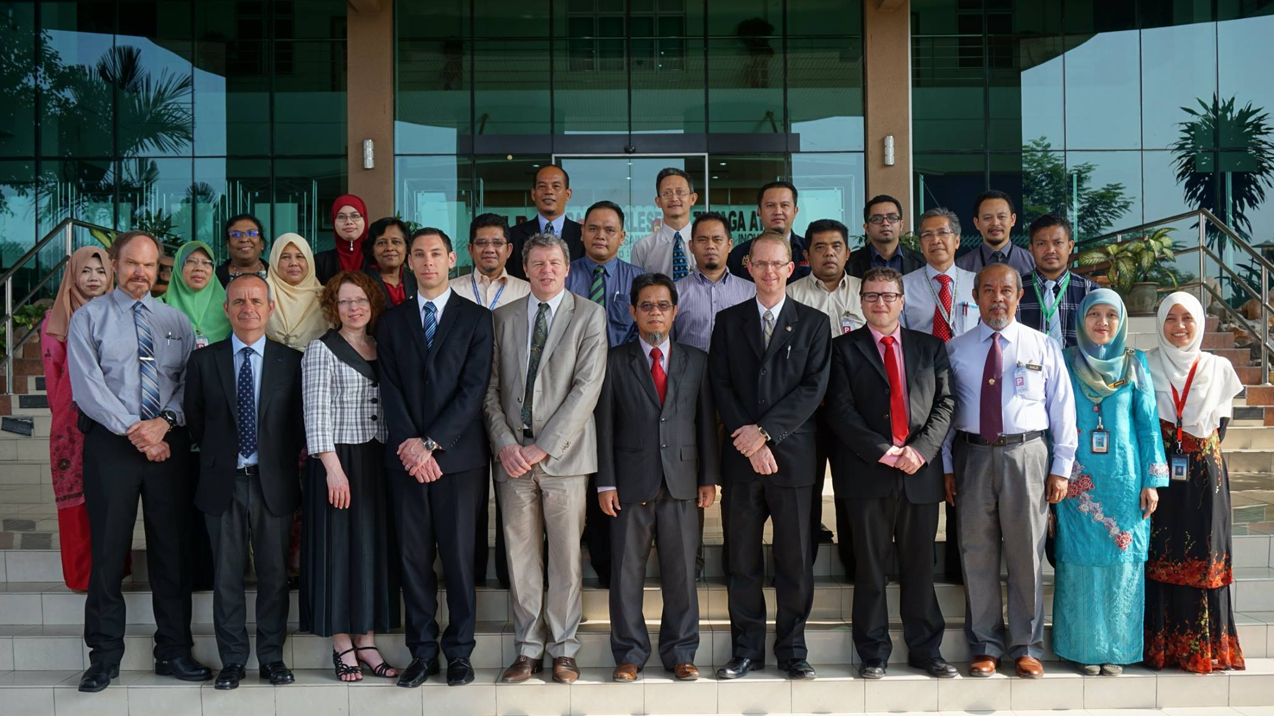
Team leader IPPAS – Lessons
Leading people who you have never met before
Putting it all together
Getting the job done vs quality
Allocation and coordination of tasks
You are still a team member
Sub-teams
Facilitate consensus
Final presentation
Media

Slide 7
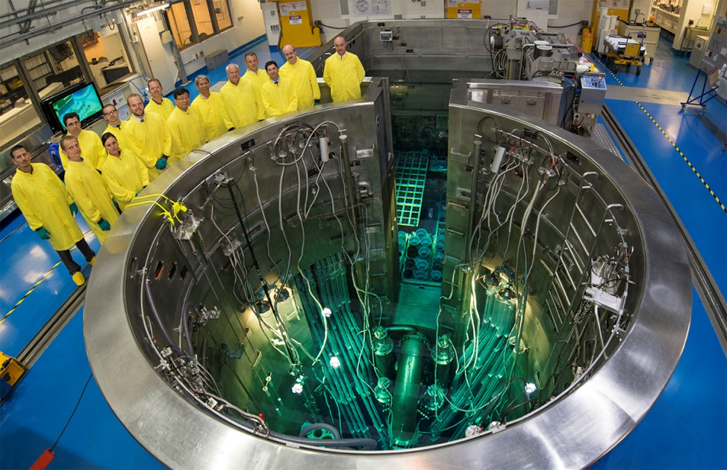
Australian IPPAS – HOST DESIGNATE - Lessons
Understand your goal and the big picture
Get the scope right
It’s not an inspection but….
Preparation is vital – advance information pack
Great value from preparation alone
Clearly understand use of Recommendations and Suggestions
Internal coordination
Value of technical writer

Slide 8
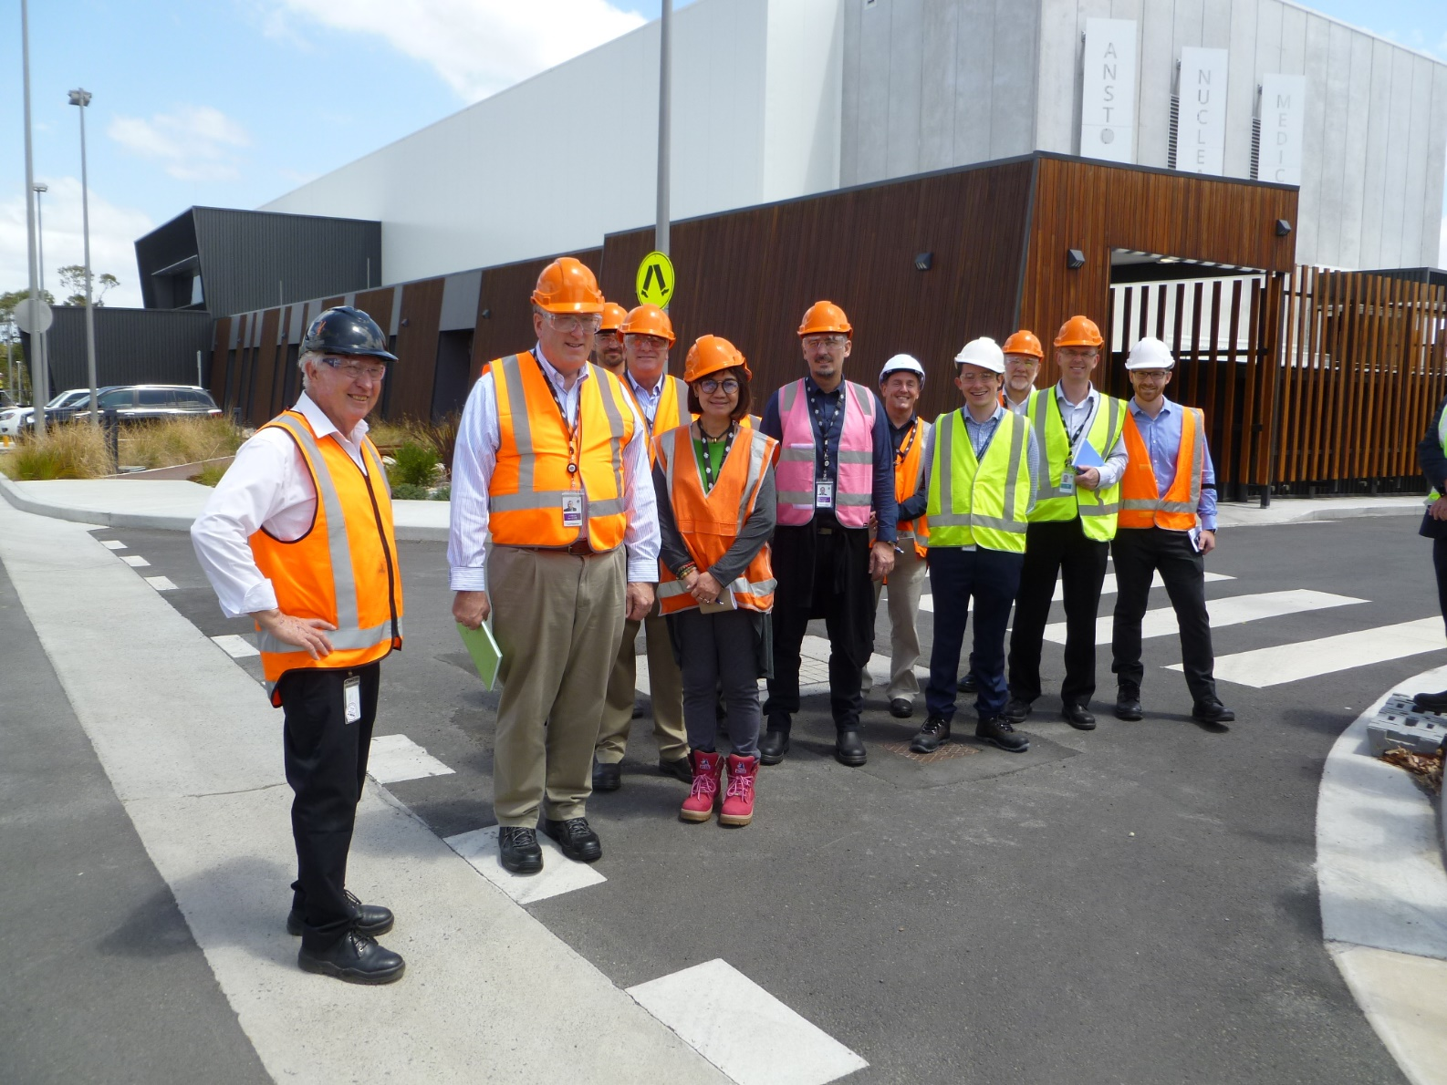
OVERALL LESSONs (1)
Be prepared
Advance Information Pack
know your objectives
plan the mission carefully and prioritise
Look after the team
allocation and coordination of tasks
transport
long nights
Coordination of feedback
Interpretation
graded approach to recommendations and suggestions

Slide 9
OVERALL LESSONs (2)
Always something to learn
Understand the national context
Don’t compare numbers of recommendations and suggestions
The mission is never over
IAEA Coordinator

Slide 10
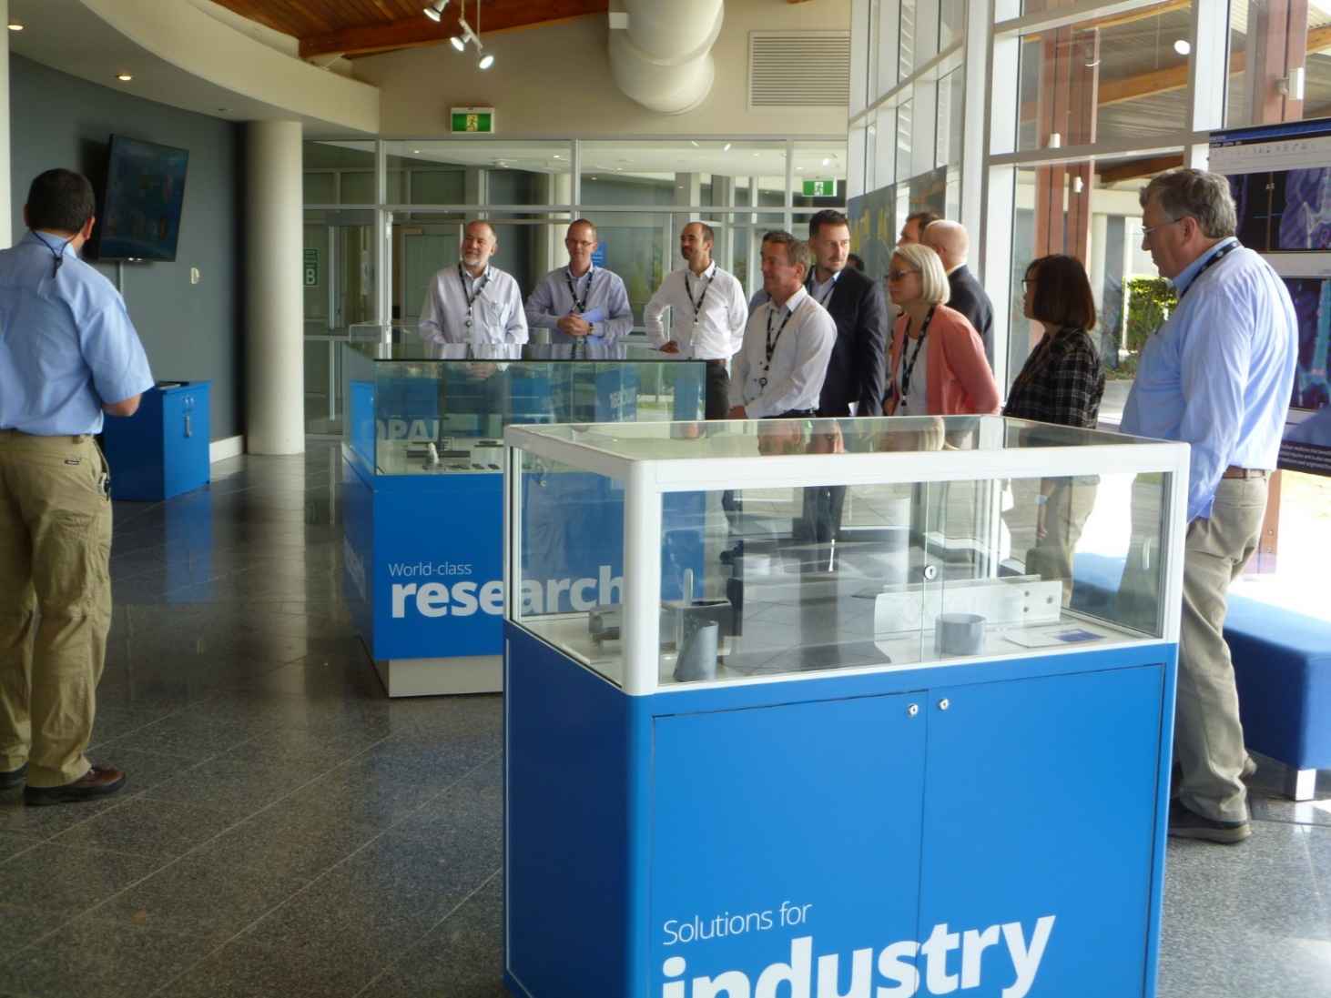
IDEAS for IPPAS EVOLUTION
Prior self-assessment
More modules (e.g. nuclear security culture, response)
Add priorities to recommendations and suggestions
Streamline report writing
Harmonisation with other review missions and services
Professional IPPAS mission team?

