Slide 1
WINS Initiatives to Support the Sustainability of Nuclear Security Support Centres (NSSC)

Slide 2
WINS Initiatives to Support the Sustainability of NSSC
International Commitment to Sustainability
WINS Services to Support NSSCs
WINS Partnership with Canada and Mexico
Current and Future Activities

Slide 3
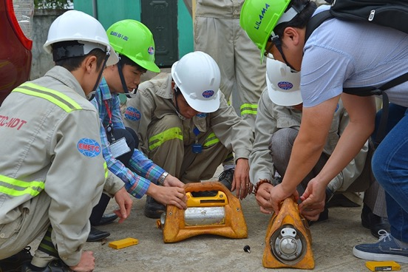
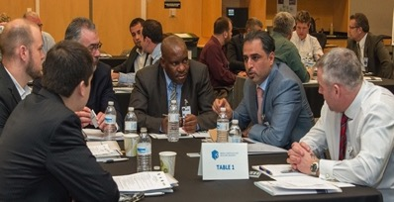
The WINS Vision of Sustainability
All nuclear and other radiological materials and facilities are effectively secured by demonstrably competent professionals applying best practice to achieve operational excellence.
*Over 6,000 Members in 145 countries
WINS Initiatives to Support the Sustainability of NSSC

Slide 4
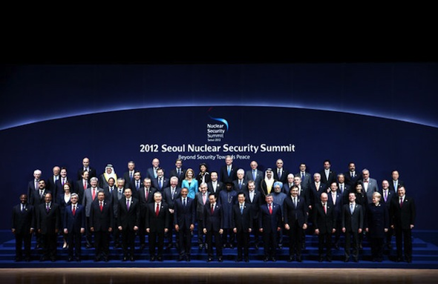
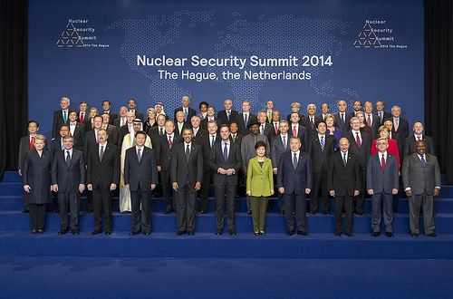
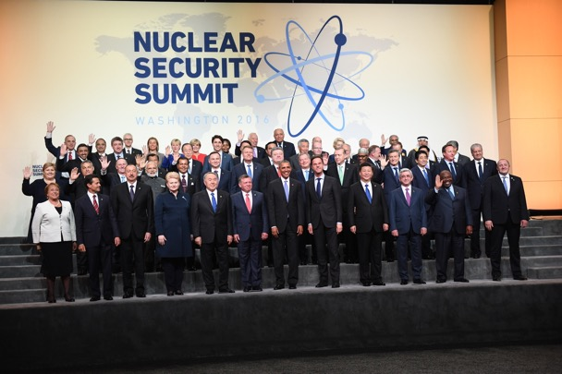
Political Commitment to Sustainable Nuclear Security: IAEA INFCIRC/869
WINS Initiatives to Support the Sustainability of NSSC

Slide 5
IAEA INFCIRC/901 Commitment
Signatory States
Canada
Finland
Hungary
Indonesia
Jordan
Kazakhstan
Malaysia
Mexico
The Netherlands
New Zealand
Norway
Romania
Thailand
UK
USA
WINS Initiatives to Support the Sustainability of NSSC
Notes:
Why WINS is involved – lay groundwork
Canada - Mexico

Slide 6
INFCIRC/869 and INFCIRC 901
Signatory States committed to:
“Maintaining and continuously improving domestic or regional training through education, certification and/or qualification activities”
“Supporting or participating in the development of World Institute for Nuclear Security (WINS) best practice guides and training activities.”
“To further support the WINS Academy in its efforts to expand its international certification program, including through the provision of advocacy, peer review support, contributions, or by other means as necessary.”
WINS Initiatives to Support the Sustainability of NSSC

Slide 7
WINS Support Services to NSSCs
Sharing Operational Experience
Knowledge Centre
Training & Certification
Evaluation

Slide 8
Sustainability Through Quality Management
IAEA Nuclear Security Series No. 20: Nuclear Security Fundamentals
Among the actions that States can take to sustain nuclear security:
Developing, implementing, and maintaining appropriate and effective integrated management systems including quality management systems.

Slide 9
Partnership with Mexico and Canada
WINS Initiatives to Support the Sustainability of NSSC

Slide 10
Achievements
March 2017 Train the Trainer Course
Establishment of an authorised Pearson VUE onsite testing centre at ININ
ININ achievement of ISO 29990 certification for learning services
National and Regional Training Courses on Radioactive Source Security Management (x3)
National and Regional Training Courses on the Security in the Transport of Radioactive Sources (x2)
Webinars on the security of radioactive sources in transport and used for industrial radiography and well-logging applications (x2)
National Roundtable on competencies for individuals with radioactive source security accountabilities
WINS Initiatives to Support the Sustainability of NSSC

Slide 11
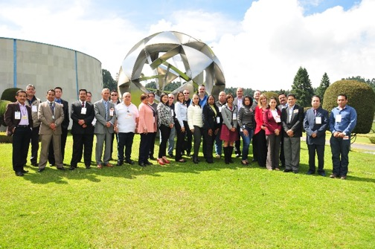
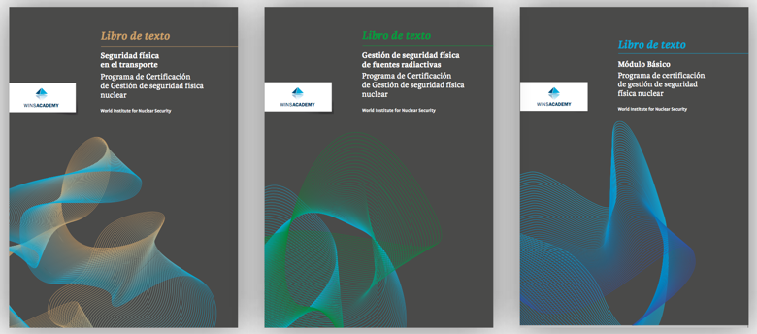
Achievements in Numbers
185
Participants took part in the training courses
50+
WINS Academy exams have been taken at the ININ test centre
3
WINS Academy certification courses translated into Spanish
WINS Initiatives to Support the Sustainability of NSSC
Notes:
.

Slide 12
“Mexico is strongly committed to the development of a certified nuclear security training centre. Thanks to the technical support and collaboration of WINS and the Government of Canada and the strong commitment of ININ, we have achieved a significant step in establishing a NSSC for Central America.”
- Mexican Secretariat of Energy (SENER)
WINS Initiatives to Support the Sustainability of NSSC

Slide 13
Current and Future Activities
WINS continued support for Mexico to ensure sustainability of achievements.
WINS active engagement and support to the NSSC Network and WG B on Best Practices.
Establishment of a WINS Advisory Group to promote certification of learning services.
WINS support to additional NSSCs, coordinated with international partners and the IAEA.
WINS Initiatives to Support the Sustainability of NSSC

Slide 14
Scoping Visit to Thailand
WINS Initiatives to Support the Sustainability of NSSC

Slide 15
Summary
WINS is well respected internationally for our large membership, training programme, extensive guidance and frequent and engaging events.
WINS has worked together with NSSCs since the inception of the IAEA Network.
We have demonstrated sustainable projects for human capacity building with partner countries and institutes.
WINS Initiatives to Support the Sustainability of NSSC

Slide 16
Thank You!
Dan.johnson@wins.org

