Slide 1
Sustaining and Strengthening Demonstrable Competence in Nuclear Security Management: The role of Gender Parity

Slide 2
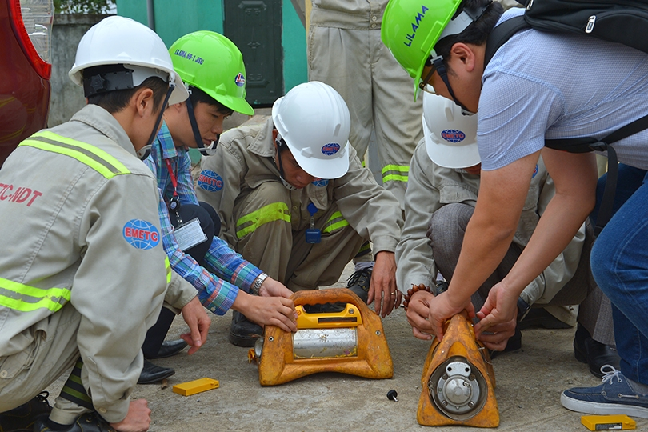

The WINS Vision
All nuclear and other radiological materials and facilities are effectively secured by demonstrably competent professionals applying best practice to achieve operational excellence.

Slide 3

The challenge: keeping pace with advancing and evolving technologies which offer both opportunities and threats to every national nuclear security regime

Slide 4
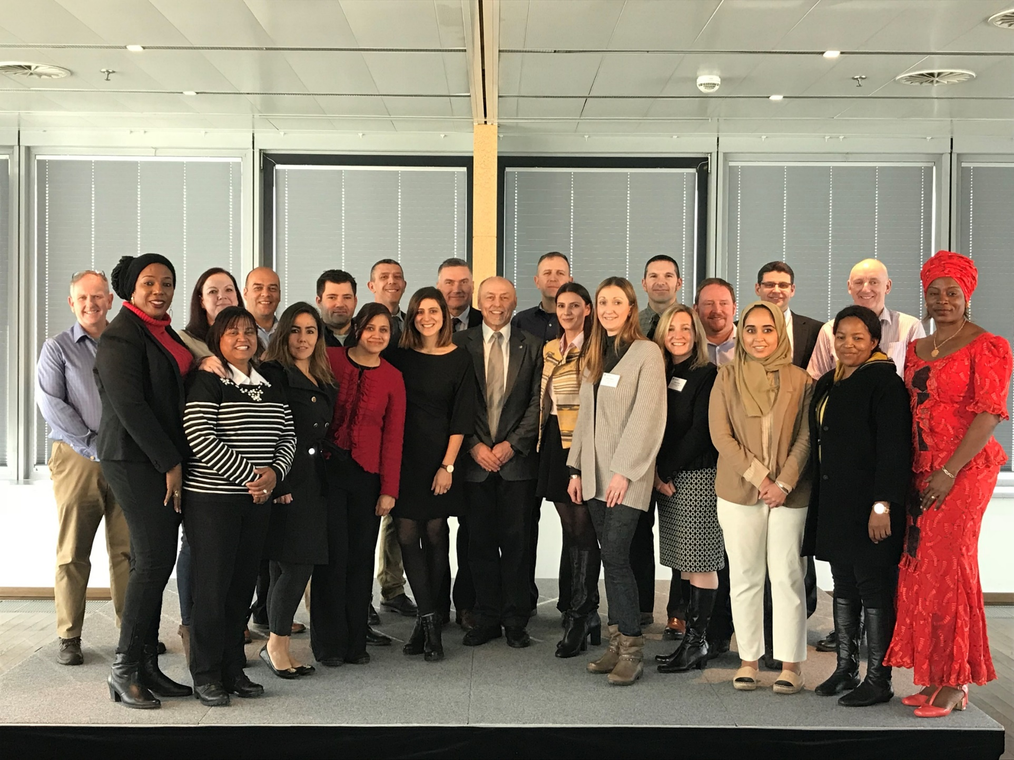
The solution: demonstrably competent, diverse workforce that sustains and strengthens each national nuclear security regime

Slide 5
Nuclear Security require diverse competency profiles
WINS is dedicated to highlighting the full range of roles and competency profiles that reflect the diversity of the nuclear security sector. This will ensure a better understanding of the range of roles that comprise the nuclear security sector.

Slide 6

Information Circular 901:
The WINS Academy is the provider of certified training for nuclear security management.
WINS is committed to certified training as a key contributor to the development of demonstrable competence to support this full range of roles.

Slide 7

The problem remains lack of diversity to meet these challenges

Slide 8

The workforce of nuclear security professionals is not diverse
This image is typical of the representation of women in nuclear = 20%
Notes:
idea first proposed by a senior group of INMM Fellows – the establishment of a new international organisation to be known as the World Institute for Nuclear Security (WINS) - whose role would be to share international best practices on nuclear security. There followed a 3-year planning effort undertaken with the leadership of NTI, INMM, with active participation from the IAEA, and I was fortunate enough to be asked to join the strategic planning group.

Slide 9
This conforms with WINS assessment of the number of women active with WINS – and reflects barriers to greater participation
WINS Female Membership – 22%
WINS Academy Programme Female Students – 26%
WINS Certifed Nuclear Security Professionals- 23%
Female Subject Matter Experts at WINS Events- 19%
Female participants at WINS Events - 23%
Notes:
idea first proposed by a senior group of INMM Fellows – the establishment of a new international organisation to be known as the World Institute for Nuclear Security (WINS) - whose role would be to share international best practices on nuclear security. There followed a 3-year planning effort undertaken with the leadership of NTI, INMM, with active participation from the IAEA, and I was fortunate enough to be asked to join the strategic planning group.

Slide 10




International and national efforts to address Gender Parity in Nuclear to address sustainable capacity and competence
International Gender Champions
Gender Champions in Nuclear Policy
Group of Friends of Women in Nuclear
Women in Nuclear
Women in Cyber
Notes:
idea first proposed by a senior group of INMM Fellows – the establishment of a new international organisation to be known as the World Institute for Nuclear Security (WINS) - whose role would be to share international best practices on nuclear security. There followed a 3-year planning effort undertaken with the leadership of NTI, INMM, with active participation from the IAEA, and I was fortunate enough to be asked to join the strategic planning group.

Slide 11
The WINS Gender Programme leverages
on WINS role in certification and professional development in nuclear security to increase women’s participation in nuclear security in all roles and at all levels

Slide 12
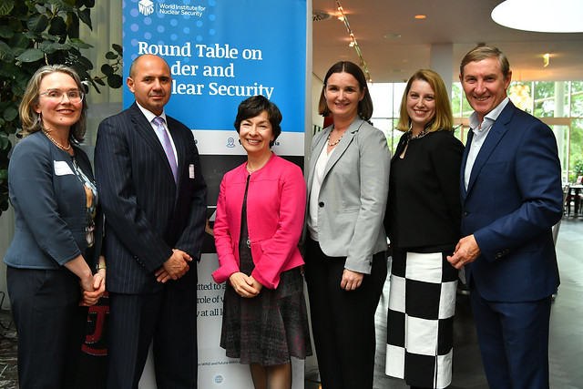
TRANSFORMING THE SECTOR TO ENSURE A DIVERSE COMPETENT WORKFORCE TO SUPPORT SUSTAINABLE NUCLEAR SECURITY:
Support for gender parity initiatives
Female role models and leaders in nuclear security
Workplace reforms
Systemic changes to organisational culture to support full participation of women in all roles in nuclear security
Male and female champions of change
Promotion of nuclear security as a careers for women and girls

Slide 13
Thank You
rhonda.evans@wins.org

