Slide 1
NUCLEAR FORENSICS CAPABILITIES IN UGANDA Now and the Future
Richard Sseggane
Atomic Energy Council - Uganda
1/3
Introduction
The Need for Forensics
Current situation
Proposed Action plan

Slide 2
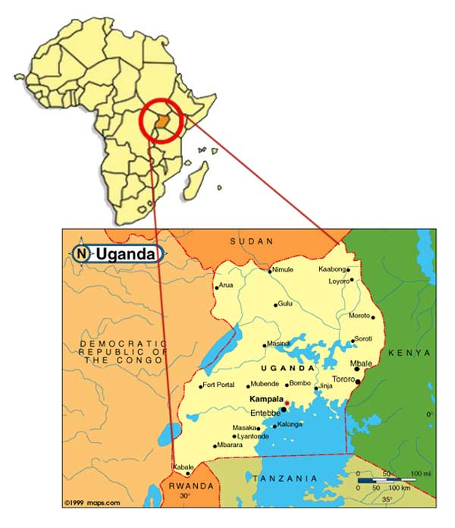
Uganda
Capital - Kampala
Independence: 1962 (British)
Language: English (Official)
Currency: Uganda Shilling
Climate: 2 seasons: Dry & Wet season
Ambient temperature -(17° - 29°c)
Population - 40 million (2018)
Total area - 241,551 sq. km
(Land) - 200,523 sq. km
2/3
Introduction
The Need for Forensics
Current situation
Proposed Action plan

Slide 3
Atomic Energy Council
AEC is an ‘independent’ government regulatory body established by Atomic Energy Act, No. 24 of 2008.
AEC mandate is to regulate peaceful applications of ionizing radiation and the development of nuclear energy for power generations.
Core functions of AEC include Development of Regulations and guides, Inspections, Authorizations, Enforcement, Review and Assessment etc.
These functions aim at achieving radiation protection, nuclear safety, nuclear security and safeguards.
3/3
Introduction
The Need for Forensics support
Current situation
Proposed Action plan

Slide 4
International Conference on Nuclear Security 2020
Richard Sseggane
Email: sricmut@gmail.com Tel: +256773823454
NUCLEAR FORENSICS CAPABILITIES IN UGANDA Now and the Future
Please click on the highlighted boxes
Introduction
The Need for Forensics Support
Current situation
Proposed Plan of action

Slide 5
ICONS 2020 – Richard Sseggane - Uganda
NUCLEAR FORENSICS CAPABILITIES IN UGANDA: Now and the Future
INTRODUCTION
Cases of Illicit trafficking and other nuclear security events are an issue worldwide.
States have the responsibility to respond to, conclusively investigate and prosecute these events. However;
There is shortage of capabilities to conduct forensic analysis of the detected and seized materials to aid prosecution.
See more
See more
Introduction
The Need for Forensics Support
Current situation
Proposed Plan of action

Slide 6
ICONS 2020 – Richard Sseggane - Uganda
NUCLEAR FORENSICS CAPABILITIES IN UGANDA: Now and the Future
INTRODUCTION
Cases of Illicit trafficking and other nuclear security events are an issue worldwide.
States have the responsibility to respond to, conclusively investigate and prosecute these events. However;
There is shortage of capabilities to conduct forensic analysis of the detected and seized materials to aid prosecution.
By the end of 2018, over 3400 cases had been reported to the ITDB(IAEA).
The CNS Global Incidents and Trafficking database recorded over 1000 cases between 2013 and 2019 (NTI).
For Uganda, the first case was confirmed in 2002 and another in 2005 along the Uganda – DR Congo border.
It is believed that many happened in the region over the years and gone undetected due to weak nuclear security detection architecture and poor nuclear forensic capabilities.
Introduction
The Need for Forensics Support
Current situation
Proposed Plan of action

Slide 7
ICONS 2020 – Richard Sseggane - Uganda
NUCLEAR FORENSICS CAPABILITIES IN UGANDA: Now and the Future
INTRODUCTION
In investigation of detected and seized materials, We need means to answer questions such as:
what exactly is the material?
what specifically could the material have been used for?
Where was the material obtained?
Was the amount seized only a sample of a much more significant quantity?
These questions can only be answered after detailed technical characterization of the material through a combination of scientific methods referred to as ‘nuclear forensics.
Nuclear Forensics capabilities are essential for such investigations but are yet to be well implemented in Uganda.
Cases of Illicit trafficking and other nuclear security events are an issue worldwide.
States have the responsibility to respond to, conclusively investigate and prosecute these events. However;
There is shortage of capabilities to conduct forensic analysis of the detected and seized materials to aid prosecution.
Introduction
The Need for Forensics Support
Current situation
Proposed Plan of action

Slide 8
ICONS 2020 – Richard Sseggane - Uganda
NUCLEAR FORENSICS CAPABILITIES IN UGANDA: Now and the Future
THE NEED FOR NUCLEAR FORENSICS
The following among other nuclear security challenges require sufficient nuclear forensics capabilities to be in place for them to be effectively dealt with.
.
Illicit trafficking
Orphan sources
Material theft
Introduction
The Need for Forensics Support
Current situation
Proposed Plan of action

Slide 9
ICONS 2020 – Richard Sseggane - Uganda
NUCLEAR FORENSICS CAPABILITIES IN UGANDA: Now and the Future
THE NEED FOR NUCLEAR FORENSICS
Illicit trafficking
The available data shows hundreds of past illicit trafficking cases worldwide. And more are being recorded.
It is believed that a number of them could have happened and gone undetected.
Detection measures are currently being enhanced in Uganda through portal monitors, handheld detectors, training programs and an improved legal framework.
There is need for forensic support capabilities to enable effective investigation of detected events.
Introduction
The Need for Forensics Support
Current situation
Proposed Plan of action

Slide 10
ICONS 2020 – Richard Sseggane - Uganda
NUCLEAR FORENSICS CAPABILITIES IN UGANDA: Now and the Future
THE NEED FOR NUCLEAR FORENSICS
Orphan sources
Radioactive materials have been used in Uganda for many years yet the regulatory framework has been in place for only the last 9 years.
Many radioactive materials could have been abandoned and can end up in scrap metal or in other areas.
These sources could be easily diverted for more malevolent purposes.
Good forensics would go along way helping the fight against nuclear terrorism both as a deterrent and in investigation.
Introduction
The Need for Forensics Support
Current situation
Proposed Plan of action

Slide 11
ICONS 2020 – Richard Sseggane - Uganda
NUCLEAR FORENSICS CAPABILITIES IN UGANDA: Now and the Future
THE NEED FOR NUCLEAR FORENSICS
Material Theft
There is known terrorist activity in the region and their known interest in acquiring a dirty bomb increases the probability of criminal actors trying to steal radioactive material from facilities.
There has been a reported incident in Uganda where criminals were intercepted smuggling a Co-60 radioactive source into the country with intention to sell it. The smugglers thought what they had was highly enriched uranium.
Introduction
The Need for Forensics Support
Current situation
Proposed Plan of action

Slide 12
ICONS 2020 – Richard Sseggane - Uganda
NUCLEAR FORENSICS CAPABILITIES IN UGANDA: Now and the Future
CURRENT SITUATION
At present no institution or center has been established or known to provide nuclear forensics services to law enforcement of judicial institutions of Uganda.
It would thus be very challenging to investigate a case of detected/seized nuclear or radioactive material in the country or at its borders.
There is also no known arrangement or understanding with any other agency or organization for obtaining expert assistance in the area of nuclear forensics.
Some capabilities may exist in the country but they’re unclear and uncoordinated which would limit their accessibility and effectiveness.
Introduction
The Need for Forensics Support
Current situation
Proposed Plan of action

Slide 13
ICONS 2020 – Richard Sseggane - Uganda
NUCLEAR FORENSICS CAPABILITIES IN UGANDA: Now and the Future
PROPOSED NUCLEAR FORENSICS PLAN OF ACTION FOR UGANDA
Nuclear forensic investigations start after a suspect radioactive source is interdicted and the initial and there is possible breach of the law.
Forensics aim to answer specific questions raised by the legal prosecution and its investigation team. It is essential that they closely interact with all other investigation measures.
The proposed is in line with the Model Action Plan in NSS 2G and it is recommended that nuclear forensic investigations in Uganda be conducted according to the following plan of action:
PROPOSED NUCLEAR FORENSICS PLAN OF ACTION FOR UGANDA
Introduction
The Need for Forensics Support
Current situation
Proposed Plan of action

Slide 14
ICONS 2020 – Richard Sseggane - Uganda
NUCLEAR FORENSICS CAPABILITIES IN UGANDA: Now and the Future
PROPOSED NUCLEAR FORENSICS PLAN OF ACTION FOR UGANDA
1/4
The site is cordoned off and guarded by the law enforcement service.
AEC confirms the nuclear or radioactive nature of the material and advises on the potential nuclear, radiological or chemical hazard that exists.
On-site, the following actions take place:
Radiation Protection officer examines the occupational and public radiation hazard;
Law enforcement checks for hidden explosives and preserve evidence, and chain of custody;
On-site categorization of seized material by mobile NDA instrumentation;
The material is safely and securely stored until transportation.
Introduction
The Need for Forensics Support
Current situation
Proposed Plan of action

Slide 15
ICONS 2020 – Richard Sseggane - Uganda
NUCLEAR FORENSICS CAPABILITIES IN UGANDA: Now and the Future
PROPOSED NUCLEAR FORENSICS PLAN OF ACTION FOR UGANDA
2/4
4. The following investigations are done at the specialized national nuclear forensics laboratory:
Checking for hidden explosives before unpacking;
Preservation of evidence and classical forensic analysis of non-radioactive material;
Detailed investigation according to the laboratory’s capabilities;
Interpretation of the data in terms of the processes used to create or manufacture the material.
from this interpretation, attribution of the origin of the material might be possible.
5. If the national nuclear forensics laboratory is not in a position to carry out certain analyses, a sample of the material should be shipped to an external nuclear forensics laboratory.
Introduction
The Need for Forensics Support
Current situation
Proposed Plan of action

Slide 16
ICONS 2020 – Richard Sseggane - Uganda
NUCLEAR FORENSICS CAPABILITIES IN UGANDA: Now and the Future
PROPOSED NUCLEAR FORENSICS PLAN OF ACTION FOR UGANDA
3/4
6. The external forensics laboratory conducts its analyses
An analytical expert opinion is written for the national law enforcement authorities.
8. A synopsis and evaluation of all evidence is made by the Directorate of Public Prosecutions.
9. The case will be treated by the national courts and closed.
Introduction
The Need for Forensics Support
Current situation
Proposed Plan of action

Slide 17
ICONS 2020 – Richard Sseggane - Uganda
NUCLEAR FORENSICS CAPABILITIES IN UGANDA: Now and the Future
PROPOSED NUCLEAR FORENSICS PLAN OF ACTION FOR UGANDA
Note
4/4
There should be pre-established arrangements for collaboration and assistance with foreign specialized nuclear forensics laboratories.
Where a foreign laboratory assists or conducts the forensic analysis, the local expert that submitted the samples should participate in drafting the expert opinion.
The Atomic Energy Council will make arrangements for safe and secure storage of the material during the court process and its disposition after closure of the case.
Introduction
The Need for Forensics Support
Current situation
Proposed Plan of action

