Slide 1
INTER-AGENCY COLLABORATION IN COMBATING ILLICIT TRAFFICKING OF RADIOACTIVE MATERIALS IN KENYA
PRESENTATION BY :
MICHAEL ATOGO
RADIATION PROTECTION OFFICER
KENYA NUCLEAR REGULATORY AUTHORITY

Slide 2
Content
INTRODUCTION
LEGAL & REGULATORY FRAMEWORK
NUCLEAR SECURITY COORDINATION CENTRE
NUCLEAR SECURITY ACTIVITIES IMPLEMENTED BY NSCC
CONCLUSION

Slide 3
INTRODUCTION
The Kenya Nuclear Regulatory Authority -competent authority on matters of radiation safety, security of radioactive and nuclear materials
Kenya serves as a hub of economic activity in East and Central Africa.
The presence of terrorist groups in some of the neighbouring countries make the threat of trafficking of nuclear and radiological material a reality.
Challenge- tracking the movement of RN materials from their points of entry to the end users in other countries, and theft and trafficking of radiological and nuclear materials
Notes:
-It provides the biggest corridor for bulk of transit goods from the port of Mombasa to the hinterland countries consisting of Uganda, Rwanda, Burundi, Zambia, Ethiopia and Southern Sudan,
-In the wake of heightened terrorism, the availability of materials and technologies necessary for terror attack delivery systems must be controlled. It is urgent that Strategic Trade Controls (STC) is put in place so as to protect national security through the import controls.
These countries import radioactive sources some of which pass through the Kenyan territory destined for use in industrial and other facilities. This has led to a challenge in tracking the movement of radioactive materials from their points of entry to the end users in other countries.

Slide 4
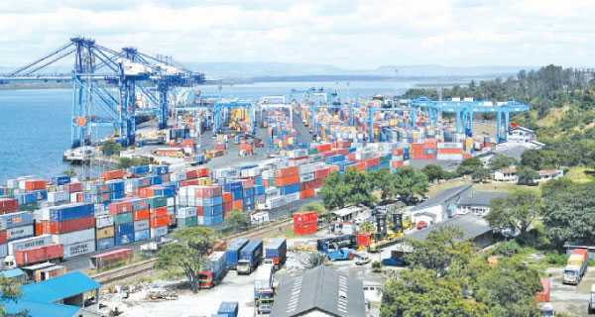
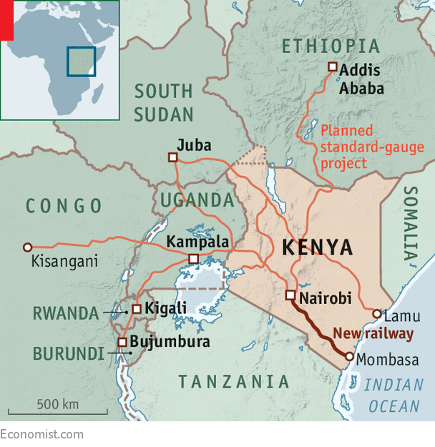
Introduction contd..
Mombasa Port & the Northern Corridor

Slide 5
LEGAL & REGULATORY FRAMEWORK
The Nuclear Regulatory Act, 2019-Part XIV- Nuclear Security and Physical Protection
The Authority coordinates threat assessment done by national nuclear institutions
The Authority issues guidelines to…(operators)? on protection from attempted or actual unauthorized access or illicit trafficking of nuclear and radioactive materials
The Authority is the lead agency responsible for coordinating recovery and response in the event of theft or unlawful taking of R/N material
The Authority provides information on incidents involving unlawful taking of nuclear, equipment and technology to the applicable international entity

Slide 6
Other Legislations & International Instruments
The Strategic Trade Control Bill, 2018; still in process of promulgation –import and export of controlled Dual-Use goods
Customs and Excise Act, 2010
UNSCR 1540,
UNSCR 1373
International Convention for the Suppression of Acts of Nuclear Terrorism
Non Proliferation Treaty
Chemical Weapon Convention (CWC)
Biological & Toxin Weapon Convention (BTWC)

Slide 7
NUCLEAR SECURITY COORDINATION CENTRE (NSCC)
The Board set up the department of Nuclear Security and Coordination Centre (NSCC) for appropriate integration and coordination of responsibilities among key government agencies.
The centre coordinates the activities of other agencies to ensure effective measures are in place to.
A six (6) member Technical Working Committee (TWC) was also formed to deliberate on many emerging issues of nuclear security following the rising global security threats.
The TWC comprises of members from: the National Disaster Operation Center; National Intelligence Service; Kenya Airports Authority; National Environmental Management Authority; chairman for RWM&NS and the NSCC.
Notes:
-To effectively carry mandate, the Board set up the department of Nuclear Security and Coordination Centre (NSCC) for appropriate integration and coordination of responsibilities among the government agencies.
-The centre coordinates activities of other agencies to ensure effective surveillance to combat illicit trafficking of radioactive and nuclear materials in the country and through the border posts

Slide 8
Roles of NSCC
Identification, coordination and strengthening of National Radiological/Nuclear threat and risk mitigation capacities, and post accident recovery strategies
Maintain inventories for Radiological and Nuclear resources- Nuclear security inventories such as equipment, technology, and experts, need to be maintained and regularly updated.
Search and secure orphan Radiological and Nuclear sources in the country- The Center in liaison with the department of Radioactive Waste Management & Nuclear Security, and development partners safely secure such sources.
Perform needs assessment in nuclear security- The NSCC plays an important role in leading and coordinating the need assessment in the country, thereby identifying and collects information on areas for potential improvement

Slide 9
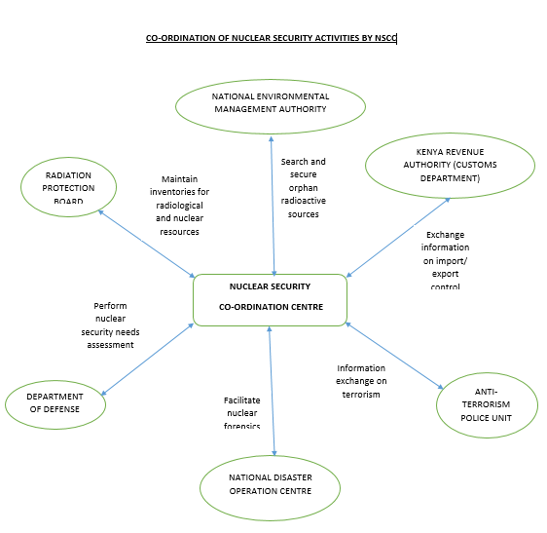

Slide 10
Nuclear Security activities implemented by the NSCC
Risk Mitigation in Chemical Biological Radiological and Nuclear Explosives (CBRNE)-CBRNE Commodity Identification Training
Establishment of CBRN Centre of Excellence for Eastern & Central Africa-Kenya hosts the regional secretariat of the EU CBRN Risk-mitigation CoE Initiative for the Eastern and Central Africa Region ,with 11 participating countries
Nuclear Security at Inland Container Depot Nairobi- Radiation Portal Monitors have been installed at ICDN to screen imports and exports for nuclear and radioactive materials.
Nuclear Security at JKIA-The Board is in partnership with Kenya Airports Authority and other security agencies to strengthen detection, interdiction and deterrence of nuclear and other radioactive materials at our international airports.
MoU between Kenya Civil Aviation Authority and the Board -The Board has a working MoU with KCAA to ensure that transportation and handling of radioactive material, in the aviation industry, is undertaken in a structured manner and in accordance with all national and international safety and security requirements.

Slide 11
CONCLUSION/RECOMMENDATION
The different initiatives by NSCC have greatly contributed to ensure detection and interdiction of nuclear and other radioactive materials at Kenyan points of entry/exit.
However, lack of adequate technical and human capacity have been identified as major challenges.
Promulgation of the Nuclear Regulatory Act offers a great break through to comprehensively address matters of nuclear security in the country

