Slide 1
Sustaining the Security of Radioactive Sources Through Compliance with Regulatory Requirements
By
Javed Iqbal
Pakistan Atomic Energy Commission

Slide 2
Outlines
Application of Sealed radioactive Sources (SRS) in Pakistan
Basis for Implementation of Security of Radioactive Sources
Accountability and Control Program for SRS
Categorization System and Security Levels for SRS
SRS Database
Corporate Oversight and Sustainability
Physical Inventory Verification and Assessment of Physical Protection Measures
Management of Disused SRS
Conclusion

Slide 3
Application of Sealed Radioactive Sources (SRS) in Pakistan
Research/Education
Medical
SRS Applications
Agriculture
Industry

Slide 4
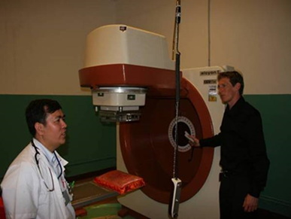
Commonly used Sealed Radioactive Sources (SRS) in Pakistan
Co-60, Ir-192, Cs-137
Activity Range: few KBq – TBq
Co-60 is used for radiotherapy
Ir-192 is used for Brachytherapy, radiography
Around 31% sources are being used in Industry (for Gamma Radiography, well-logging, level gauges, moisture gauges etc.)
Co-60 Teletherapy Machine
Notes:
On the basis of Categorization 7.8% SRS fall in Category-1, 1.7% in Category-2,
1.9% category-3 while 88.4% fall in category-4 & Category-5

Slide 5
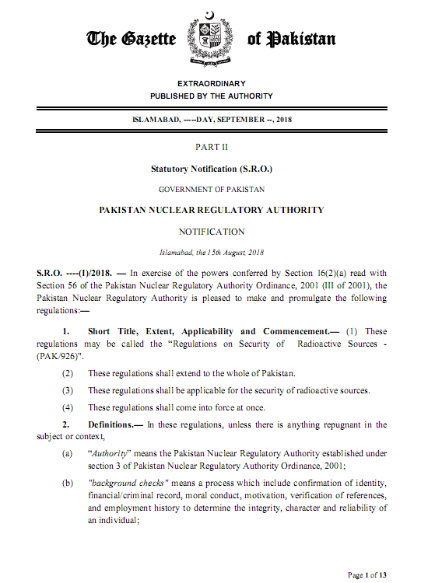
Basis for Implementation of Security Measures for Radioactive Sources
IAEA code of Conduct – INFCIRC/663
IAEA nuclear Security Recommendations (NSS14)
IAEA Nuclear Security Implementing Guide (NSS-11)
PNRA Regulations on “Security of Radioactive Source(s)-PAK/926”

Slide 6
Accountability and Control Program for SRS
Accountability and Control Program
SRS Database
Physical Inventory Verification
Inspection:
Safety and Physical Protection Measures
Management of DSRS

Slide 7
Categorization and Security Level for SRS
Overriding priority for the categorization of radioactive sources shall be given to their use in a certain practice.
In case of radioactive sources is not listed in column 2 of the above table, then A/D ratio shall be used for their categorization
For the radioactive sources during manufacture and storage, their A/D value shall only be considered for categorization
Reference: PAK/926

Slide 8
Periodic SRS Inventory Status
Periodic SRS data is acquired by Corporate level
Quarterly for Category 1
Bi-annually for remaining categories of SRS
Approved SRS Accountability form (SRS-1 Form)
Part-A of SRS-1 Form
Summary of inventory of SRS
Detail of each SRS
Status and application of SRS
SRS transfer information
Custodian

Slide 9
Periodic SRS Inventory Status Cont…
Part-B of SRS-1 Form
Questionnaire about onsite measures for secure handling of SRS
Administrative physical protection measures
SRS handling procedures
Record keeping

Slide 10
SRS Database
Information Extracted from SRS-1 Form
SRS ID
SRS Name
Half Life
Number of SRS
Activity
Category of SRS
Physical Form
Application
Remarks
In-use
Dis-used

Slide 11
Corporate Oversight and Sustainability
Physical Inventory Verification (PIV)
Technical Security Measures
Detection
Delay
Access Control
Administrative Security Measures
Sustainability
Maintenance and testing program
Adopting emerging technologies to enhance effectiveness of PPS
Policies and procedures

Slide 12
Physical Inventory Verification
Inventory and records
SRS receipt and transfer record
SRS use/movement log
Periodic Inventory Verification by the custodian
SRS transportation and disposal record
SRS certificate and relevant documentation provided by the manufacturer

Slide 13
Technical Security Measures
Physical Protection System
Intrusion detection System
Assessment of Detection (CCTV)
Automatic Access Control System
Physical Barriers (Robust doors, Secure containers and enclosures, Locks for doors)
Strong room for sources storage
Locked Shielded Containers

Slide 14
Security Measures for Source(s)
Security Function | Security Measures
 | Category-1 (Security Level A) | Category-2 (Security Level B) | Category-3 (Security Level C)
Goal | To prevent unauthorized removal | To Minimize likelihood of unauthorized removal | To reduce likelihood of unauthorized removal
Detection | IDS and/or continuous surveillance | IDS and/or continuous surveillance | -
 | Electronic Temper detection | Temper detection or periodic checks by operating personnel | Temper detection or daily checks by operating personnel
 | Immediate assessment of detection: CCTV or by operating personnel | Immediate assessment of detection: CCTV or by operating personnel | Immediate Assessment by operating personnel
 | Physical Verification: Fortnightly | Physical Verification: Fortnightly | Physical Verification: Monthly
Reference: PAK/926

Slide 15
Security Measures for Source(s)
Security Function | Security Measures
 | Category-1 (Security Level A) | Category-2 (Security Level B) | Category-3 (Security Level C)
Delay | Two Layers of Delay Barriers (at least) | Two Layers of Delay Barriers (at least) | Single Barrier or surveillance by security personnel
Access Control | Provision of identification and verification | Identification measure | Identification measure
Response | Rapid, dependable and diverse means of communication; | Rapid and reliable means of communication | Appropriate actions in accordance with Physical Protection Plan
 | Interrupt and neutralize adversary as per Physical Protection Plan | Interrupt and neutralize adversary as per Physical Protection Plan | Appropriate response actions in accordance with Physical Protection Plan

Slide 16
Administrative Security Measures
Physical Protection Plan
Security Event Reporting
Reliability and Trustworthiness of Personnel
Operating Procedures
Access Control Procedures
SRS handling and storage procedure
Key control procedures
Alarm assessment and response procedures
SRS disposal procedures
Training of Personnel
Security Culture

Slide 17
Event Reporting Mechanism
Required Actions | Timeline
Remedial measures and inform local law enforcement agencies | Immediate
Notify to Authority | 24 Hours
Submit a preliminary report to the Authority | 72 Hours
Submit to the Authority a detailed report on the causes of the event, its circumstances and consequences, and on the corrective actions taken or to be taken. | 60 Days
Reference: PAK/926
Notes:
Event: unauthorized access/intrusion, loss of control over SRS

Slide 18
Management of Disused SRS
Return to manufacturer
Interim Storage
Regulatory requirement as per PAK/915
Applicable to SRS with initial activity > 100 GBq and Half-life > 1 year
SRS shall be returned to country of origin as part of contract with supplier
Mandatory condition for “NO Objection Certificate” from PNRA
PPRWMF (PINSTECH Predisposal Radioactive Waste Management Facility) Islamabad
Covers two provinces (i.e. Punjab, KPK) and Capital territory
RAWSA (Radioactive Waste Storage Area) KANUPP, Karachi
Covers Provinces Sindh and Balochistan

Slide 19
Conclusion
Sealed Radioactive Sources are being used in Medicine, Agriculture, Industry, Research and Education in Pakistan
Relevant Regulations for Safety and Security of SRS are in place for Safe and Secure use/ handling, storage and transport of radioactive sources
All radioactive sources and under strict regulatory control from cradle to grave

