Slide 1
Capacity Building of Regulatory Staff for Nuclear Security
The IAEA International Conference on Nuclear Security 2020
Muhammad Abid Aslam
Pakistan Nuclear Regulatory Authority

Slide 2
Scheme
Pakistan Nuclear Regulatory Authority
History of training activities at PNRA
Training of Regulatory staff
Training Needs Assessment
Competence Development Matrix of PNRA

Slide 3
Pakistan Nuclear Regulatory Authority
PNRA was established under the Ordinance called “PNRA Ordinance (III of 2001)” in January, 2001.
PNRA performs the following core functions:
Development of Regulations & Regulatory Guides
Authorization / Licensing
Review and Assessment
Inspection and Enforcement & Emergency Response
PNRA believes that well educated and experienced manpower contributes more effectively towards meeting the organizational objectives and goals.
Notes:
Independent regulatory Authority

Slide 4
History of Training activities at PNRA (1/2)
1965
Nuclear Regulatory Infrastructure started since first research reactor PARR-I was commissioned
1971
Establishment of Nuclear Safety and Licensing Division
1984
Establishment of Pakistan Nuclear Regulatory Board (PNRB)
4

Slide 5
History of Training activities at PNRA (2/2)
2003
Quality Management & Educational Training (QM & ET)
2006
School for Nuclear and Radiation Safety (SNRS)
Nuclear Security Training Center (NSTC)
2014
National Institute of Safety and Security (NISAS) - A merger of SNRS and NSTC
5

Slide 6
Training of the PNRA Staff (1/2)
All the successful organizations in the world consider their employees as the most valuable asset;
Building employees skills and knowledge is an important investment for the future of organization;
Overall training programs for regulatory body personnel are considerably different from operator since the roles of regulatory & operating staff are quite different;
Although some elements of training programmes for regulatory body personnel may be similar to some elements of operator training programmes.
6

Slide 7
Training of the PNRA Staff (2/2)
PNRA utilizes various means for capacity building of its employees to keep them abreast with the latest technological advancements in the areas of nuclear safety, nuclear security and radiation protection;
PNRA has in place a systematic approach to identify the existing and desired competencies for its employees;
On the basis of identified gaps (Training Needs Assessment), plans are developed and implemented to achieve the desired competencies in its employees.
7

Slide 8
Training Needs Assessment
Analysis
Design
Development
Implementation
Evaluation
8

Slide 9
Competence Development Matrix of PNRA
9

Slide 10
Thank You

Slide 11
Competence Development Through In-House Resources
National Institute of Safety & Security
Competence Development through In-House Resources
Knowledge Sharing Programme
Leadership Development Programme

Slide 12
Competence Development Through National Organizations
Higher Education
Competence Development through National Organizations
Training, Workshops, Seminar

Slide 13
Competence Development Through International Organizations
Fellowship/training through IAEA
Competence Development through International Organizations
Fellowship/training through bilateral Cooperation
Higher Education through International Universities

Slide 14
Analysis
During this phase, competencies required to perform particular jobs/tasks and the training needs to achieve these competencies are identified;
Output of this phase is learning points that identify what a learner must know.

Slide 15
Design
During this phase, training needs and learning points related to specific competencies are converted to learning objectives, including evaluation strategies;
An annual training program is developed by the management .

Slide 16
Development
During this phase, training materials and evaluation tools are prepared so that the achievement of training objectives can be confirmed;
Work performed in this phase as well as in the design phase ensures that the intended training is both appropriate and adequate.

Slide 17
Implementation
During this phase, training is conducted as per PNRA competence development matrix to enhance the competence of regulatory staff.

Slide 18
Evaluation
During this phase, all aspects of the training program are continuously evaluated on the basis of data collected during each of the other phases;
It is followed by suitable feedback leading to training possible program improvements.

Slide 19
National Institute of Safety and Security
Mandate of NISAS
Major Tasks & Functions
Training & Education
Coordination & Support
Training in Nuclear Security
Capabilities in Nuclear Security – Physical Protection Labs
Nuclear Security Training Courses
Prevention, Detection & Response and General including training in International obligations and National requirements

Slide 20
Mandate of NISAS
National Institute of Safety and Security (NISAS) is established with the mandate to train professionals of PNRA, its licensees, and other stakeholders in the field of nuclear safety, radiation protection, and nuclear security in Pakistan.
NISAS conducts a range of in-house professional training courses, workshops, seminars to build overall competency of regulatory staff as well as that of PNRA licensees / stakeholders.

Slide 21
Major Tasks & Functions
Design, develop, and conduct training events for PNRA and stakeholders;
Plan and Implement the Public Awareness Program;
Maintain and upgrade NISAS laboratories for training purposes and organize demonstrations for National & International delegations;
Implementation of PNRA Management System and requirements of ISO 9001:2015 standards.

Slide 22
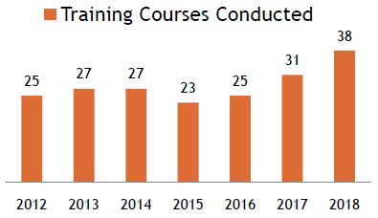
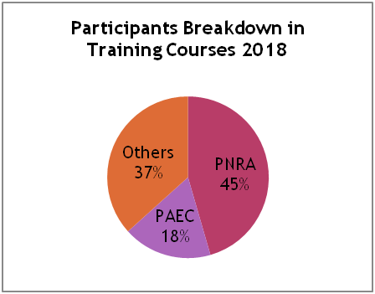
Training and Education
NISAS designs, develops, coordinates and conducts training courses for PNRA personnel, licensees and other stakeholders in the area of nuclear safety, security and managerial skills

Slide 23
Coordination & Support
NISAS coordinates and supports to other PNRA directorates as well as national and international stakeholders
NISAS
PIEAS
IAEA
PNRA
Other stake-holders

Slide 24
Training in Nuclear Security
Up till now, 146 training courses have been conducted in various area of nuclear security.

Slide 25
Overview of Security Training Courses

Slide 26
Capabilities in Nuclear Security
Has fully equipped lecture hall and auditorium
State-of-the-art training labs for practical demonstration and hands on training
Radiation Detection Equipment Lab (RDE)
Equipment Repair and Maintenance lab
Physical Protection Interior Labs (PPIL)
Access Control Lab, CCTV and Mock Up Model Lab
Intrusion Detection Lab
Physical Protection Exterior labs (PPEL)

Slide 27
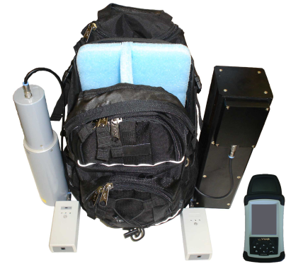
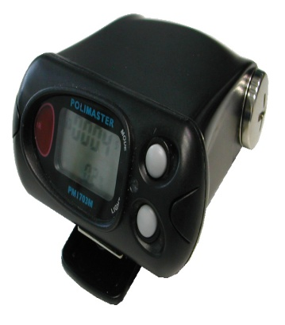
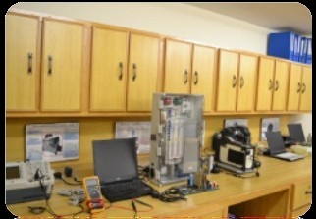
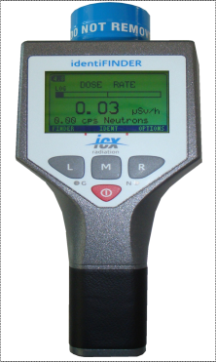
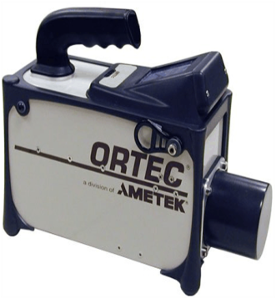
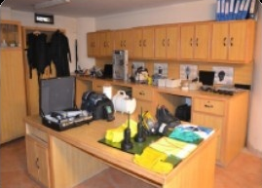
Radiation Detection Equipment Lab

Slide 28
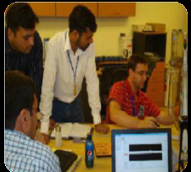
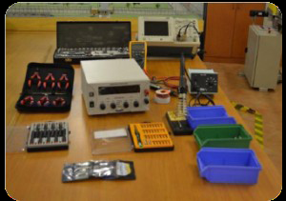
Technical Support Lab

Slide 29
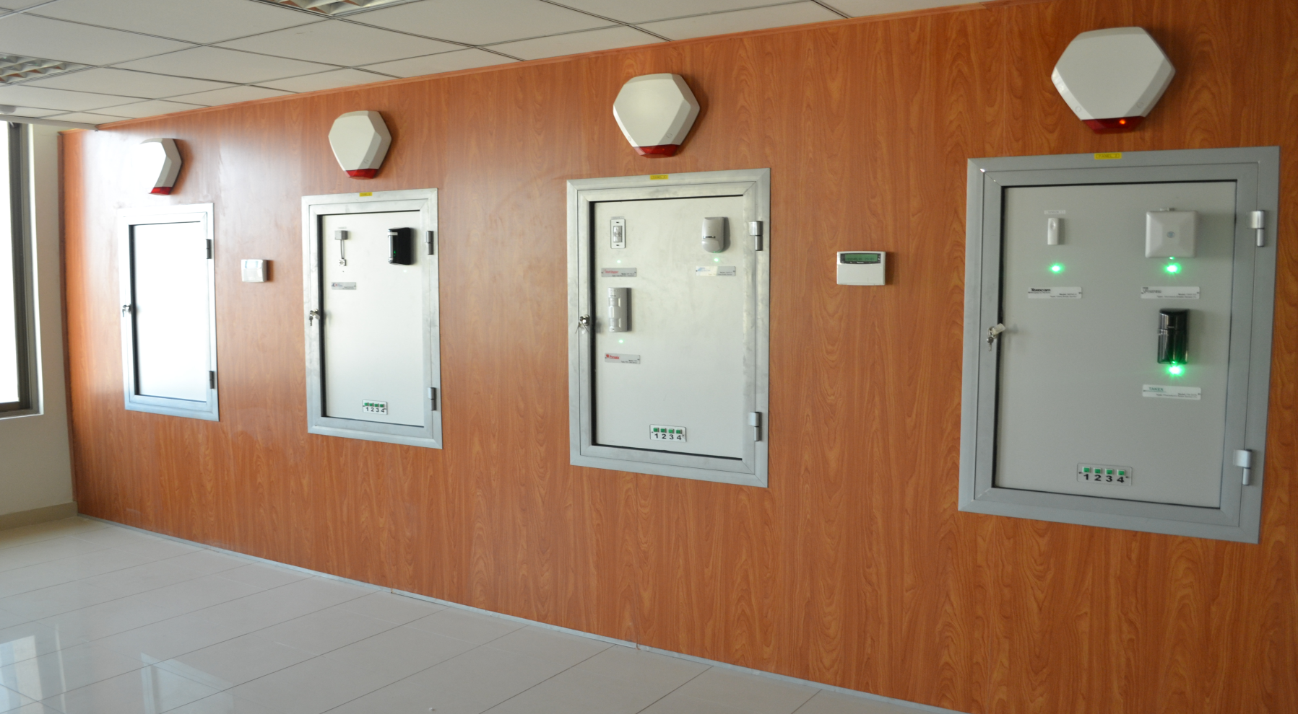
Physical Protection Interior Lab
Interior intrusion detection sensors installed on Wall mounted panels, ceiling and glass windows

Slide 30
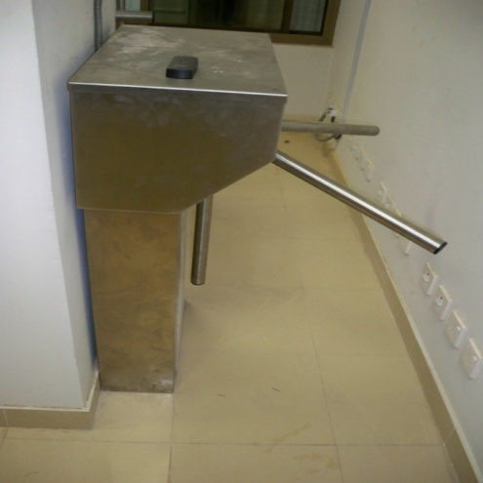
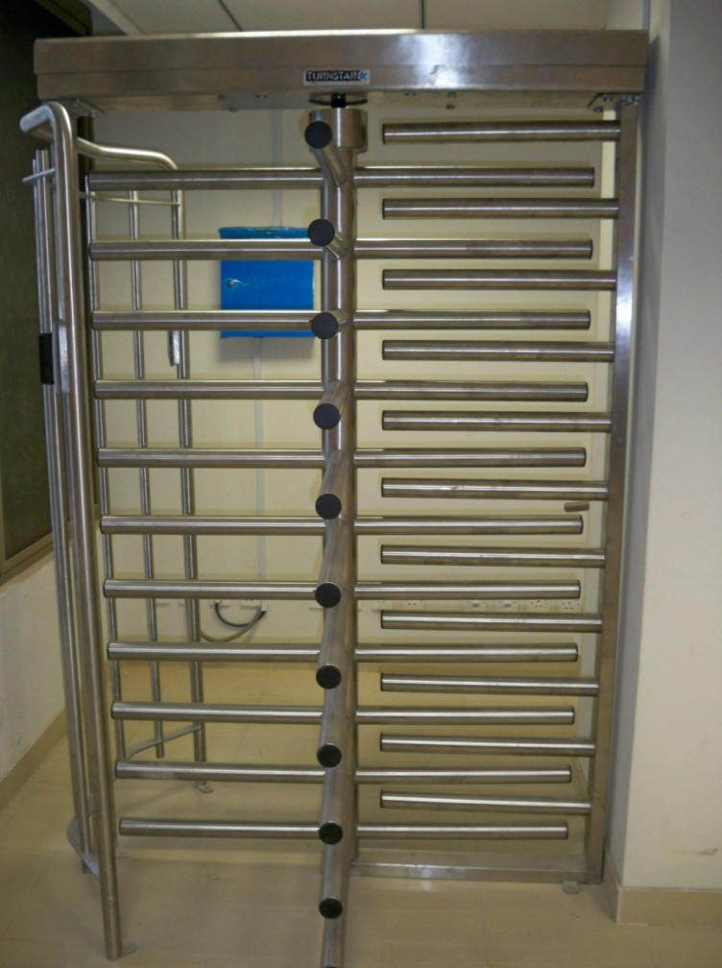
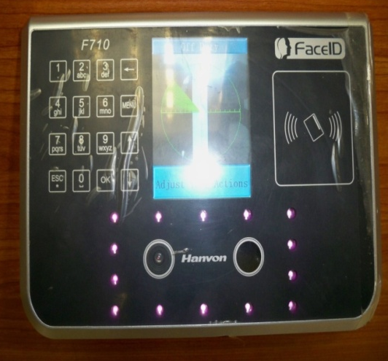
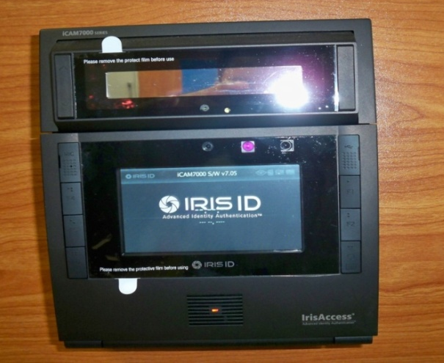
Physical Protection Interior Lab
Half height turnstile
Hand Geometry Scanner
Full height turnstile
Face Geometry Scanner
Iris Scanner

Slide 31
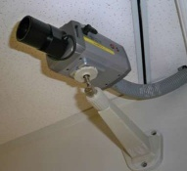
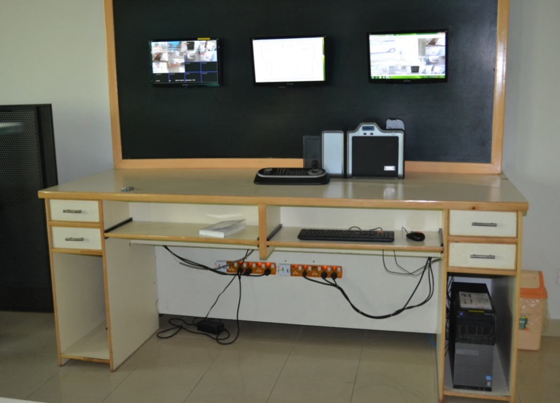
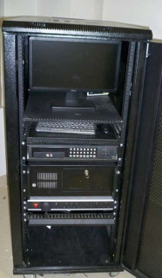
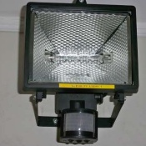
Physical Protection Interior Lab
CCTV Cameras
Display Monitors
Digital Video Recorders
IR-Light

Slide 32
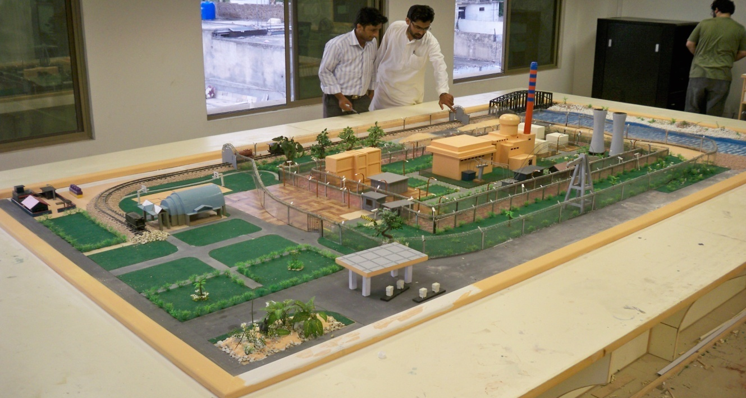
Physical Protection Interior Lab
Mock-up Model of NPP

Slide 33
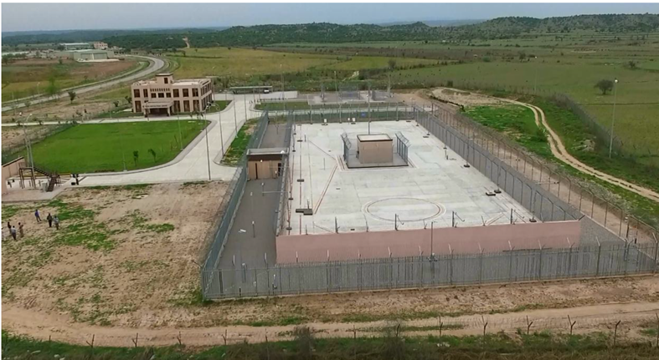
Physical Protection Exterior Lab
Overview of PPEL

Slide 34
Knowledge Sharing Program
Knowledge portal Site on Intranet
Transfer of tacit knowledge
Panel discussions
Knowledge Cafe
Organizing Colloquium
Utilization of expertise of retired peoples in the Training Institute, as a teacher and an advisor or consultant in PNRA
Glimpses of Knowledge Sharing Program

Slide 35
KM Tools Applications at PNRA
Overview of Web Portal
Notes:
Web Portal
PNRA has organizes a web portal for its internal use as PNRA-Local, which serves as a source of technical documents, procedures, regulations, events and reports etc. All directorates and projects can be accessed just by clicking on their respective links. Fig. 6. The web portal of PNRA

Slide 36
Mentoring/Transfer of tacit Knowledge at PNRA
Senior officers in PNRA transfer their tacit knowledge by frequent interaction with their subordinates in the regulatory areas like:
Regulation development
Inspection at NPPs and manufacturing facilities
Reviewing technical and licensing documents
Carrying out Investigation of any event
Performing Licensing activities, etc

Slide 37
Panel Discussion
Following are the objectives of panel discussion:
To learn from the experience of senior reviewers
To learn tips on how to work in stressful situations
Learning how to minimize communication barriers during official gatherings
Through this forum lessons learnt during various organizational tasks have been shared within the organization so that existing practices may be reviewed with a view to improvement

Slide 38
Knowledge Cafe
A forum, where the experts are invited and share their experience on the relevant topics:
How they performed special tasks
Hurdles faced during specific tasks
How they resolve the problems
Effective output of the process
Current opinion about that task

Slide 39
Colloquium
To provide a forum where individuals can utilize their intellectual and communication skills in a more informal manner by putting aside official barriers.
This activity, at one hand, would provide the speaker a chance to demonstrate his/her abilities to express an idea;
While on the other, the audience will have an opportunity to engage in an intellectual discussion.

Slide 40
Leadership Development Program
Introduction
PNRA Leadership Framework
360-Degrees Feedback
Perceptual Gaps
Individual Development Plans
Action Learning Projects

Slide 41
Leadership Development Program - Introduction
As per PNRA comprehensive self assessment of its regulatory activities-2006, one of the weak areas indicated was “Leadership Development”.
As a result in 2007, PNRA along with a leading business school in Pakistan started a structured program of leadership development
Purpose of this program was to develop such leaders with leadership qualities who could contribute towards organization improvement and themselves

Slide 42
PNRA Leadership Framework
PNRA Leadership framework based on 4Cs & 1P
 | Competitiveness | Create an inspiring vision of the future, make tough strategic decisions, act with regulatory foresight
 | Compassion | To be caring, willing to motivate and capacity for counseling, coaching and mentoring
 | Credibility | Be reliable, professional and authentic while dealing with licensee and stakeholders
 | Consistency | Consistent in decision making achieving targets and be energetic for achieving objectives
 | Passion | Having heartfelt, deep and authentic excitement about our stakeholders, the profession and PNRA

Slide 43
Leadership Development Framework
Candor & Forthrightness
Controlled Aggressiveness
Courage
Candor & Forthrightness
Motivating
Will to Lead
Analytical & Judgment
Politeness
Cultural Fluency
Business Acumen
Counseling
Caring and sensitive
Self-Confidence
Managing Self and Organizing
Outstanding Mind
Managing Team and Organizing
Communication and Networking
Optimistic/Positive Attitude
Personal energy

Slide 44
360 Degree Feedback
360-degree feedback provides perceptions of others on leader competencies and behaviors
The challenge for individual leaders is to reconcile the gap between self-perception and others’ perceptions to enhance their leadership

Slide 45
Perceptual gap
Perceptual gap is the differences between the leader and others perspective on the level of behavioral competencies demonstrated by the leader at work.
Individual’s supervisor, seniors, subordinates, and peers observe the leader’s level of competencies, when leader demonstrates competencies through performing different tasks and activities.

Slide 46
Individual Development Plan
Based on the perceptual gap in the 360 degree evaluation, individual development plan is developed with time line for the potential leader.
The individual development plans include mechanism in the form of assignments, coaching and training to overcome deficiencies.

Slide 47
Action Learning Projects
In order to enhance their leadership competencies and reduce positive or negative perceptual gap, every participant of the leadership development program is required to select an “action learning project”.
Participants have to select the Action Learning project that will improve their leadership qualities indentified in perceptual gap.

Slide 48
Higher Education
Competency through fellowship scheme
Higher Education
Competency through Self finance arrangements

Slide 49
Competency Through Fellowship Scheme
PNRA recruits young graduates and awards fellowships for higher studies at:
Karachi Institute of Nuclear Power Engineering (KINPOE)
Pakistan Institute of Engineering and Applied Sciences (PIEAS)
Capacity building of these graduates are enhanced through in-house courses/educational programs of nuclear security including prevention, detection & response

Slide 50
Competency Through Self Finance Arrangements
Employees are facilitated for higher studies through self finance arrangements at various national universities and institutions.
Eleven (11) employees are currently pursuing their postgraduate degree in various national universities in technical as well as managerial disciplines.

Slide 51
Training, Workshop and Seminars
PNRA collaborates with various national institutes for knowledge enhancement of its regulatory staff and also provides expert to deliver lectures in the nuclear security training courses, workshops and seminars i.e.
Pakistan Center of Excellence in Nuclear Security (PCENS)
Pakistan Institute of Engineering and Applied Sciences (PIEAS)

Slide 52
Training, Seminars & Workshops
PNRA collaborates with various national institutes for knowledge enhancement of its regulatory staff and also provides expert to deliver lectures in the nuclear security training courses, workshops and seminars i.e.
Pakistan Center of Excellence in Nuclear Security (PCENS)
Pakistan Institute of Engineering and Applied Sciences (PIEAS)

Slide 53
Pakistan Center of Excellence in Nuclear Security (PCENS)
PCENS has been established to train dedicated security force, with a focus on security, intelligence, counter-intelligence and technical aspect.
PCENS offers nuclear security training in the following areas:
Protective Force and Physical Protection System
Security and Intelligence
Material Control and Accounting
Delay and Response

Slide 54
Pakistan Institute of Engineering and Applied Sciences (PIEAS)
PIEAS has started a program on Nuclear Security Education in 2009 as a part of Nuclear Engineering.
Courses on ‘Nuclear Security’ and ‘Physical Protection Systems’ are also being run at PIEAS on regular basis.
PIEAS also offers academic trainings and other research activities in different scientific fields with the collaboration of IAEA and other international organizations.

Slide 55
Fellowship/training through IAEA
In 2005, IAEA and Pakistan signed an agreement for the capacity building of regulatory staff in the field of nuclear security.
Activities under these agreement include
Trainings,
Workshops,
Scientific visits,
Fellowships,
Capacity building through missions

Slide 56
Fellowship/training through IAEA
A three-pronged methodology was adopted which consisted of:
Train-the-trainer program to develop faculty
Training of national stakeholders by inviting foreign experts
National training courses using indigenous resources.

Slide 57
Competence Development under Bilateral Cooperation
PNRA has bilateral agreements of cooperation with
National Nuclear Safety Administration (NNSA);
Nuclear Safety Centre (NSC) and
China Nuclear Power Operation Technology Corporation, Ltd. (CNPO)
Under these agreements PNRA avails training opportunities for its employees in specific technical areas.
These organizations also conduct various trainings, workshops at PNRA.

Slide 58
Competence Development through International Universities
PNRA encourages its officials to enhance their qualification by allowing them to undertake higher education from international universities/institutes.
Twenty five (25) officials successfully completed the professional diploma in Integrated Security Systems from BTEC-UK.
During 2018, four regulatory officials joined PNRA after successful completion of post graduation, master and PhD programmes.

Slide 59
History of Training activities at PNRA
In order to implement its national and international obligations,
Govt. of Pakistan approved a national Nuclear Security Action
Plan (NSAP) Project in 2006 and entrusted Pakistan Nuclear
Regulatory Authority (PNRA) with the responsibility for its
implementation from 2005 to 2013.
One of the key area of this project was to establishment of
Nuclear Security Training Center (NSTC)
2003
Quality Management & Educational Training (QM & ET)
2006
2014
National Institute of Safety and Security (NISAS) - A merger of SNRS and NSTC
Nuclear Security Training Center (NSTC)
School for Nuclear and Radiation Safety (SNRS)

Slide 60
History of Training activities at PNRA
School for Nuclear and Radiation Safety (SNRS) has been established to develop the new and younger generation with relevant education and skills to replace the ageing nuclear workforce
SNRS provided training in the field of Nuclear safety and radiation protection
2003
Quality Management & Educational Training (QM & ET)
2006
2014
National Institute of Safety and Security (NISAS) - A merger of SNRS and NSTC
Nuclear Security Training Center (NSTC)
School for Nuclear and Radiation Safety (SNRS)

Slide 61
History of Training activities at PNRA
QM&ET was established to provide basic level of training
courses to the newly recruited officers in the technical field
2003
Quality Management & Educational Training (QM&ET)
2006
2014
National Institute of Safety and Security (NISAS) - A merger of SNRS and NSTC
Nuclear Security Training Center (NSTC)
School for Nuclear and Radiation Safety (SNRS)

Slide 62
Nuclear Security Training Courses (General)
Module -1 | Training Course on Introduction to Nuclear Security | 05 days
Module – 2 | Professional Training Course on Nuclear Security (Level-II) | 30 days
Module – 3 | Workshop on Nuclear Security Culture | 05 days
Module – 4 | Basic and Advance Project Management Training Course (for Nuclear Security Projects) | 05 & 10 days
Module – 5 | Seminar on Nuclear Security | 01 day

Slide 63
Nuclear Security Training Courses (Prevention)
Module -1 | Foundation of Physical Protection Systems | 05 days
Module – 2 | Security of Radioactive Sources | 05 days
Module – 3 | Basic and Advance Training Course on Design and Evaluation of Physical Protection System | 05 & 10 days
Module – 4 | Basic and Advance Course on Operations and Maintenance of Physical Protection System for Nuclear Medical Centers | 05 & 10 days
Module – 5 | Training Course on Inspections of Physical Protection System | 05 days

Slide 64
Nuclear Security Training Courses (Detection & Response)
Module -1 | Training Course on Radiation Detection Equipment for Front Line Officers | 03 days
Module – 2 | Training Course on Radiation Detection Equipment for Nuclear and Other Radioactive Material | 05 days
Module – 3 | Training Course on Response to Malicious Act involving Nuclear and Other Radioactive Material | 03 days
Module – 4 | Training Course on Locating and Securing Orphan Radioactive Material | 05 days
Module – 5 | Training Course on Repair and Maintenance of Radiation Detection Equipment | 05 days
Module – 6 | Training Course on Mobile Expert Support Team | 05 Days

Slide 65
Training in International Obligations, National Legal & Regulatory Framework
National Legal &
Regulatory Framework
UN Resolutions
i.e. 1540
Code of Conduct on
Safety and Security of
Radioactive Sources
[not a legal binding]
IAEA Resolutions
CPPNM
IAEA-INFCIRC-225/NSS-13

Slide 66
Competency Through Fellowship Scheme
For more information, please visit
http://www.kinpoe.edu.pk/
PNRA recruits the young graduate and awarded fellowships for higher studies at:
Karachi Institute of Nuclear Power Engineering (KINPOE) or
Pakistan Institute of Engineering and Applied Sciences (PIEAS)
Capacity building of these graduates are enhanced through in-house professional development courses/educational programs of nuclear security including prevention, detection & response

Slide 67
Competency Through Fellowship Scheme
PNRA recruits the young graduate and awarded fellowships for higher studies at:
Karachi Institute of Nuclear Power Engineering (KINPOE) or
Pakistan Institute of Engineering and Applied Sciences (PIEAS)
Capacity building of these graduates are enhanced through in-house professional development courses/educational programs of nuclear security including prevention, detection & response
For more information, please visit
http://www.pieas.edu.pk/

Slide 68
Nuclear Security Training Courses (General)
Objective:
The Objective of this course is to enhance the capacity building of the participants in the field of nuclear security.
Course Content:
The modules containing several lectures related to Introduction to Nuclear Security, International Instruments on Nuclear Security, Prevention (Defining Physical Protection System Requirements, Physical Protection Equipment , Design of Physical Protection Systems, Evaluate the Physical Protection System Design, Assessment and Inspection Methodologies), Detection (Radiation Detection Equipment used in nuclear security), Response, Management of Radioactive Material Out of Regulatory Control
Module -1 | Training Course on Introduction to Nuclear Security | 05 days
Module – 2 | Professional Training Course on Nuclear Security (Level-II) | 30 days
Module – 3 | Workshop on Nuclear Security Culture | 05 days
Module – 4 | Basic and Advance Project Management Training Course (for Nuclear Security Projects) | 05 & 10 days
Module – 5 | Seminar on Nuclear Security | 01 day

Slide 69
Nuclear Security Training Courses (General)
Objective:
The objective of this training course is to facilitate the evaluation of the characteristics of nuclear security culture at the facility level.
Course Content:
Topics includes in this training course are Security risk with the use, storage of nuclear and other radioactive material, Basic of nuclear security, Human factor in nuclear security, IAEA nuclear security culture concept, its applications with relevant exercises, Roles and responsibilities, Nuclear security culture self assessment & Nuclear security culture enhancement
Module -1 | Training Course on Introduction to Nuclear Security | 05 days
Module – 2 | Professional Training Course on Nuclear Security (Level-II) | 30 days
Module – 3 | Workshop on Nuclear Security Culture | 05 days
Module – 4 | Basic and Advance Project Management Training Course (for Nuclear Security Projects) | 05 & 10 days
Module – 5 | Seminar on Nuclear Security | 01 day

Slide 70
Nuclear Security Training Courses (General)
Module -1 | Training Course on Introduction to Nuclear Security | 05 days
Module – 2 | Professional Training Course on Nuclear Security (Level-II) | 30 days
Module – 3 | Workshop on Nuclear Security Culture | 05 days
Module – 4 | Basic and Advance Project Management Training Course (for Nuclear Security Projects) | 05 & 10 days
Module – 5 | Seminar on Nuclear Security | 01 day
Objective:
To develop understanding of the project management processes and to enhance the participants' skills needed for effective planning, implementation of security related and other technical projects to manage project effectively and achieve the desire goal.
Course Content:
Topics includes Basic concept of project, Stages of project management, Risk consideration and management,
Stakeholders analysis, Issue management and change control, Testing and commissioning and closing & handover of project

Slide 71
Nuclear Security Training Courses (Prevention)
Module -1 | Foundation of Physical Protection Systems | 05 days
Module – 2 | Security of Radioactive Sources | 05 days
Module – 3 | Basic and Advance Training Course on Design and Evaluation of Physical Protection System | 05 & 10 days
Module – 4 | Basic and Advance Course on Operations and Maintenance of Physical Protection System for Nuclear Medical Centers | 05 & 10 days
Module – 5 | Training Course on Inspections of Physical Protection System | 05 days
Objective:
The objective of this course is to train the participants on operation of physical protection equipment installed at NMCs so that they become able to perform operation and possible preventive repair and maintenance activities of installed physical protection system.
Course Content:
Topics includes in this training course are Overview of PNRA, Nuclear security regime for radioactive material, Security and physical protection concepts, Regulatory requirement for SRS (PAK-926), Overview of CCTV, ACS, IDS, Design, implementation and commissioning of Physical Protection Equipment, Operation and management of CAS

Slide 72
Nuclear Security Training Courses (Prevention)
Objective:
The objective of this training course is to design and evaluation of the physical protection system at the facility level with the help of different technologies.
Course Content:
In this training course, the topics covered are design and evaluation process, Defining the requirement of physical protection system, Physical protection system design, Physical protection system technologies, Video technologies, Lighting requirement & concept on contraband detection
Module -1 | Foundation of Physical Protection Systems | 05 days
Module – 2 | Security of Radioactive Sources | 05 days
Module – 3 | Basic and Advance Training Course on Design and Evaluation of Physical Protection System | 05 & 10 days
Module – 4 | Basic and Advance Course on Operations and Maintenance of Physical Protection System for Nuclear Medical Centers | 05 & 10 days
Module – 5 | Training Course on Inspections of Physical Protection System | 05 days

Slide 73
Nuclear Security Training Courses (Prevention)
Module -1 | Foundation of Physical Protection Systems | 05 days
Module – 2 | Security of Radioactive Sources | 05 days
Module – 3 | Basic and Advance Training Course on Design and Evaluation of Physical Protection System | 05 & 10 days
Module – 4 | Basic and Advance Course on Operations and Maintenance of Physical Protection System for Nuclear Medical Centers | 05 & 10 days
Module – 5 | Training Course on Inspections of Physical Protection System | 05 days
Objective:
The purpose of the training course is to address the challenges and constraints with regard to inspecting a PPS, and to provide the participants with the required information to enable them to conduct an inspection of a PPS in a nuclear facility.
Course Content:
Topics includes are Introduction to PNRA, Preparation and conduct of regulatory inspections, Inspection of security management, Inspection of CCTV, ACS, IDS, Barriers, security lights, CAS, guards and response force
and Practical exercises

Slide 74
Nuclear Security Training Courses (Detection & Response)
Objective:
The objective of the course is to familiarize the participants with the techniques for scanning of the cargos and goods, methodologies for response to equipment alarm and coordination mechanism between FLOs and MEST in case an illicit radioactive material is detected.
Course Content:
The topics includes are nuclear security frame work, Basics of radiation protection, Radioactive sources and their uses, Legal framework, Nuclear security recommendations (NSS15), IAEA sustainability development, radiation portal monitor, RPM, PRD and RID.
Module -1 | Training Course on Radiation Detection Equipment for Front Line Officers | 03 days
Module – 2 | Training Course on Radiation Detection Equipment for Nuclear and Other Radioactive Material | 05 days
Module – 3 | Training Course on Response to Malicious Act involving Nuclear and Other Radioactive Material | 05 days
Module – 4 | Training Course on Locating and Securing Orphan Radioactive Material | 05 days
Module – 5 | Training Course on Repair and Maintenance of Radiation Detection Equipment | 05 days
Module – 6 | Training Course on Mobile Expert Support Team | 05 Days

Slide 75
Nuclear Security Training Courses (Detection & Response)
Module -1 | Training Course on Radiation Detection Equipment for Front Line Officers | 03 days
Module – 2 | Training Course on Radiation Detection Equipment for Nuclear and Other Radioactive Material | 05 days
Module – 3 | Training Course on Response to Malicious Act involving Nuclear and Other Radioactive Material | 03 days
Module – 4 | Training Course on Locating and Securing Orphan Radioactive Material | 05 days
Module – 5 | Training Course on Repair and Maintenance of Radiation Detection Equipment | 05 days
Module – 6 | Training Course on Mobile Expert Support Team | 05 Days
Objective:
The objective of the course was to familiarize the participants with that a vulnerable radioactive source is one, which is currently under regulatory control, but for which control is insufficient to provide assurance of long term safety and security.
Course Content:
Topics covered in this training course are applications of radiations, Historical problems of orphan sources, Categorization of SRS, Transport of radioactive material, Administrative search of orphan sources, PRD, RID, Survey meter, Actions after finding orphans sources, Response to radiological emergencies

Slide 76
Training on International Obligations & National Legal & Regulatory Framework
National Legal &
Regulatory Framework
UN Resolutions
Code of Conduct on
Safety and Security of
Radioactive Sources
[not a legal binding]
IAEA Resolutions
CPPNM
IAEA-INFCIRC-225

