Slide 1
Titre
International Conference on Nuclear Security - 2018 French IPPAS mission
Experience and lessons
learned
Tuesday, 11 February 2020

Slide 2
Introduction
Outcomes and lessons learnt
Suggestions

Slide 3
Consideration of France on the great value of IPPAS missions
IPPAS missions play an important role to provide with an external review of a nuclear security regime and its implementation on a nuclear facility
Gives international weight to the reliability and credibility of a country in the field of nuclear security
Improves nuclear security globally

Slide 4
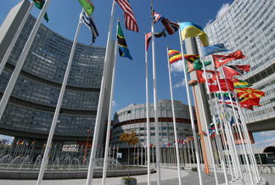
Consideration of France on the great value of IPPAS missions
Relevant tool developed by the IAEA whose legitimacy is internationally recognized
Internally
good leverage to make evolve the national security regime
strengthens the importance given to nuclear security by the different stakeholders and authorities (national resonance of the event) and develops a shared vision

Slide 5
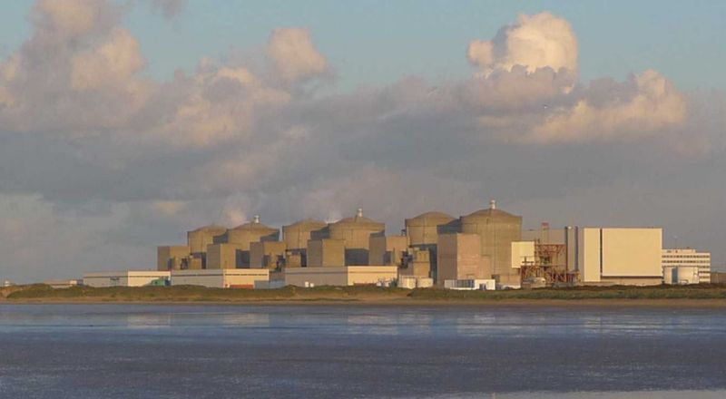
2011 French IPPAS mission
France hosted in 2011 its first IPPAS mission
Themes of the mission: Two modules reviewed :
National review of nuclear security regime for nuclear material and nuclear facilities (module 1)
Nuclear facility review (module 2) : visit of Gravelines NPP (one of the biggest in Western Europe) operated by EDF

Slide 6
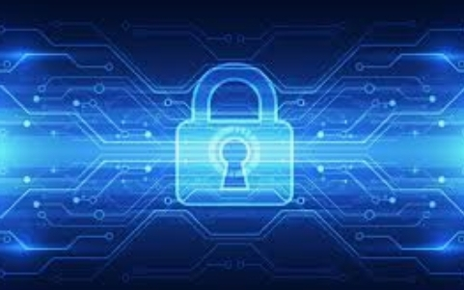
2018 French IPPAS mission
Follow-up of the previous mission (2011), and in addition:
Three modules reviewed:
New National review of nuclear security regime for nuclear material and nuclear facilities (module 1)
Nuclear facility review (module 2) : visit of Georges Besse II enrichment facility operated by ORANO
Computer security (module 5)
Mission hosted and organized by the Ministry of Energy

Slide 7
2018 French IPPAS mission
2 weeks of work including 2 days in the facility
Invitation of key French stakeholders to make presentations
Specific interviews between experts and competent services to clarify some issues
Draft report submitted for comments and observations before the closing meeting

Slide 8
Introduction
Outcomes and lessons learnt
Suggestions

Slide 9
2018 French IPPAS mission – Outcomes and lessons learnt
Conclusions of the report
“The nuclear security regime in France is robust and well-established, and incorporates the fundamental principles of the amended CPPNM”
Contains Recommendations and Suggestions applying to the State and the operator ORANO
Good practices identified

Slide 10
2018 French IPPAS mission – Outcomes and lessons learnt
Lessons learnt
One year required for the preparation of the mission
Possibility to approve the selection of experts
Intensive mission that gave only short time to experts to write their report : importance of the AIP given to the experts
A rehearsal of the mission is an efficient way to ensure a smooth running of the actual mission
No need to give classified information to the IPPAS team
Use of interpreters valuable to make the speech given to the experts as clear and precise as possible

Slide 11
2018 French IPPAS mission – Outcomes and lessons learnt
Lessons learnt
Great quality of exchanges with experts who did an impressive work and quickly acquired the complexity of the French nuclear security regime different from their own one
Collaborative and constructive approach of experts
Not an inspection, nor an audit
Possibility to review and discuss the findings, recommendations and suggestions
Importance to involve different stakeholders to dive into details for some topics that experts want to discuss

Slide 12
Introduction
Outcomes and lessons learnt
Suggestions

Slide 13
Suggestions
Modules (especially the first one) could be subdivided
Each of these submodules would cover different principles of the CPPNM (e.g. regulatory framework, responsibilities, security culture, confidentiality…)
Then, some IPPAS could cover only one or several selected submodules, according to the needs of the host country
This approach could be relevant for countries
With low human or financial resources
Who need to upgrade their nuclear security regime, only on specific topics
Who need an external efficient leverage to make evolve the national security regime

Slide 14
Questions ?

