Slide 1
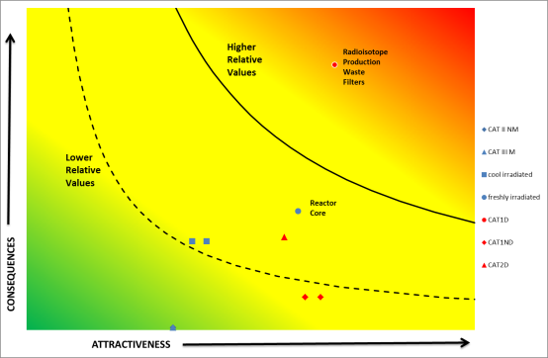
Quantifying Potential Target Attractiveness In Research Reactors And Associated Facilities
A. Sfetsos, J. Tsourounakis, M. Varvayianni, N. Catsaros, NCSRD, Greece
D.R. Ek, C.A. Potter, Sandia National Laboratories, USA
W.C. Schuster, Nuclear Regulatory Commission, USA
G. Bultz, Oak Ridge National Laboratory, USA
S. Adu, O. Abgenorku, Nuclear Regulatory Authority, Ghana
D.S. Shull, International Atomic Energy Agency (IAEA), Vienna, Austria

Slide 2
Objective of CRP J02006 – Task 2
Identify factors for developing a comprehensive normalized ranking scheme for security risk posed by NM/RM considering the unique characteristics of RRAFs.
Develop a methodology to compare seemingly dis-similar types of events (unauthorized removal and/or sabotage) and also different types of NM/RM to support risk informed decisions for improving RRAF physical protection regimes.
Iterative process presented and discussed within CRP and RR Conference

Slide 3
Identified types of events
Unauthorized removal with the intent to construct an improvised nuclear device (IND);
Unauthorized removal which could lead to use in a subsequent radiological dispersal device (RDD);
Unauthorized removal which could lead to use in a subsequent radiological exposure device (RED);
Risk of sabotage to research reactor (RR) nuclear material / core
Risk of sabotage to RR other radioactive materials

Slide 4
Methodology
Assess and quantify “relative risk” through the determination of “Attractiveness of NM/RM” and “Consequences”
Accounting collectively for every possible event per NM/RM Category type.
It does not consider the effectiveness of the physical protection measures or the threat environment
Word Ladder and Scales (VERY LOW / LOW / MEDIUM / HIGH / VERY HIGH)
Notes:
The “word ladder” approach combines relative rating categories with narrative qualitative descriptions and is a more sophisticated scaling to the qualitative type of assessment, using descriptors or qualifiers to describe the attractiveness and consequences ratings, and allowing the elicitation of expert judgement.

Slide 5
Attractiveness Factors Overview
Factor | Relative Scaling
Accessibility | 25%
RRAF location | 10%
Potential to weaponize | 55%
Ease of handling / Detection avoidance | 5%
Portability | 5%

Slide 6
Attractiveness factors - 1
Accessibility: The accessibility to the location of nuclear material/radioactive material (NM/RM) inside the facility by an external adversary is captured by the number of locked boundary layers the material is contained within. The most attractive target is the one with no boundary layers, and the attractiveness value is reduced by adding extra boundary layers.
Attractiveness | 1 - Very Low | 2 - Low | 3 -Medium | 4 - High | 5 - Very High | Relative scaling
Target accessibility | 4 or more layers | 3 layers | 2 layers | 1 layer | no layers | 25%

Slide 7
Attractiveness factors - 2
Facility location: This factor provides an estimation of the attractiveness based on the location of a facility.
Attractiveness | 1 - Very Low | 2 - Low | 3 -Medium | 4 - High | 5 - Very High | Relative scaling
RRAF location | low population density | national monument / iconic site | Major public event | significant agriculture / infrastructures | city centre / highly populated | 10%

Slide 8
Attractiveness factors - 3
Potential to weaponize. The proposed factor is a combination of: a) the relative ease at which a potential adversary can initiate a security event based on NM/RM material type, category and form and b) a composite indicator accounting for all possible types of events that can be initiated by an adversary.
Table below shows relative difficulty to initiate event.
Each type of material has been assigned a relative weighting factor.
Relative Scaling 55%
Event | IND | NM / RM sabotage | RDD | RED
Difficulty to weaponize | 0.5% | 42% | 25% | 32.5%

Slide 9
Attractiveness factors - 4
Ease of handling / detection avoidance, which is linked to the NM/RM radioactivity. Unirradiated nuclear material is perceived as the easiest target type to handle and avoid detection, as compared to high energy gamma emitting (γ) sources that require additional shielding to reduce risk of biological effects and avoid detection.
Attractiveness | 1 - Very Low |  | 3 -Medium |  | 5 - Very High | Relative scaling
ease of handling / detection avoidance | > 1MeV /decay | >0.75 MeV /decay | >0.5 MeV /decay | <0. 5 MeV /decay | Unirradiated nuclear material and other alpha | 5%

Slide 10
Attractiveness factors - 5
The portability factor is linked to the size and weight of the target material and can include shielding. The most attractive material is the one that can be handheld and easily man-portable.
Attractiveness | 1 - Very Low |  | 3 -Medium |  | 5 - Very High | Relative scaling
Portability | Truck |  | Hand Truck |  | Handheld | 5%

Slide 11
Consequences
Human health. These may include casualties (deaths and injuries) caused by the device (e.g. resulting from an explosion) as well as exposure to radiation or intakes of radionuclides.
Economic costs. May include assumed relative cost factors addressing impacts on people, property and the environment and also account for the [scaled] half-life of cool / fresh irradiated NM and RM
A [scaled] thermal power factor also accounts for the RRAF (cool / freshly irradiated NM)
A composite indicator accounting for the consequences for all possible types of malicious actions that can be initiated by an adversary is proposed to contain a weighted estimate of the health (75%) and economic (25%) components.
FINAL VALUE = (75% * HEALTH + 25% * ECONOMIC * HALF-LIFE_SCALE)* THERMAL_POWER_SCALE

Slide 12
Key results
Example application on IAEA virtual facilities
Operator perspective
Hypothetical Atomic Research Institute (HARI).
University Medical Center (UMC)
Shapash Nuclear Research Institute (SNRI)
HARI Security upgrades
Regulator perspective
A comparison of all facilities

Slide 13
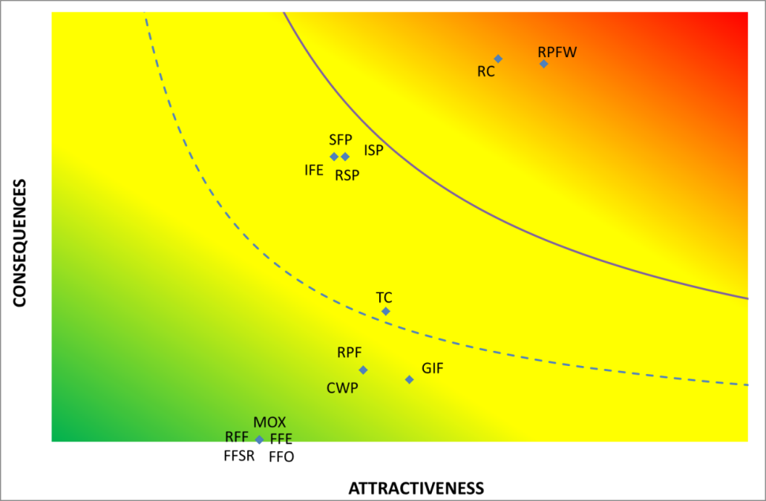
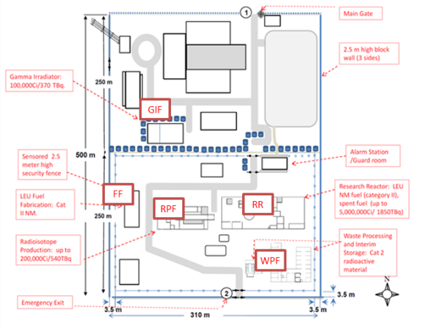
HARI

Slide 14
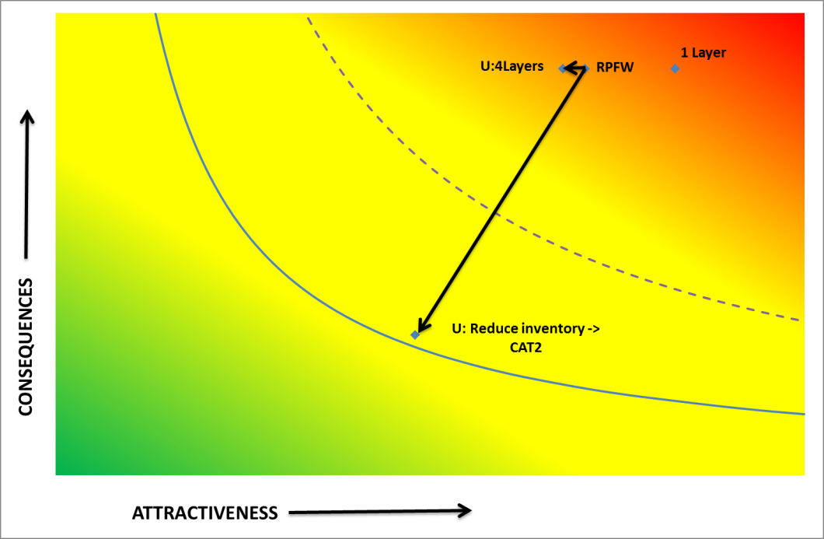
HARI – RPWF Security Upgrades

Slide 15
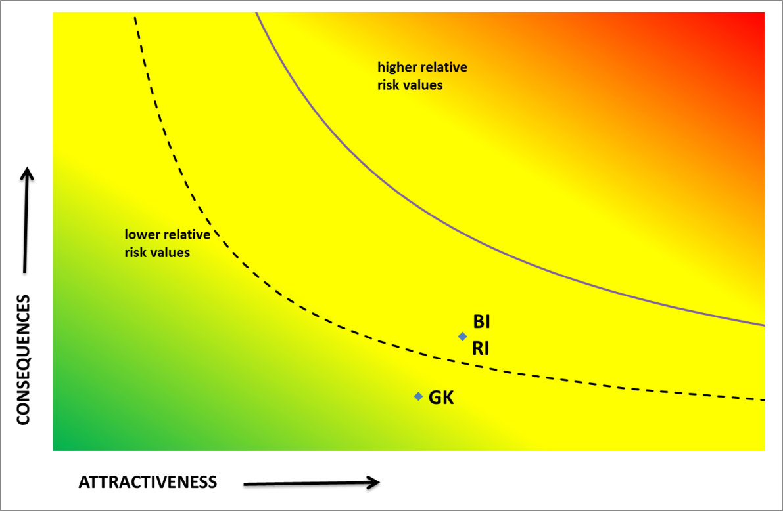
UMC

Slide 16
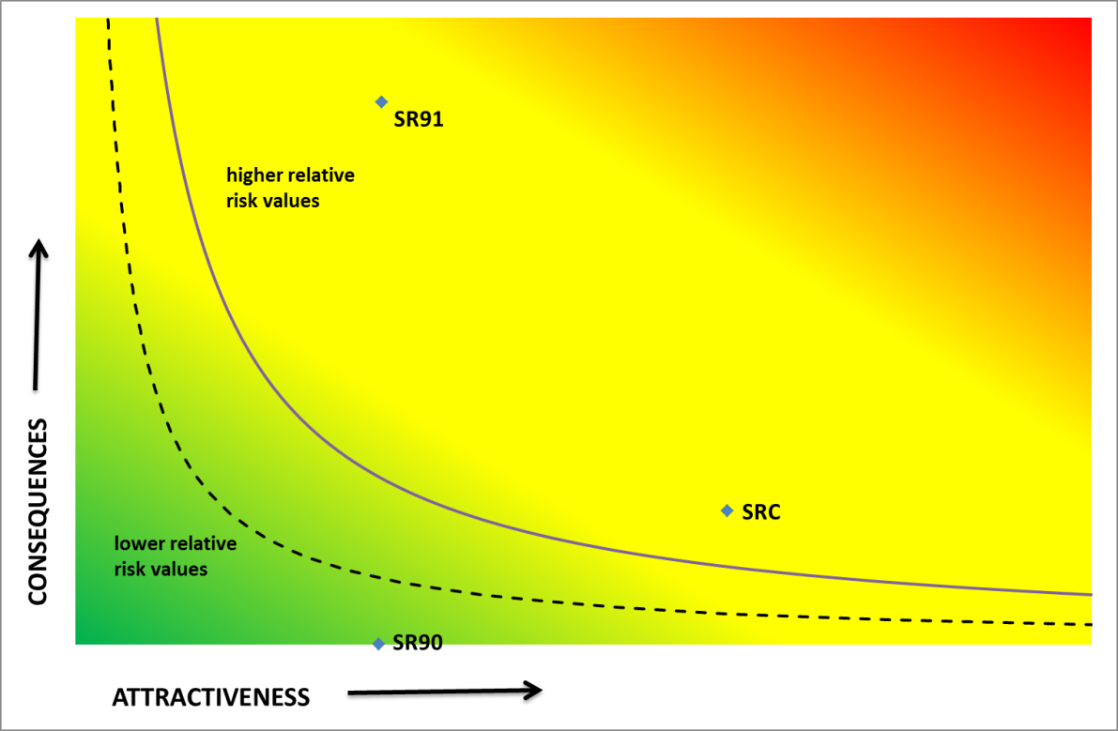
Shapash

Slide 17
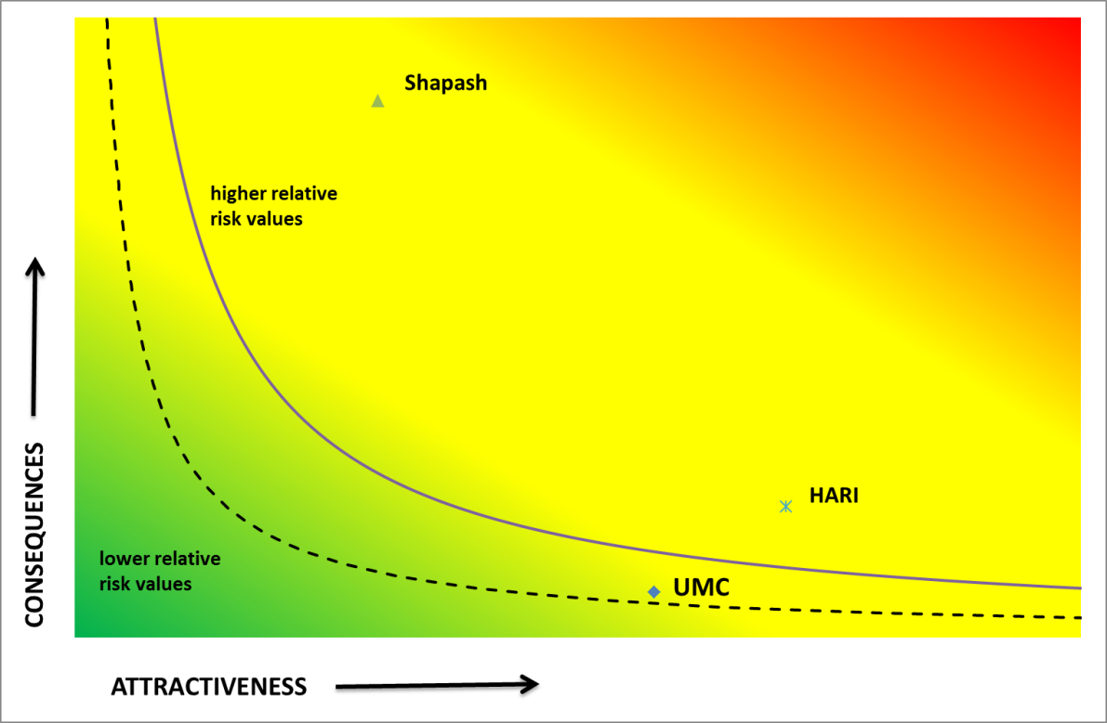
Comparison of facilities

Slide 18
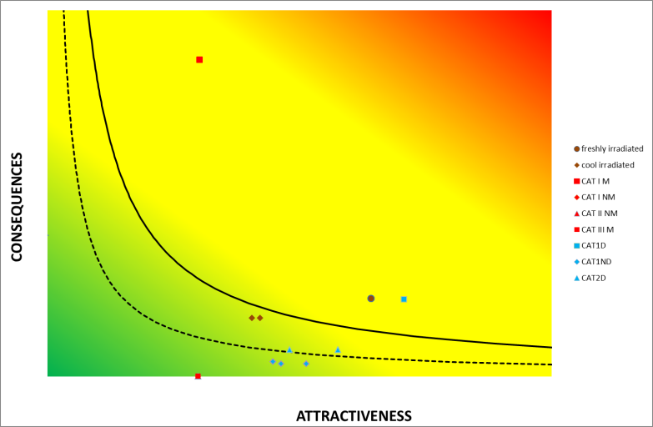
Conclusions
Develop a methodology to compare NM and RM under a common risk ranking scheme
Potential applications can include:
Ranking of respective targets in a RRAF that could be further assessed in terms of vulnerabilities and physical protection measures.
Identification of groups of RN/NM based on the risk ranking scheme that could be considered as higher priority for further analysis of physical protection measures, and risk-informed security upgrades.
Definition of potential targets that could be tested in nuclear security capacity building activities

Slide 19
Many thanks !!!! – Questions
Email: ts@ipta.demokritos.gr
You are cordially invited to the side event “Assessing Attractiveness of Nuclear Materials and Radiological Materials for Research Reactors” Date and Time: Thursday 13 February 2020; 12:30 - 14:00
Venue: Conference Room M5, M Building, Ground Floor
We are seeking your valuable feedback on the merits and suggestions for improvement of the proposed approach.

