Slide 1
Interactive Content Presentation
for the
International Conference on Nuclear Security 2020
THE NUCLEAR SECURITY CONCERNS ABOUT THE RECENTLY DEVELOPED BRAZILIAN NATIONAL NUCLEAR POLICY
National Security Cabinet (GSI)/ Presidency of the Republic of Brazil liliane.silva@presidencia.gov.br
1/14
Notes:
Good afternoon, ladies and gentlemen,
I´m Liliane Ferreira, Geologist and Technical Advisor of the National Security Cabinet to the Brazilian Presidency.
I´m here to talk about what we are doing, in Brazil, as concerns nuclear security regulation.

Slide 2
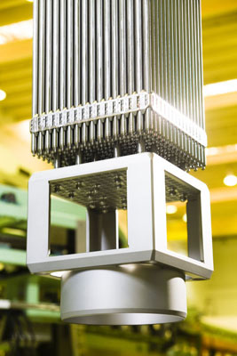
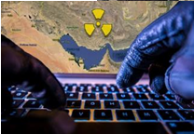
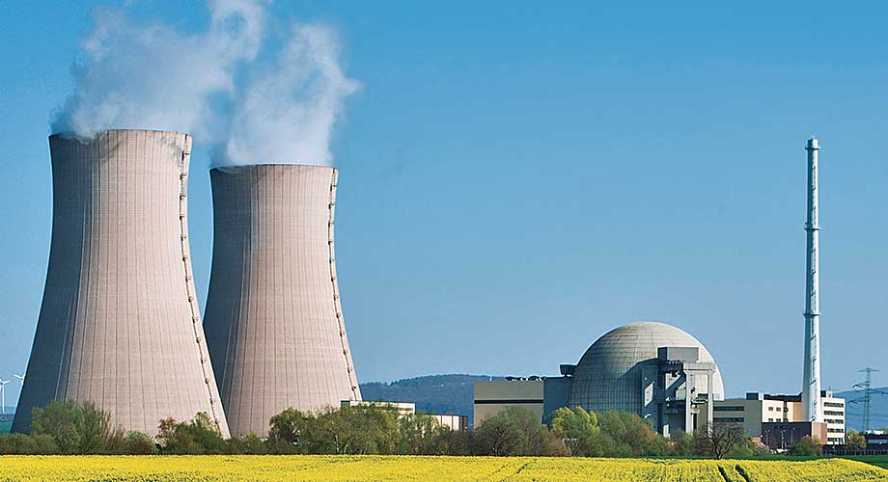
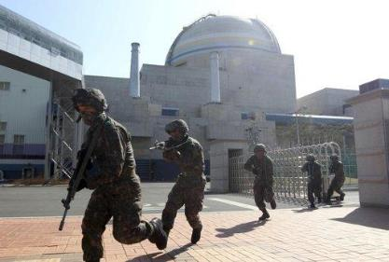
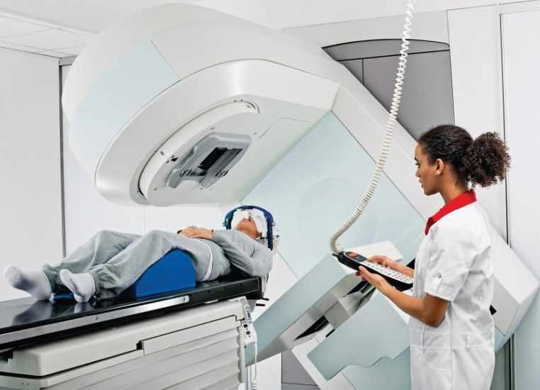
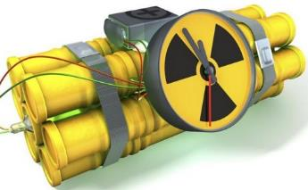
International Conference on Nuclear Security 2020
State
Regulatory
Progress
2/14
Notes:
I will show a little of our evolving in the regulatory aspects since the publication of the Brasilian Nuclear Policy.

Slide 3
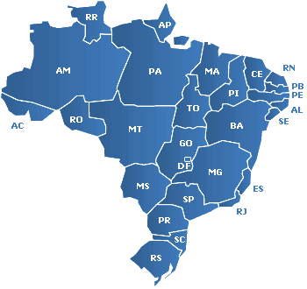
International Conference on Nuclear Security 2020
MAIN NUCLEAR FACILITIES
Consórcio Mineração de Urânio Galvani – INB Santa Quitéria / CE
Unidade de Concentrado de Urânio – INB Caetité / BA
Unidade de Tratamento de Minérios – INB Caldas / MG
Central Nuclear Almirante Álvaro Alberto - Eletronuclear Angra dos Reis / RJ
Fábrica de Combustível Nuclear – INB Resende / RJ
Centro Tecnológico da Marinha em São Paulo - MB Iperó / SP
3/14
Notes:
We have different Nuclear Facilities spread over Brazilian territory.
We can mention as an example: uranium mining in the Bahia Province, nuclear fuel manufacturing and a NPP in Rio de Janeiro, and a research reactor in São Paulo, amongst others.
Besides protecting our Nuclear Facilities we need to protect nuclear material during transport.

Slide 4
International Conference on Nuclear Security 2020
PRESIDENCY OF THE REPUBLIC
The Brazilian Nuclear Sector
National Security Cabinet
Head of CDPNB
Main body of Sipron
MCTIC
MME
MD
MRE
CNEN
Eletronuclear
Air Force
Army
Permanent
Mission at AIEA
INB
NUCLEP
Nuclear Power Plant Admiral Álvaro Alberto
DCTA
CTEX
IPEN
Navy
MMA
MS
DGDNTM
MEC
IBAMA
Nuclear
Medicine
Universities
CTMSP
ANSNQ
4/14
Notes:
This picture shows the structure of the Brazilian Nuclear Sector.
Together with the head of Presidency of the Republic we´ve got the National Security Cabinet, that has two assignments:
To head the BRAZILIAN NUCLEAR PROGRAM DEVELOPMENT COMMITTEE and
To be the central body of the Brazilian Nuclear Program protection system
In addition, we've got Ministries, Agencies, companies, institutions, universities.
MCTIC – Science, Technology, Innovation and Communications Ministry;
MME – Mining and Energy Ministry;
MD – Defense Ministry;
MRE – Foreign Affairs Ministry;
MMA – Environment Ministry;
MS – Health Ministry;
MEC – Education Ministry;
CNEN – Brazilian National Commission for Nuclear Energy;
INB – Nuclear Industries of Brazil;
IBAMA – Brazilian Institute for the Environment and Renewable Natural Resources

Slide 5
International Conference on Nuclear Security 2020
GOVERNMENT ROLE IN NUCLEAR SECTOR
National Security Cabinet
Head of CDPNB
Main body of Sipron
CENTRAL BODY OF THE BRAZILIAN NUCLEAR PROGRAM PROTECTION SYSTEM
COORDINATOR OF THE BRAZILIAN NUCLEAR PROGRAM DEVELOPMENT COMMITTEE
PROTECTION + DEVELOPMENT
OF THE BRAZILIAN NUCLEAR PROGRAM
5/14
Notes:
In short, the National Security Cabinet has got the mission to protect our nuclear facilities and develop our BRAZILIAN NUCLEAR PROGRAM

Slide 6
International Conference on Nuclear Security 2020
BRAZILIAN NUCLEAR PROGRAM DEVELOPMENT COMMITTEE
CDPNB is coordinated by GSI and must, as its mission, advise the Chief of Executive Power, through a high level commitee, on the establishment of guidelines and goals for the development and the monitoring of the BRAZILIAN NUCLEAR PROGRAM, in order to contribute to the NATIONAL DEVELOPMENT and to the promotion of BRAZILIAN SOCIETY WELFARE.
6/14
Notes:
The CDPNB Mission is to assist directly the President of the Republic on the establishment of guidelines and goals for the development and monitoring of the Brazilian Nuclear Program, through a high level group, in order to contribute to national development and to the promotion of the welfare of Brazilian society.

Slide 7
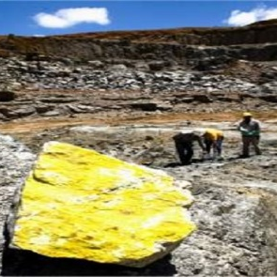
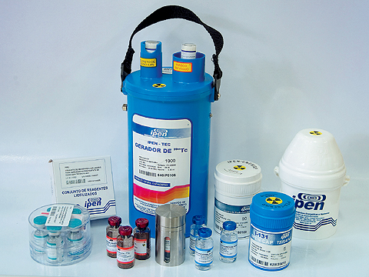
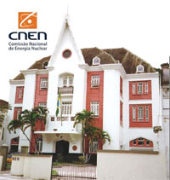
International Conference on Nuclear Security 2020
The Brazilian government brought to the Presidency of the Republic level the nuclear affairs, by the Brazilian National Security Cabinet guidance.
Public policy
Uranium Mining
Nuclear Medicine
Regulatory Structure
Food Irradiation
Waste Management
Human Resources
Social Communication
International Agreements
CTNA
7/14
Notes:
This Committee has got Technical groups to study nuclear affairs and to build proposals for the Nuclear sector.
Each Technical group has got specific members to study different subject, like:

Slide 8
International Conference on Nuclear Security 2020
NATIONAL POLICY
HIGHEST LEVEL DOCUMENT
Use of a macro level approach (“what”);
Target audience: brazilian society;
Document with the longest lifetime as possible; and
Opportunity to point out solutions to current obstacles to the development of the sector.
8/14
Notes:
The Brazilian nuclear sector needed of a high level document to present the principles, guidelines and goals for the development of this sector.
The Brazilian Nuclear Policy was the first proposal of the BRAZILIAN NUCLEAR PROGRAM DEVELOPMENT COMMITTEE .
This Policy was important to promote the reestructuring of the Brasilian nuclear sector And to contribute to the planning of nuclear and radioactive activities in Brazil, in compliance with national sovereignty, focusing on the development and on the protection of human health and the environment.

Slide 9
International Conference on Nuclear Security 2020
Brazilian Nuclear Policy strengthened the Nuclear Security Regime. A National Nuclear Policy must be the first step on the evolving of a nuclear security regulation. Its promulgation can legitimizes and reinforce several and necessary actions to be undertaken and allows to restructure the governance of a State nuclear sector.
9/14
Notes:
Brazilian Nuclear Policy was the first step in the evolution of a nuclear security regulation.
From that Policy we can work with different plans for nuclear affars.

Slide 10
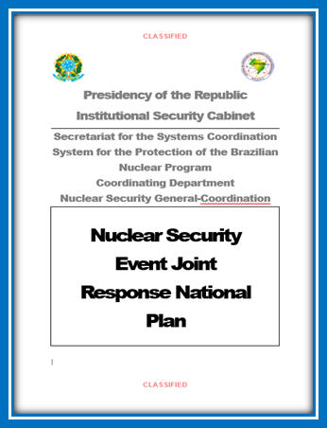
International Conference on Nuclear Security 2020
What are we doing now?
We don't stop at Brazilian Nuclear Policy.
We are working to establish and
implement the Nuclear Security
Event Joint Response National Plan.
10/14
Notes:
The purpose of the Plan is to establish nuclear security guiding principles to responders, within the physical protection of nuclear facilities and transport of nuclear material. The plan will apply to a preventive and an operative phase.
This Plan is in its final phase and will be published in 2020. It contains high level preventive and operative coordinating directives to all nuclear security responders in case of a nuclear security event.
The Plan will be the basis for local arrangements among responders to ensure effective measures to counter hostile acts against nuclear facilities.

Slide 11
International Conference on Nuclear Security 2020
The Plan has the purpose to establish nuclear security guiding principles to responders, within the physical protection of nuclear facilities and transport of nuclear material approach. It contains high level preventive and operative coordinating directives to all nuclear security responders in case of a nuclear security event.
11/14

Slide 12
International Conference on Nuclear Security 2020
This Plan is in its final phase and will be published in 2020.
12/14

Slide 13
International Conference on Nuclear Security 2020
The principles, guidelines and objectives of this Policy will be used to guide the Nuclear Security Event Joint Response National Plan.
The construction of the Brazilian Nuclear Policy was an example of stakeholder involvement in building solid foundations for the development of the nuclear sector.
Brazilian Nuclear Policy will allow the improvement of nuclear safety regulation.
Its promulgation legitimizes and strengthens the Nuclear Security Event Joint Response National Plan.
13/14
Notes:
The Brazilian nuclear sector is experiencing an important moment of restructuring and the Brazilian Nuclear Program Development Committee has been the driving force of these changes.
The construction of the Brazilian Nuclear Policy was an example of stakeholder involvement
In this sense, we recognize that the International Atomic Energy Agency (IAEA) contribution is important to achieve the efficiency of Brazilian nuclear security and safety, by establishing comprehensive guidance and supporting us building technical capacity, including education and training. All the work developed reflects the maturity of the Brazilian Nuclear Sector.

Slide 14
International Conference on Nuclear Security 2020
Thank you!
National Security Cabinet (GSI)/ Presidency of the Republic of Brazil liliane.silva@presidencia.gov.br
14/14

