Slide 1
Interactive Content Presentation
for the
International Conference on Nuclear Security 2020
THE NUCLEAR SECURITY CONCERNS ON THE RECENTLY DEVELOPTED BRAZILIAN NATIONAL NUCLEAR POLICY
National Security Cabinet (GSI)/ Presidency of the Republic of Brazil liliane.silva@presidencia.gov.br
1/14

Slide 2
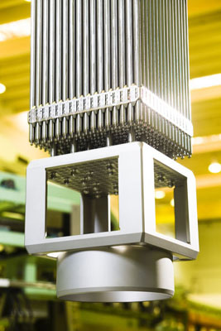
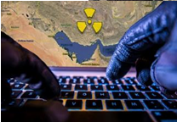
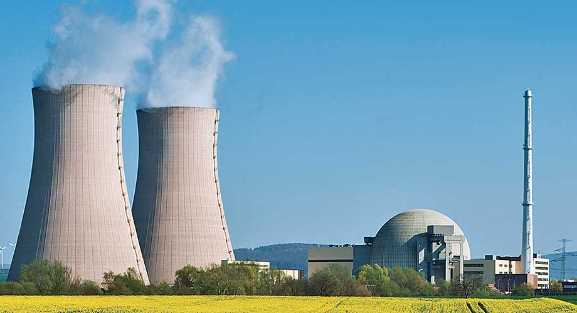
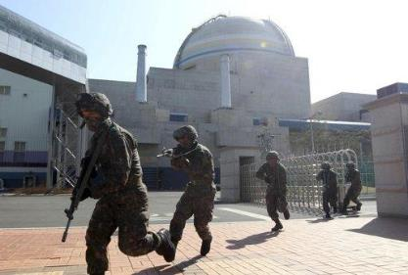
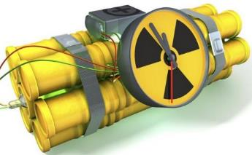
International Conference on Nuclear Security 2020
State
Regulatory
Progress
2/14

Slide 3
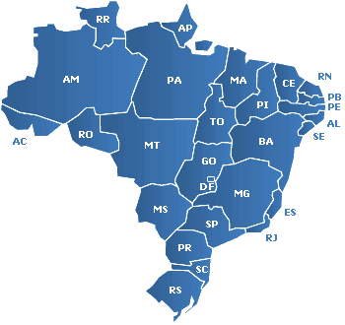
International Conference on Nuclear Security 2020
MAIN NUCLEAR FACILITIES
Consórcio Mineração de Urânio Galvani – INB Santa Quitéria / CE
Unidade de Concentrado de Urânio – INB Caetité / BA
Unidade de Tratamento de Minérios – INB Caldas / MG
Central Nuclear Almirante Álvaro Alberto - Eletronuclear Angra dos Reis / RJ
Fábrica de Combustível Nuclear – INB Resende / RJ
Centro Tecnológico da Marinha em São Paulo - MB Iperó / SP
3/14

Slide 4
International Conference on Nuclear Security 2020
PRESIDENCY OF THE REPUBLIC
The Brazilian Nuclear Sector
National Security Cabinet
Head of CDPNB
Main body of Sipron
MCTIC
MME
MD
MRE
CNEN
Eletronuclear
Air Force
Army
Permanent
Mission at AIEA
INB
NUCLEP
Nuclear Power Plant Admiral Álvaro Alberto
DCTA
CTEX
IPEN
Navy
MMA
MS
DGDNTM
MEC
IBAMA
Nuclear
Medicine
Universities
CTMSP
ANSNQ
4/14

Slide 5
International Conference on Nuclear Security 2020
GOVERNMENT ROLE IN NUCLEAR SECTOR
National Security Cabinet
Head of CDPNB
Main body of Sipron
CENTRAL BODY OF THE BRAZILIAN NUCLEAR PROGRAM PROTECTION SYSTEM
COORDINATOR OF THE BRAZILIAN NUCLEAR PROGRAM DEVELOPMENT COMMITTEE
PROTECTION + DEVELOPMENT
OF THE BRAZILIAN NUCLEAR PROGRAM
5/14

Slide 6
International Conference on Nuclear Security 2020
BRAZILIAN NUCLEAR PROGRAM DEVELOPMENT COMMITTEE
CDPNB is coordinated by GSI and must, as its mission, to advise the Chief of Executive Power, through a high level collegiate, on the establishment of guidelines and goals for the development and the monitoring of the BRAZILIAN NUCLEAR PROGRAM, in order to contribute to the NATIONAL DEVELOPMENT and to the promotion of BRAZILIAN SOCIETY WELFARE.
6/14

Slide 7
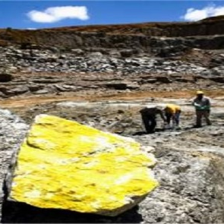
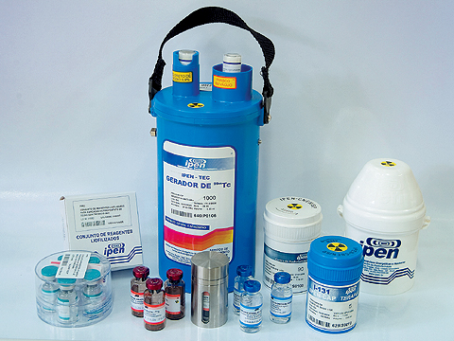
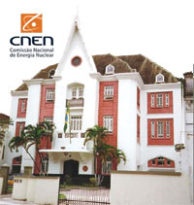
International Conference on Nuclear Security 2020
The Brazilian government brought to the Presidency of the Republic level the nuclear affairs, by the Brazilian National Security Cabinet guidance.
Public policy
Uranium Mining
Nuclear Medicine
Regulatory Structure
Food Irradiation
Waste Management
Human Resources
Social Communication
International Agreements
CTNA
7/14

Slide 8
International Conference on Nuclear Security 2020
NATIONAL POLICY
HIGHEST LEVEL DOCUMENT
Use of a macro level approach (“what”);
Target audience: brazilian society;
Document with the longest lifetime as possible; and
Opportunity to point out solutions to current obstacles to the development of the sector.
8/14
Notes:
vironment

Slide 9
International Conference on Nuclear Security 2020
Brazilian Nuclear Policy strengthened the Nuclear Security Regime. A National Nuclear Policy must be the first step on the evolution of a nuclear security regulation. Its promulgation can legitimizes and reinforce several and necessary actions to be undertaken and allows to restructure the governance of a State nuclear sector.
9/14

Slide 10
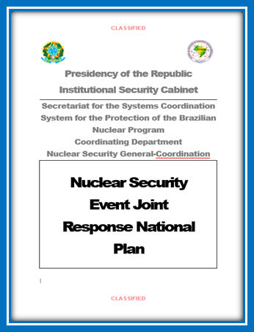
International Conference on Nuclear Security 2020
What are we doing now?
We don't stop at Brazilian Nuclear Policy.
We are working to establish and
implement the Nuclear Security
Event Joint Response National Plan.
10/14

Slide 11
International Conference on Nuclear Security 2020
The Plan has the purpose to establish nuclear security guiding principles to responders, within the physical protection of nuclear facilities and transport of nuclear material approach. It contains high level preventive and operative coordinating directives to all nuclear security responders in case of a nuclear security event.
11/14

Slide 12
International Conference on Nuclear Security 2020
This Plan is in its final phase and will be published in 2020.
12/14

Slide 13
International Conference on Nuclear Security 2020
The principles, guidelines and objectives of this Policy will be used to guide the Nuclear Security Event Joint Response National Plan.
The construction of the Brazilian Nuclear Policy was an example of stakeholder involvement in building solid foundations for the development of the nuclear sector.
Brazilian Nuclear Policy will allow the improvement of nuclear safety regulation.
Its promulgation legitimizes and strengthens the Nuclear Security Event Joint Response National Plan.
13/14

Slide 14
International Conference on Nuclear Security 2020
Thank you!
National Security Cabinet (GSI)/ Presidency of the Republic of Brazil liliane.silva@presidencia.gov.br
14/14

