Slide 1
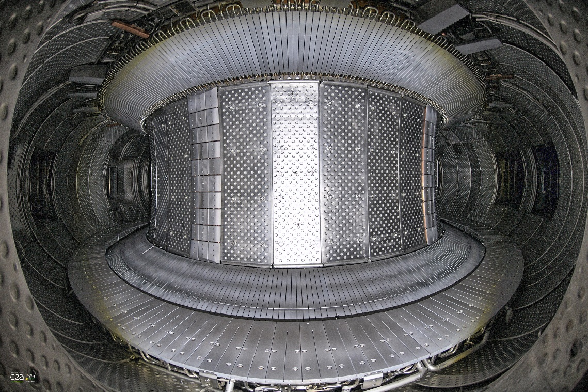



From Tore Supra to WEST: Evolution of the CODAC infrastructure
A. Berne, B. Santraine, N. Ravenel, J. Colnel, G. Caulier , F. Leroux, A. Barbuti, B. Vincent, Y. Moudden and the WEST Team
12th IAEA Technical Meeting on Control, Data Acquisition, and Remote Participation for Fusion Research
IAEA TM 2019

Slide 2
Summary
Introduction
  WEST Project and Timeline
  Tore Supra CODAC system
Evolution of WEST CODAC system
  Motivations and solutions
  Selection and development
  WEST CODAC infrastructure
Results obtained
Conclusion and plan forward
IAEA TM 2019
| PAGE 2

Slide 3
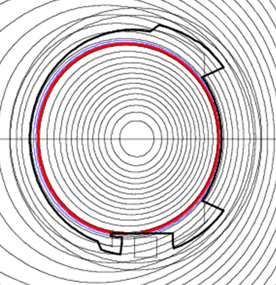
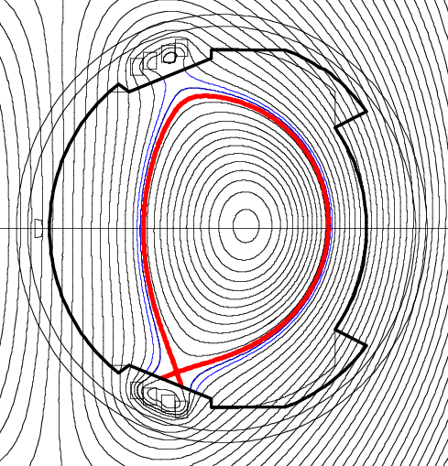
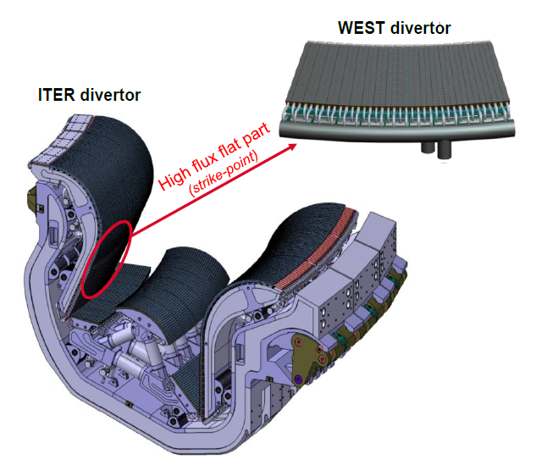
WEST Project
Tore Supra:
Limiter configuration
Carbon PFCs
WEST (W [tungsten] Environment in Steady-state Tokamak)
Tokamak for long pulse operation
Testing and qualifying ITER-like tungsten divertor
Refurbishment of Tore Supra
International platform
In kind procurement with partners
Divertor coils
WEST:
Divertor configuration; Tungsten PFCs
IAEA TM 2019
| PAGE 3

Slide 4
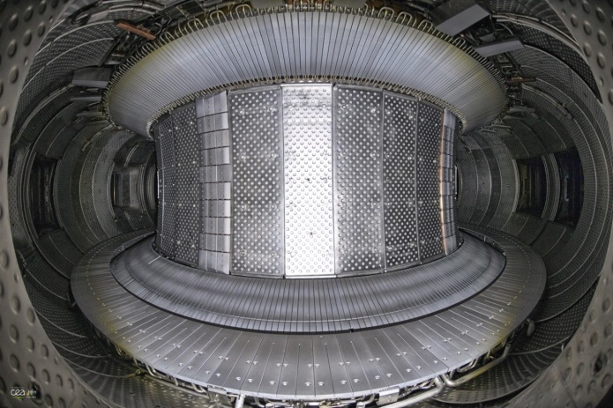
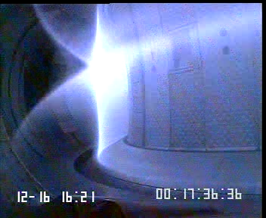
WEST Timeline
Tore Supra [1988 – 2012]: superconducting tokamak for long pulse operation
2013
2014
2015
2016
2017
2018
2019
2020
= Study
= Construction
First X-point
configuration
>30 seconds
discharge
First plasma
= Commissioning
= Experiments
I_{p}/10 (MA)
P_{LHCD} (MW)
nl (10¹⁹m⁻³)
nl_{Div} (10¹⁹m⁻³)
IAEA TM 2019
| PAGE 4

Slide 5
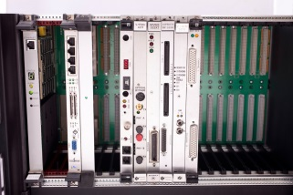

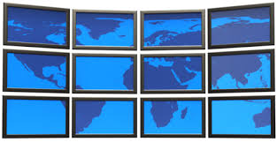

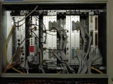
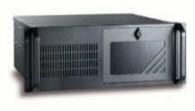
Tore Supra CODAC - Infrastructure
VME Compiler
VME Server
Control Room
Ethernet Network
Real-Time Network
Timing System Network
VME Acquisition Units
PC Acquisition Units
Database
1995 – 2011
2004 – 2012
INTEL acquisition unit: one unit remaining
IAEA TM 2019
| PAGE 5

Slide 6




Tore Supra CODAC – Acquisition unitS
 | VME | Industrial Computer
Operating System | LynxOS Diskless system | Windows XP Local hard drive
Processing Unit | 1 or 2 CPU board | Single processor (possibly multiple cores)
Acquisition boards | VME board | PCI/PCIe board Ethernet boards
Timing System | Home made board | PCIe boards from NI
Real Time (reflective memory) | ScramNet | No support
Number of unit | 26 | 22
Advantages | Centralized system Real Time OS Easy bus analysis | Cheap components (<1k€)
Issues | Obsolescence issue Limited performance Cost (>5k€) | Lack of RT data Hard maintenance No Real Time No bus analyzer available in house
IAEA TM 2019
| PAGE 6

Slide 7
Evolution of the WEST CODAC System
- Motivations and solutions
- Acquisition Units
- Acquisition boards
- Real-time Network
- Timing System Network
- Timeline

Slide 8
Evolution – Why ?
  Motivations for an upgrade:
        Make maintenance easier
        Improve performances (acquisition and computation)
        Reduce cost
        Manage obsolescence
  Solutions:
        Centralized management for acquisition units
        Define a “WEST acquisition unit” reference and upgrade old units
        Change the “Real Time Network”
        Suppliers selection
        Choose “Off-the-shelf” components
IAEA TM 2019
| PAGE 8

Slide 9
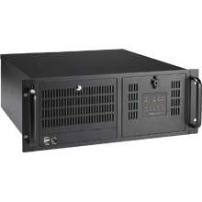
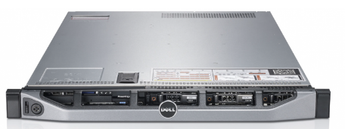
Acquisition Unit – CentrAlized
  PXE (Preboot eXecution Environment):
        The server can host several “Operating System”
        The client recovers the OS at startup and runs it from internal RAM
        Configuration files are used to manage all units:
        PHY Address ➔ IP Address ➔ OS Version ➔ User data
Production Server
PXE Booting Clients
LAN Network
Backup Server
Easier maintenance (configuration, update and replacement)
High risk on server – Higher network traffic
Local disk required for high data throughput
DHCP = Dynamic Host Configuration Protocol / TFTP = Trivial File Transfer Protocol
NFS = Network File System
IAEA TM 2019
| PAGE 9

Slide 10

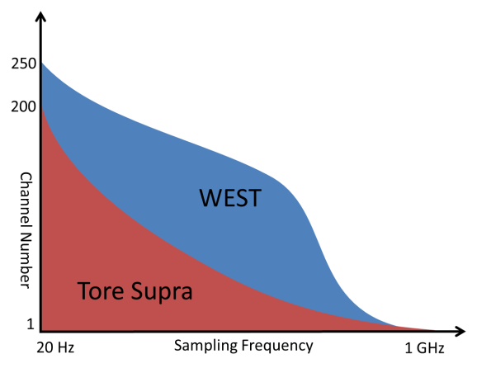
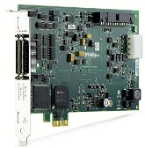
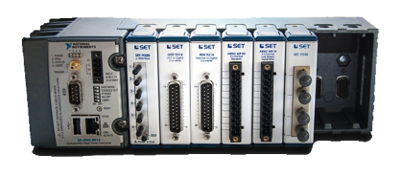
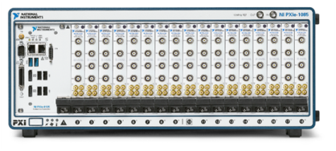





Acquisition Boards
  Supplier selection:
        Performance (number of channel, sampling frequency …)
        Cost
        Linux / Windows support
        Multiple format (PXIe, PCIe, Ethernet)
        Reconfigurable (FPGA)
        ➔ National Instruments ^{tm}
Requirements for WEST
acquisition
PCI/PCIe cRIO PXI/PXIe
  Additionnal suppliers:
        Scientific instruments
        Specific needs
        Collaborations
IAEA TM 2019
| PAGE 10

Slide 11
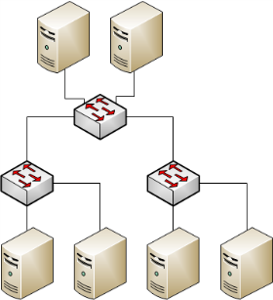

Real-Time Network
  Supplier selection:
        Performance / Cost / Multiplatform
        ➔ Dolphin Interconnect Solutions
  Features:
        Extended star topology
        Flexible network (remove / add nodes)
        1 master ➔ multiple nodes
        Remote monitoring
        Copper (40 Gbps – 5m) or optic link (20 Gbps – 300m)
        High “theoretical” performances
IAEA TM 2019
| PAGE 11

Slide 12
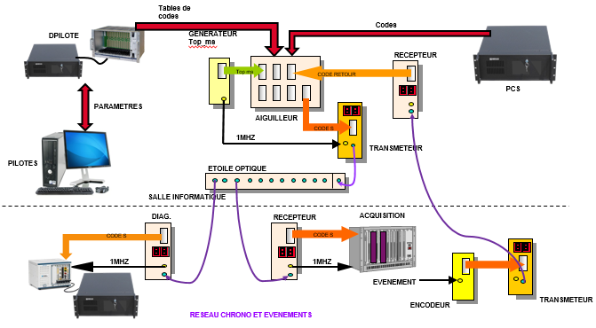
Timing System Network
  Main functionalities:
        Distribution of 1 MHz time-stamping clock
        Distribution of events (shot scheduling, data sampling, trigger, safety …)
        Star topology
        Simplex mode
No modification
New format needed
  Types of boards:
        PXIe: FPGA (VHDL) board from “Marvin Test Solution”
        PCIe: FPGA (LabView) board from “NI”
        PCIe: FPGA (VHDL) board from “Techway”
        ➔ To maintain a single code (VHDL)
IAEA TM 2019
| PAGE 12

Slide 13

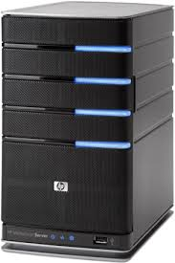
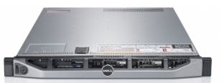

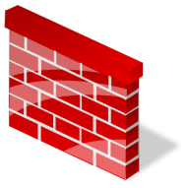
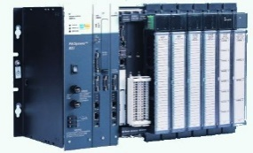
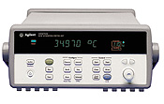
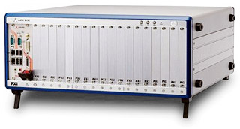
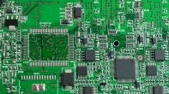
WEST CODAC
Plasma
Control
System
CEA
Network
Linux Boot
Servers
VME Boot
Server
Database
Control Room
Firewall
Ethernet Acquisition Network
Real Time Network
Timing System Network
PCIe/VME
RS232
VME Units
LAN
PCIe/PXIe
GPIO
Win XP

Slide 14
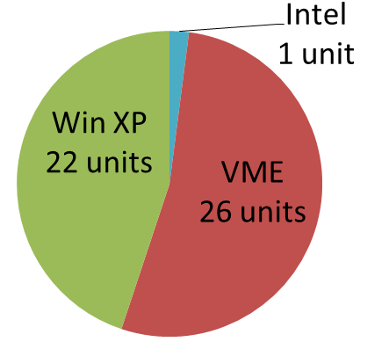
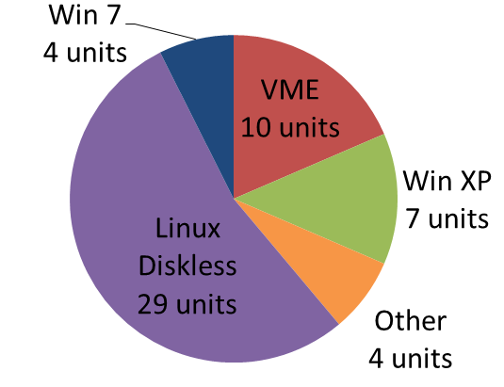
WEST CODAC
  Results:
        WEST preferred solution:
        Linux centralized Operating System
        CentOS 7.5
        All drivers installed: NI, Dolphin, Marvel, Spectrum, CAEN, …
        Wide supported hardware: PCIe/PXIe/VME, GPU, Ethernet, single/dual processor, single module computer …
        Reduction of VME and Win XP units
        Still open for other types of systems (collaboration)
Tore Supra
Units
WEST
Units
IAEA TM 2019
| PAGE 14

Slide 15

WEST CODAC TIMELINE
  Creation of the first centralized OS
  Acquisition Units specifications
  Suppliers selection
  Prototyping acquisition unit
  Test selected solutions
2013
2014
2015
2016
2017
2018
2019
2020
  In Kind Procurement from IPR
  On site collaborators from 2013 to 2018
  Installation and commissioning
  Scientific Operation
  CODAC upgrade and maintenance
  Acquisition units development and improvement
  ≈ 3 new units per year (full upgrade, new diagnostic)
IAEA TM 2019
| PAGE 15

Slide 16
Example of acquisition unit
- standard acquisition unit: Magnetics
- HYBRID acquisition unit: Fueling
- Continuous acquisition unit: Calorimetry

Slide 17
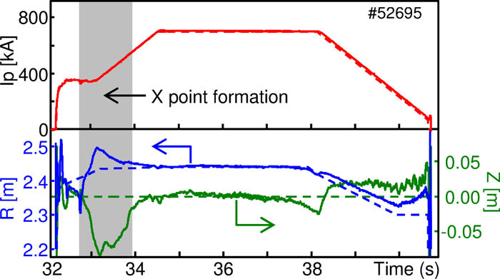
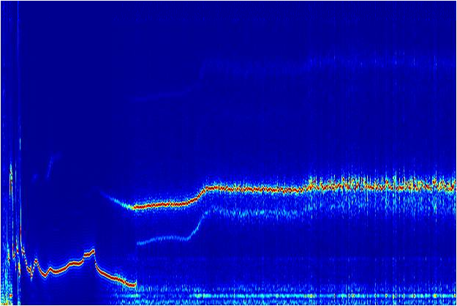
Example - Standard acquisition unit
  Magnetics → Full upgrade :
    PC Linux + PXIe + cRIO
    112 channels @ 1kHz
    96 channels @ 250 kHz
    2 ms time cycle
    Data on Real-Time network for Plasma Control System
    OpenMP computation (plasma boundary reconstruction)
    MHD → Full upgrade :
    PC Linux + PXIe
    More channels (38 → 51)
    Higher sample clock (100kHz → 2MHz)
    Trigger on plasma events
Time evolution of the main plasma
parameters used for the plasma control
10
9
8
7
6
Fréquence (kHz)
5
4
3
2
1
0
2
4
6
8
Temps (s)
Time evolution of the MHD frequency
IAEA TM 2019
| PAGE 17

Slide 18
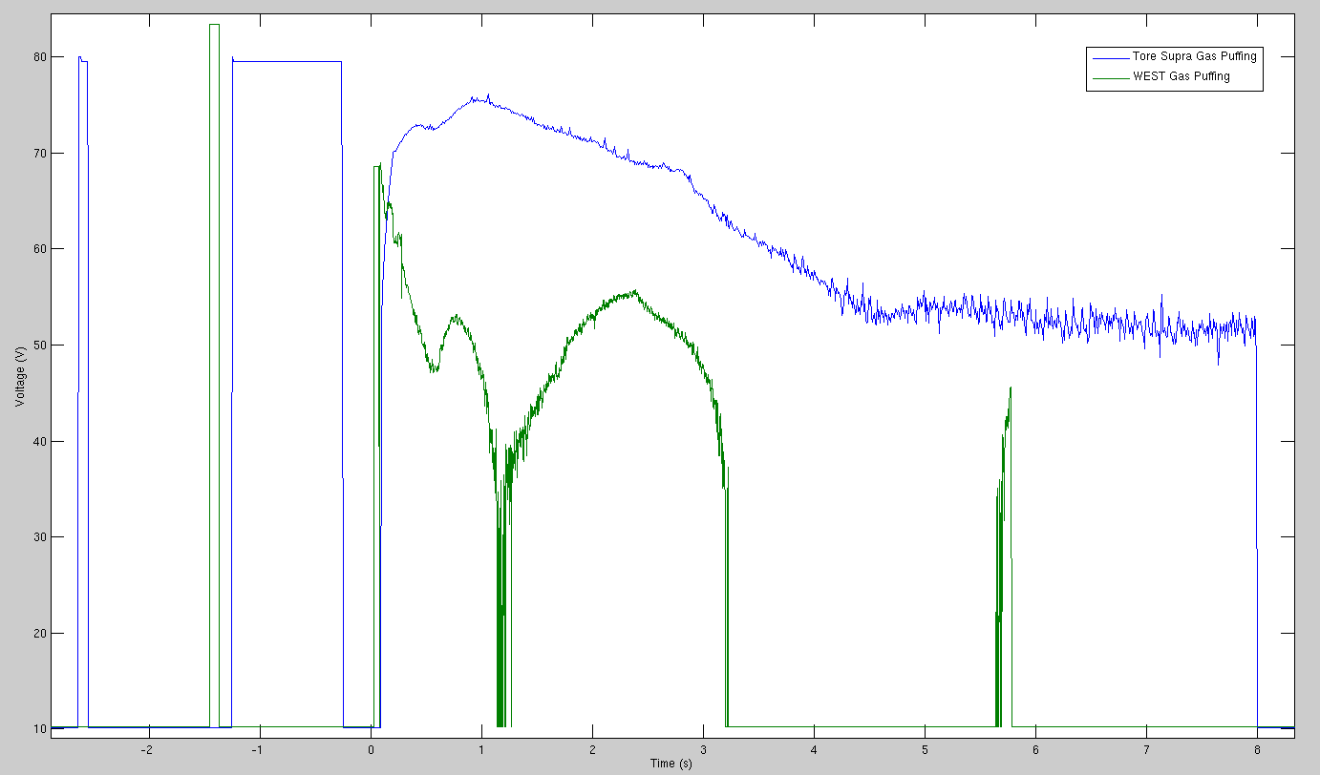
Example - HYBRID acquisition unit
  Fueling → Hybrid upgrade :
    PC Linux + VME
    Keeping VME crate and boards
    Bridge PCIe/VME
    Same channels
    Data on Real-Time network
    Managing CPU obsolescence
  Timing System → Hybrid upgrade :
    PC Linux + VME
    Keeping VME crate and boards
    Time cycle improved (1ms → 500µs)
    Read data on Real-Time network
    Managing CPU obsolescence
IAEA TM 2019
| PAGE 18

Slide 19
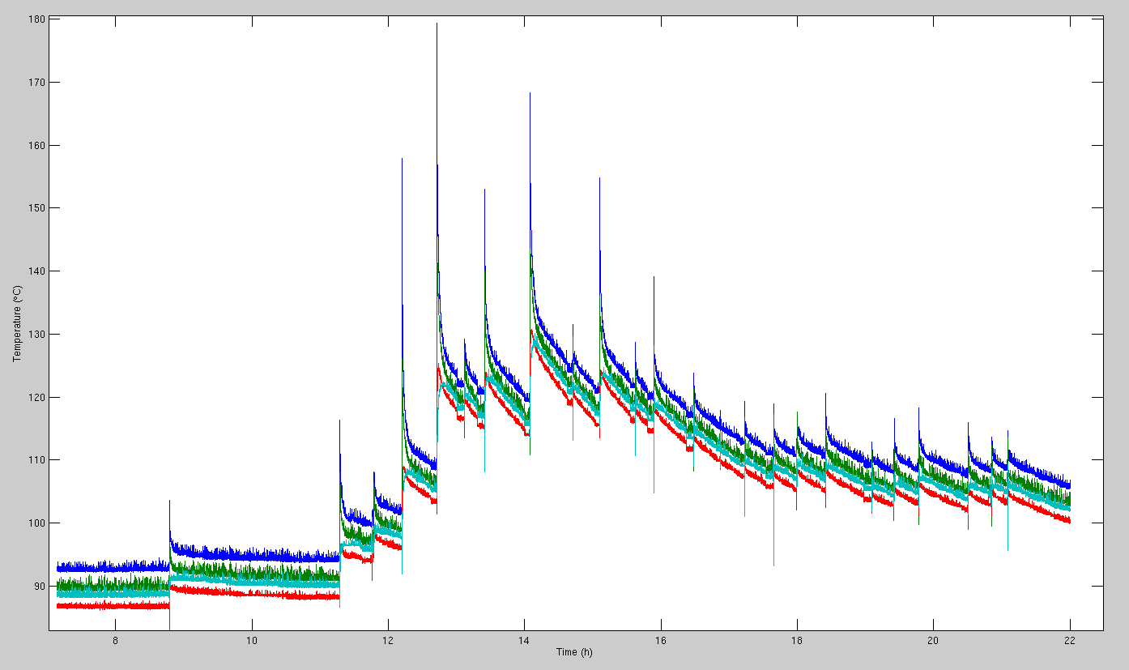
Example - CONTINUOUS acquisition unit
  Calorimetry → Full upgrade :
    PC Linux + 7 x cRIO
    Continuous acquisition of 250+ sensors (T°C + Flow)
    Data on Real-Time network for PCS
    Variable cycle time during day and night
IAEA TM 2019
| PAGE 19

Slide 20
Conclusion and plan forward
        4000+ experiments
        Almost 24/7 operation
        High availability of the CODAC infrastructure
        Easier maintenance (troubleshooting during experiments, Operating System, driver installation, X-compiler)
        Pursue standardization
        Offer advance support (computing with GPU, synchronization with PTP, etc.)
        Improvements (network, middleware, parallel computing)
        Improve Real Time performances (soft patch)
IAEA TM 2019
| PAGE 20

Slide 21
DRF
IRFM
STEP
Thank you for your attention
Commissariat à l’énergie atomique et aux énergies alternatives
Centre de Cadarache | 13108 Saint Paul Lez Durance Cedex
T. +33 (0)4 42 25 62 25 | F. +33 (0)4 42 25 26 61
  Etablissement public à caractère industriel et commercial | RCS Paris B 775 685 019

