Slide 1
Lessons Learned in Planning for the Removal of Spent Nuclear Fuel from Shutdown Nuclear Power Plant Sites in the US
Steven J. Maheras
International Conference on the Management of Spent Fuel from Nuclear Power Reactors: Learning from the Past, Enabling the Future
June 24-28, 2019
Vienna, Austria

Slide 2
Disclaimer
This is a technical presentation that does not take into account contractual limitations under the Standard Contract for Disposal of Spent Nuclear Fuel and/or High-Level Radioactive Waste (10 CFR Part 961). For example, under the provisions of the Standard Contract, DOE does not consider spent fuel in multi-assembly canisters to be an acceptable waste form, absent a mutually agreed to contract amendment. To the extent discussions or recommendations in this presentation conflict with the provisions of the Standard Contract, the Standard Contract provisions prevail.
This presentation reflects research and development efforts to explore technical concepts which could support future decision making by DOE. No inferences should be drawn from this presentation regarding future actions by DOE.

Slide 3
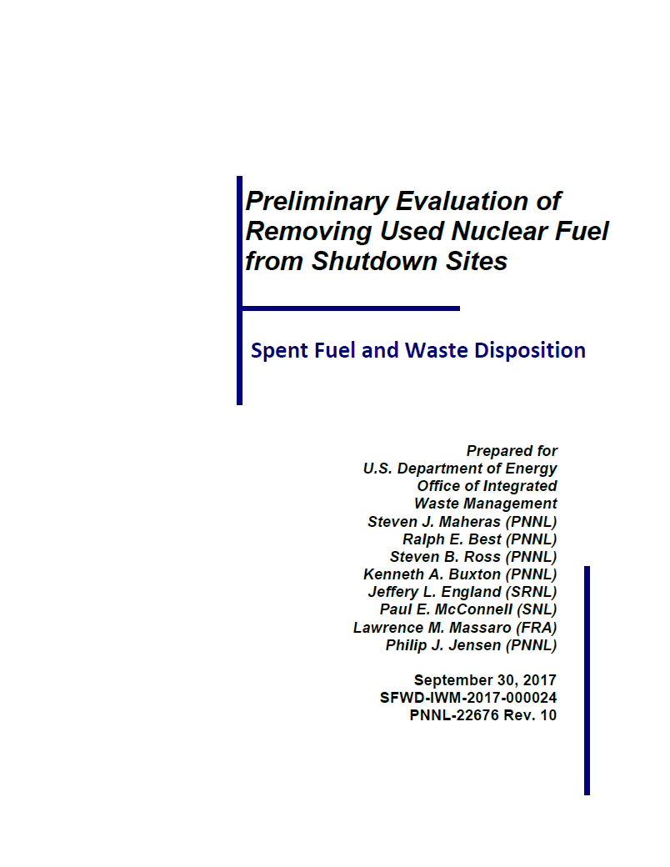
Nuclear Power Plant Site Evaluations
The purpose of site evaluations is to support planning for removing spent nuclear fuel (SNF) and greater-than-Class C (GTCC) waste from nuclear power plant sites
Site inventory
Site conditions
Near-site transportation infrastructure and experience
Identify gaps in information needed to ship SNF and GTCC waste from the nuclear power plant sites
Based on the available information, identify options for transporting SNF and GTCC waste from nuclear power plant sites

Slide 4
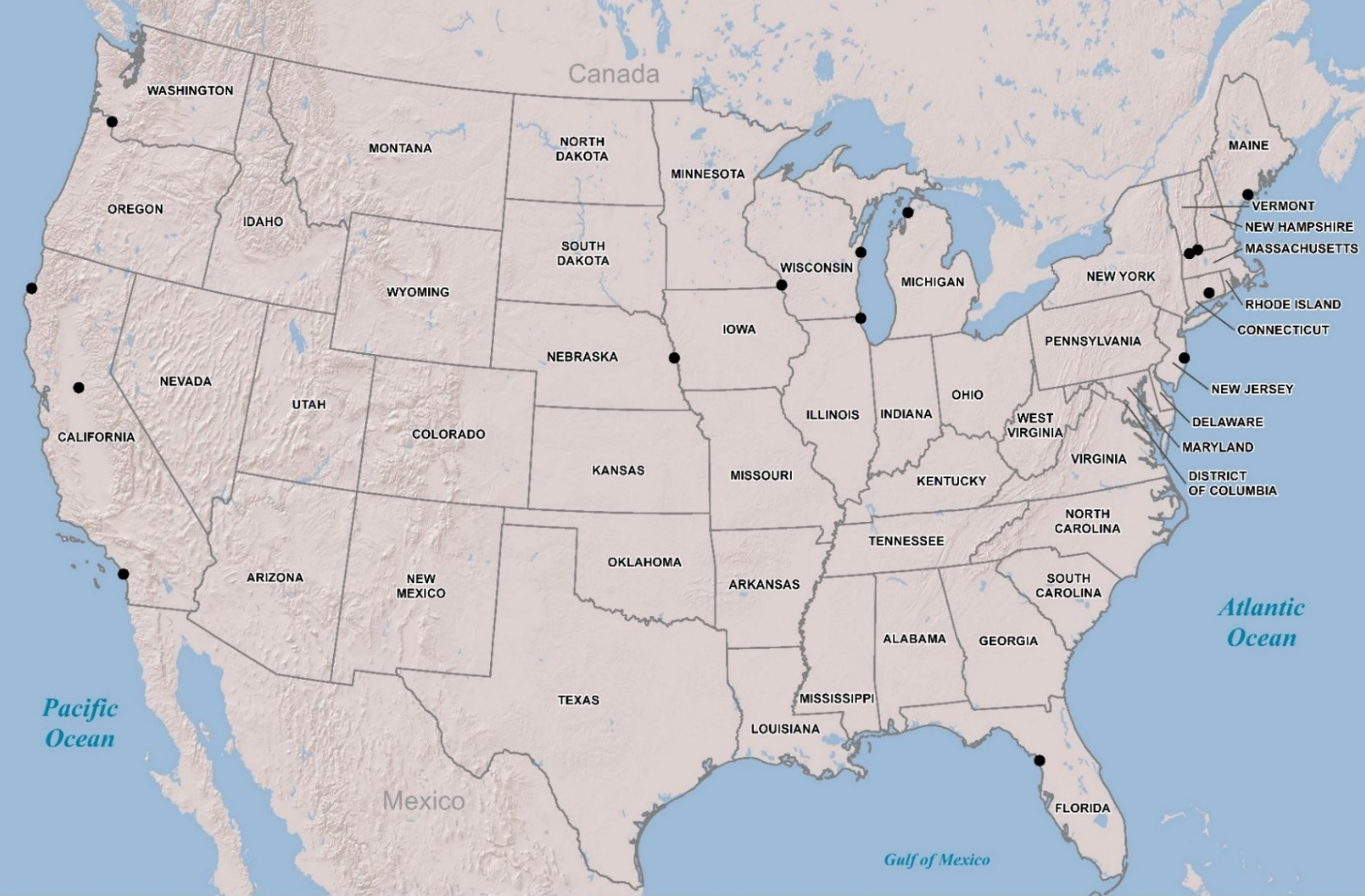
Current Shutdown Nuclear Power Plant Sites
There will be 648 total canisters (609 SNF, 39 GTCC waste) at 15 shutdown sites
There are 12 dry storage systems in use at the shutdown sites; 10 transportation cask models would be used to remove SNF and GTCC waste from the sites
Trojan SNF 34; GTCC 0
Kewaunee SNF 38; GTCC 2 (Estimated)
Big Rock Point SNF 7; GTCC 1
Vermont Yankee SNF 58; GTCC 2 (Estimated)
Maine Yankee SNF 60; GTCC 4
Humboldt Bay SNF 5; GTCC 1
La Crosse
SNF 5; GTCC 0
Yankee Rowe SNF 15; GTCC 1
Rancho Seco SNF 21; GTCC 1
Fort Calhoun SNF 40; GTCC 2 (Estimated)
Connecticut Yankee
SNF 40; GTCC 3
Zion SNF 61; GTCC 4
Oyster Creek SNF 63; GTCC 2 (Estimated)
San Onofre SNF 123; GTCC 11 (Estimated)
NAC System SNF 205; GTCC 12
ORANO System SNF 198; GTCC 21
Holtec System SNF 199; GTCC 5
Key
SNF – spent nuclear fuel canisters
GTCC – canisters of greater-than-Class C waste
Crystal River SNF 39; GTCC 5 (Estimated)
EnergySolutions System SNF 7; GTCC 1

Slide 5
The Site Evaluation Process
Planning starts before site closes when site research begins
GC-859 spent nuclear fuel database
Environmental Impact Statements and Environmental Impact Reports
Facility Interface Data Sheets (FIDS), Services Planning Documents (SPDs), Facility Interface Capability Assessment reports (FICAs), and Near-Site Transportation Infrastructure reports (NSTIs)
Local newspaper articles, industry publications (StoreFuel)
Google Earth imagery
Site visit is scheduled after site closes and fuel is removed from the reactor vessel
Schedule site visit before staff begin to depart
Develop list of participants
U.S. Department of Energy and National Laboratory staff
Tribal and state representatives, State Regional Group representatives, and Federal Railroad Administration representatives

Slide 6
The Site Evaluation Process
Develop agenda with the site, local railroads, and community engagement panel
Typical site visit is three days
Develop list of questions for the site
General site questions
Operating and shutdown spent nuclear fuel management
Site heavy load transportation experience, and on-site and near-site large/heavy load transportation infrastructure and capabilities
Cultural affiliation and tribal involvement
Submit to site one month before visit
Continuous coordination with the site and among participants required
Hotels, logistics, security paperwork, etc.
Sharing of information and data before and after site visit facilitated by using CURIE website
Write report
Draft site sections provided to sites for review

Slide 7
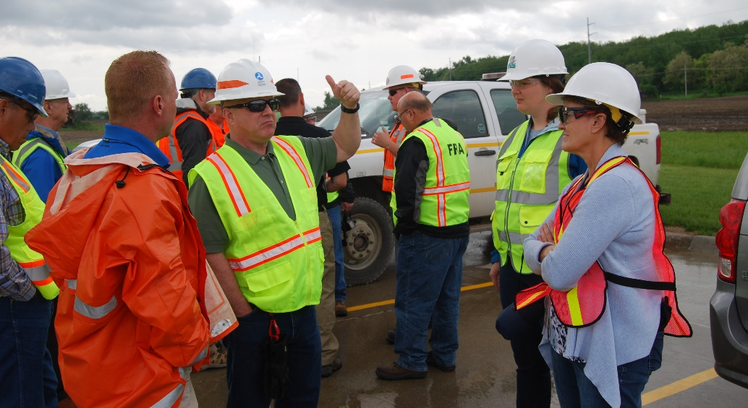
Site Evaluation Lessons Learned #1
Importance of Safety
Site visits involve field work in nuclear and railroad environments
The railroad environment in particular has unique hazards
For this reason, morning safety briefings are conducted each day of a site visit
Personal protective equipment is worn, as appropriate

Slide 8
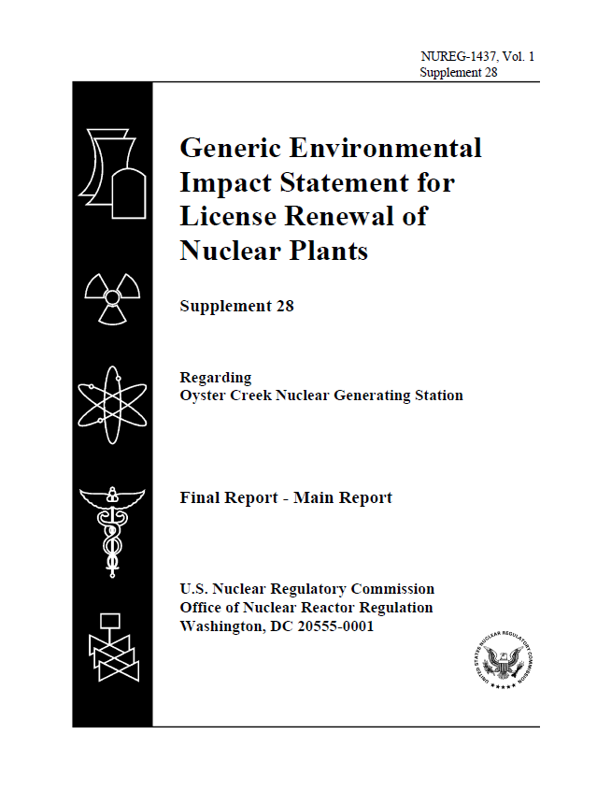
Lessons Learned #2
Importance of Preparation
The success of a site visit depends greatly on the background research performed prior to the site visit
This preparation takes the form of collecting and reviewing the data sources collected during site research
Site-specific questions are developed and submitted to the site approximately one month prior to the visit.
Each shutdown site visit team member is typically assigned an area of responsibility and prepares the questions for their area

Slide 9
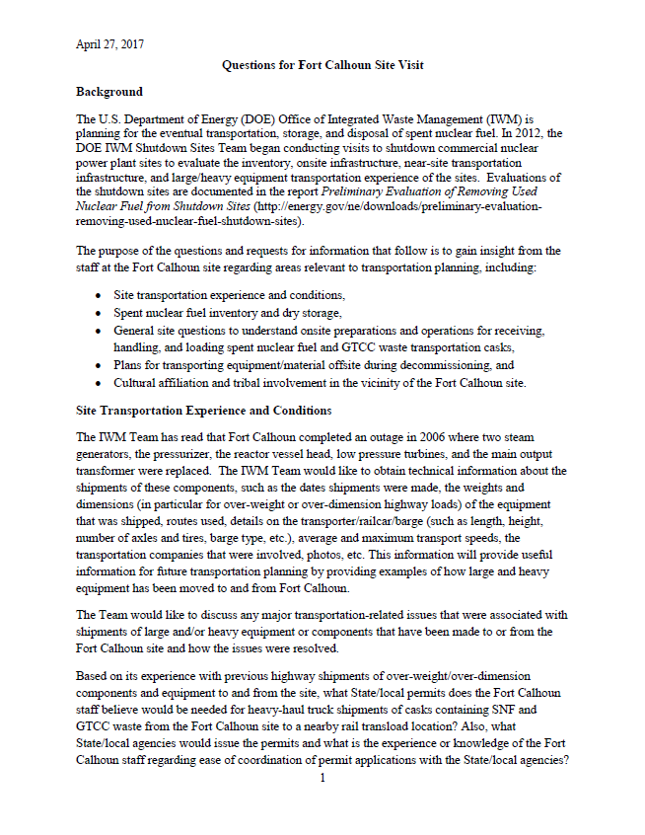
Lessons Learned #3
Length of Questions Submitted to the Sites
The length of the site-specific questions submitted to the shutdown sites has varied between 2-8 pages
Based on experience from the site visits, the optimum number of pages to gather necessary information without overwhelming the site staff, appears to be 4-6 pages

Slide 10
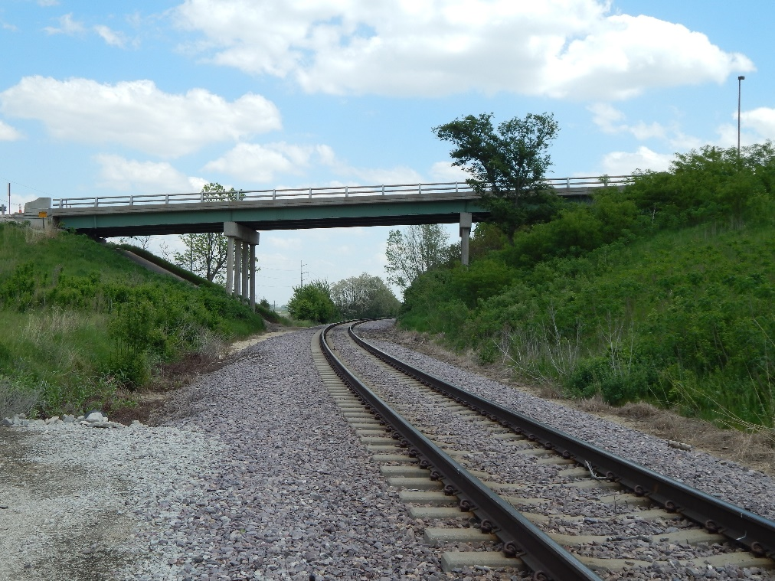
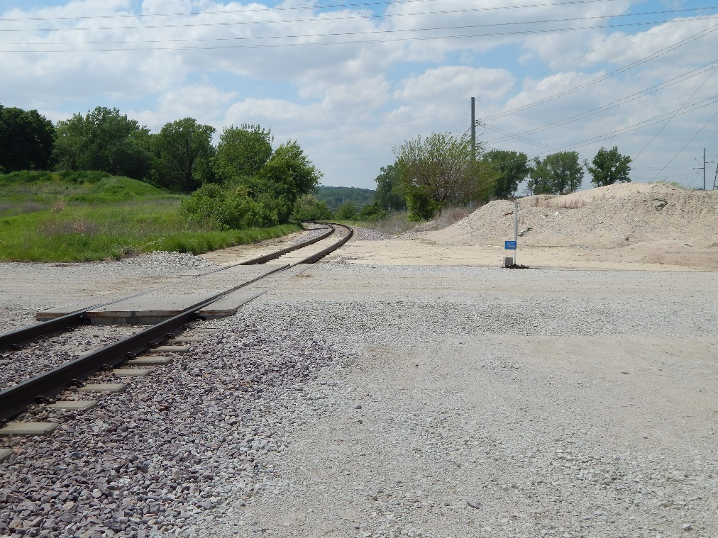
Lessons Learned #4
Importance of Photographs to Provide Documentation of Site Conditions
Photographs taken during the site visits have been important in documenting conditions that exist to the shutdown sites
Photographs are typically geo-tagged to enable the files to be easily imported into DOE’s Stakeholder Tool for Assessing Radioactive Transportation (START) web-geographic information system to visualize transportation routes and features like potential transload sites

Slide 11
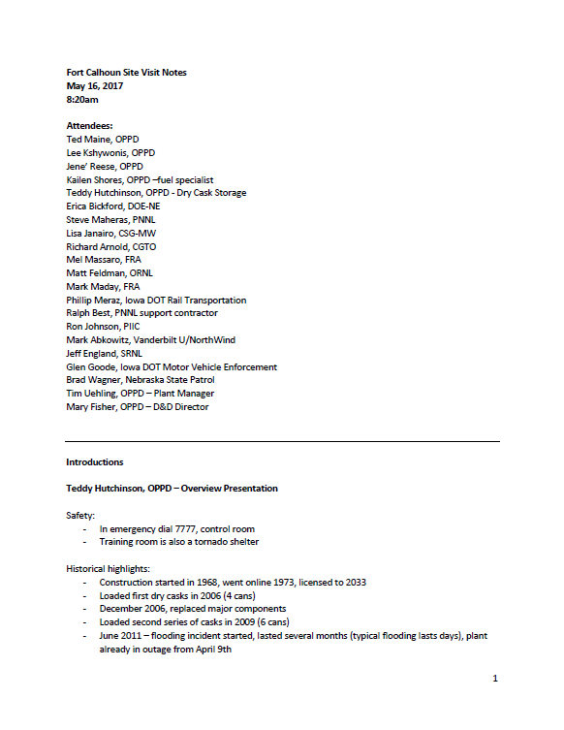
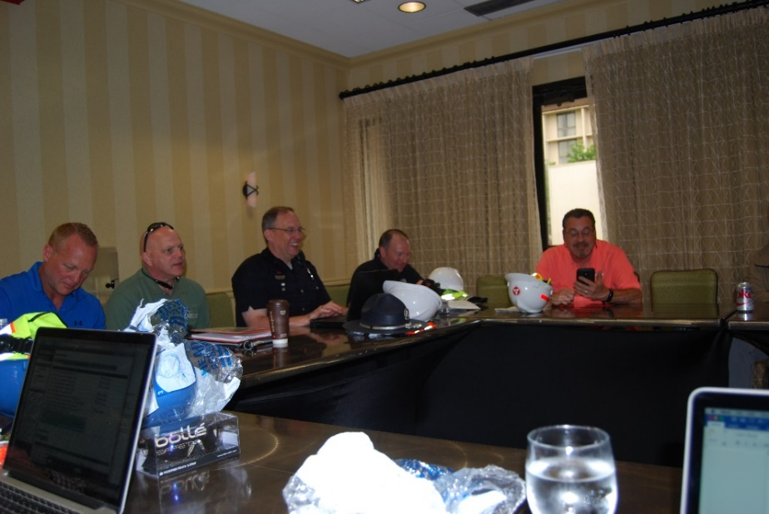
Lessons Learned #5
Importance of Compiling Notes at the Conclusion of Each Day
It has been the practice to review and compile the groups’ notes from the site visits at the conclusion of each day, so that memories and recollections are fresh
Done most efficiently in a group setting using a projector and screen

Slide 12
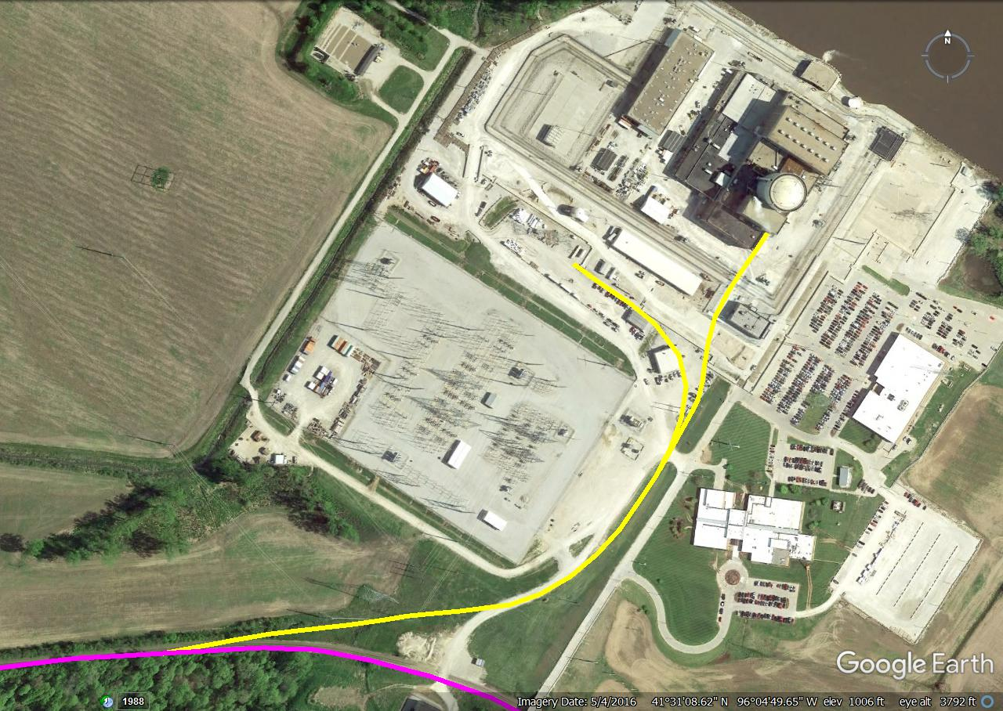
Lessons Learned #6
Importance of Tools such as Google Earth
The availability of tools such as Google Earth has eliminated the need for paper maps
The imagery contained in Google Earth enables commercial nuclear power plant sites, independent spent fuel storage installations, roads, rail lines, potential transload locations, and barge slips or docks to be easily identified, mapped, and distances determined
Former Onsite Rail Spur
Cargill
Rail Spur

Slide 13
Lessons Learned #7
Importance of Identifying Issues associated with the Spent Nuclear Fuel Inventory
US Nuclear Regulatory Commission regulation 10 CFR 72.48 allows changes to be made in an independent spent fuel storage installation or spent nuclear fuel storage cask design as described in the final safety analysis report (FSAR); or in the procedures described in the FSAR; and conduct tests or experiments not described in the FSAR—provided that certain conditions are met
In addition, licensees may also request exemptions from the U.S. Nuclear Regulatory Commission (NRC) from the requirements contained in 10 CFR Part 72.
Making these changes or exemptions granted could result in a dry storage canister not being transportable as the canister might not meet the requirements contained in 10 CFR Part 71

Slide 14
Lessons Learned #8
Importance of Capturing Data and Experience Shortly After Shutdown
The number of site personnel reduces dramatically, from roughly 600-800 to 120-150 in the 18-month period following shutdown
Further personnel reductions to less than 50 on-site may be encountered if the site decides to move the facility into long-term safe storage before decommissioning begins years later
Therefore, the collection of the data from the site could represent a challenge if data collection is delayed
Some data may no longer be available, due to the site closure and staff departures

Slide 15
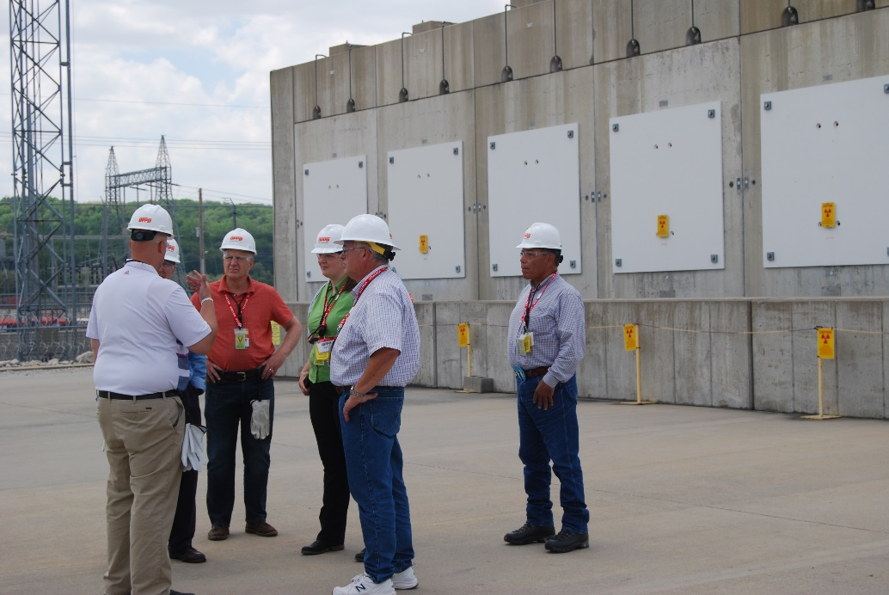
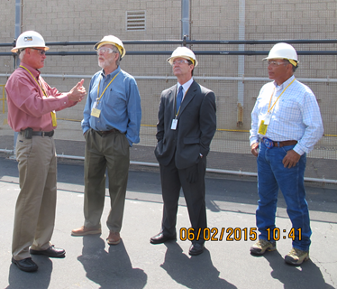
Lessons Learned #9
The Importance of Building Relationships with the Shutdown Sites
A key part of the shutdown site evaluations is the information obtained from personnel at the sites
Site personnel have provided:
Data on spent nuclear fuel to augment the data contained in the GC-859 and RW-859 spent nuclear fuel databases
Information on how large components were shipped on and offsite
Photographs of past activities at their sites
The opportunity to directly observe onsite infrastructure, spent nuclear fuel storage installations, and near-site transportation infrastructure
The opportunity to take photographs at the site, which provides documentation of site conditions

Slide 16
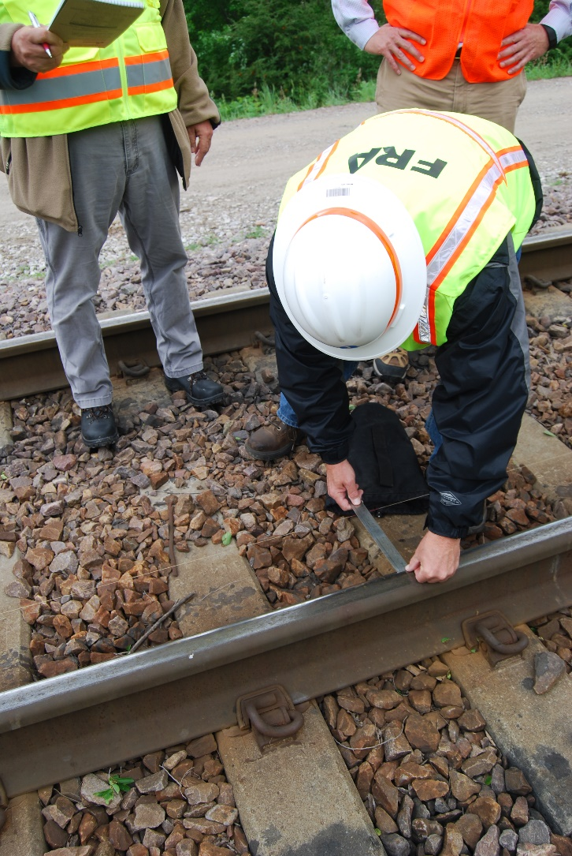
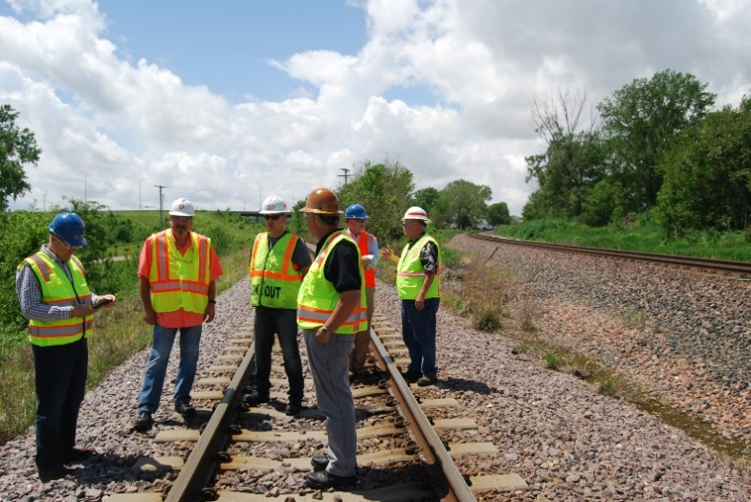
Lessons Learned #10
Importance of Including Tribal and State Representatives, State Regional Group Representatives, and Federal Railroad Administration (FRA) Representatives in the Site Visits
FRA and State Rail Safety Participation Program representatives provide expertise in the five primary railroad safety technical disciplines—track, motive power and equipment, operating practices, signals and train control, and hazardous materials
FRA also coordinates meetings with the rail carriers that serve the shutdown sites
State representatives typically represent their state department of energy, state department of environmental or natural resources, state police, state department of transportation, radiation protection organization, or emergency management organization, and provide expertise in these areas
Tribal representatives provide expertise associated with cultural affiliation and tribal involvement with past and present site activities

Slide 17
Future Shutdown Nuclear Power Plant Sites (2019-2025)
Pilgrim (2019)
Perry (2021)
Palisades (2022)
Duane Arnold (2021)
Davis-Besse (2020)
Diablo Canyon (2024 and 2025)
Beaver Valley (2021)
Indian Point (2020 and 2021)
Three Mile Island (2019)

Slide 18
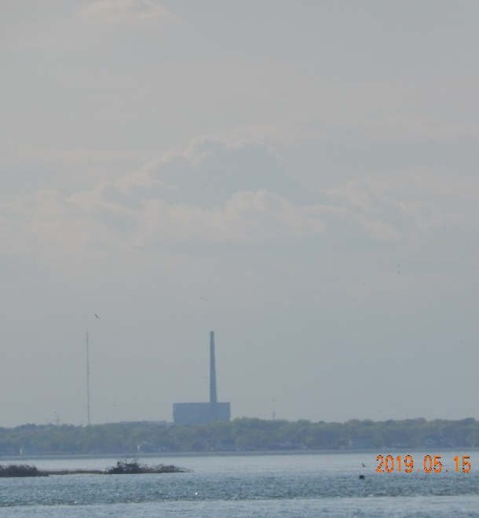
Future Work – Nuclear Power Plant Site Evaluations
New version of shutdown sites report (SSR) due on November 30, 2019
Oyster Creek will be added to the new shutdown sites report
Planning for Pilgrim and Three Mile Island site visits will start in FY2019
Pilgrim will be visited in Fall 2019/Spring 2020 (estimated)
TMI will be visited in Spring 2020 (estimated)
Continuing to collect data on conditions at the sites
Additional SNF discharge data
Additional information on storage systems in use at the sites
Additional information on the local transportation infrastructure and transload locations around the sites
Potential visits to Maine Yankee, Connecticut Yankee, and Yankee Rowe Summer/Fall 2019 to evaluate rail infrastructure
FRA not included in original site visits
Planning for additional sites will occur as they shut down, such as Indian Point, Davis-Besse, Duane Arnold, Perry, Beaver Valley, Palisades, and Diablo Canyon
Photo courtesy of Pacific Northwest National Laboratory

Slide 19
Questions?

