Slide 1
TRANSPORTATION CASK AND CONCRETE MODULE DESIGN FOR MANAGING NUCLEAR SPENT FUEL PRODUCED IN BUSHEHR NUCLEAR POWER PLANT
A.M. TAHERIAN
Iran Radioactive Waste Management Company Co. (IRWA)
ataherian@aeoi.org.ir

Slide 2
Spent Fuel Management Policy
Fresh Fuel
Closed Fuel Cycle
Nuclear Power
PERCEPTION
POLICY
(Asset )
Recycle
SPENT FUEL
Do & See
(Liability)
Disposal
Open Fuel Cycle
2

Slide 3
Spent Fuel Management Steps

Slide 4
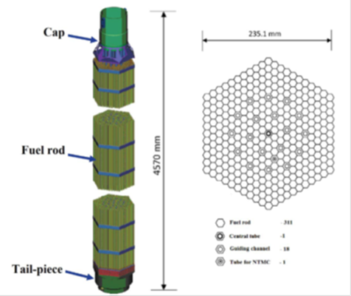
Power Plant and Fuel Specification
Bushehr Nuclear Power Plant:
Officially opened: Sep 2011
Commercially operated: Sep 2013,
Russian type VVER 1000/446,
Reactor core: 163 fuel assemblies fuel assemblies
fuel life time: 3 up to 4 years
Up to now: 3 refueling in reactor core (3*163 fuel assemblies)

Slide 5
Source Terms Calculation
Considerations for determining source term:
47000 MWD/MTU burnup,
4.2 % enrichment,
3 up to 4 years’ fuel life time,
3 and 6 years cooling time

Slide 6
Source Terms Calculation
Energy (MeV) | Gamma Flux (photons/sec) |  | Energy (MeV) | Gamma Flux (photons/sec)
 | After 3 years | After 6 years |  | After 3 years | After 6 years
0.01~0.05 | 4.85E+15 | 2.1E+15 | 1.33~1.66 | 3.03E+14 | 1.06E+15
0.05~0.10 | 1.10E+15 | 4.82E+14 | 1.66~2.00 | 1.49E+14 | 2.22E+14
0.10~0.20 | 1.14E+15 | 5.72E+14 | 2.00~2.50 | 6.70E+12 | 6.45E+12
0.20~0.30 | 9.54E+14 | 4.12E+14 | 2.50~3.00 | 1.94E+13 | 1.51E+12
0.30~0.40 | 6.52E+14 | 2.72E+14 | 3.00~4.00 | 1.75E+11 | 6.93E+10
0.40~0.60 | 6.83E+14 | 3.00E+14 | 4.00~5.00 | 2.07E+10 | 8.98E+09
0.60~0.80 | 5.42E+14 | 2.21E+14 | 5.00~6.50 | 6.18E+04 | 48270000
0.80~1.00 | 3.04E+14 | 1.25E+14 | 6.50~8.00 | 7.00E+03 | 5567000
1.00~1.33 | 3.70E+15 | 4.24E+15 | 8.00~10.0 | 7.98E+02 | 639600
Total Gamma Flux:
1.44E+16 photons/sec for 3 years cooling time
1.04E+16 photons/sec for 6 years cooling time
PHOTON FLUX SPECTRUM AFTER 3 AND 6 YEARS COOLING TIME FOR 12 FUEL ASSEMBLIES

Slide 7
Source terms
(α, n) reaction |  |  | Spontaneous fission
Radionuclides | per fuel element (neutrons/sec) |  | Radionuclides | per fuel element (neutrons/sec)
 | After 3 years | After 6 years |  | After 3 years | After 6 years
PU-238 | 3.50E+06 | 3.45E+06 | PU-240 | 1.22E+06 | 1.22E+06
PU-239 | 1.16E+05 | 1.16E+05 | PU-242 | 9.97E+05 | 9.97E+05
PU-240 | 2.31E+05 | 2.32E+05 | CM-242 | 2.54E+06 | 1.34E+05
AM-241 | 4.60E+05 | 6.89E+05 | CM-244 | 1.21E+09 | 1.12E+09
AM-243 | 3.30E+04 | 3.30E+04 | CM-246 | 1.57E+07 | 1.57E+07
CM-242 | 5.24E+05 | 2.77E+04 | CF-252 | 7.23E+06 | 4.27E+06
CM-243 | 4.56E+04 | 4.34E+04
CM-244 | 1.01E+07 | 9.31E+06
NEUTRON SOURCE DUE TO (α, n) REACTION AND SPONTANEOUS FISSION AFTER 3 AND 6 YEARS COOLING TIME FOR 12 FUEL ASSEMBLIES

Slide 8
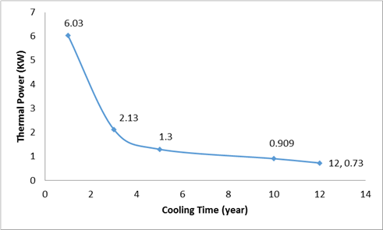
Source Terms Calculation
Thermal power results:
2.13 kW after 3 years cooling time,
considered for cask design.
1.2 kW after 6 years cooling time
taken into account for module design.
Thermal power for spent fuel assembly after removing from the core

Slide 9
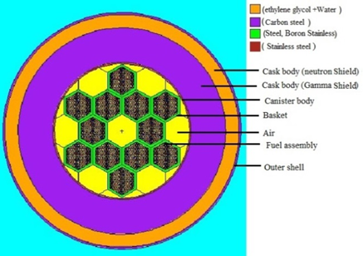
Principal Specifications of Cask and Canister
Component |  |  | Value | Component | Value
Basket
 | Thickness (cm) |  | 2
 | Material |  | Borated Stainless Steel
Canister |  |  |  | Cask (inner body)
 |  | Thickness (cm) | 1.5 | Thickness (cm) | 33.5
 |  | Inner diameter (cm) | 130 | Inner diameter (cm) | 133
 |  | Outer diameter (cm) | 133 | Outer diameter (cm) | 200
 |  | Thickness of Top Lid (cm) | 25.4 | Thickness of Outer Top Lid (cm) | 26.6
 |  | Thickness of Bottom Lid (cm) | 20 | Material | Carbon Steel
 |  | Material | Stainless Steel
Neutron absorber |  |  |  | Cask (Outer Shell)
 |  | Thickness (cm) | 12.7 | Thickness (cm) | 2
 |  | Inner diameter (cm) | 200 | Inner diameter (cm) | 225.4
 |  | Outer diameter (cm) | 225.4 | Outer diameter (cm) | 229.4
 |  | Material | Ethylene Glycol (67%) | Material | Carbon Steel

Slide 10

Dose Rate and Criticality Calculation for Canister and Cask
Distance | Dose rate (mSv/hr)
surface | 5.23E+05
1 m from the surface of the Canister | 1.74E+05
2 m from the surface of the Canister | 8.22E+04
dose measurement Location | Gamma dose rate (µSv/h) | Neutron dose rate (µSv/h) | Total dose rate (µSv/h)
Outer surface of Cask | 10.10 | 1.08E-01 | 10.21
2 m from surface of Cask | 4.54 | 2.02E-02 | 4.56
The neutron multiplication factor and its relative error were obtained about 0.31463 and 0. 019% for cask filled by the air.

Slide 11
Dose Rate and Criticality Calculation for Canister and Cask

Slide 12
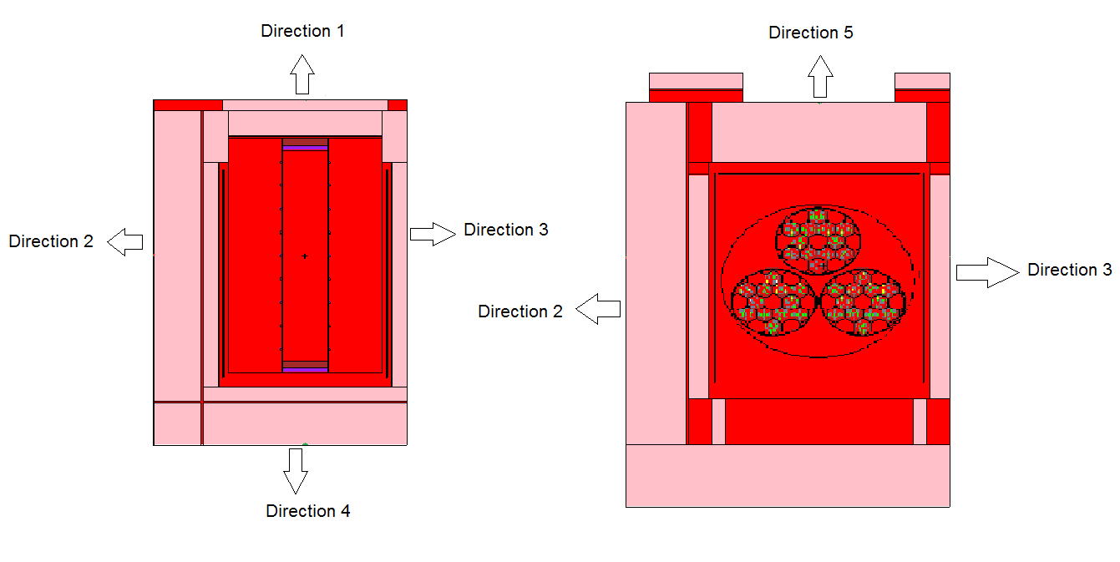
Designing Concrete Module
Item | Value (cm)
Base/roof width | 417
Base/roof length | 652
Base upper side wall thickness | 30.5
Base upper rear wall thickness | 30.5
Roof thickness | 135
Rear/end (side) shield wall thickness | 114.44
Rear/end (side)/corner shield wall height | 564
End (side) shield wall length | 297
Corner shield wall width (square) | 114.44
Door inner steel plate thickness | 2.5
Door concrete thickness (centerline) | 50,67

Slide 13
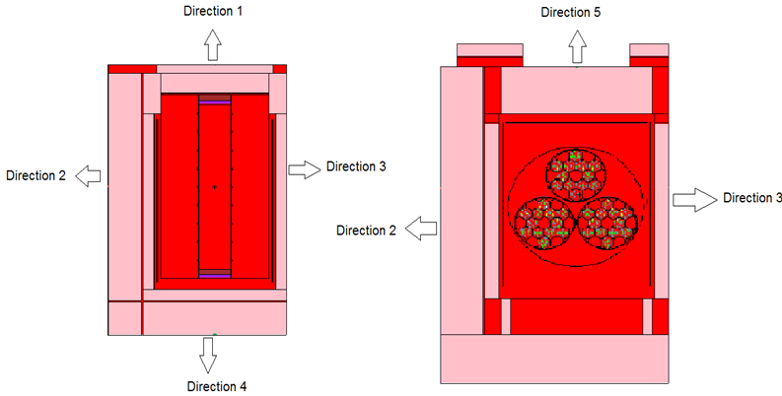
Dose Rates in 5 Directions in Concrete Module
Location | Distance (m) | Dose rate (mSv/hr)
 |  | Before adding another module
Direction No. 1 | On the surface | 0.011
 | 1 m from the surface | 0.027
 | 2 m from the surface | 0.030
Direction No. 2 | On the surface | 0.0007
 | 1 m from the surface | 0.0005
 | 2 m from the surface | 0.0004
Direction No. 3 | On the surface | 4.3399
 | 1 m from the surface | 2.1914
 | 2 m from the surface | 1.2152
Direction No. 4 | On the surface | 0.00010
 | 1 m from the surface | 0.00194
 | 2 m from the surface | 0.00421
Direction No. 5 | On the surface | 0.0043
 | 1 m from the surface | 0.1861
 | 2 m from the surface | 0.1923

Slide 14
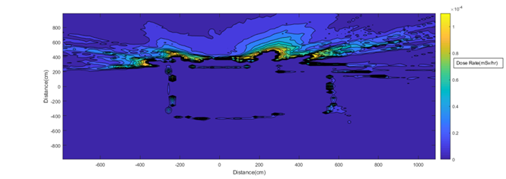
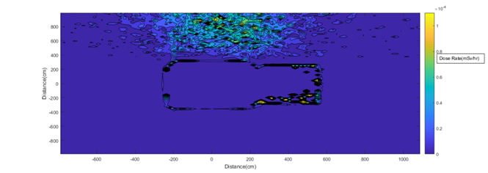
Dose Rates in 5 Directions in Concrete Module
Location | Distance (m) | Dose rate (mSv/hr)
 |  | Before adding another module
Direction No. 3 | On the surface | 4.3399
 | 1 m from the surface | 2.1914
 | 2 m from the surface | 1.2152
Direction No. 5 | On the surface | 0.0043
 | 1 m from the surface | 0.1861
 | 2 m from the surface | 0.1923

Slide 15
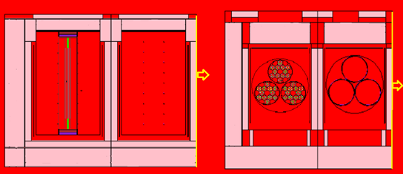
Dose Rates in 5 Directions in Concrete Module
Location | Distance (m) | Dose rate (mSv/hr) | Dose rate (mSv/hr)
 |  | Before adding another module | After adding another (new) module
Direction No. 1 | On the surface | 0.011
 | 1 m from the surface | 0.027
 | 2 m from the surface | 0.030
Direction No. 2 | On the surface | 0.0007
 | 1 m from the surface | 0.0005
 | 2 m from the surface | 0.0004
Direction No. 3 | On the surface | 4.3399 | 0.0321
 | 1 m from the surface | 2.1914 | 0.0206
 | 2 m from the surface | 1.2152 | 0.0154
Direction No. 4 | On the surface | 0.00010
 | 1 m from the surface | 0.00194
 | 2 m from the surface | 0.00421
Direction No. 5 | On the surface | 0.0043
 | 1 m from the surface | 0.1861
 | 2 m from the surface | 0.1923

Slide 16
Summary of Results and Conclusions
Determination of the source term for spent nuclear fuel, designing the canister and cask for transportation, designing the concrete module for storing spent fuel were carried out using Origen 2.1 and MCNPX 2.6.
Canister:
thickness of the stainless steel: 2 cm
Dose rate on the canister surface: 3.95E+08 mSv/hr
on 1 meter from the surface: 1.32E+08 mSv/hr
2 meters from the surface:6.24E+07 mSv/hr
at the top of the canister: 7.07E+03 mSv/hr
Thermal power:
for each spent fuel assembly after 3 years: 2.13 kW
for each spent fuel assembly after 6 years: 1.2 kW

Slide 17
Summary of Results and Conclusions
Cask:
The thickness of carbon steel: 35.5 cm
The neutron multiplication factor: 0.31463 for the cask filled by the air
Dose rate on the cask surface: 10.21 µSv/h
2 meters from the surface: 4.56 µSv/h
Concrete module
inlet and outlet vents have a crucial role in the dose rate around the module
maximum dose rates on the surface: 0.011 mSv/hr for front side (door side)
maximum dose rates 2 meters from the surface: 0.192 mSv/hr for roof side
The relative errors were less than 10% for all calculations.

Slide 18
Future Activities
Simulation of fire test, drop tests (9m and 2m) and submersion in water for transportation Cask
Study of Dual purpose cask (DPC) as a alternative option

