Slide 1
Educating Policy Students in Nuclear Forensics George M. Moore PE PhD JD Scientist-in-Residence James Martin Center for Nonproliferation Studies Monterey Institute of International Studies A Graduate School of Middlebury College International Conference on Advances in Nuclear Forensics: Countering the Evolving Threat of Nuclear and Other Radioactive Material out of Regulatory Control Vienna July 7-10, 2014

Slide 2
What is a Policy
Student?
Why should we
educate them?

Slide 3
Policy Students are those students who will become diplomats, politicians, managers, etc.—these are decision makers
Most are non-technical—if they are grad students they probably studied international relations, government, pre-law, etc. as an undergraduate
A small group will have technical backgrounds, but many have had no math or science since high school

Slide 4
They are bright and good students, but most lack fundamentals of science.
ax=b implies x=b/a
3 x 10³ 5E-02 N(t)=N(0)e^{-(.693t/T)}
Monterey experience

Slide 5
Why education of Policy Students is important
Because they may have a great potential downstream impact on sustainability of nuclear forensics programs
Because they have or are the general public and public understanding of nuclear forensics is lacking
So, why are almost all programs geared to technical students?

Slide 6
How to educate
Policy Students

Slide 7
There are two basic issues
What to teach
How to teach it
What to teach
Scope of nuclear forensics
Basic science—but needs broad introduction and must be grounded
International organizations and domestic organizations and their roles
Don’t forget the “forensics” bit

Slide 8
What to teach
How much science vs. how much policy (or lack thereof)
Monterey syllabus
How to teach
Opinion—lecture is now the best course format—seminar may be preferable
Concepts need to be taught at a high (overview ) level

Slide 9
How to teach
Basic science will need to be covered as will definitions
One of my declared objectives is not to make the students nuclear forensics experts, but to give them the background and language to talk to experts and read reports
Perhaps thinking of it as a language course is helpful
Importance of case studies
Texts?

Slide 10
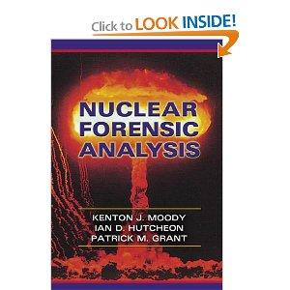
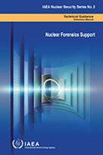

Slide 11
Texts?
Updates to Moody?
Society studies
Journal publications
Media
Timeliness
Death by Lecture and PowerPoint—the Need for Flipping—Guided reading

Slide 13
The “Flipped Classroom”
Hot topic with teachers (query whether university instructors, professors, lecturers are teachers)
Concept is to present outside the classroom by video
Post on class site (Moodle, etc.) is a possibility
Reading guide videos for assigned reading
Post-class videos of difficult topics

Slide 14
How is educating
Policy Students
different?

Slide 15
We’ve been talking about it
But we haven’t discussed
Fears re grades and competition, particularly with more technically oriented students
Reluctance to ask questions in class
Need for increased office hours?

Slide 16
Problems
Or
Opportunities

Slide 17
Little to work with
Text suitable for Policy Students
Accepted curriculum
Lack of sponsorship (faculty, funder)
Nuclear Security Series No. 12
INSEN

Slide 18
What is needed—

Slide 19
Definitely a text
Broad coverage
Policy and International format
Pre-calculus
Potential for graded approach
Why rather than How
A lead sponsor

