Slide 1
LA-UR-14-24844
Challenges in Bulk Nuclear Forensics Sample Analysis
-
Lisa Colletti, Laura Ortega, Karen Haynes, Kevin Kuhn, Peter Mason,¹ Richard Essex,¹ Kevin McLeary,² Jim Blankenship,² Lav Tandon
Los Alamos National Laboratory, USA | ¹New Brunswick Laboratory, USA | ²Federal Bureau of Investigation, USA
IAEA International Conference on Advances in Nuclear Forensics IAEA-CN-218
July 7-10, 2014 Vienna, Austria

Slide 2
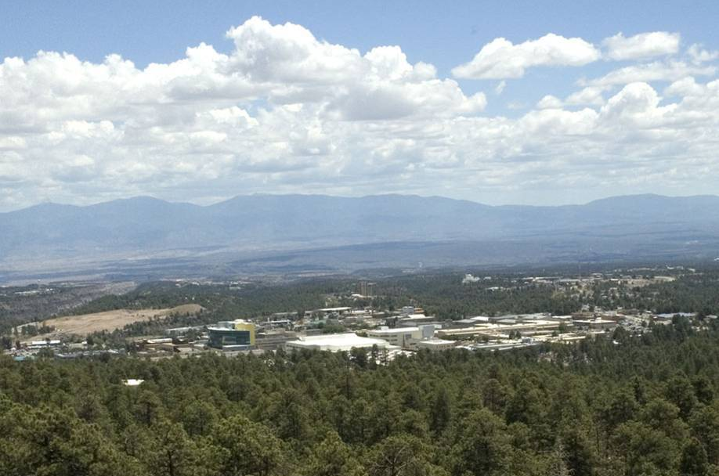
LA-UR-14-24844
Introduction - Los Alamos National Laboratory
Over 70 years of actinide nuclear science
Mission Statement
To solve national security challenges through scientific excellence.
Continuing Mission
Develop and apply science and technology to ensure the safety and reliability of the United States nuclear deterrent; reduce the threat of weapons of mass destruction, proliferation, and terrorism; and solve national problems regarding defense, energy, environment, and infrastructure.

Slide 3
LA-UR-14-24844
Introduction - Los Alamos National Laboratory
Continuing Mission - Operational Requirements
Nuclear Facilities
safe handling of actinide materials
actinide material processing capabilities
Analytical Chemistry
actinide analysis capabilities
quality assurance program
Quality Assurance Program
actinide product certification standard

Slide 4
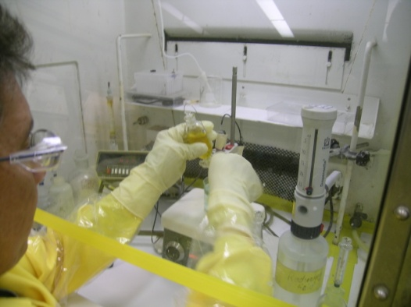
LA-UR-14-24844
Introduction - Los Alamos National Laboratory
Continuing Mission – Capability Requirements
alpha spectrometry
colorimetry
controlled potential coulometry
gamma spectrometry
gravimetry
combustion - infrared spectroscopy
ion chromatography
neutron counting
thermal ionization mass spectrometry
titrimetry
icp - mass spectrometry
icp - atomic emission spectroscopy
x-ray fluorescence
Davies & Gray titrimetry
Capability Application – Actinide Product Certification

Slide 5
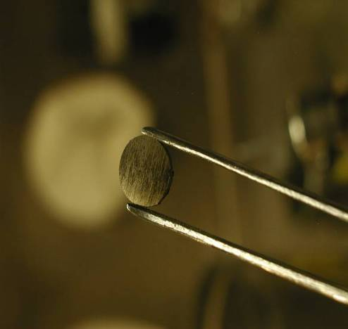
LA-UR-14-24844
Introduction - Los Alamos National Laboratory
Continuing Mission – Analytical Chemistry Samples
Plutonium Metal
Uranium Oxide
pure
impure
heat source
power source
precursors
pure (EU)
targets (NU)
MOX fuels (EU)
reactor fuel (EU)
metal precursor (EU)
ore concentrate (NU)
Plutonium Oxide
Uranium Metal
pure
impure
MOX fuels
heat source
pure (EU)
targets (NU)
Uranium Fluoride
Neutron Source
tetrafluoride
hexafluoride
PuBe

Slide 6
LA-UR-14-24844
Introduction – Analytical Chemistry
Continuing Mission – Quality Assurance Standards
QC-1
Implements quality assurance requirements for domestic nuclear industry contractors performing work in relevant product life-cycles. Institutional quality requirements are implemented through Manufacturing Administrative Procedures
NQA-1
Implements quality assurance requirements for nuclear facility applications including design and operation.

Slide 7
LA-UR-14-24844
Nuclear Forensics - Analytical Chemistry
Nuclear Forensics Mission - Operational Requirements
Nuclear Facilities
safe handling of actinide materials
actinide material processing capabilities
Analytical Chemistry
actinide analysis capabilities
quality assurance program

Slide 8
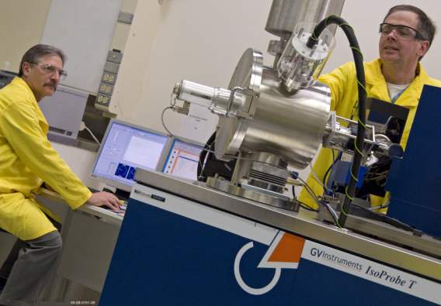
LA-UR-14-24844
Nuclear Forensics - Analytical Chemistry
Nuclear Forensics Mission – Capability Requirements
alpha spectrometry
colorimetry
controlled potential coulometry
gamma spectrometry
gravimetry
combustion - infrared spectroscopy
ion chromatography
neutron counting
thermal ionization mass spectrometry
titrimetry
icp - mass spectrometry
icp - atomic emission spectroscopy
x-ray fluorescence
density
particle size analysis
optical microscopy
secondary electron microscopy
x - ray diffractometry
x - ray radiography
thermal ionization mass spectrometry
Capability Application – Actinide Sample Analysis

Slide 9
LA-UR-14-24844
Nuclear Forensics - Analytical Chemistry
Nuclear Forensics Mission – Quality Assurance Standard
ISO/IEC 17025:2005
General Requirements for the Competence of Testing and Calibration Laboratories
ISO/IEC 17025:2005 specifies the general requirements for the competence to carry out tests and/or calibrations, including sampling. It covers testing and calibration performed using standard methods, non-standard methods, and laboratory-developed methods.
It is applicable to all organizations performing tests and/or calibrations.

Slide 10
LA-UR-14-24844
Nuclear Forensics - Analytical Chemistry
New Mission – Quality Assurance Requirements
ISO-17025 Procedures
NF-QA-001, Nuclear Forensics Analysis Results Review, Approval and Release
NF-QA-003, Calculation of Uncertainties
NF-QA-006, Root Cause Analysis
NF-QA-007, Management Review
NF-QA-008, Review of Requests, Tenders, and Contracts
NF-QA-009, Nuclear Forensics Case Notebook

Slide 11
LA-UR-14-24844
Nuclear Forensics - Analytical Chemistry
New Mission – Quality Assurance Standard
ISO-17025 Customer Interaction
NF-QA-008, Review of Requests, Tenders, and Contracts
Name of Customer:________________________ Date of Request/Tender/Contract: ______
Written or Oral? ________________ Reference Number: _________________
Are the customer requirements adequately defined, documented, and understood?
Can listed customer requirements be addressed by existing capabilities and resources? Do personnel/equipment have the skills and expertise necessary to perform the tests?
Have appropriate test methods been selected to meet the customer requirements?
If any of the above are not met, consult with the customer to resolve, or if not possible, turn down the request, tender, or contract.
List any issues/concerns which need to be addressed prior to acceptance:

Slide 12
LA-UR-14-24844
Nuclear Forensics - Analytical Chemistry
New Mission – Quality Assurance Requirements
ISO-17025 Quality Testing
NF-PLAN-006 LANL Actinide Analytical Chemistry Proficiency Testing (PT) Plan
The laboratory policy is to run proficiency test samples (PTs) where applicable and when PTs are available. Applicability is based on the analyte/nuclide, available matrix, and concentration range of the PT.
When a PT is not available, appropriate quality control standards will be analyzed to ensure the accuracy and precision for quantitative methods. For the qualitative identification, other appropriate schemes within the laboratory test procedures will be implemented.

Slide 13
LA-UR-14-24844
Nuclear Forensics - Analytical Chemistry
New Mission – Quality Assurance Requirements
ISO-17025 Quality Testing
NF-PLAN-006 LANL Actinide Analytical Chemistry Proficiency Testing (PT) Plan
LANL analytical chemistry has one accreditation discipline, chemistry, with two sub disciplines: general or wet chemistry and spectroscopy. Note there are no ISO/IEC 17043 accredited domestic (U.S.) PT Programs for the bulk nuclear fuel or nuclear material programs.

Slide 14
LA-UR-14-24844
Nuclear Forensics - Analytical Chemistry
New Mission – Quality Assurance Requirements
ISO-17025 Quality Testing
Applicable Proficiency Test Programs Would Require…
Appropriate nuclear (Pu and U) materials for distribution
Certified Reference Materials
Working Reference Materials
Viable Control Materials
Accurate and precise measured reference values for materials
GUM compliant reference value uncertainties
Accredited Proficiency Test program administrator
Infrastructure and skill to package and ship bulk quantities of nuclear materials

Slide 15
LA-UR-14-24844
Nuclear Forensics - Analytical Chemistry
New Mission – Quality Assurance Requirements
ISO-17025 Quality Testing Options
Proficiency Test Programs
Round-Robin Nuclear Material Exchanges
Measurement Quality Control Samples

Slide 16
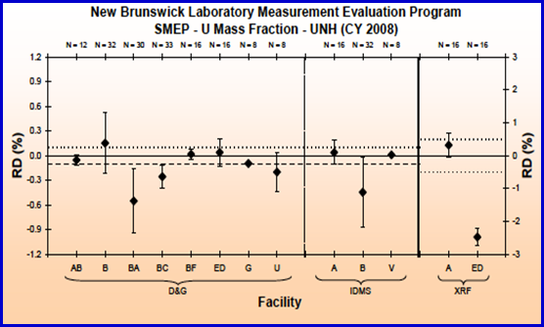
LA-UR-14-24844
Nuclear Forensics – Reference Materials
New Mission – Quality Assurance
Round-Robin Uranium Material Exchange
Safeguards Measurement Evaluation (SME) Program - NBL
ITV Requirements

Slide 17
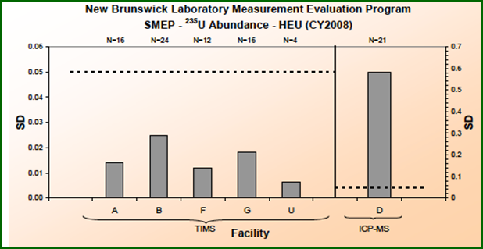
LA-UR-14-24844
Nuclear Forensics – Reference Materials
New Mission – Quality Assurance
Round-Robin Uranium Material Exchange
Safeguards Measurement Evaluation (SME) Program - NBL
ITV Requirements

Slide 18
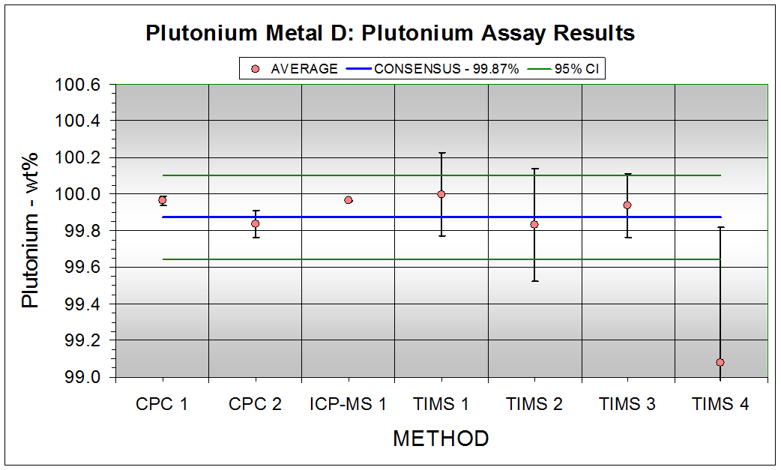
LA-UR-14-24844
Nuclear Forensics – Reference Materials
New Mission – Quality Assurance
Round-Robin Plutonium Material Exchange
Plutonium Standards Metal Exchange Program - LANL
Evaluate Bias and Method Precision

Slide 19
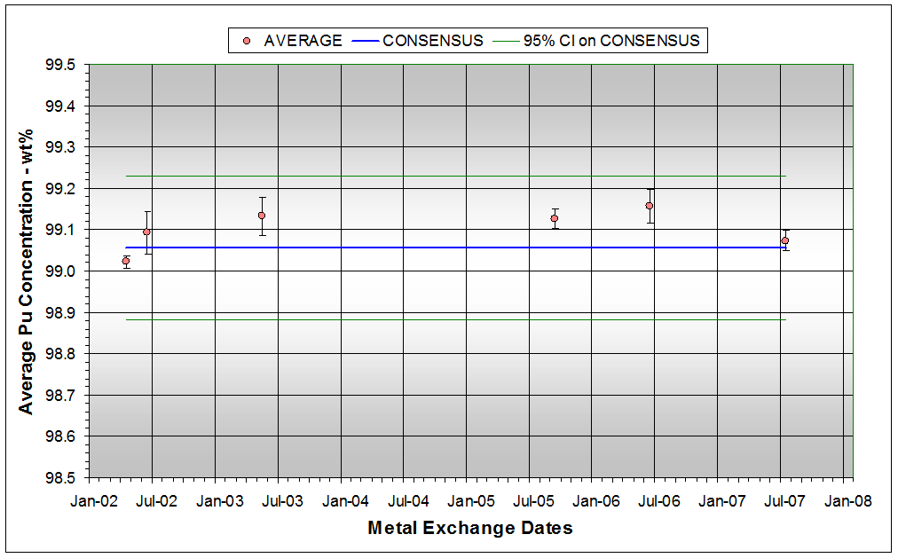
LA-UR-14-24844
Nuclear Forensics – Reference Materials
New Mission – Quality Assurance
Round-Robin Plutonium Material Exchange
Plutonium Standards Metal Exchange Program - LANL
Validate Method and Trend Detection

Slide 20
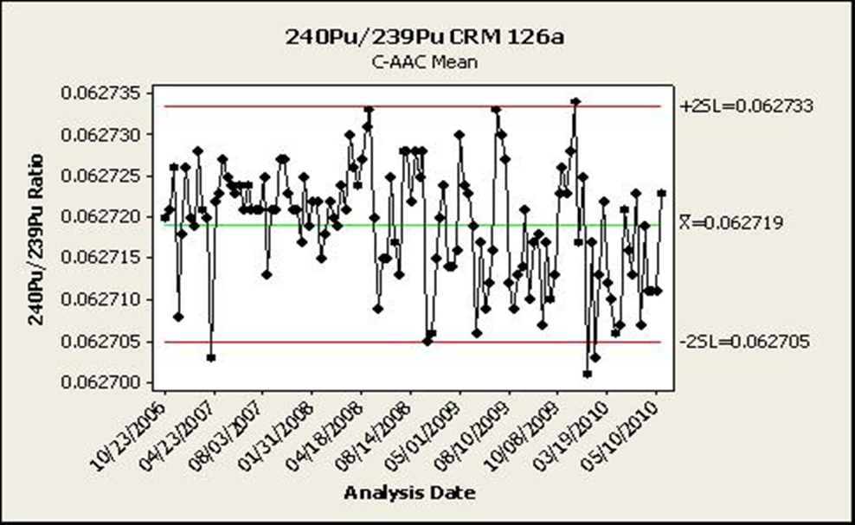
LA-UR-14-24844
Nuclear Forensics – Reference Materials
New Mission – Quality Assurance
Measurement Quality Control Sample
Plutonium Standards Metal Exchange Program - LANL
Evaluate Bias & Trends
Certified Atom Ratio
0.062711 ± 0.000016*
* Decay corrected
LANL Atom Ratio
0.062719 (%RD = -0.013)

Slide 21
LA-UR-14-24844
Nuclear Forensics - Analytical Chemistry
New Mission – Quality Assurance Requirements
ISO-17025 Uncertainties
NF-QA-003, Calculation of Uncertainties
There are various methods of calculating uncertainties, any of which may be used. If requested by customer, the uncertainty calculation may be performed through the use of GUM compliant methods.
GUM
Guide to the Expression of Uncertainty in Measurement (International Organization for Standardization, 1995)

Slide 22
LA-UR-14-24844
Nuclear Forensics - Analytical Chemistry
New Mission – Quality Assurance Requirements
ISO-17025 Uncertainties
NF-QA-003, Calculation of Uncertainties
Measurement | Result | n | Replicate Standard Dev. (n=12) | Method Uncertainty (k=2) | GUM Uncertainty (k=2)
Pu Assay | 87.60 wt% | 12 | 0.07 wt% | 0.08 wt% | 0.08 wt%
²³⁸Pu content | 0.0120 at% | 12 | 0.0003 at% | 0.0004 at% | 0.0009 at%
²³⁹Pu content | 93.9645 at% | 12 | 0.0008 at% | 0.0007 at% | 0.0021 at%

Slide 23
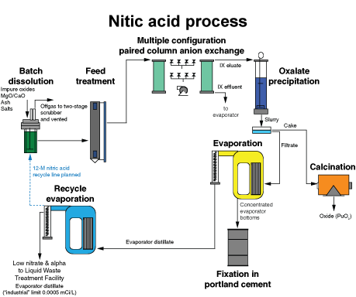
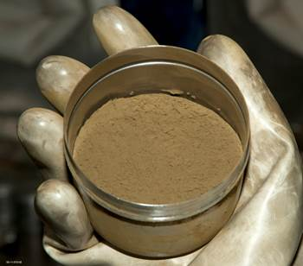
LA-UR-14-24844
Nuclear Forensics – Reference Materials
New Mission – Quality Assurance
New Reference Material Production – Pu Oxide via Recycle
Nitric Acid Process

Slide 24
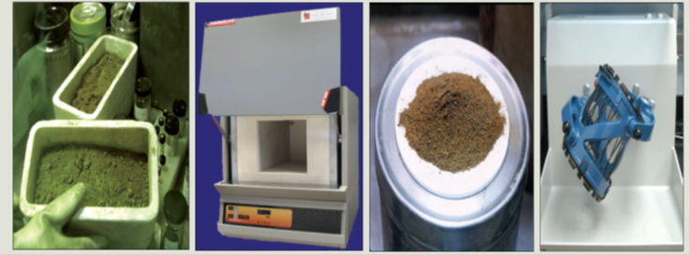
LA-UR-14-24844
Nuclear Forensics – Reference Materials
New Mission – Quality Assurance
New Reference Material Production – Pu Oxide to RM
Nuclear Material Production ● Production Records ● Packaging ● Shipping (Send/Receive) ● Stabilization ● Homogenization ● Blending ● Material Analysis

Slide 25
LA-UR-14-24844
Nuclear Forensics – Reference Materials
New Mission – Quality Assurance
New Reference Material Production – Sample Analysis
 | CRM | WRM
Form | Pu oxide | Pu oxide
Sample Size | 160-200 mg | 160-200 mg
Attributes | Pu Isotopics (238-244) | Pu Isotopics (238-244)
 | Pu assay | Pu assay
 | U assay and isotopics | U assay and isotopics
 | Am assay (isotopics if appropriate) | Am assay (isotopics if appropriate)
 | Np assay | Np assay

Slide 26
LA-UR-14-24844
Conclusions
Los Alamos National Laboratory operates capable analytical chemistry and material science laboratories suitable for nuclear material forensic measurements
LANL analytical chemistry has numerous ISO 17025 accredited measurement processes to support nuclear forensic customers
LANL analytical chemistry uses numerous means to validate and independently verify that ISO17025 measurement data quality objectives are met

Slide 27
LA-UR-14-24844
Acknowledgments
Heather Dion, Steve LaMont, Steve Goldberg, DOE NNSA
Jacqueline Mann, NIST
Jeff Morrison, DHS
Mike Kristo, LLNL
Mike Holland, SRNL/SRS
Chris Worley, LANL

