Slide 1
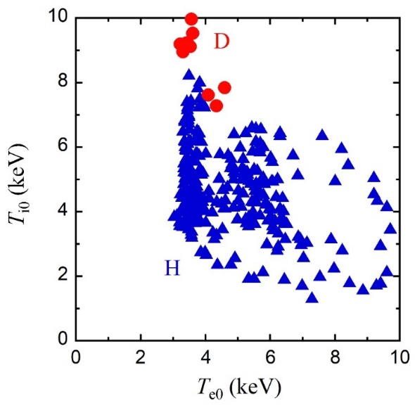
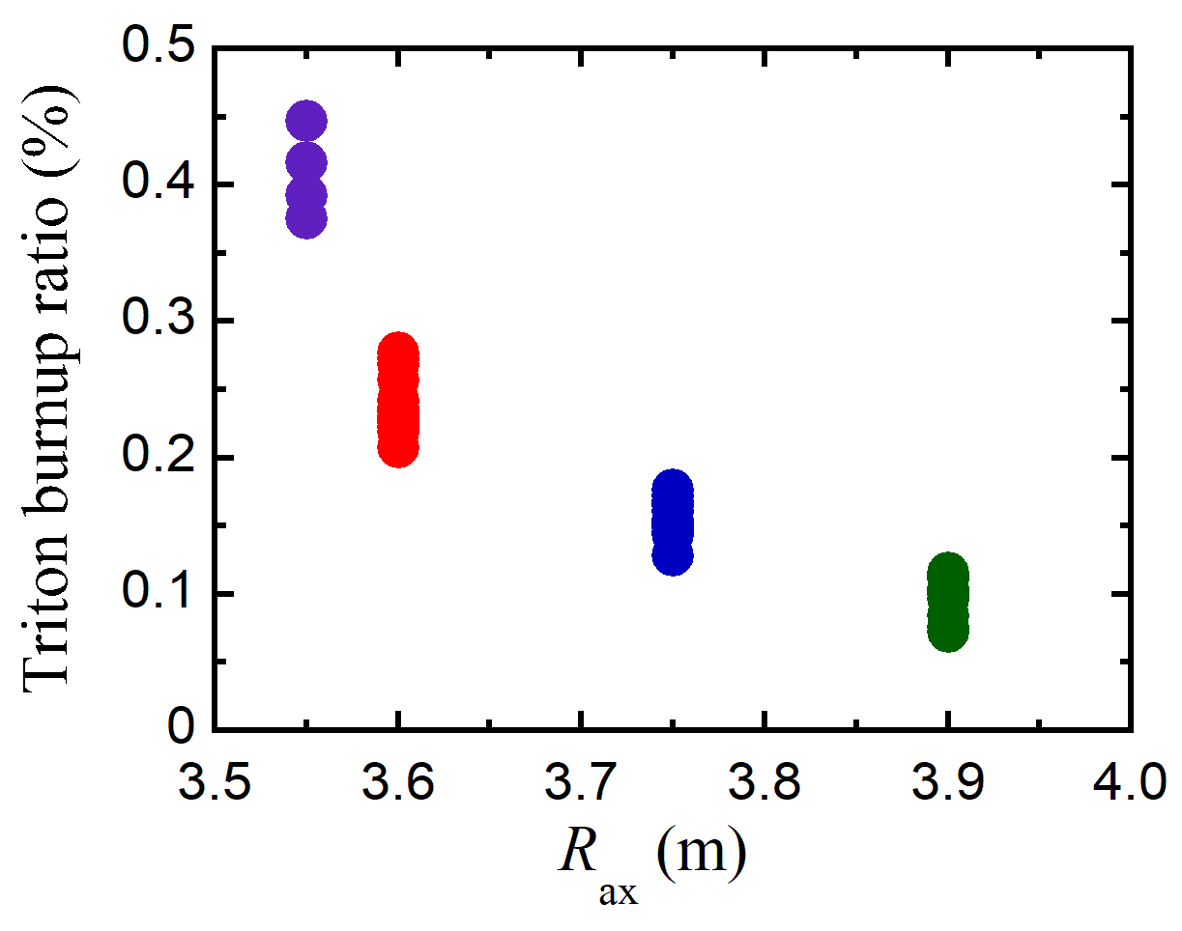
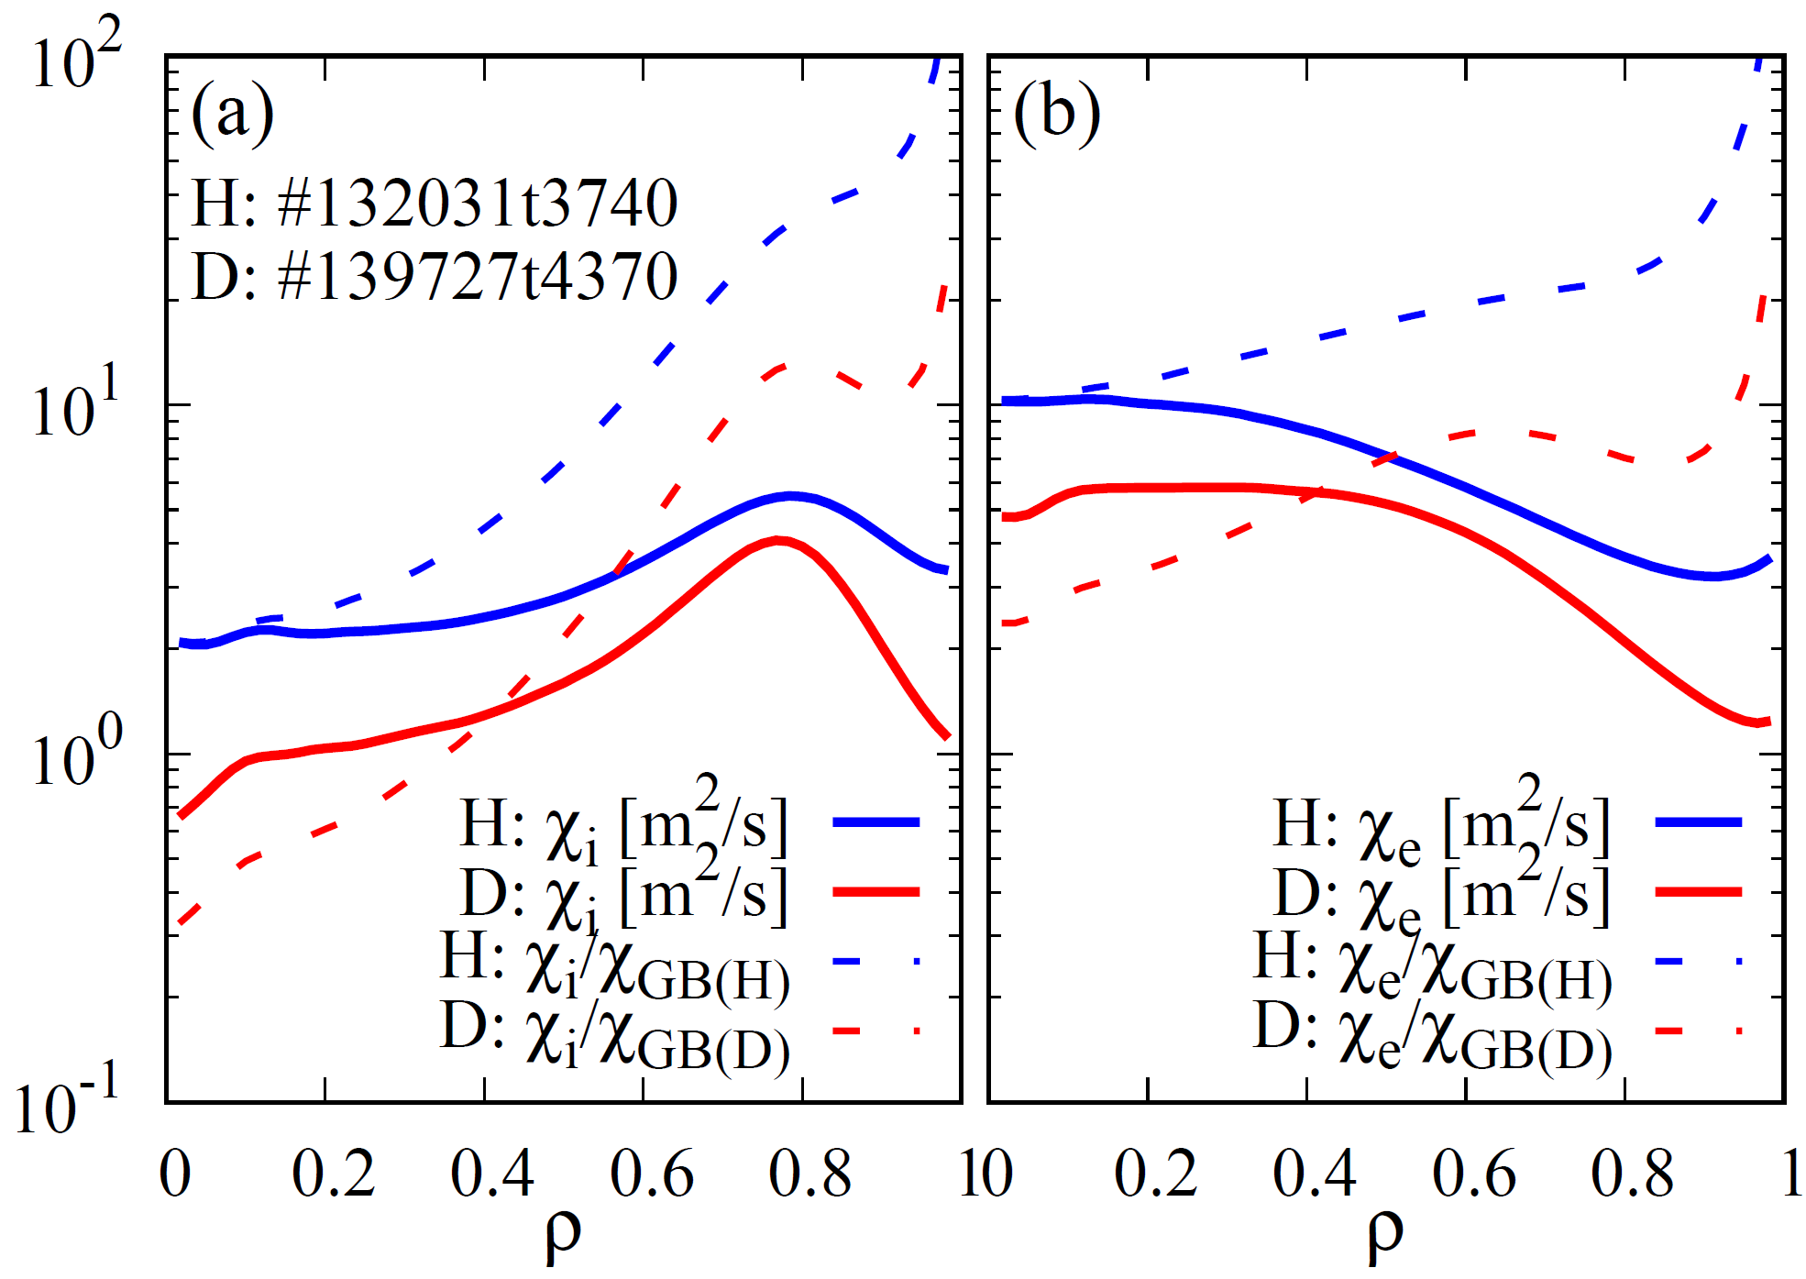
OV4-2
T. Morisaki
Overview of the First Deuterium Experiment in LHD
LHD extended its operational regime with D plasma
Energetic ions are well confined in heliotron configuration
Fusion-relevant T_{i} = 10 keV was first achieved in stellarator/heliotron
Ion thermal diffusivity was found to be small in D plasma with ITB
Similar improvement was observed in ECH plasma
=> Observation of clear isotope effect in stellarator/heliotron
Triton burn up experiment with newly installed neutron diagnostics proved the good performance of energetic particle confinement,
which are comparable to tokamak with similar plasma cross section as LHD
χ_{I} (m²/s)
ρ

