Slide 1
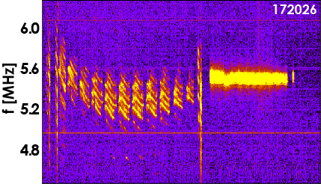
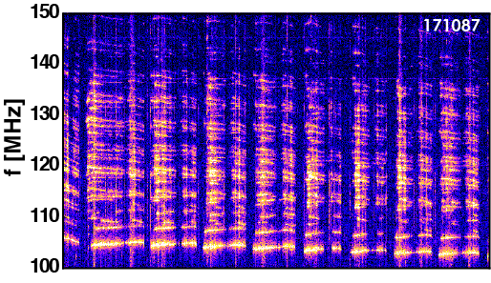
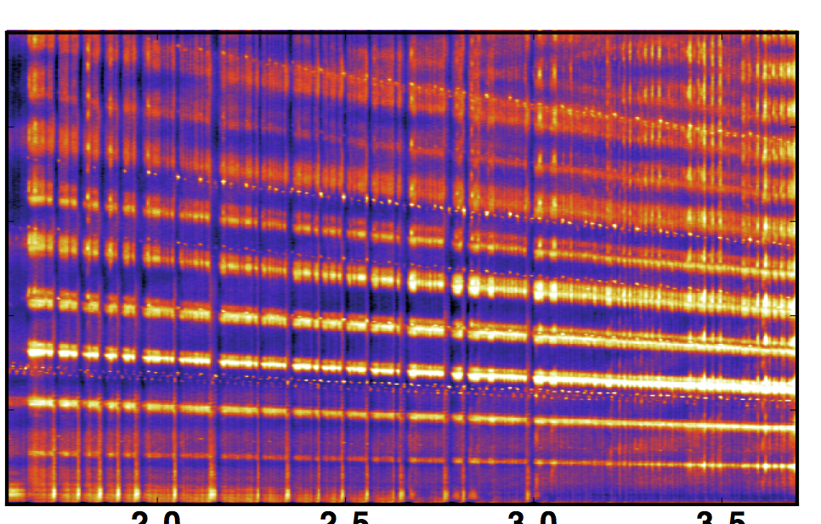
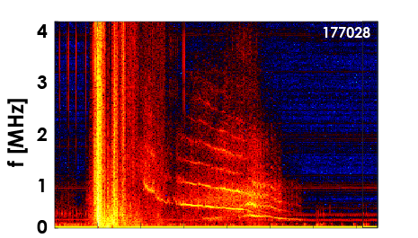
Four High-Frequency Energetic Particle Driven Instabilities Observed in the DIII-D Tokamak
Simple magnetic loop and fast digitizer enable studies
Fast beam ions excite:
Runaway electrons excite:
Compressional Alfvén
Eigenmodes f~0.6f_{ci}
Whistler waves f_{ci}<<f<<f_{ce}
These instabilities could diagnose a reactor fast-ion population and control runaway electrons following a disruption
Collective Ion Cyclotron Emission f= 𝓁 f_{ci}
Mode that suppresses runaway beam f~0.1f_{ci}
100
168781
80
𝓁=9
f [MHz]
60
𝓁=7
40
𝓁=5
20
𝓁=3
𝓁=1
0
K.E. Thome (EX/P6-29)

