Slide 1
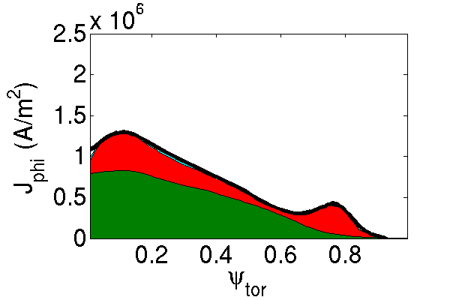
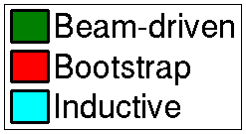
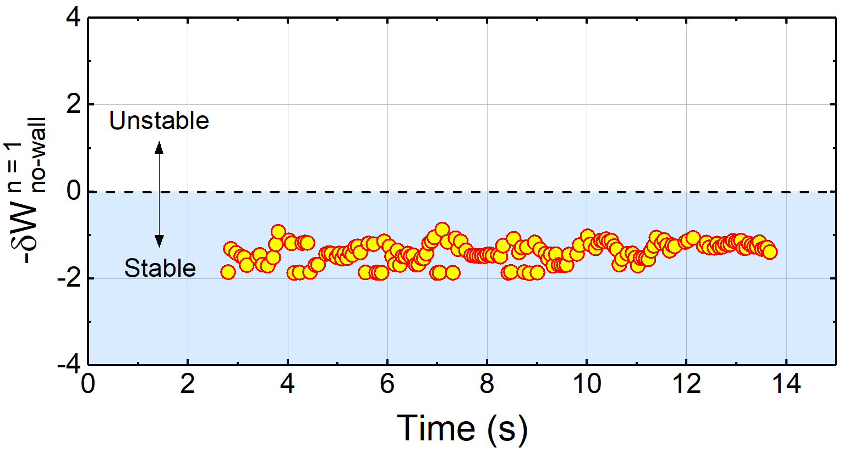
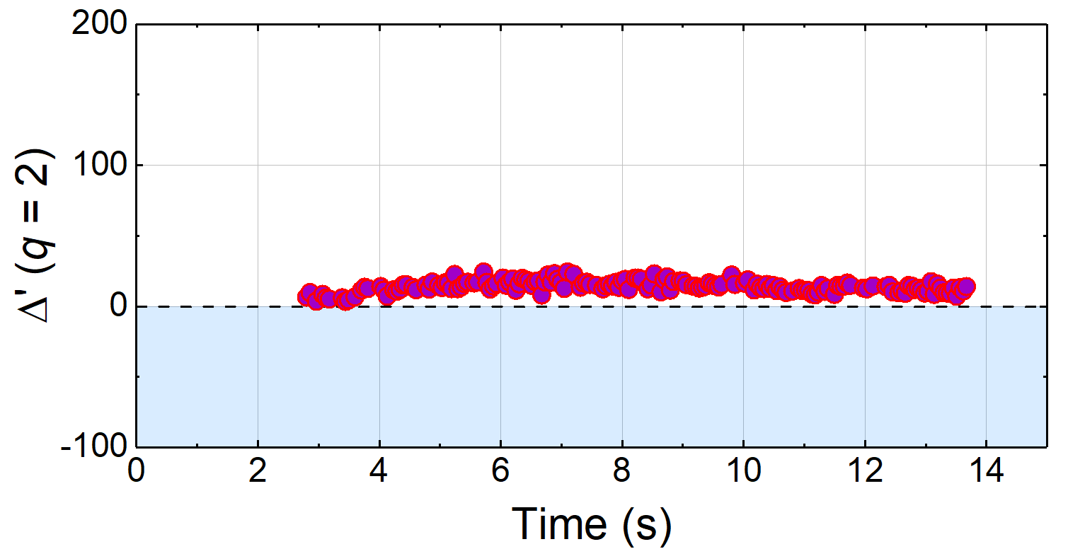
EX/P7-16 : Stability, Transport, and Active MHD Mode Control Analysis of KSTAR High Performance Plasmas Supporting Disruption Avoidance
A2
Interpretive and predictive TRANSP analysis
for various KSTAR operational regimes
Y.S. Park, S.A. Sabbagh, et al.
<TRANSP>
National Fusion
Research Institute
P_{NBI} = 6.5 MW
β_{N} = 3.4
f_{NI} = 96%
Stability and transport analysis for fully non-inductive, high performance operation without disruptions
Kinetic EFIT reconstructions including MSE data used as input to transport and stability analysis
With newly increased P_{NBI} in KSTAR, high β_{N} > 4 with fully non-inductive current is computed from predictive TRANSP analysis (A2)
Ideal and resistive stability analyzed using resistive DCON, MISK and M3D-C¹ are compared to the experimental stability (A3)
Development of active RWM feedback system
A real-time RWM identification and control algorithm including sensor compensation of the induced passive plate currents is implemented in the KSTAR PCS and will be used in 2018 with increased P_{NBI}
A3
Resistive DCON-computed ideal mode stability and tearing mode stability, Δ′
KSTAR 16325
<DCON>
n = 1
Ideal stability δW_{no-wall}
<R-DCON>
Resistive stability Δ′ (q = 2)

