Slide 1

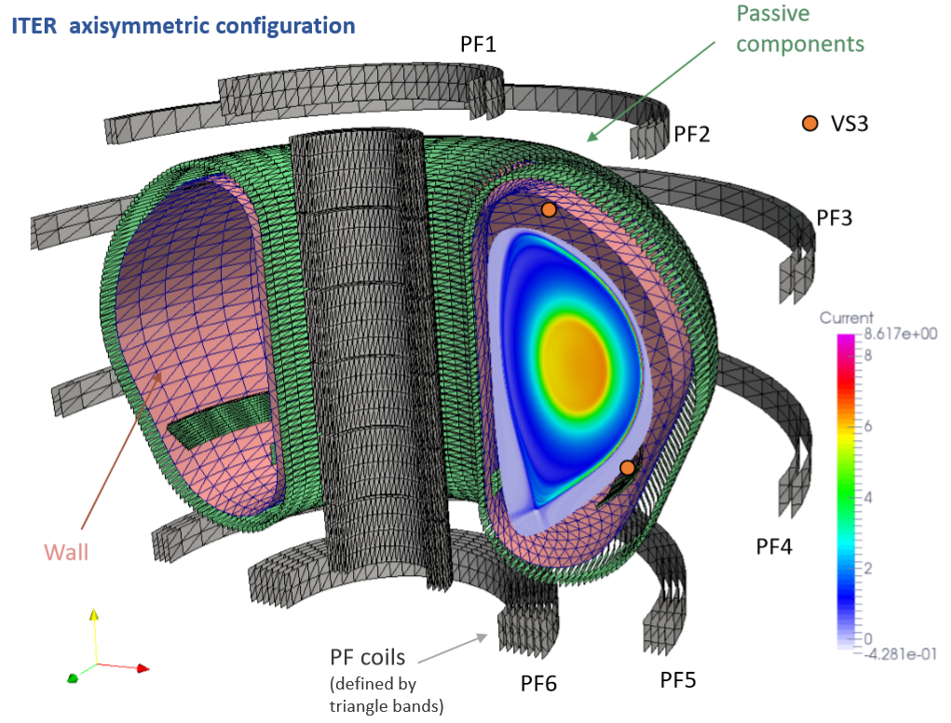
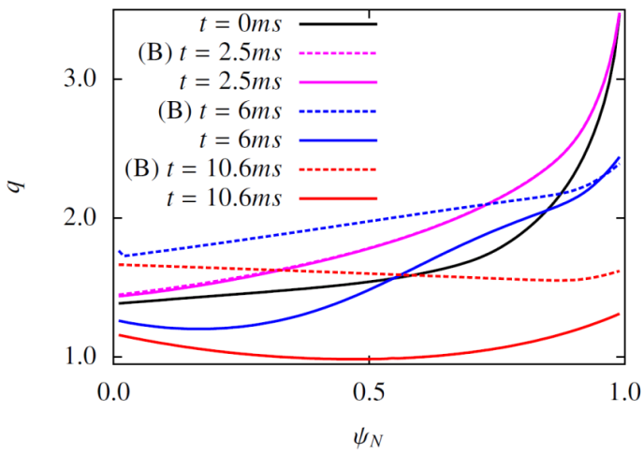
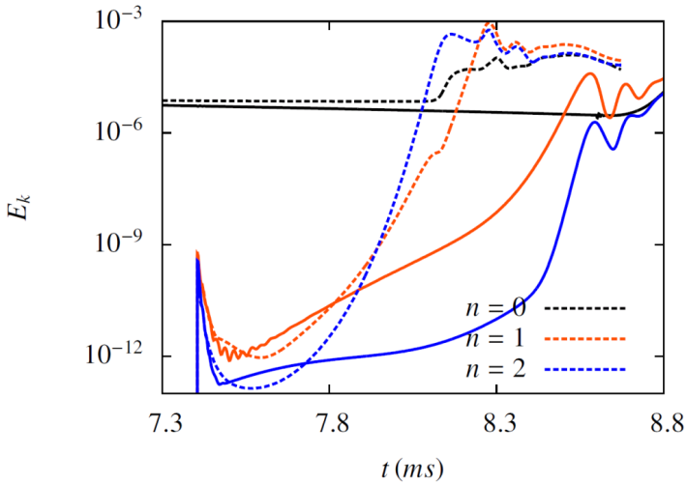
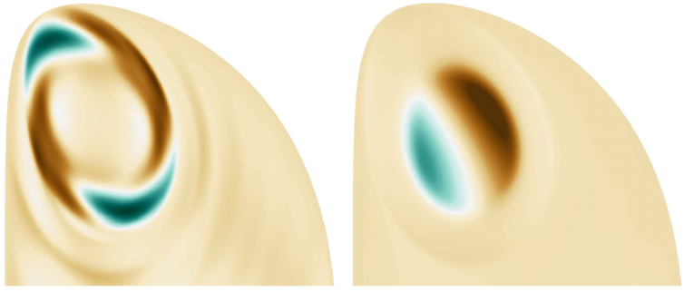
V. Bandaru, F.J. Artola, M. Hoelzl, G. Papp, P. Aleynikov, G.T.A. Huijsmans
Non-linear MHD simulations of ITER VDE with runaway electrons
Non-linear MHD simulations of ITER VDE with simultaneous generation of runaway electrons using JOREK-STARWALL* code
Cold VDE of a non-stochastic post thermal- quench plasma
I_{p}=15MA, constant density and constant
temperature
Effects of all conducting structures considered
Fluid model for runaway electrons
Configuration#
Preliminary results
Safety factor
Poloidal kinetic energy
Electric potential : non-zero modes
Without REs
With REs
RE current profile peaking leads to q<1
(1,1) mode observed to dominate in the presence of REs$
* Czarny et. al . J. Comput. Phys. 2008
* Hoelzl et. al . J. Phys 2012
# Artola et. al .NF 2018
$ Aleynikova et. al. PPR 2016

