Slide 1
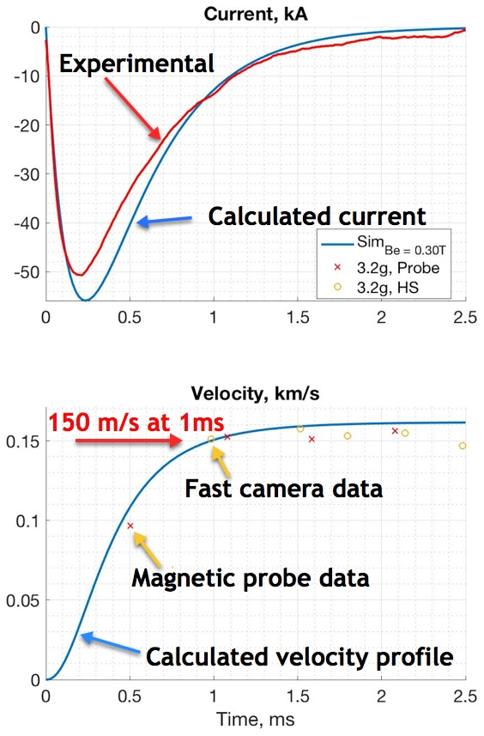
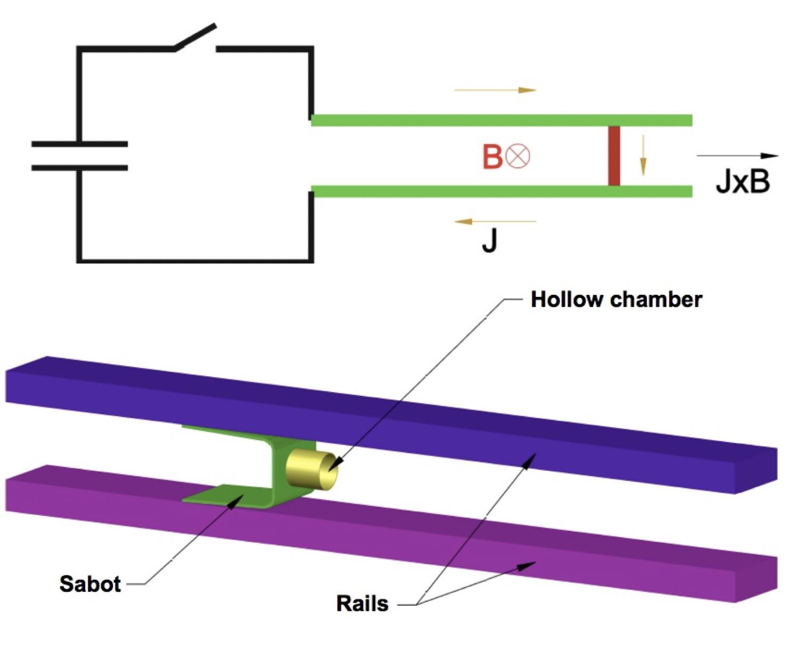
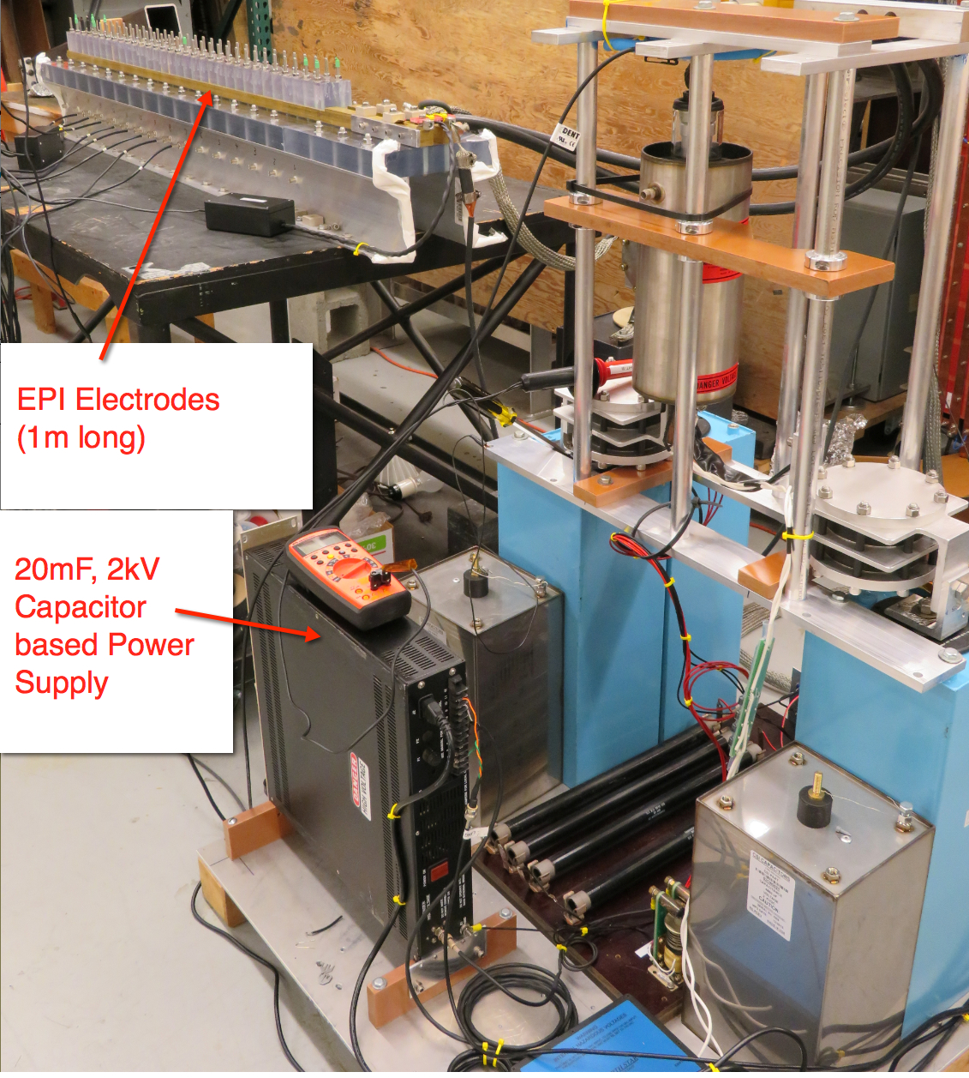
Electromagnetic Particle Injector (EPI) Proposed as a Backup Disruption Mitigation System for ITER
The EPI system accelerates a sabot to high-velocity using an electromagnetic impeller
At the end of the acceleration, within 2-3ms, the sabot will release granules of known velocity and distribution – or a Shell Pellet
The primary advantage of the EPI concept over SPI and other gas propelled systems is its potential to meet short warning time scales, while accurately delivering the required particle size and materials at the velocities needed for achieving the required core penetration (into the RE channel) in high power ITER discharges.
Experimental Confirmation of Rapid Response Time and Velocity that is consistent with projections
University of Washington / PPPL
R. Raman, et al., FIP/P1-51

