Slide 1
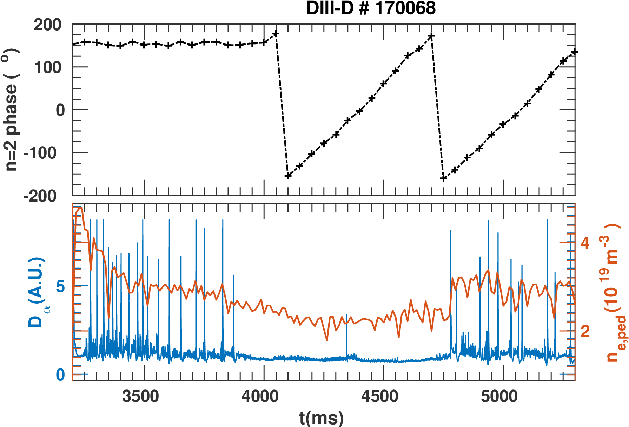
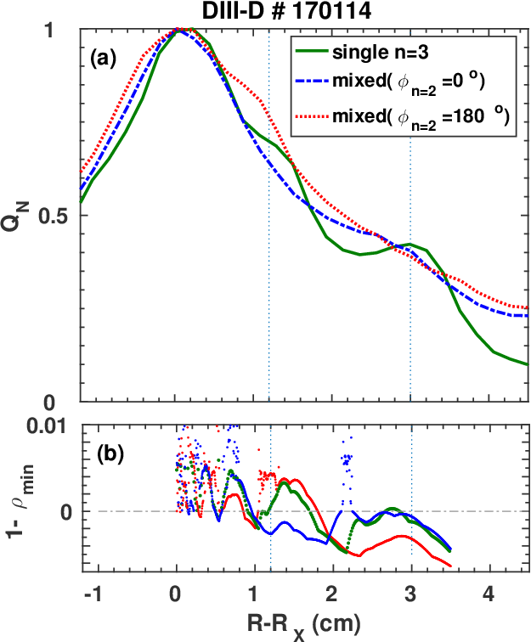
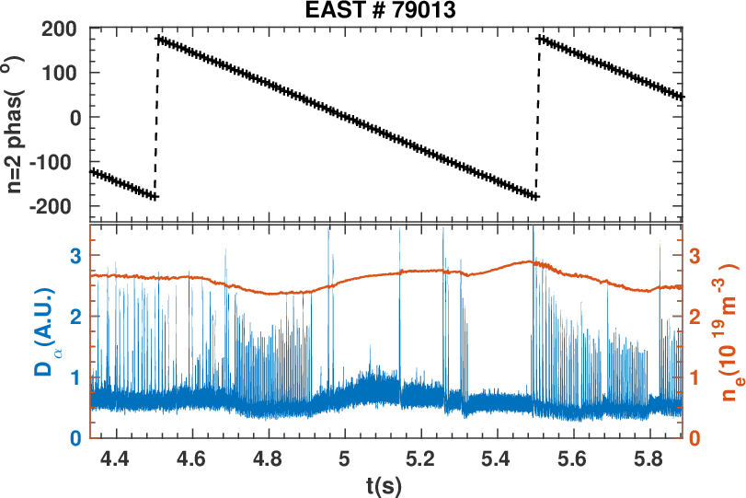
Divertor flux can be dynamically controlled using mixed-n RMPs while maintaining ELM suppression in both DIII-D and EAST
DIII-D
Phase of n=2
suppression
Observed
heat flux
EAST
suppression
Phase of n=2
Modeled 1-ρ_{min}
ELM suppression with mixed rotating n=2 and static n=3 RMPs achieved in a similar standard H mode operational window in both DIII-D and EAST
Footprint of heat flux on the divertor is periodically changing during n=2 RMP rotation in both DIII-D and EAST, which is consistent with the modeling by TOP2D taking into account plasma response modeled by MARS-F
[Y. Sun et al., EX/7-2]

