Slide 1
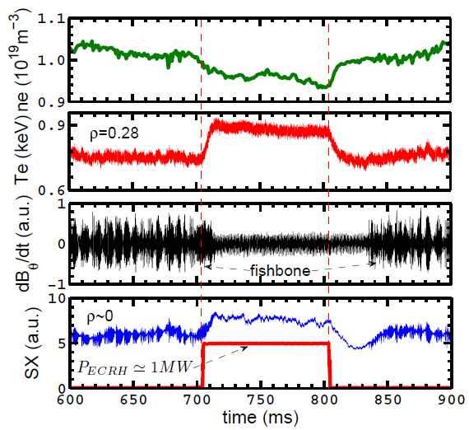
Stabilization of m/n=1/1 fishbone by ECRH
Stabilization of the ion fishbone by ECRH is observed firstly on HL-2A.
Typical discharge parameters with the stabilization of ion fishbone activities by ECRH.
Te near q=1 rational surface,
Bt = 1.34T, Ip =150kA, and P_{NBI}~1MW.
The ECRH power is power is deposited at $ρd$=0.42.
W. Chen, et al, IAEA2018 EX/P5-20&Nucl. Fusion 58 (2018) 014001

Slide 2
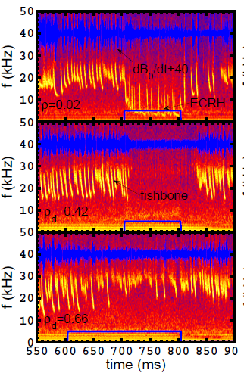
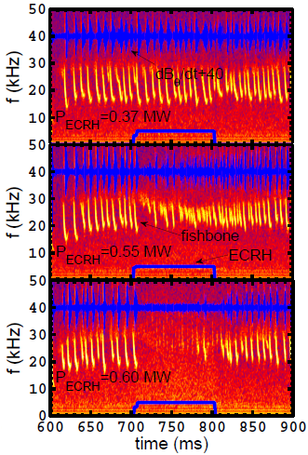
Stabilization of m/n=1/1 fishbone by ECRH
The mode stability depends not only on the injected power but also on the radial deposition location of ECRH, and the instability can be completely suppressed when the injected ECRH power exceeds certain threshold.

Slide 3
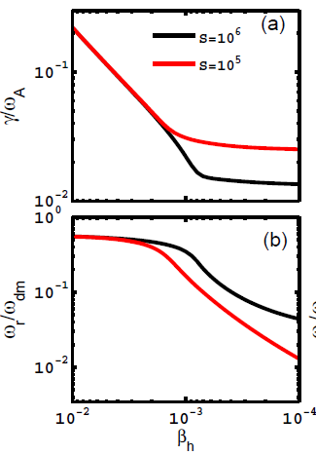
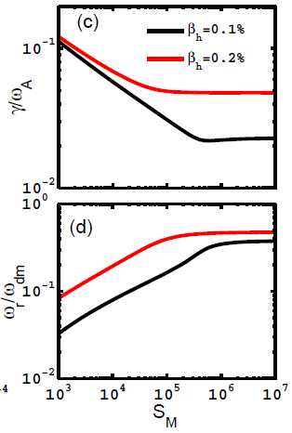
Effects of magnetic Reynolds number and EP beta
Analysis by the FB dispersion relation, including the resistive effect, suggests that the magnetic Reynolds number plays a key role in the mode stabilization - it weakens the mode growth-rate and enhances the critical energetic-ion beta without changing the energetic-ion population.

Slide 4
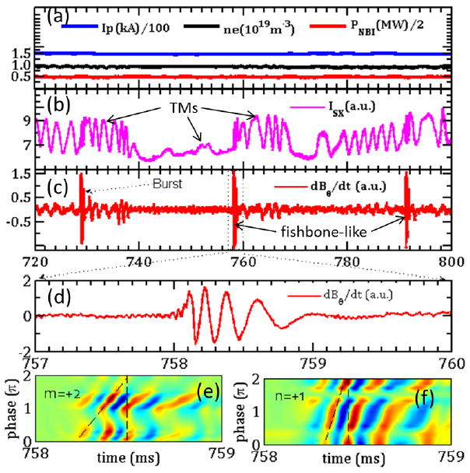
Excitation of m/n=2/1 fishbone
Resonant interactions between energetic ions and the unstable m/n=2/1 TM are observed for the first time on HL-2A.
Typical discharge parameters with TMs and fishbone-like activities during NBI heating on HL-2A.
W. Chen, et al, IAEA2018 EX/P5-20.

Slide 5
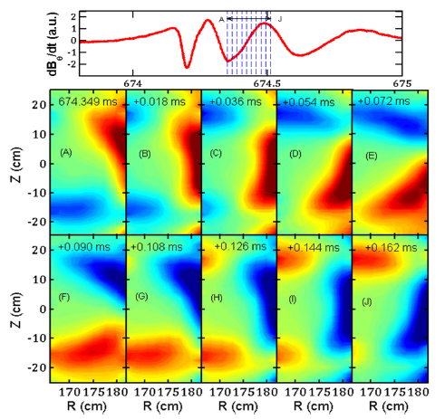
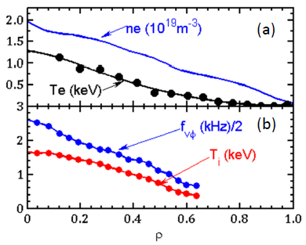
2D mode structures from ECEI &Profiles
(a) plasma density n_{e} from the HCOOH laser interferometer and electron temperature from the ECE, (b) ion temperature T_{i} and toroidal rotation frequency f_{vφ} from the CXRS.
Evolution of 2D mode structures (δT_{e}/T_{e} contour diagram) of the fishbone-like activity (Shot II). The mode propagates in the ion diamagnetic drift (clockwise) direction. Approximate one period from the moment A to J. Only partial structure is measured due to the limited cover region of the ECEI.

Slide 6
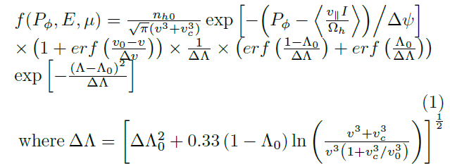
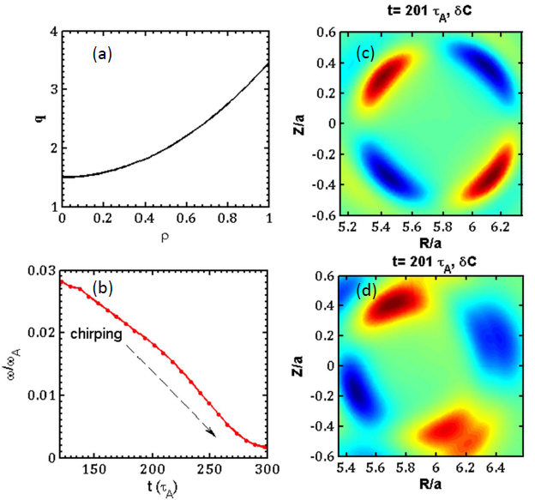
Nonlinear hybrid kinetic-MHD simulation
Chirping & mode structures
The chirping range and time are ω/ω_{A} ∼ 0.028 − 0.002 and δt ∼ 180τ_{A}, respectively. is the Alfven angular frequency, is the reverse aspect ratio and τ_{A} is the Alfven time. For the experimentally determined value f_{A} = ω_{A}/2π ~300kHz, the calculated mode frequency and chirping time are f ~8.4 − 0.6kHz and δt ∼ 0.6ms. Obviously, the simulated results including 2D structure and mode frequency both consistent with experimental measurements.
Mode frequency and 2D mode structure. (a) q-profile in M3D-K simulation, (b) evolution (chirping) of mode frequency with β_{f} = 0.65% energetic-ions, and mode structures (c) without energetic-ions and (d) with β_{f} = 0.65% energetic ions. δC denotes the perturbed current.
Collaborate with X. L. Zhu, F. Wang and Z. X. Wang from DLUT

Slide 7
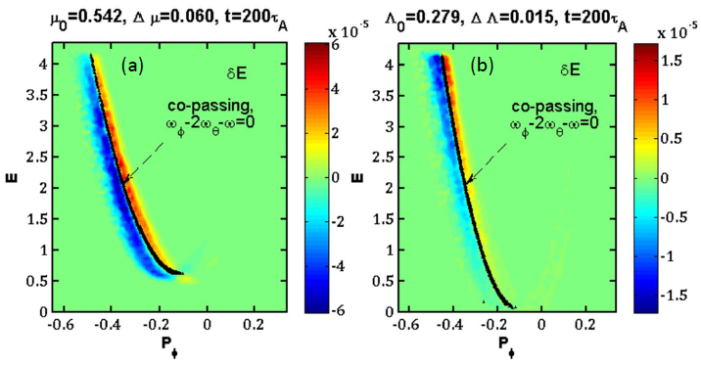
Nonlinear hybrid kinetic-MHD simulation
Resonance condition
δf structures in Λ (a)and µ (b) spaces. Energetic-ion beta β_{f} = 0.65%. The black solid curve denotes the resonance line.
The test particle method gives that the precise resonance line is ω_{φ}−2ω_{θ}−ω = 0, and co-passing energetic-ions are responsible for the mode drive. The effects of counter-passing and trapped energetic-ions on the TM have also explored, and it is found that the TM is influenced by them, but the corresponding resonance conditions are both unfound.

