Slide 1
Summary Magnetic Confinement Theory
Contributions
  THC: Confinement 54
  THD: Plasma–material interactions; divertors; limiters;
    scrape-off layer (SOL) 38
  THS: Stability 35
  THW: Wave–plasma interactions; current drive; heating; energetic particles 49
  TOTAL 176

Slide 2
Summary Magnetic Confinement Theory
Main Topics
  Divertor, and Plasma-Wall Interaction 25
  SOL, ELMs 15
  Transport, Integrated Modelling 22
  Gyrokinetic Analysis/Modelling 21
  Energetic Particles 16
  Runaway Electrons 12
  H Mode, Pedestal 9
  Alfvén Eigenmodes 9
  “Basic” Theoretical models 14

Slide 3
Summary Magnetic Confinement Theory
Highlight
Outstanding Progress in Integrated Simulations

Slide 4
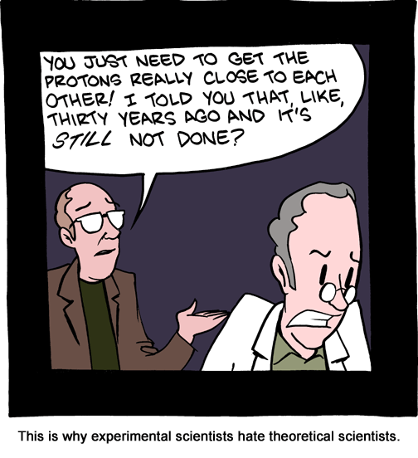
Summary Magnetic Confinement Theory

Slide 5
SEGWAY Integrated-Modeling Workflow Developed & Applied to Predict-First MHD Modeling of Upcoming Experiments – B.C. Lyons et al. (TH/P1-8)
SEGWAY generates equilibria with self-consistent pedestal structures
Vary shape, q₉₅, β, etc.
Equilibria analyzed with M3D-C1
Predict-first studies
Qualitatively predicted trends in magnetic signals on DIII-D as plasma varied between single- and double-null
Predict plasma response to decrease with q₉₅ in DIII-D
high-β_{p} experiments
  May explain difficulty in achieving ELM suppression
  To be explored on future DIII-D and EAST experiments

Slide 6
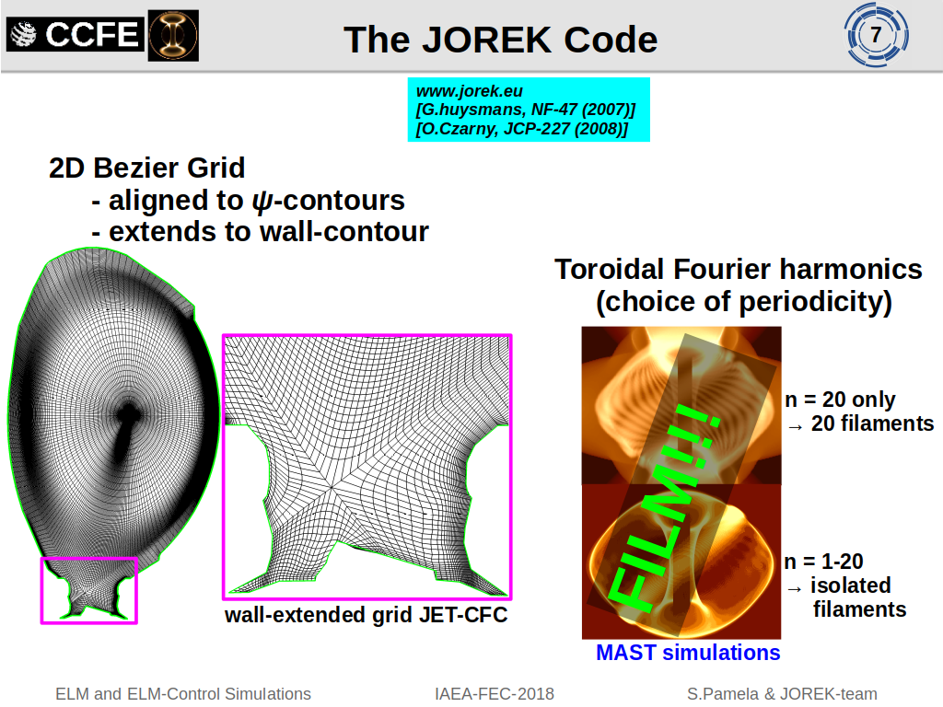
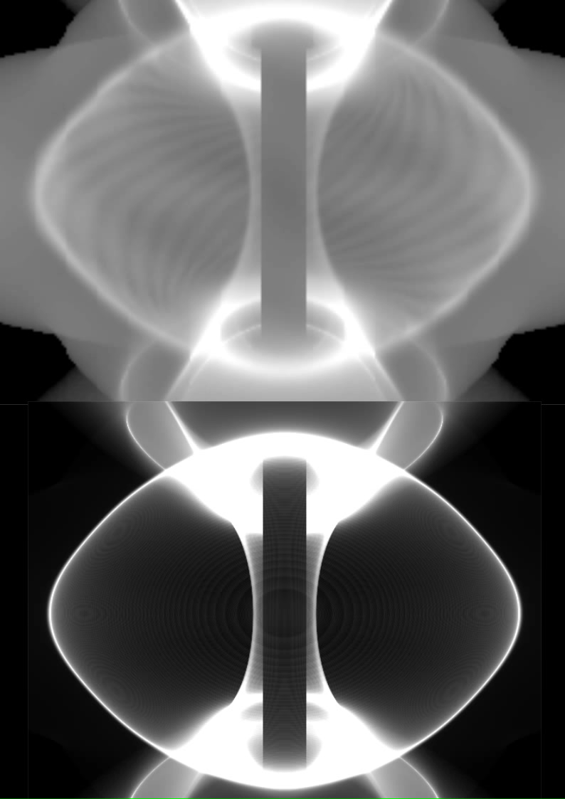

Slide 7
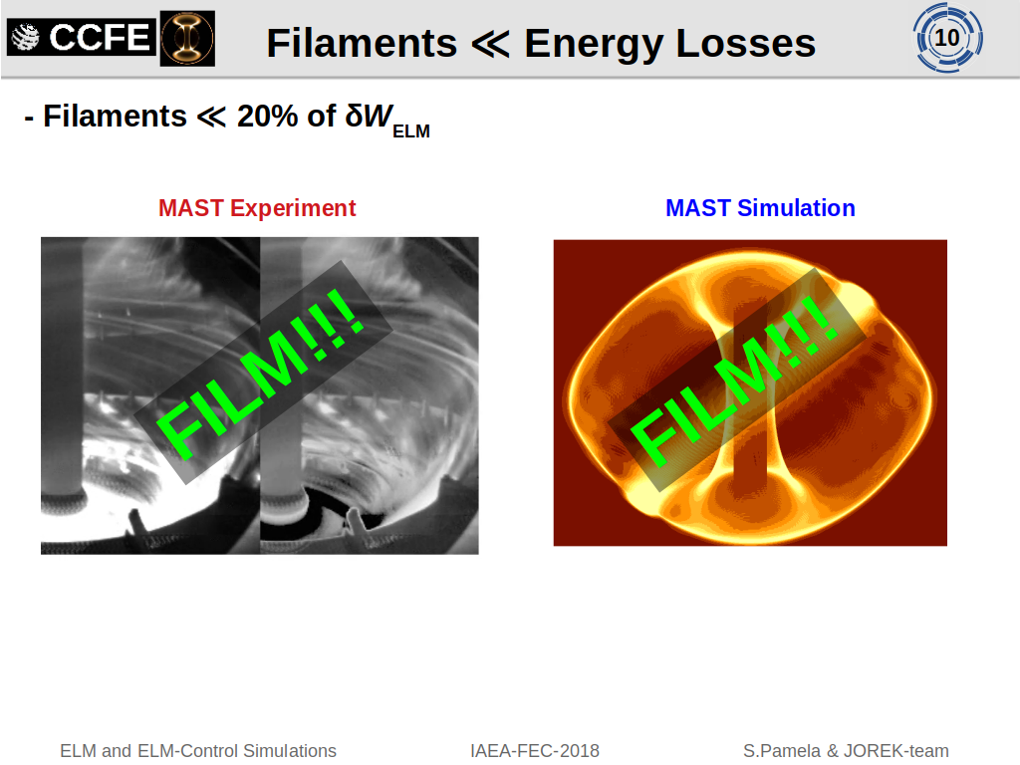
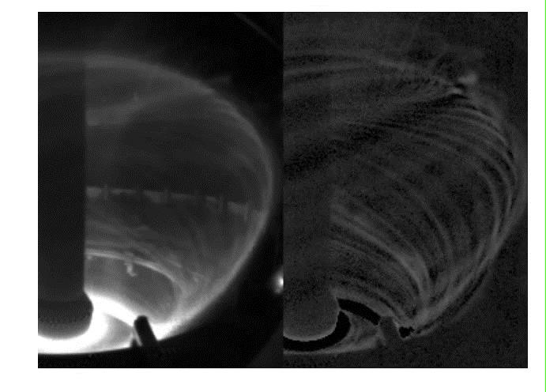
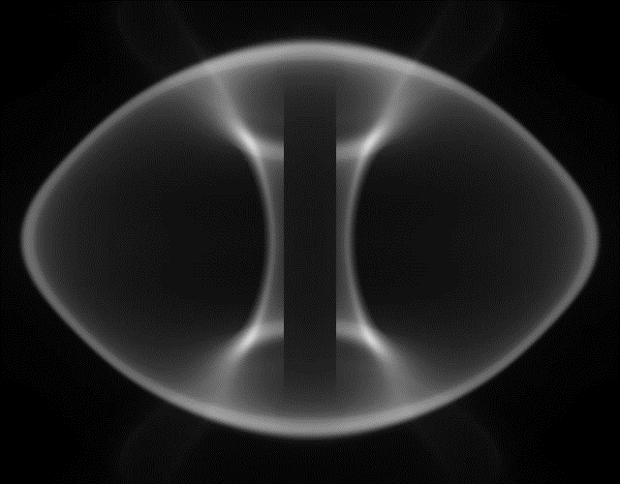

Slide 8
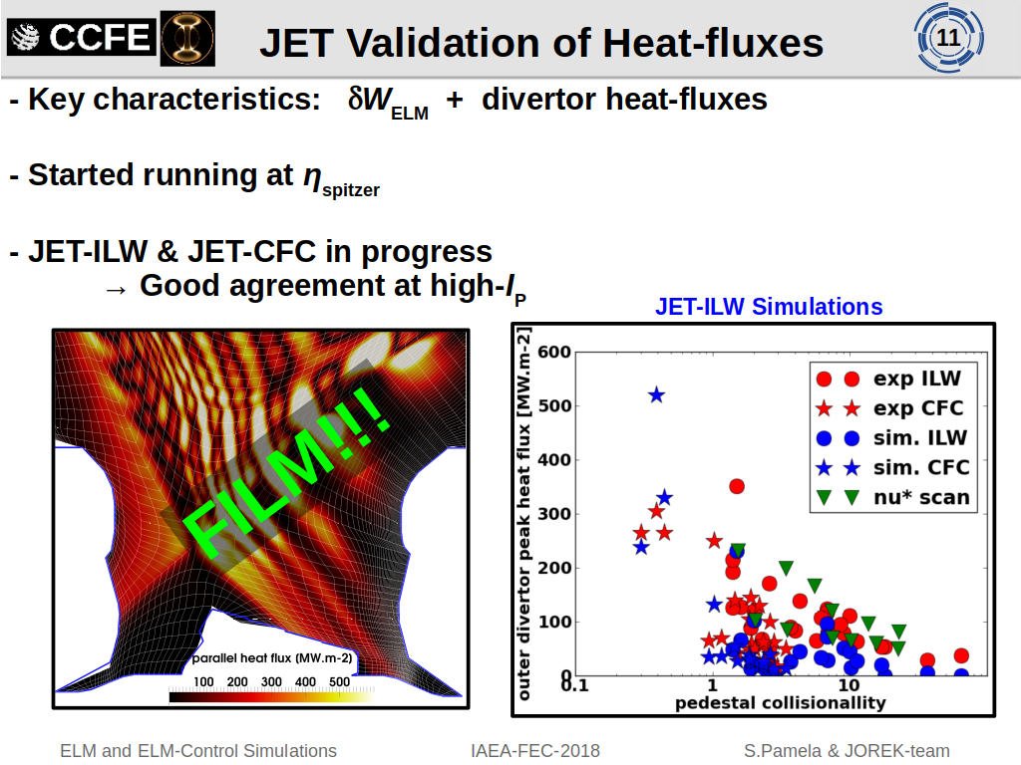
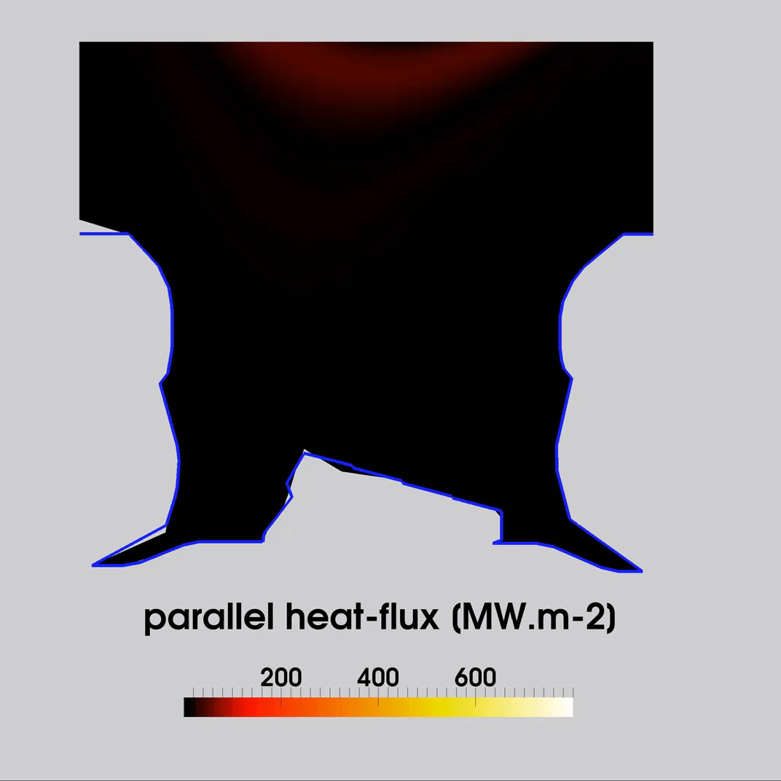

Slide 9
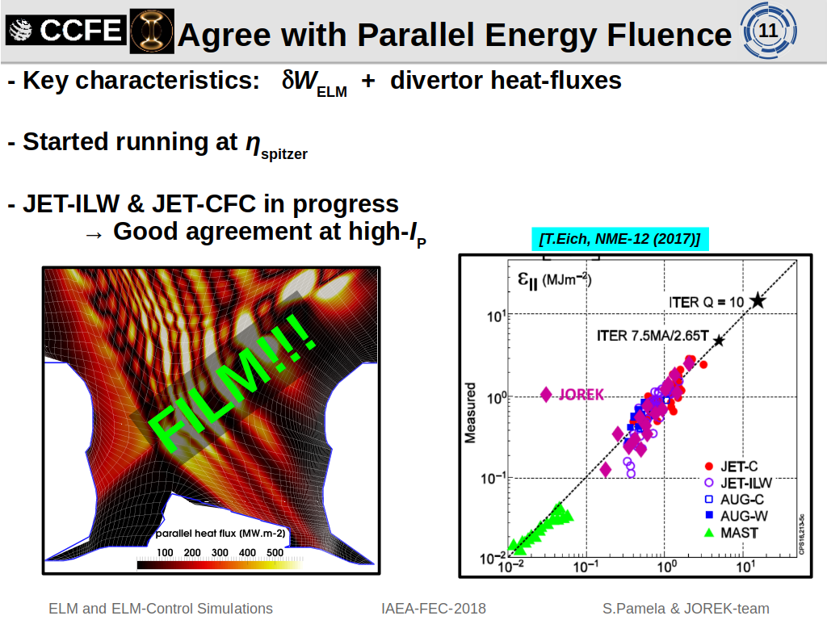

Slide 10
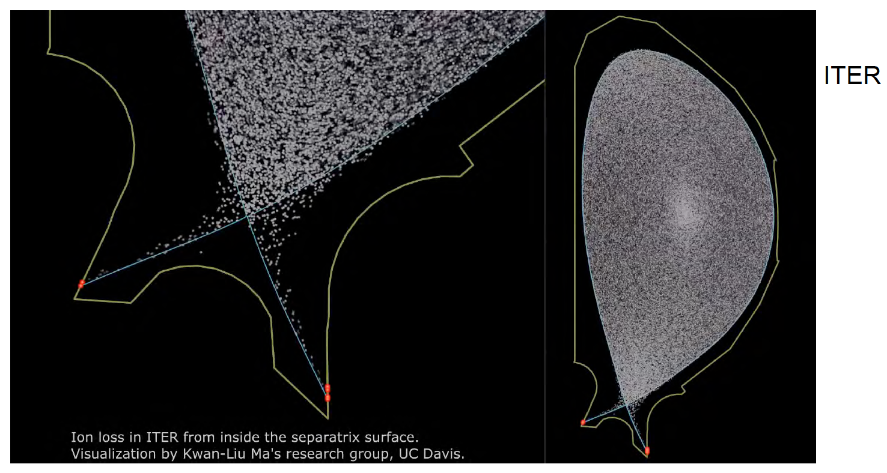
XGC1 can study divertor heat-flux at unprecedented detail
TH/P7-22 C.-S. Chang

Slide 11
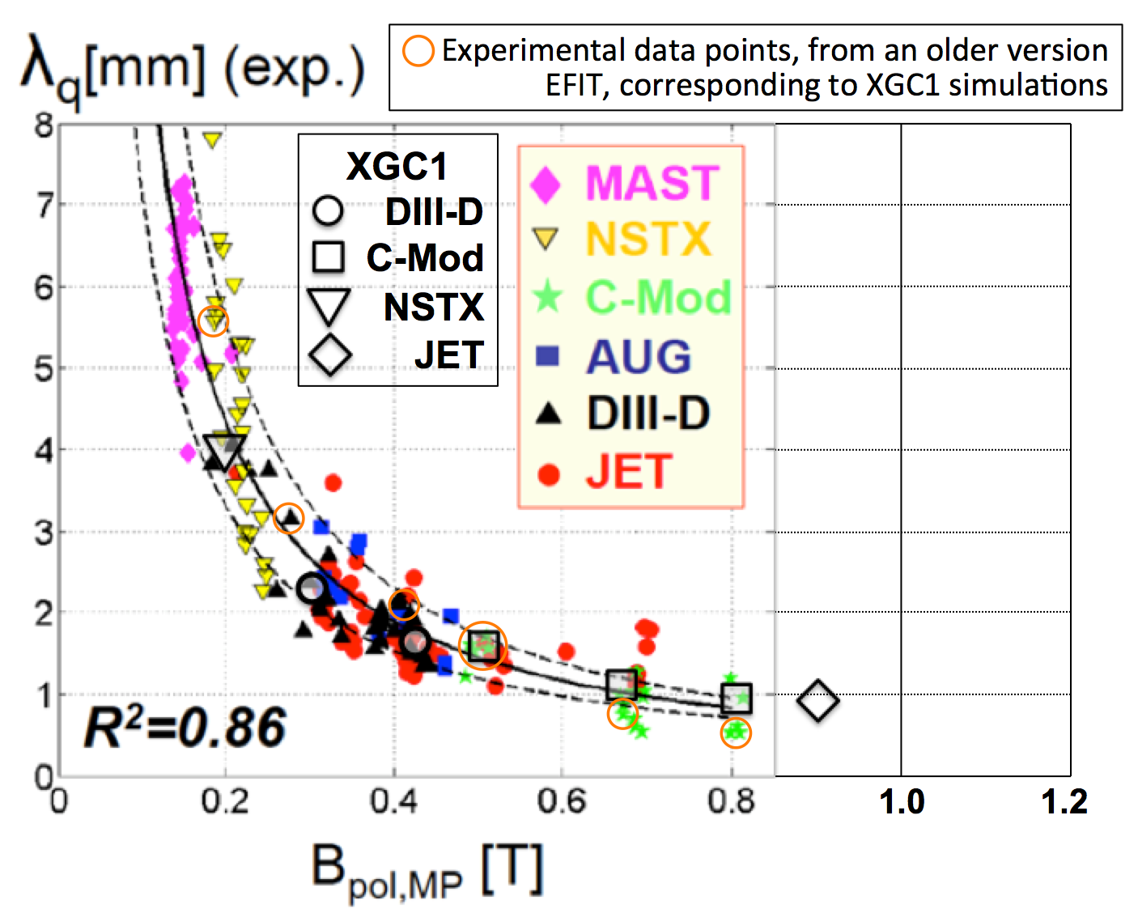
Validation of XGC1, and a surprising result for ITER
XGC1 predictions agreed well with the existing experimental results from the three large US tokamaks + a JET high-current (4.5MA) case
Divertor heat-flux width was dominated by the ion neoclassical dynamics
  X-point orbit-loss type of ion-drift dynamics is the dominant mechanism
  Turbulent e-transport is a “follower,” for ambipolar transport & determining E-field
λ_{q} physics agreed with the previous picture presented by
  XGC0: Report on 2010 US-DOE Joint Research Target study
  [A. Pankin et al., Phys. Plasmas 22, 092511 (2015)]
  Heuristic ion-drift model: R. Goldston, NF 52, 013009 (2012)
XGC1 finds ubiquitous blobby turbulence
  However, the same XGC1 on 15MA ITER
  produced λ_{q}^{Eich} ≳ 6λ_{q}^{Eich}. Why???
  Triggered a deeper study
    Size effect: parallel and neutral physics
    ∆_{banana}/a effect: perpendicular physics
TH/P7-22
C.-S. Chang
ITER
JET 79692
4.5MA
Streamer-type turbulence across the separatrix

Slide 12
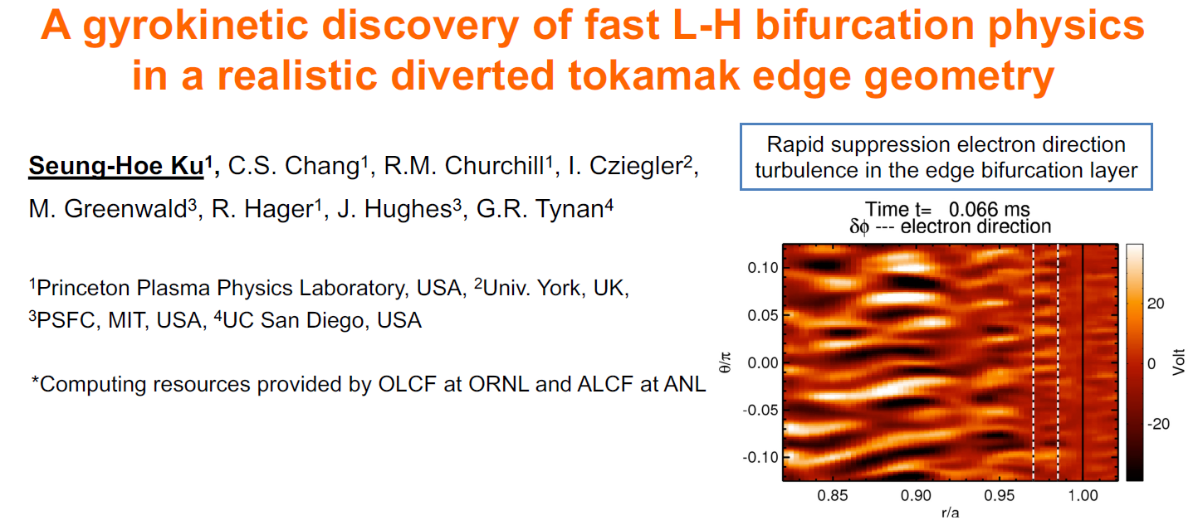

Slide 13
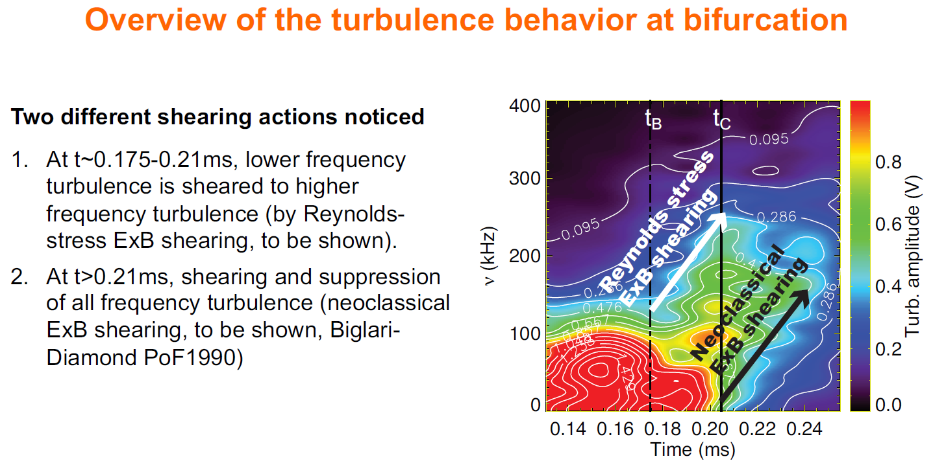

Slide 14
GYROKINETIC ANALYSIS OF PEDESTALS
M.T. Kotschenreuther TH/2-2
Explores “new”concept
Built on exploiting the “fingerprints” of pedestal instabilities
based on what they do
Specifically: their relative transport in different channels: a very important characteristic, whose consequences have not been realized till now
These differences among instability types are a consequence of fundamental differences in mode physics: what they are
We interpret multiple experimental observations of transport through these characteristic signatures of potential instabilities
We conclude, turbulent energy transport is dominated by
Micro-Tearing Modes (MTM) and Electron Temperature Gradient modes
Whereas, MHD-like modes (e.g. KBM) may dominate density transport

Slide 15
Uniquely different physics of these modes leads to their “fingerprints”, by using:
  Basic analytic kinetic theory
  Gyrokinetic simulation
MODE: | χ_{i} / χ_{e} | D_{e} / χ_{e} | D_{Impurity} χ_{e} | Inward particle pinches | Shear Sup- pressed?
MHD-like (e.g. KBM) | ~1 | ~2/3 | ~2/3 | No | NO
MTM | ~0 | ~0 | ~0 | No | NO
ETG | ~0 | ~0 | ~0 | No | NO
ITG/TEM | ≥ 1 | -0.2 - 1 | ~ 1 | Sometimes | Usually
Since velocity shear is strong in a pedestal, only a few types of modes can escape shear suppression (the above)

Slide 16
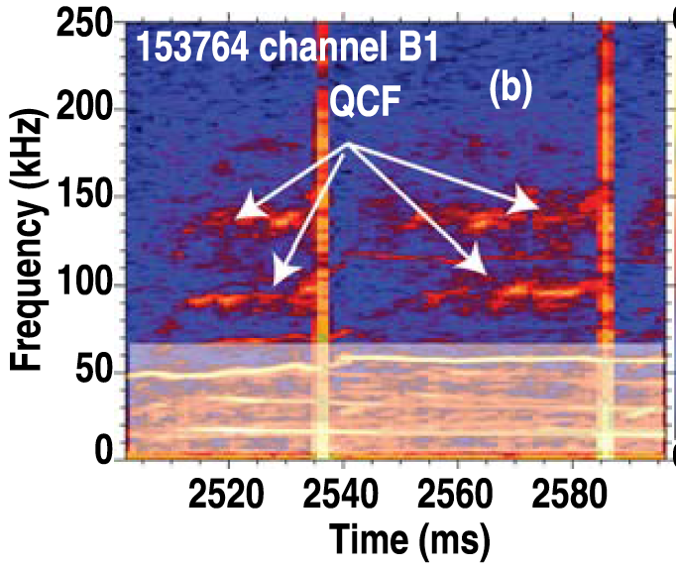

DIII-D 153764 Nonlinear Global MTM Simulations
Mode Type | Frequency (kHz)
MTM (global linear) | -350
MTM (non-linear downshift and broadening of linear frequency) | ~ - 200 (strong nonlinear downshift by 40%)
KBM (local linear) | ~ -35
MTM QCF ONLY affect T_{e} profile
Not other channels
Consistent with observations
T_{e}
n_{c}
n_{Carbon}
Nonlinear MTM
(1.5 x too high)
n_{e}
QCF
T_{i}
Linear KBM (4x too low)
  Mod 5 case: MTM roughly match QCF frequency, not KBM

Slide 17
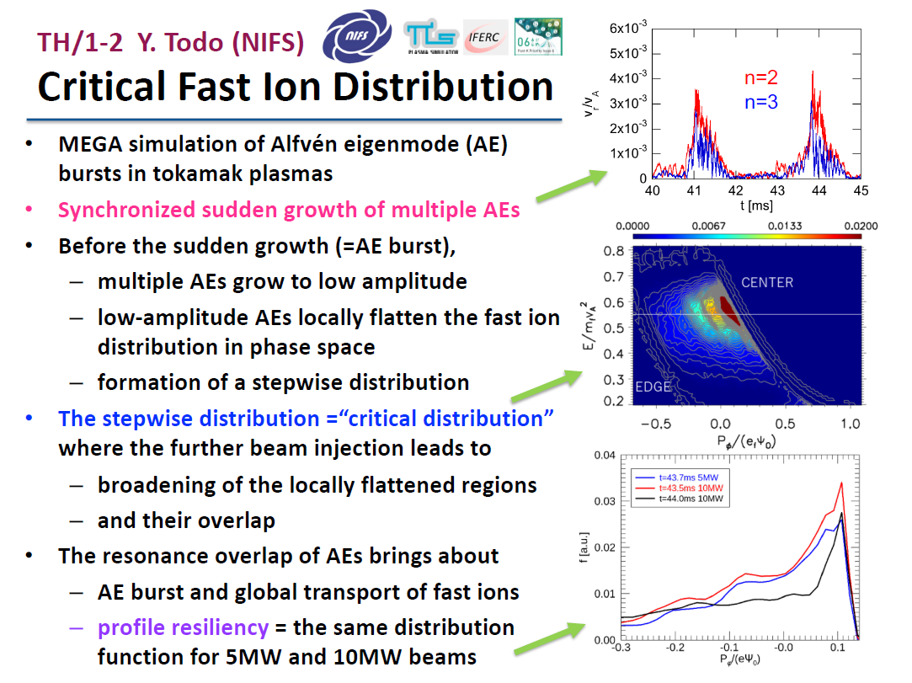
K. L. Wong, et al; Phys. Rev. Lett. 66, 1874 (1991)
Summary Magnetic Confinement Theory

Slide 18
Relevant questions for a burning plasma campaign
First principles and integrated modelling achievements towards trustful fusion power predictions for JET and ITER
TH/3-1 J. Garcia
Is the physics of pedestal, transport/turbulence, MHD and heating very different in DT with respect to DD plasmas?
Are the usual models used for predicting DD also valid for different isotopes?
Can we predict the neutrons generated in DD and extrapolate to DT?
Can optimum plasmas in DD be also optimum for DT operation?
Can JET-DT integrated operation be ITER relevant? i.e. it can help to minimize ITER risks in DT operation?
J. Garcia, 27th IAEA Fusion Energy Conference, Gandhinagar 25 October 2018|

Slide 19
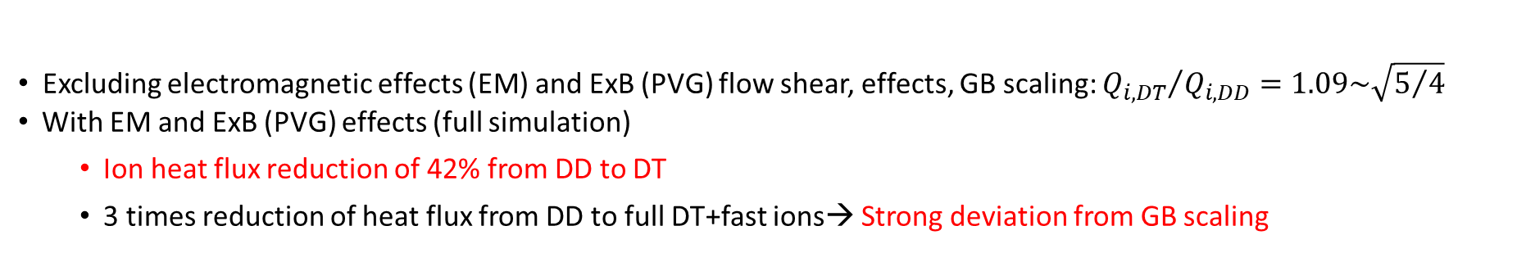
Isotope effects in DT ITER plasmas: strong heat flux reduction
Non-linear results of ITER hybrid scenario with GENE at $ρ=0.33$
J. Garcia et al. NF17
J. Garcia et al. POP18
Excluding electromagnetic effects (EM) and ExB (PVG) flow shear, effects, GB scaling: ${Q_{i,DT}}/{Q_{i,DD}=1.09\sim \sqrt{5/4}}$
With EM and ExB (PVG) effects (full simulation)
  Ion heat flux reduction of 42% from DD to DT
  3 times reduction of heat flux from DD to full DT+fast ions→ Strong deviation from GB scaling
Some of these effects are non-linear (zonal-flows) still have to be included in QL models, but some trends are captured
Message 3: DT isotope effects are complex and simplified modelling can only partially capture (for instance ExB shearing)
The physics of the DT isotope effect can be studied at JET for minimizing ITER risks
J. Garcia, 27th IAEA Fusion Energy Conference, Gandhinagar 25 October 2018|
Page 19

Slide 20
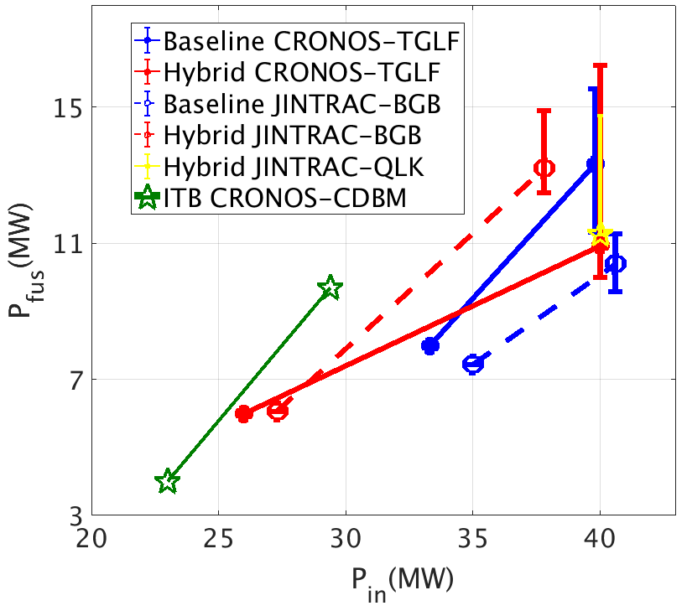
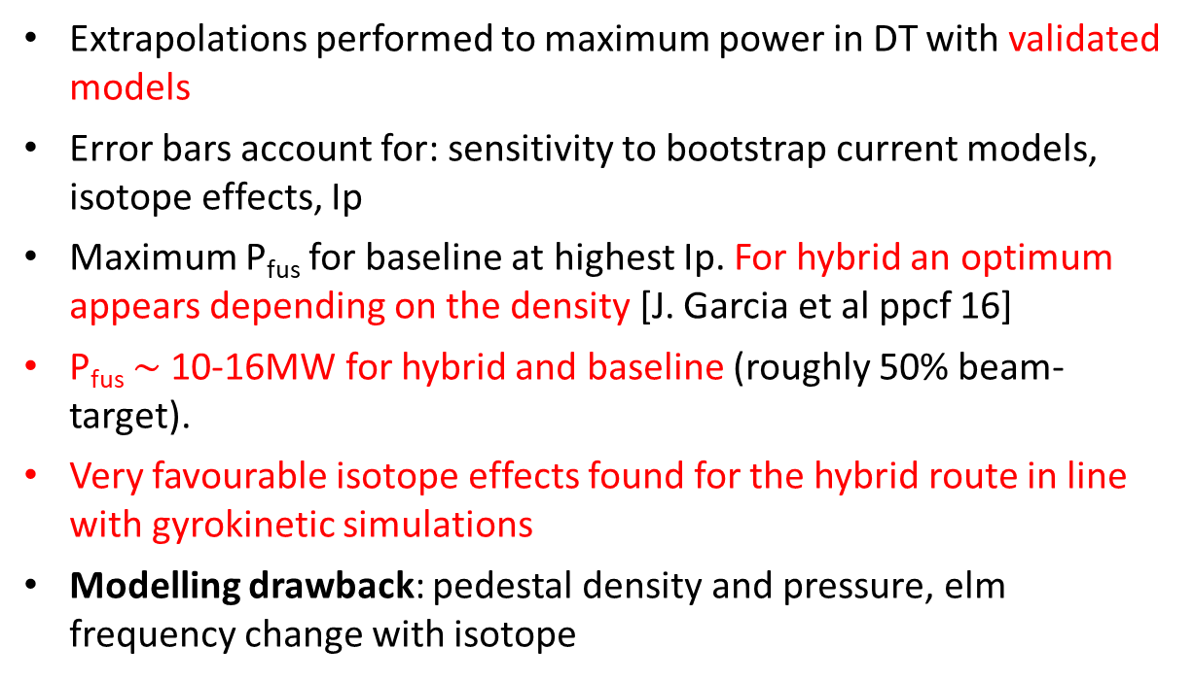
DT fusion power at JET extrapolation: significant isotope effects
Extrapolations performed to maximum power in DT with validated models
Error bars account for: sensitivity to bootstrap current models, isotope effects, Ip
Maximum P_{fus} for baseline at highest Ip. For hybrid an optimum appears depending on the density [J. Garcia et al ppcf 16]
P_{fus} $\sim$10-16MW for hybrid and baseline (roughly 50% beam-target).
Very favourable isotope effects found for the hybrid route in line with gyrokinetic simulations
Modelling drawback: pedestal density and pressure, elm frequency change with isotope
J. Garcia et al ppcf 16
S. Saarelma et al. ppcf 18
Message 4: Similar P_{fus} than the first DT campaign at JET but with plasmas closer to ITER conditions. The DT isotope effect obtained could be even underestimated
J. Garcia, 27th IAEA Fusion Energy Conference, Gandhinagar 25 October 2018|

Slide 21
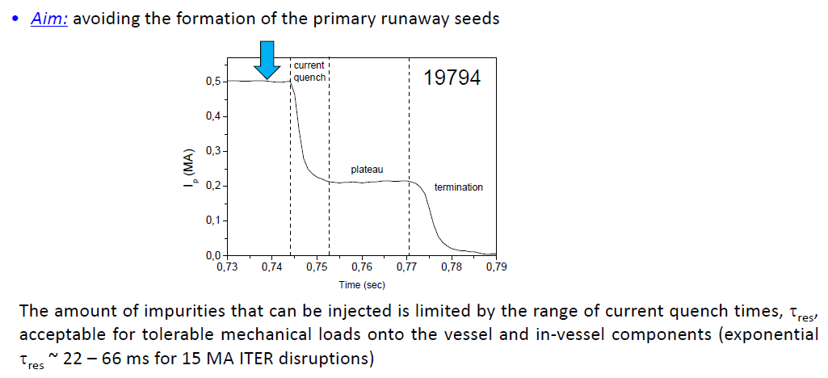
J.R. Martín-Sólis TH/4-1
Before Thermal Quench

Slide 22
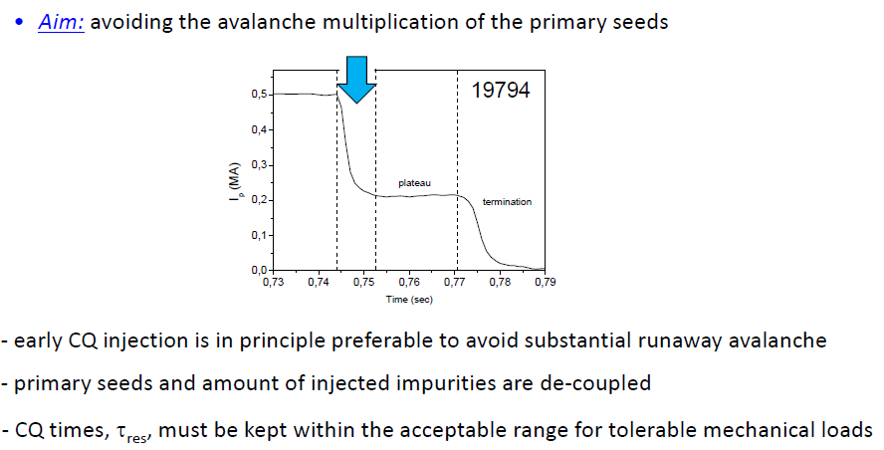
During the Current Quench phase of disruption

Slide 23
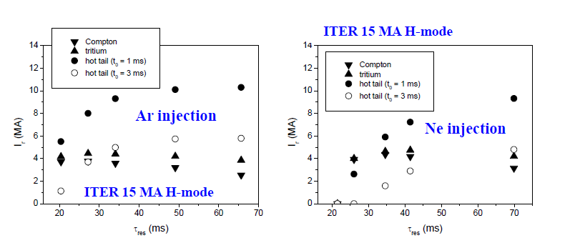
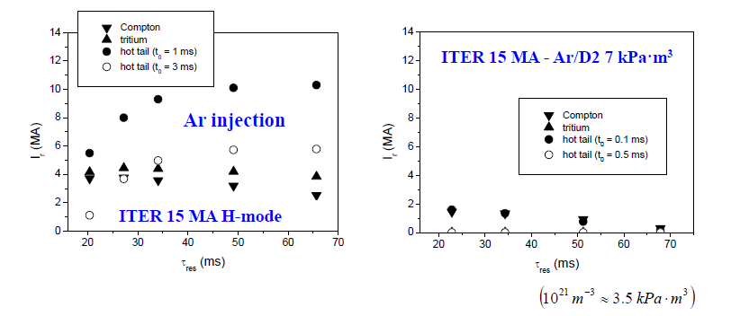
Injection of gas mixtures (Ar+D or Ne+D) might overcome limitations if a sufficient amount of Ar/Ne and deuterium (~ 14 kPa.m³ ) can be assimilated in the plasma

Slide 24
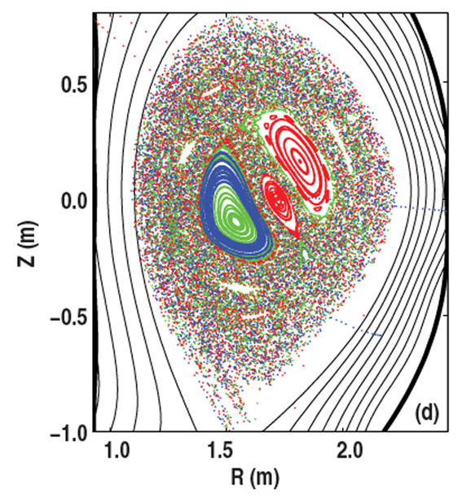
Self-consistent runaway beam formation in 3D magnetic fields during radiation-driven disruptions A. Matsuyama TH/4-2
2/13
Significant gap lies in our understanding of seed electron mechanisms in thermal quench (TQ)
Generation mechanisms
Transport/loss mechanisms
Seed currents are produced during TQ, e.g., by hot-tail mechanism due to radiative cooling
Prompt loss of runaways due to stochastization of magnetic field during TQ
[Yoshino+, NF2000]
Extremely large avalanche gain makes projection to ITER difficult
Scope of this work:
to address the gap by simulation of RE generation with MHD instabilities during TQ
Fokker-Planck sim. of hot-tail electrons
[Matsuyama & Yagi, PFR2017]
Stochasticity during MGI
[Izzo+, NF2011]
2/12

Slide 25
Proof-of-principle for 15MA ITER grade disruption simulation
4/13
Demonstrating the simulation of avalanche generation w/ MHD-based TQ model
T_{e}(0) = 20 keV, n_{D-T}(0) = 1.2 x 10²⁰/m³,
j(0)=1.52MA/m², Δn_{Ar} = 1.2 x 10²⁰/m³, Δt = 3ms, V=1000m³
n_{Ar}/(n_{D-T} +n_{Ar})
impurity
Argon (radially uniform)
W_{kin}^{MHD}(a.u.)
MHD (n=1-3)
TQ
T_{e} ^{r=0} (eV)[log]
~ eV range
I_{RE} (A) [log.]
seed
avalanche
E||/E_{c} (r=0)
voltage
I_{tot}, I_{RE} (MA)
CQ
plateau
TIME (ms)

Slide 26
Seed electron mechanisms for D-T activation phase
19/13
REs due to tritium decay and compton scattering of gamma rays
[Matsuyama+, 28th DDA Task Meeting, IPP Garching 2017]
Gamma-ray spectrum with MCNP
Gamma-ray flux
for 1.5GW JA-DEMO
(average over 4 poloidal location)
Table. evaluation of Compton seed electrons
Ref. | Γ_{γ} | dn_{RE}/dt(/m³/s) I_{seed} [A]
ITER (Feher, et al. PPCF2011) | 10¹⁸/m²/s | 10¹⁰/m³/s
ITER (Martin-Solis, et al., NF2017) | 10¹⁸/m²/s | 0.01-0.1A
JA-DEMO (I_{p}=12.3MA) | 6.3x10¹⁷/m²/s | 10¹⁰/m³/s 0.01-0.1A
Courtesy by Someya (QST)

Slide 27
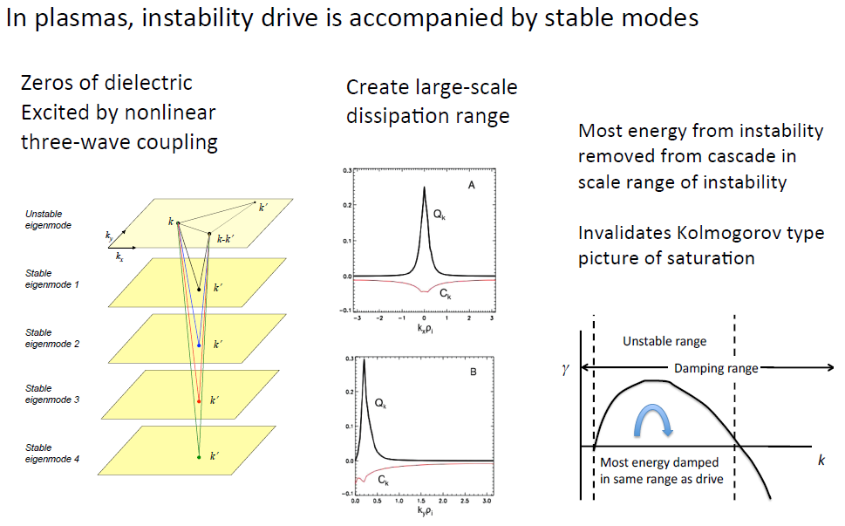
Scaling of Ion Temperature Turbulence and Transport
P.W. Terry TH/P6-19

Slide 28
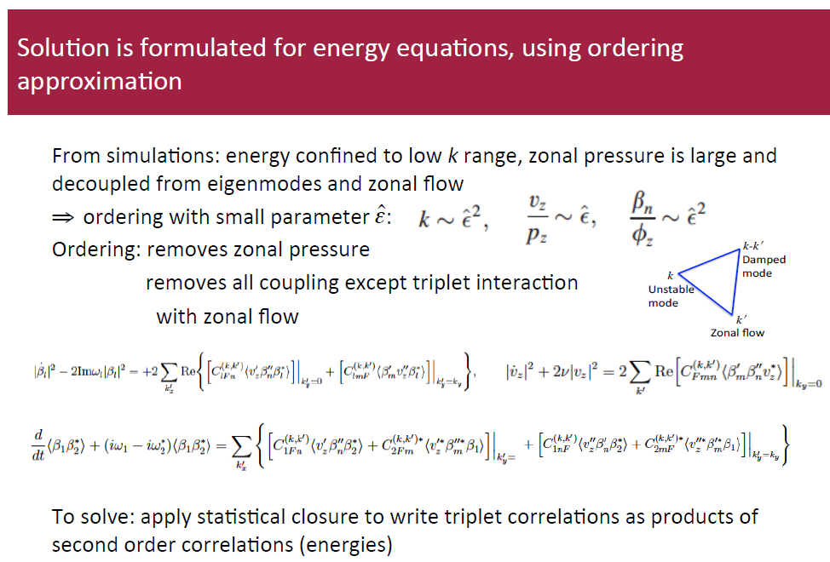

Slide 29
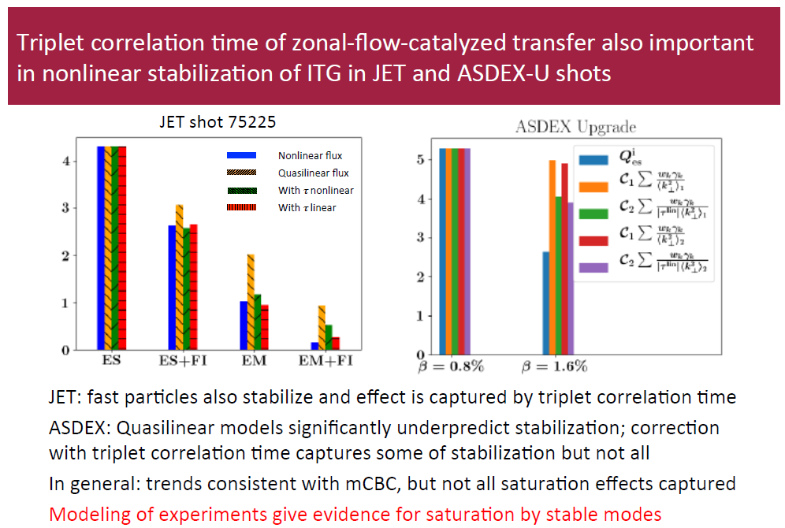

Slide 30
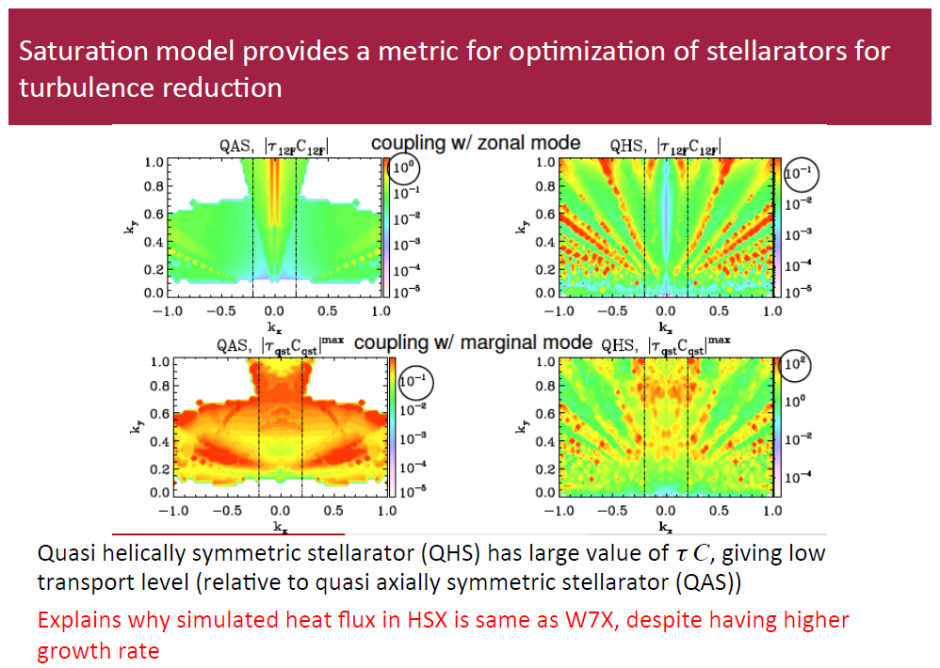

Slide 31
THANK YOU

