Slide 1
SUMMARY
- FIP, FNS, MPT, SEE -
TAKASHI INOUE
QST Naka
National Institutes for Quantum and Radiological Science and Technology
Naka Fusion Institute
ITER Japan Domestic Agency
Notes:
Thank you chairman. Good afternoon ladies and gentleman. It is my great honor to be here as a summary speaker of FIP, FNS, MPT and SEE.
I used to be a scientist of negative ion source and accelerator, and now working for ITER project. I apologize if my summary talk was too much biased to the heating systems and project oriented activities.

Slide 2
26th-27th FEC Statistics
Comparison of number of papers 27th 2018 (upper) and 26th 2016 (lower)
 | China | EU | India | ITER | Japan | Korea | Russia | USA | Others | Total
FIP | 6 (14) | 21 (40) | 63 (17) | 1 (0) | 16 (24) | 0 (2) | 4 (9) | 13 (13) | 1 (3) | 125 (122)
FNS | 5 (3) | 6 (3) | 34 (2) | 0 (0) | 5 (3) | 0 (0) | 2 (2) | 3 (1) | 1 (2) | 56 (16)
MPT | 3 (7) | 4 (9) | 14 (1) | 0 (0) | 2 (13) | 0 (0) | 4 (3) | 2 (6) | 3 (7) | 32 (46)
SEE | 1 (0) | 5 (3) | 2 (0) | 0 (0) | 4 (3) | 0 (0) | 0 (0) | 0 (0) | 0 (2) | 12 (8)
Total | 15 (24) | 36 (55) | 113 (20) | 1 (0) | 27 (43) | 0 (2) | 10 (14) | 18 (20) | 5 (14) | 225 (192)
Great contribution from India (20 -> 113), covering ADITYA, SST-1, ITER and DEMO.
Paper increasing in FNS (neutron sources) and SEE (socio-economics, safety and waste).
Notes:
Stats. This is a table summarizing number of papers in each category. You see there was a great contribution from India, covering wide range of engineering and technological activities. I will touch this point later. Another trend is now papers are increasing in FNS and SEE.

Slide 3
Oral topics
Oral topics of 2018 FEC almost identical to those of 2016.
ITER Technology
  Construction on site,
  Superconducting coils:
  TF coil structure, Center solenoid,
  Heating system: ECH, ICH, NBTF,
  Diagnostics: mirror, integrated design,
  TBM,
  Disruption mitigation system,
  JT-60SA
DEMO and Advance Technology
  EU/JA DEMO design,
  Current drive,
  Negative Triangularity Tokamak,
  Liquid Li limiter, Liquid Tin limiter
In Vessel components and plasma interface
  First wall for DEMO, Tungsten PFCs, Thermo-mechanical modelling
MPT, FNS, SEE
  Fusion Neutron Source
  Tritiated dust, Fuel retention,
  Biomass utilization by Fusion heat
Notes:
Oral topics. We had several oral topics in the technology categories, they were ITER Technology, DEMO and advanced technology, In vessel components and plasma interface, and Material, FNS, Environment. This is almost identical to those of previous Kyoto conference. In each topics, presentation of these contents were included. Here I want to revisit these presentations

Slide 4
ITER Technology
OV/1-2 Bigot
Worksite progress
2,300 workers are working everyday.
4th Oct. 2018
Notes:
ITER Technology. Construction of ITER is in progress, and 2,300 workers are working everyday. Construction is on-going in parallel all over the wide construction platform.

Slide 5
ITER Technology
OV/1-2 Bigot
Cryostat
Vaccum vessel
Port
Manufacturing progress
TF coil winding
PF coil
Cryoplant
Notes:
Manufatcuring of components are also in progress in each participating parties. You see here vacuum vessel, cryostat, vacuum vessel port, TF coil winding, PF coil, cryoplant. Such large components are being built to achieve first plasma 2025.

Slide 6
ITER Technology
OV/1-1 Chakraborty
Challenges – Some examples (1/2)
Cryostat
  Distortion control & Dimensional accuracy (~0.3%) in welding across 25-200 mm thick SS304/304L for ~29 m dia, ~29 m height structure
  Segmentation, assembly in workshop and pit assembly and welding
Cryo lines and Cryo distribution
  Cryolines: Low heat load 1.2 W/m @ 4.5 K & 4.5 W/m @ 80K, Multiprocess lines (upto 7 process pipes). 5 km of cryogenic transfer lines
  Cryo Distribution: Minimizing the pulse effect to 75 kW refrigerator, using a 3 kg/s cold circulator – which requires development
IWS
  Ensuring ~9000 block assemblies out of 3,50,000 components
  Establishing corrosion data for IWS under simulated operating conditions
CWS
  System Design, taking into account concurrent client design evolution
  Execution of manufacturing of >20 km hydraulic piping under stringent quality requirements, Procurement management in phase with construction activities
Challenging everyday, and ITER is moving forward everyday.
Notes:
Chakraborty presented challenges of component manufacturing. There are many challenges everyday. And resolving these issues, ITER is moving forward everyday. This is the everyday of ITER life, and hence, ITER technology is progressing everyday.

Slide 7

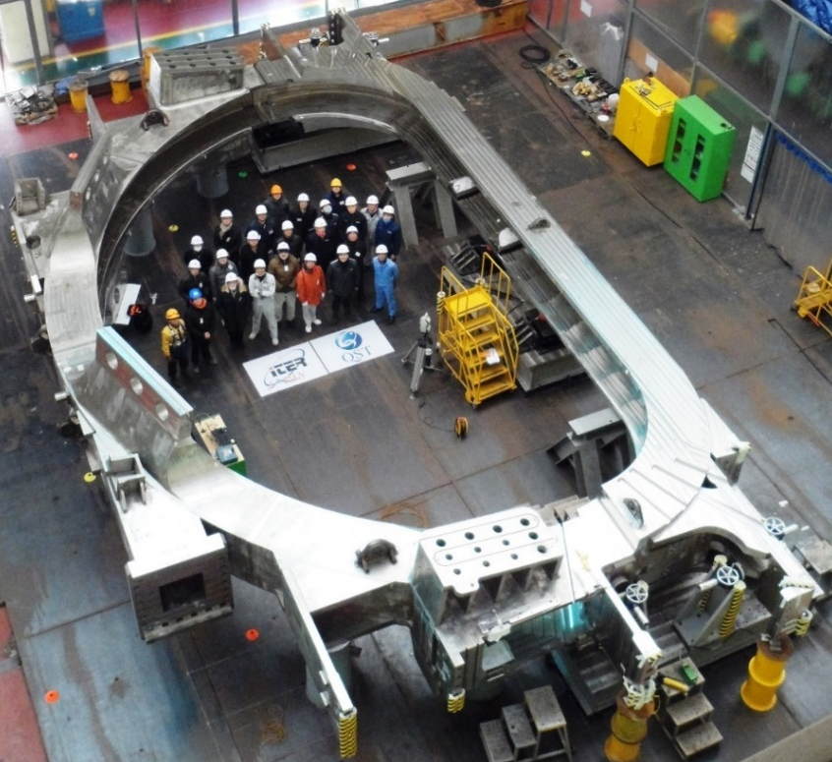
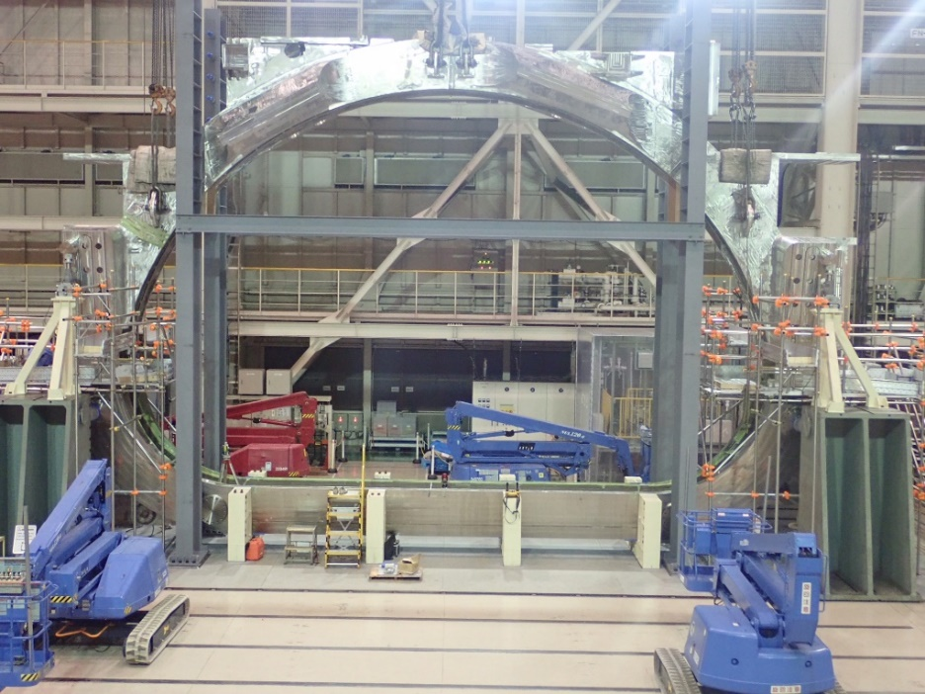
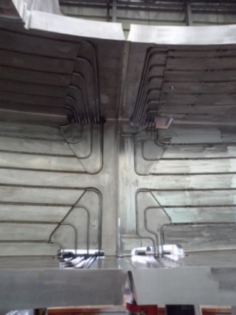
ITER Technology
FIP/1-1 Nakahira, FIP/P1-4 Smith
Completion the first TF coil structure of ITER
The first ITER Toroidal field Coil Structure (TFCS) has been successfully completed by Japan and Korea.
This was achieved resolving five major breakthroughs:
i) New materials, ii) Partial penetration welding, iii) Welding deformation control, iv) Specialized ultrasonic testing, and Fitting the large (16 m x 9 m) structure within tolerances of 0.5 mm.
Aligned
grooves
Fitting test at Hyundai Heavy Industries (left) and at Mitsubishi Heavy Industry(right), where inboard and outboard structures were placed 0.5 mm apart each other
First module of Center Solenoid scheduled for completion in 2018
Notes:
There was a report of Nakahira on the completion of the first TF coil structure of ITER. This is the picture of this TF coil structure. It is 16m and 9 m wide big stainless steel magnet case. Although this is big structure, the dimension tolerance is of the order of millimeter. In particular the bevels to close the case here and bevels connect inboard and outboard structure here are required to fulfill o.5 mm plus-minus 0.25 mm. Such very precise machining was achived in this TF coil structure.
There was Another talk from Smith of USA. He reported progress of Center solenoid. The first module of CS is scheduled for completion in this year.

Slide 8
ITER Technology
FIP/1-2Ra Oda, Rb Gantenbein
Status of ITER Gyrotron R&D in JA, RF, EU and IN
Notes:
Let’s move on to the heating and current drive system. This table summarizes status of ITER gyrotron R&D in JA, RF, EU and IN. Both Russia and Japan have already achieved 1 MW of RF power at 170 GHz for long pulses. So the gyrotrons for first plasma are ready for operation.

Slide 9
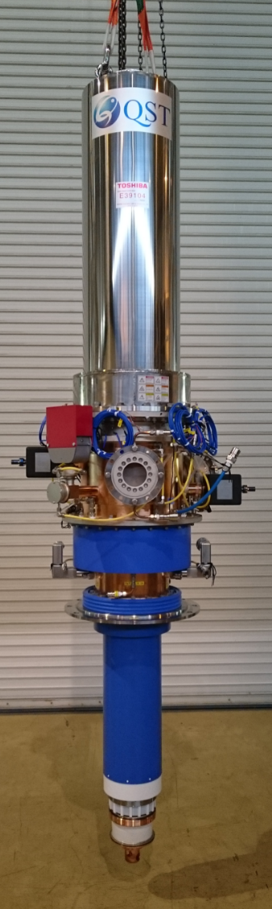
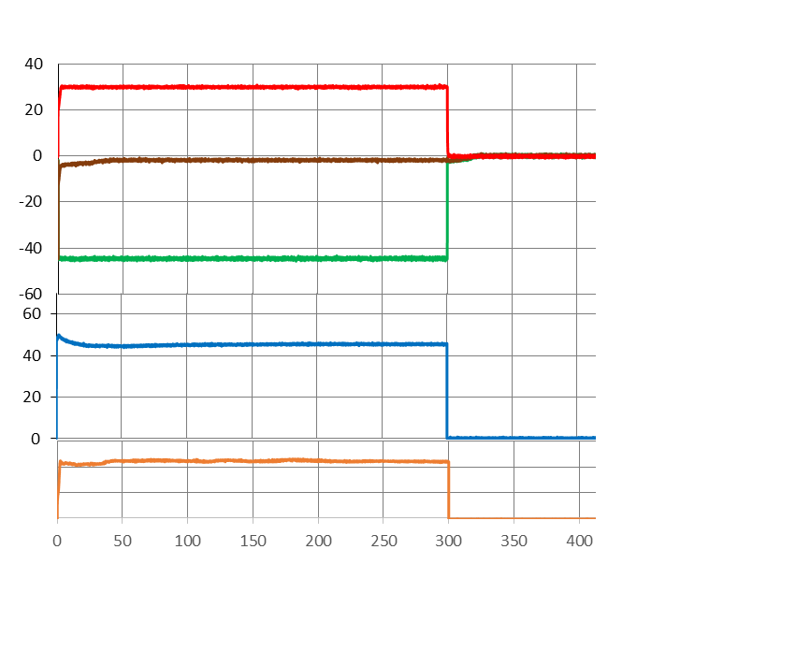
ITER Technology
1st 170 GHz Gyrotron demonstrated 1 MW output
FIP/1-2Ra Oda
CW operation
1st ITER gyrotron
Modulation
Body voltage
5 kHz modulation achieved at 200 s pulse with 0.84 MW power.
Anode voltage
Voltage [kV]
Reliability
Cathode voltage
300 s
95% reliability was achieved
with 20 shots of 1MW / 300 s pulse.
Current [A]
Beam current
1st ITER gytoron is now
Ready for Shipment to ITER.
RF
[a.u.]
RF signal
1 MW
Time [s]
170 GHz / 300 s pulse with 1.04MW output power at 51% electric efficiency succeeded achieving criteria for acceptance.
FIP/1-2Rb Trivedi
1st ICRF source for ITER was tested (1.5 MW/55 MHz) with 5 shots each for 2,000 s.
Notes:
Oda reported recent achievement of 1st 170 GHz gyrotron demonstrating 1 MW output for 300 s. It also fulfilled the requirement of modulation and reliability. Thus the 1st ITER Gyrotron is now ready for shipment to ITER.
Trivedi reported test of 1st ICrF source for ITER, also here long pulse operation was confirmed.

Slide 10
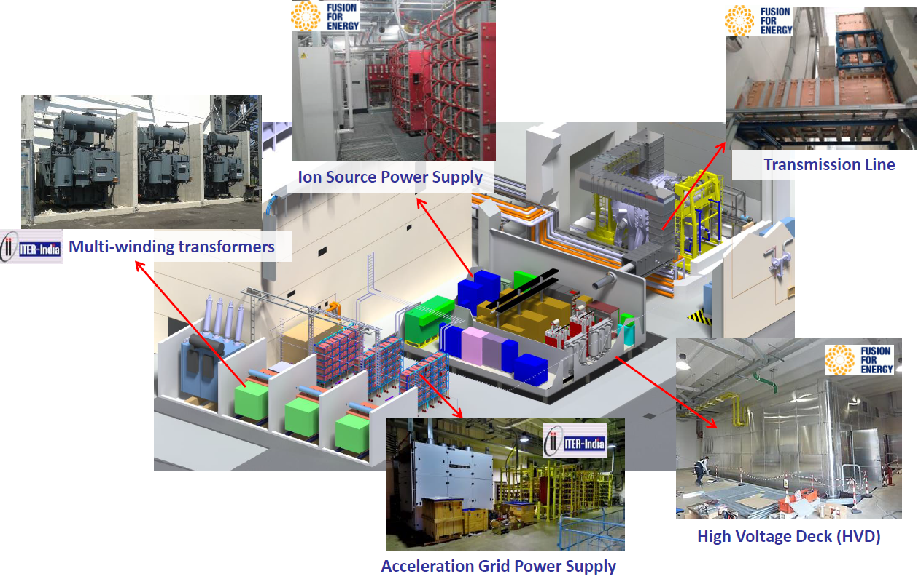
ITER Technology
FIP/1-3Ra Joshi, Rb Toigo
ITER Ion Source Test Facility: SPIDER started operation
Spider negative ion source, identical to that of ITER
Power supplies provided by F4E and ITER India
Notes:
This slide shows a progress of ITER neutral beam system reported by Joshi and Toigo. As you know, we are building neutral beam test facility in Padova Italy, the NBTF consists of Ion source test facility and injector test facility. The ion source test facility was made up of EU and Indian contributions. Now ITER ion source test facility, SPIDER started operation.

Slide 11
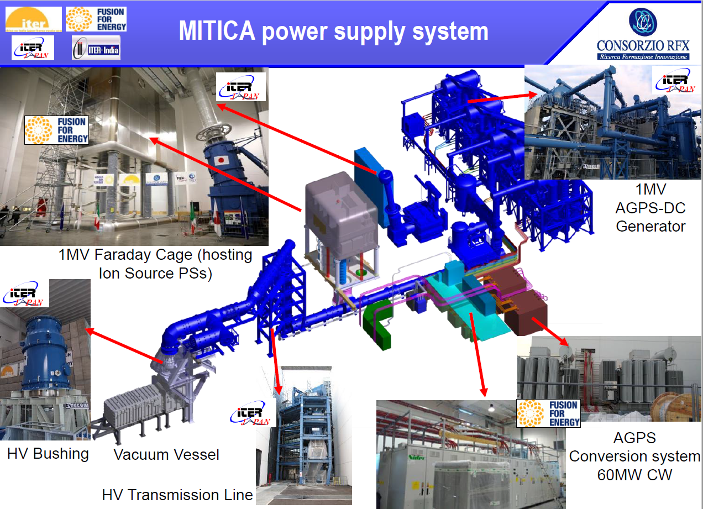
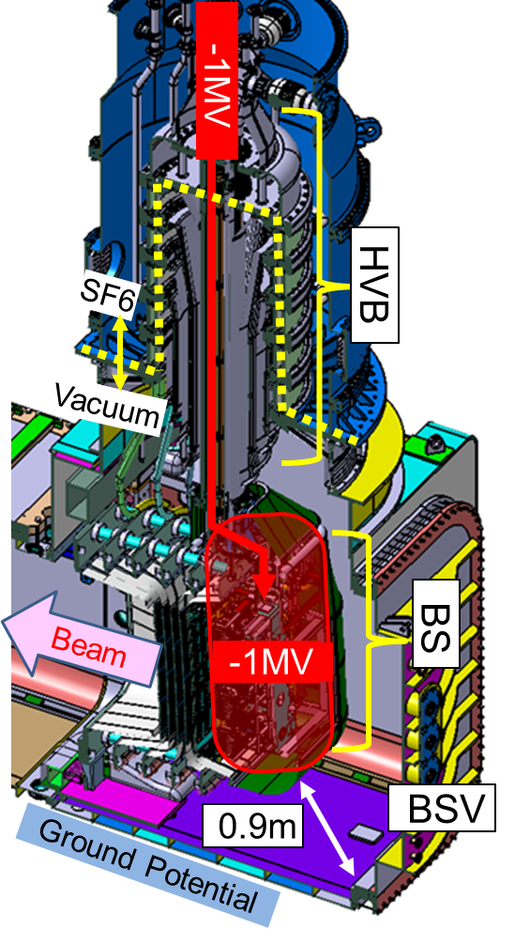
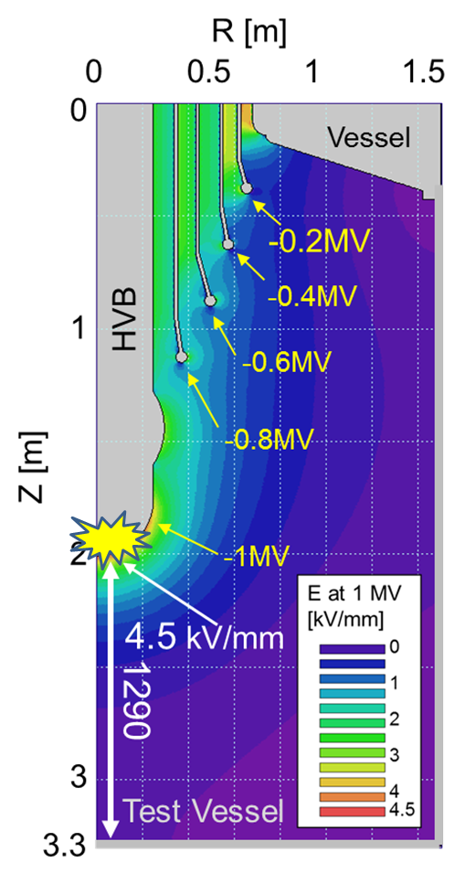
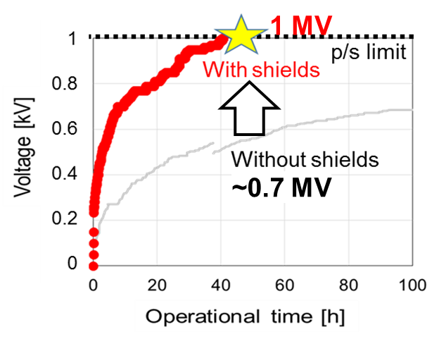
ITER Technology
FIP/1-3Rb Toigo, Rc Kojima
ITER Injector Test Facility: MITICA, 1 MV insulation test started.
1 MV Beam Source
HV bushing (HVB)
Beam source (BS)
Breakdown
~0.7 MV
Vacuum insulation
optimization.
Most of power supply components delivered and installed.
Notes:
Another progress from neutral beam test facility. Toigo and Kojima reported progress of ITER injector test facility: MITICA. MITICA 1 MV power supply was procured by Japan, all components were already shipped to Italy, assembled, installed on site, and it started 1 MV insulation test on the Padova site.

Slide 12
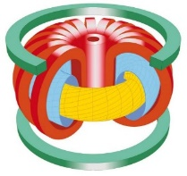
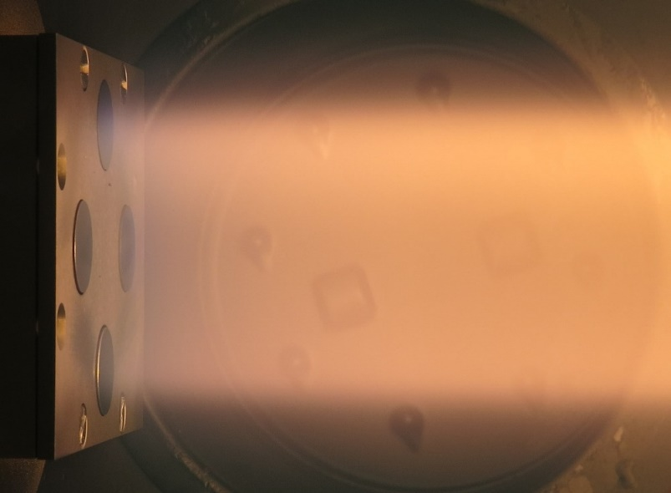
ITER Technology
FIP/1-4 Litnovsky, 1-5 Mukhin
Diagnostic mirrors for ITER
from ITPA
Integration in ITER Divertor
Thomson Scattering & Laser-induced Fluorescence
ITPA
35 diagnostics using 85 mirrors in total,
In situ cleaning of mirrors by plasma sputtering planned,
Shutters, gas shutters and ducts to suppress the mirror contaminations
Mock-up testing underway, testing of real-size prototype started
Long distance transmission of laser light,
Design constraints, vacuum boundary, fire protection …
Interface with building, other systems,
Diagnostics requirement for physics.
Mirror as an interface with Plasma
Integration of diagnostics within ITER
Mirrors in PSI 2 linear plasma device
Copy right Forschungzentrum Julich
Notes:
Here two talks from Litnocsky and Mukhin for the ITER diagnostics R&D. Litnovsky reported R&D of mirrors for ITER diagnostics. Mukhin reported integration of diagnostics within ITER. Interface with plasma and integration of system within the large tokamak are one of concerns tackled by many of us.

Slide 13
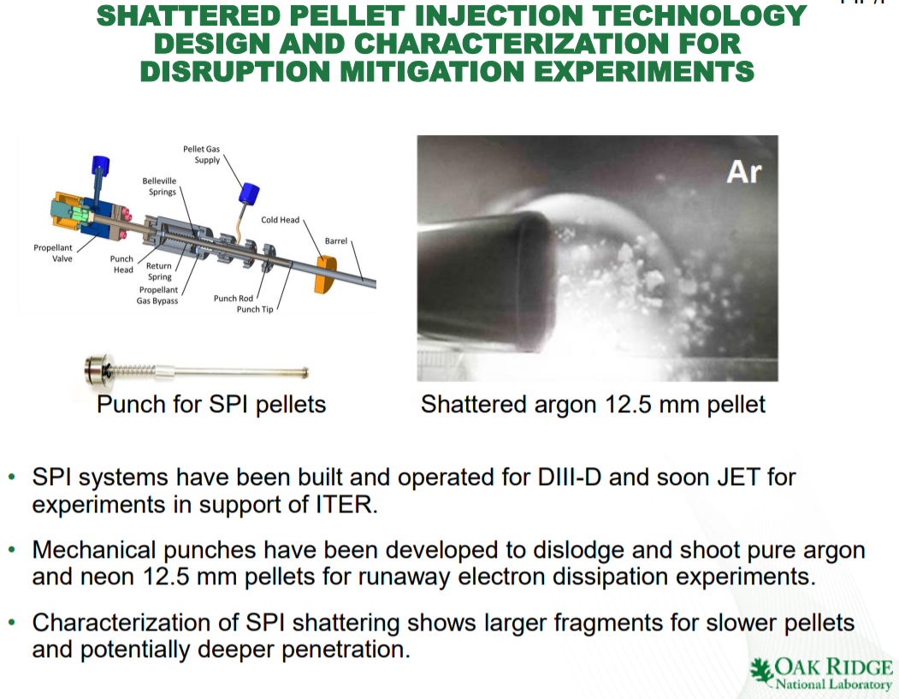
ITER Technology
FIP/P1-1 Baylor
ITER equips enough number of Shattered Pellet Injectors (SPI)
for disruption (incl. runaway electron) mitigation.
Notes:
Another ITER technology development. Baylor presented development of shattered pellet injector for disruption mitigation. This is a hot issue in ITER now, and ITER will equip enough number of Shattered pellet injector for disruption mitigation including runaway electron prevention and mitigation.

Slide 14
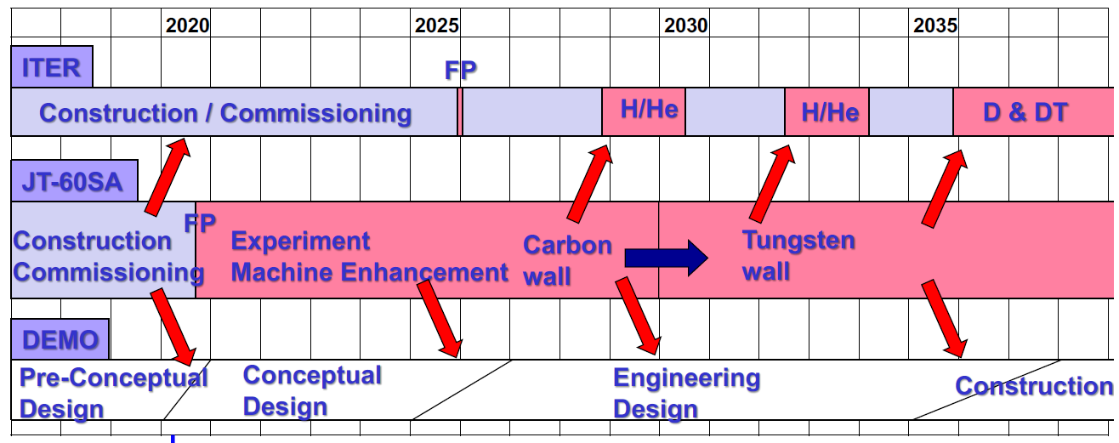
ITER Technology
OV/3-1 Barabaschi
Assembly of JT-60SA in progress on schedule
JT-60SA supports ITER addressing key engineering and physics issues for ITER and DEMO.
Notes:
Barabaschi reported progress of JT-60SA assembly. Now the vacuum vessel has been closed with 18 TF coils in the place with good positioning accuracy. He showed how JT-60SA can support ITER and DEMO addressing key engineering and physics issues.

Slide 15
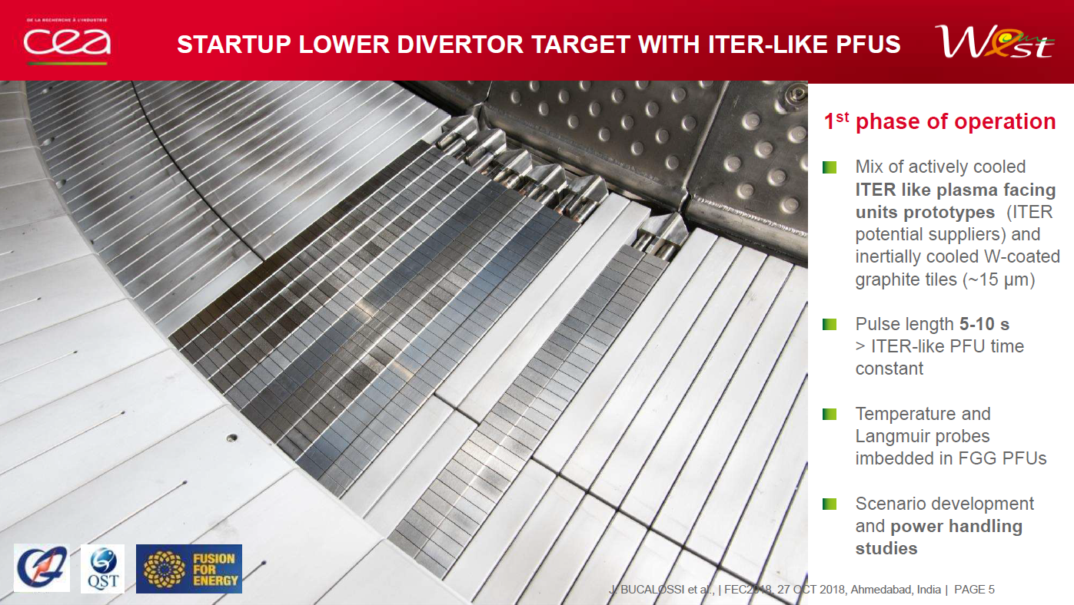
ITER Technology
PD/1-2 Bucalossi
Tungsten Divertor test at WEST
Notes:
Bucalossi reported status of tungsten divertor test at WEST. Here several ITER like plasma facing unit prototypes were installed in the lower divertor target. The high power test is schedule in November this year.

Slide 16

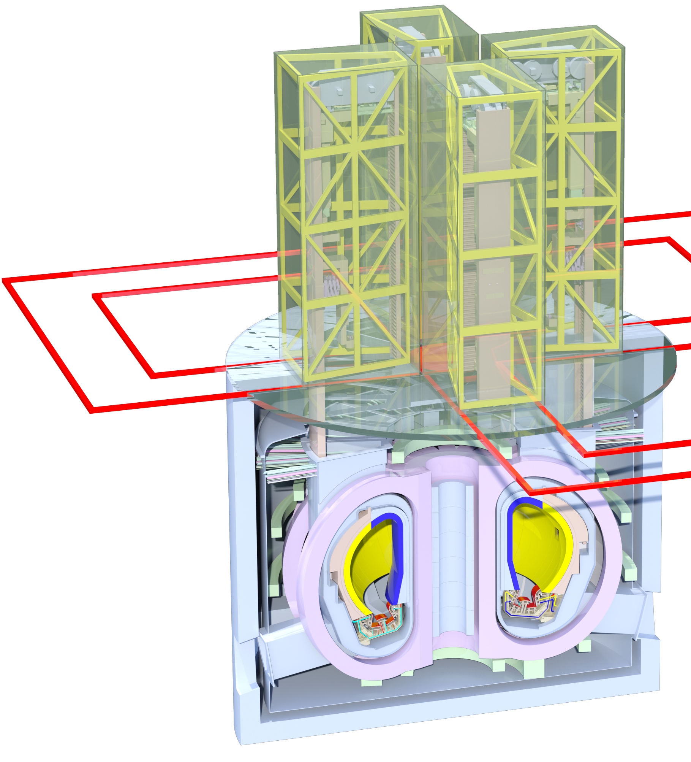
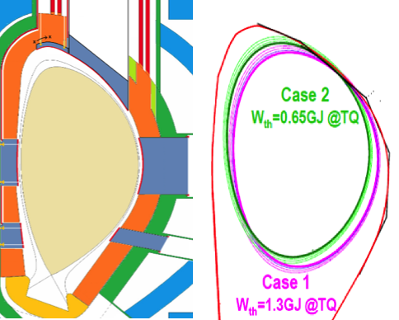
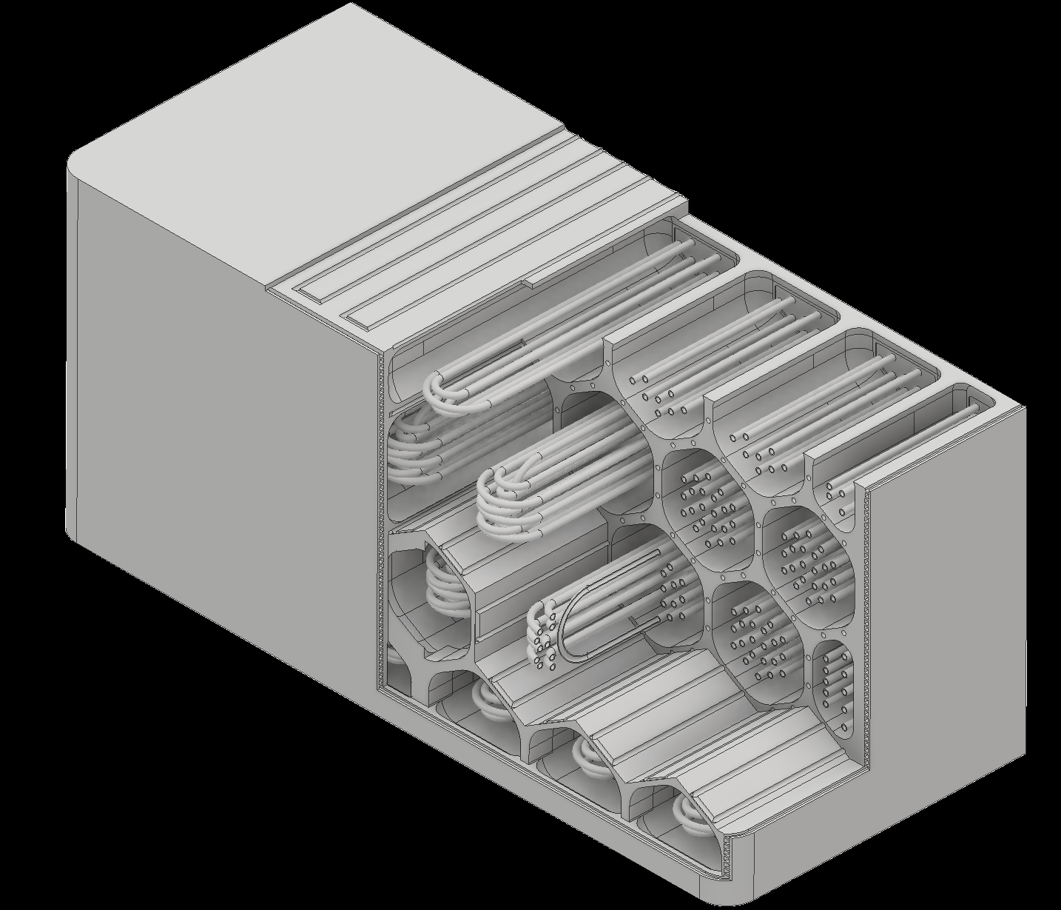
DEMO& Advance Technology
EU/JA DEMO both in preconceptual design
EU & JA:
similar DEMO
timeline
EU DEMO (FIP/3-1 Federici)
JA DEMO (FIP/3-2 Sakamoto)
Key lessons learnt during DEMO pre-CD phase
Still large plasma physics uncertainties that impact the design (Off- normal transients)
Integration of multiple design drivers across different systems (BLK maintenance, piping)
To increase feasibility of concept, physics and engineering designs are progressed.
Compatibility btw core and divertor plasmas
Pressure-tightness BLK with TBR > 1.05
RM scheme with availability up to 70%
Mitigation of TF tolerance
Notes:
Next topics, DEMO and advanced technology. There were presentations from EU and JA on their DEMO design activities. Both of them are in pre-conceptual level. And their time schedule is similar toward DEMO. Federici pointed out uncertainty of plasma physics and integration issue for example in blanket maintenance. Sakamoto presented progress in physics, TBR, machine availability and so on.

Slide 17
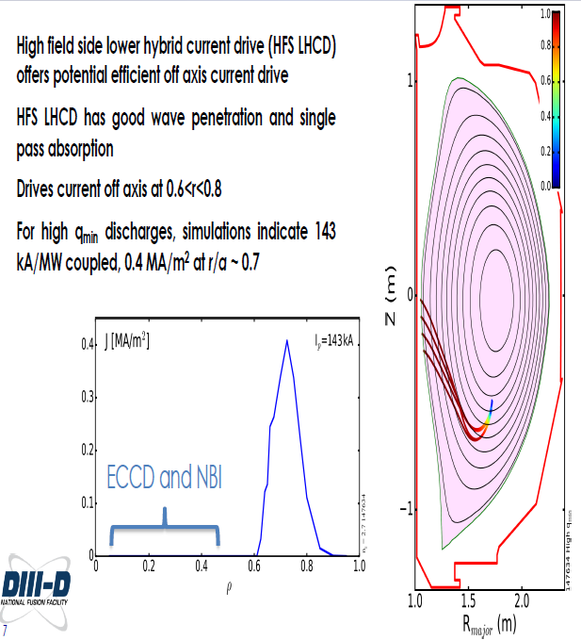
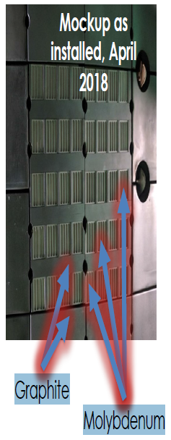
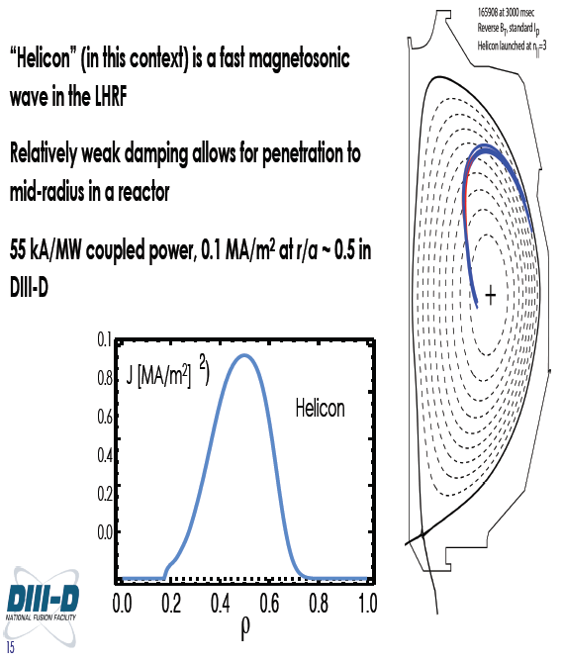
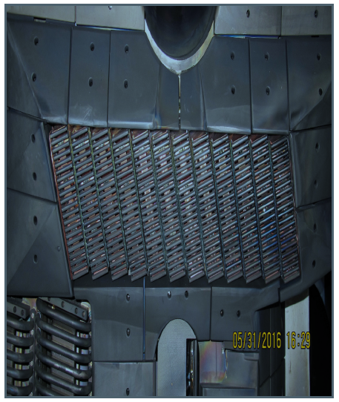
DEMO & Advance Tech.
FIP/3-3 Wallace
Efficient, off-axis RF current drive by HFS LHCD and Helicon
in DIII-D and future tokamak reactors
LHCD: 0.4 MA/m2 at r/a ~ 0.7, 143 kA/MW
Helicon: 0.1 MA/m2 at r/a ~ 0.5, 55 kA/MW
Notes:
Wallace presented a novel current drive method in DIII-D, LHCD from high field side, and Helicon current drive.

Slide 18
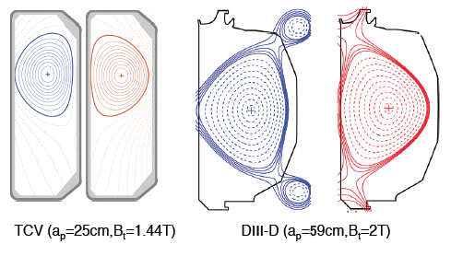
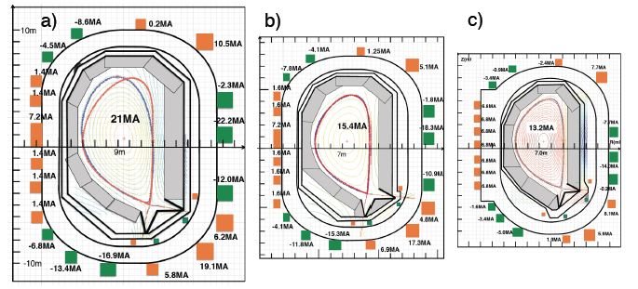
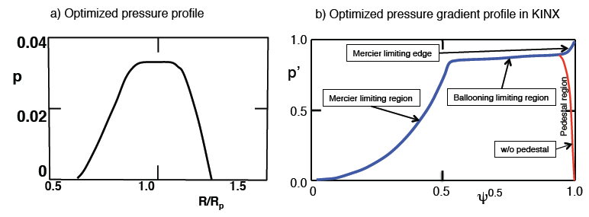
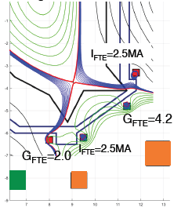
DEMO & Advance Tech.
FIP/3-4 Kikuchi
NTT: “Power handling-first” Negative Triangularity Tokamak
Success of TCV& DIII-D experiments DIII-D: β_{N}=2.6, HH=1.2, L-mode edge, M. Austin(this conference)
FEC2016 (R=9m, 3GW, SSO ) FEC2018(R=7m, ~2GW, SSO)
D. Chen System code (δ<0) , T. Ando, Racetrack TF design
2.5MAT FTE coils :
J. Li
Grazing angle: ~2 deg.
Both legs controllable
β_{N}>3 stable:Mercier limited core ballooning limited outer
(S. Medvedev, NF2015)
Small pedestal pressure limit to reduce ELM energy loss
(G. Melre, PPCF2017)
Power handling in long pulse operation
Notes:
Kikuchi presented a new reactor design based on negative triangularity with L-mode edge. It maximizes power handing area by locating divertor to large major radius and expanding flux tube. MHD stability calculation shows reasonably high beta relevant to fusion reactor. They also showed compact reactor size can be realized by higher confinement and/or higher field. This concept is experimentally supported by TCV and DIII-D tokamaks with high confinement with L-mode edge.

Slide 19
In Vessel Components
FIP/3-6 Goldstone
FIP/3-5Ra Maingi
FIP/3-5Rb Mazzitelli
Advanced concepts of Flowing Liquid Limiters:
Li in EAST (open flow in vacuum)
SN in FTU (capillary porous) tested
tested in plasma,
Li vapor limiter concept proposed
Notes:
In this conference, to solve the issue of high heat flux on in vessel components, two advanced concept of flowing liquid metal limiter concepts have been presented. One is Flowing Liquid Lithium limiter from EAST reported by Maingi. This is an idea to flow Liquid lithium in vacuum. And the other one is Liquid Tin limiter made of capillary porous reported by Mazzitelli. There influence to the plasma performance were found good in liquid lithium limiter and okay in liquid tin limiter.
Goldstone proposed a unique idea of Lithium vapor box divertor concept.

Slide 20


Tritiated dust in tokamak
SEE/1-1 Grisolia
What to take away ...
Large set of dust properties including particles of high chemical reactivity
  Dust collection needed during the ITER life
Dust Tritium inventory:
  ~10 GBq/g for W, unknown for Be
Dust adhesion/aerosol creation:
  Metallic dust are covered by an electrical insulating layer
  Tritiated metallic dust are positively charged
  Adhesion:
    In case of isolated particles, tritiated dust adhesion 
    In case of aggregate, tritiated dust adhesion remains unknown
Tritium measurement in aerosol:
  Open issue due to limited β path in material
  Needs: development of real-time diagnostic
Toxicity Studies of W Tritiated/untritiated dust :
  Rapid dissolution in biologic media
  no Cytotoxicity observed (no lung cell toxicity)
  Genotoxicity induced
Tritiated dust from nuclear safety aspect:
Dust behavior in vacuum vessel
Dust collection needed in ITER
Complementary studies needed
(inhalation on rodent, tritiated Be)
Notes:
Grisolia pointed out concerns on tritiated dust from nuclear safety aspect. He presented dust behavior in vacuum vessel, and stressed that dust collection is needed in ITER.

Slide 21
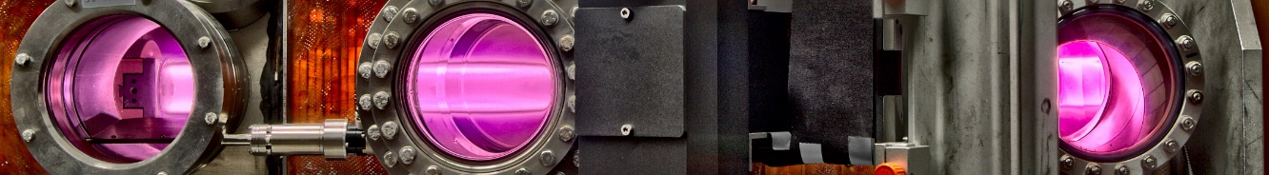


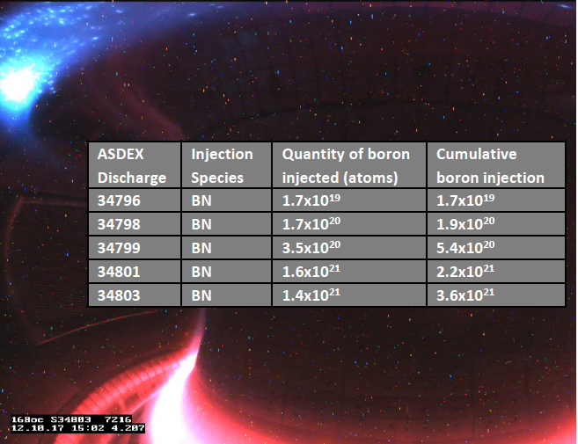


In Vessel Components
Influence of Plasma Impurities
on the Fuel Retention in Tungsten
FIP/2-3 Lunsford
in PSI-2 and Pisces-A
MPT/1-1 Kreter
Initial AUG experiments suggest that boron powder injection can be used to augment boronization coating during tokamak operation
  Successful modification of edge impurity levels
  Successful access to low density for RMP ELM suppression
  Upcoming experiments planned to corroborate results and optimize technique
Addition of He reduces the D retention by a factor of 3 - 10
For D+He+Ar, the D retention does not significantly change compared to pure D
Effect of Ar and Ne is temperature dependent: increase of D retention at T_{s}=500 K but reduction at T_{s}=770 K (for E_{i} > E_{threshold})
Addition of nitrogen increases the D retention by a factor of ~10 and ~100 for 500 K and 770 K, respectively. N enriched layer serves as a desorption barrier for D.
Particulate wall conditioning could aid steady-state operation where initial coatings will erode rapidly
Advanced concepts of:
B powder injection,
D Retention in W with impurities tested.
Notes:
Two advanced concepts were reported in the conference.
Lunsford reported boron powder drop into ASDEX upgrade plasma.
And Kreter reported influence of plasma impurities on the fuel retention in Tungsten, showing He reduces D retention considerably, but addition of nitrogen increases retention significantly. This is the first systematic experiment to figure out the retention in tungsten with impurities.

Slide 22
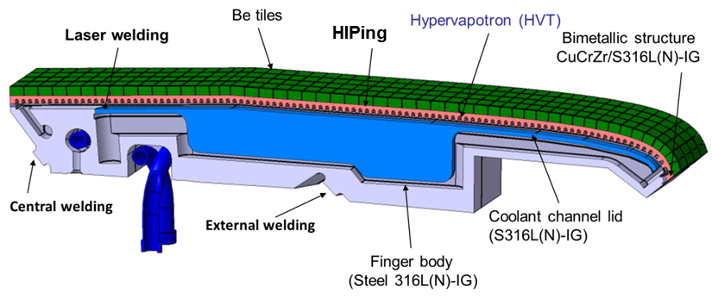
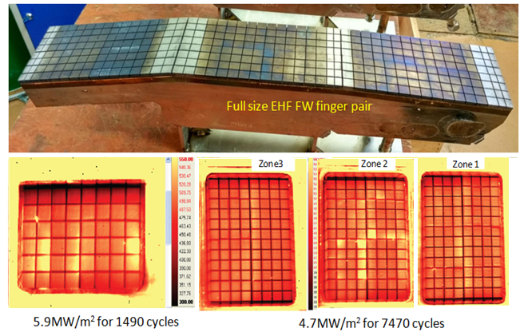
In Vessel Components
FIP/2-1 Chen
ITER Enhanced Heat Flux First wall
Outlet
inlet
Design optimization to reduce thermal strain
Improvement of Be/CuCrZr bonding
Strengthening CuCrZr/316L(N) bonding
Improving CuCrZr alloy property
5.9MW/m² at 1490th cycle 4.7MW/m² at 7470th cycle
Chinese First Wall for ITER qualified to proceed procurement, as the result of High Heat Flux test at Efremov.
Notes:
Chen reported the design and analysis of ITER first wall. As a result of high heat flux test at Efremov Institute, the Chinese First wall was qualified by the ITER organization, and they proceeded to the procurement, mass production of such first wall for ITER.

Slide 23
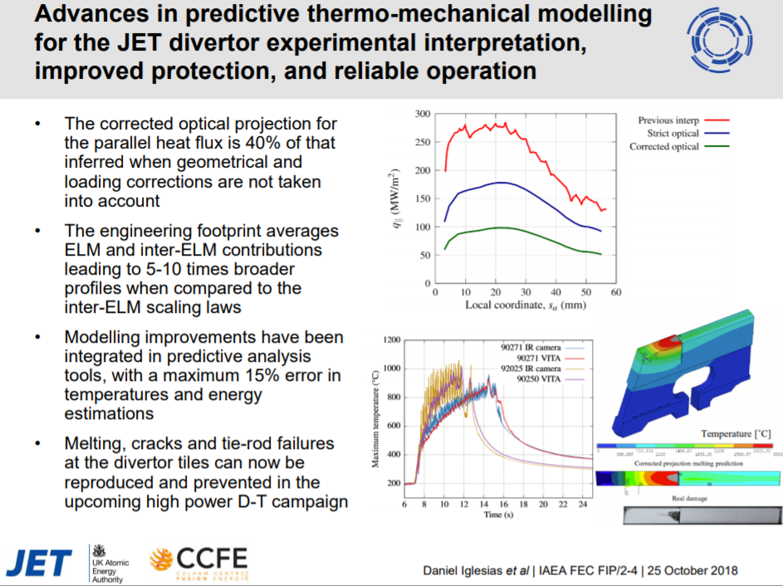
In Vessel Components
FIP/2-4 Ingresias
FIP/2-2 Barrett
Advanced thermo-mechanical modeling for JET divertor
EU DEMO limiter designed forplasma transient.
Notes:
Ingresias reported thermo-mechanical modelling for JET divertor, and Barrett reported plasma wall protection in EU DEMO for its plasma transition.

Slide 24






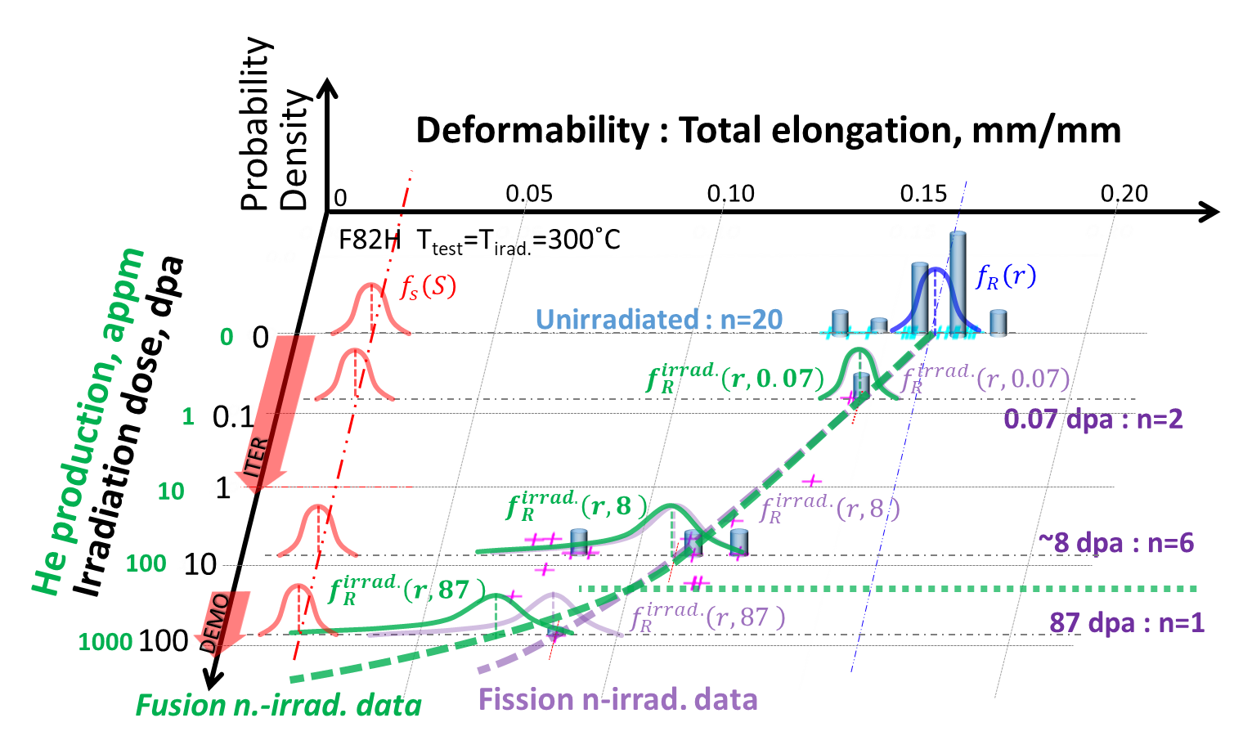
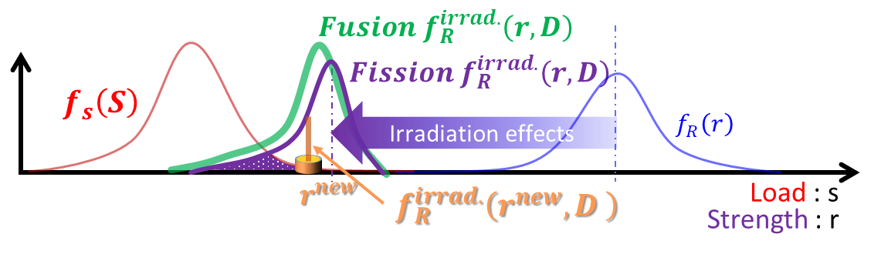
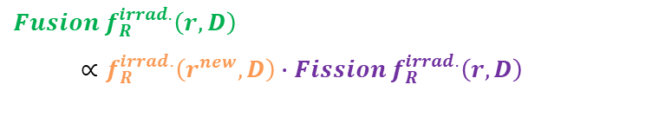
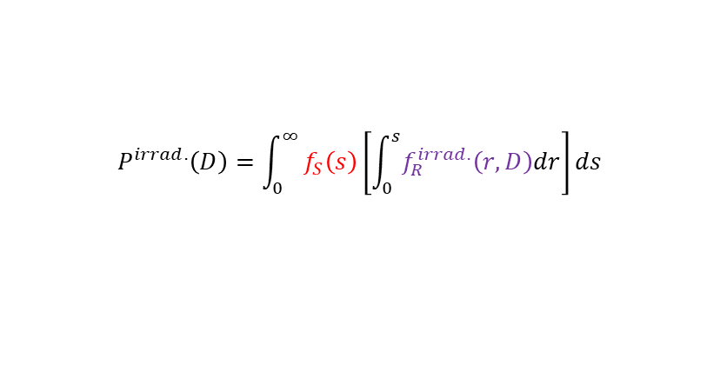
Material Phys. Tech.
OV/3-4 Tanigawa
Fusion DEMO Structural Material Development
A new strategy based on probability based design method was proposed to mitigate the difficulty to define the allowable limit for irradiation induced degradation without enough "empirical” evidence.
Probability of fracture after irradiation up to D dpa can be calculated by integrating probability functions,
$$P^{irrad.}\left(D\right)=\int_{0}^{∞}{f_{S}\left(s\right)\left[\int_{0}^{s}{f_{R}^{irrad.}\left(r,D\right)dr}\right]ds}$$
the critical condition
Fusion n irrad. data distribution could be estimated by updating fission n irrad. based probability function by Bayesian inference, which compromise the limitation of data size.
It is essential to accumulate a reasonable amount of fission n irradiation data to estimate the probability density function.
${Fusion f}_{R}^{irrad.}\left(r,D\right)$
$∝f_{R}^{irrad.}\left(r^{new},D\right)∙{Fission f}_{R}^{irrad.}\left(r,D\right)$
Notes:
In MPT, Material Physics and Technology, Tanigawa proposed a new strategy based on probability based design method. Definition of allowable limit for irradiation induced degradation is difficult because of lack of enough empirical evidence. To mitigate the difficulty he proposed this probabilistic approach.

Slide 25
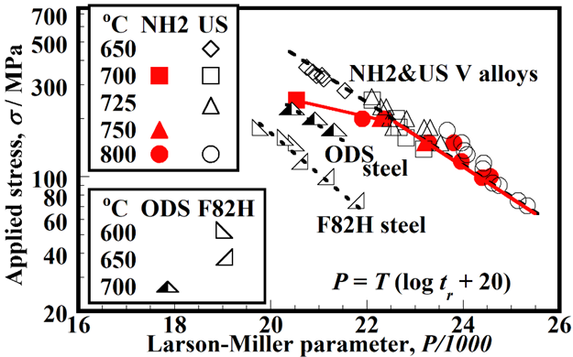
Material Phys. Tech.
MPT/2-1 Nagasaka
Creep of NIFS-HEAT-2 high-purity vanadium alloy
NIFS-HEAT-2 (highest purity V-4Cr-4Ti alloy in the world) has achieved enhanced workability, weldability and low-activation property, demonstrating that there is no negative effect of purification on high-temperature creep properties under projected blanket service stresses.
Impurities’ concentration of V-4Cr-4Ti alloys
(mass ppm)
Creep property
ID | Country | Interstitial impurities | Harmful radioactive impurities
 |  | C+N+O | Al+Co+Nb+Ni+Mo
NIFS-HEAT-2 | Japan | 339 | 92
US832665 | USA | 600 | 740
RF-VVC3 | Russia | 590 | 308
SWIP-30 | China | 420 | 217
CEA-J57 | France | 470 | 282
Notes:
Nagasaka reported their achievement of good creep property by NIFS-HEAT-2 high purity vanadium alloy. HEAT-2 showed no negative effect of purification on high temperature creep properties.

Slide 26
Material Phys. Tech.
MPT/2-2 Ding
Model validation on EAST and DIII-D experiments highlight the roles of the Low-Z background impurities and the sheath potential determining high-Z materials erosion. Overall erosion and deposition balance in a mixed materials surface depends on the transport and deposition of low-Z impurities. Local sheath potential perturbation change the material erosion rate due
to modification of both ion incident energy and flux
MPT/2-3 Maya
The effect of Primary Knock-on Atom (PKA) spectrum on the damage creation and subsequent deuterium trapping at the defects has been investigated using computer simulations and surrogate ion-irradiation experiments.
SEE/2-1 Gilbert
Computational waste assessments for current European DEMO designs highlight the potential issues surrounding minor impurities contained (sometimes deliberately) within many fusion materials including EUROFER. Some components may not be acceptable in near-surface disposal facilities (low-level waste) for 100s of years.
MPT/2-2 Ding
MPT/2-3 Maya
SEE/2-1 Gilbert
Notes:
From model validation on EAST and DIII-D experiments, Ding presented roles of the Low-Z background impurities and the sheath potential determining high-Z materials erosion
Maya reported the effect of Primary Knock-on Atom (PKA) spectrum on the damage creation and subsequent deuterium trapping at the defects has been investigated using computer simulations and surrogate ion-irradiation experiments.
Gilbert reported results of his computational waste assessments for current European DEMO designs.

Slide 27



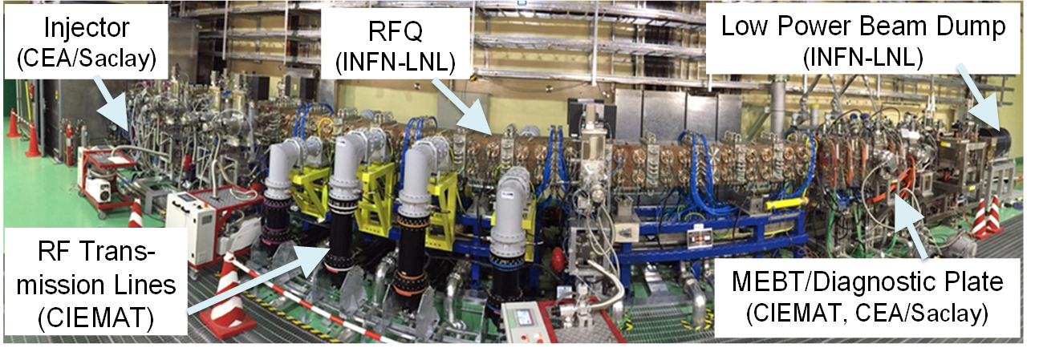
Neutron Source
OV/3-3 Sugimoto
Commissioning ongoing IFMIF/EVEDA
First proton beam (50 keV, 0.3 ms pulse) was injected into the RFQ.
RFQ in
LPBD
RFQ out
Diag.
  Injector commissioning completed with 100 keV/140 mA deuteron beam successfully with twice better emittance than acceptable one.
  RFQ beam commissioning started with 50 keV proton, and the initial measurements show RFQ transmission (96% at maximum) and beam energy (2.5±0.2 MeV).
  IFMIF/EVEDA deployed RFQ toward 5 MeV D beam
Notes:
Let’s move on to the next. Neutron Source as part of Fusion Nuclear physics and technology.
Sugimoto reported progress of IFMIF/EVEDA commissioning. The injector commissioning was completed with D- beam of 100 keV/140 mA, and First proton beam was injected into the RFQ and accelerated to 2.5 MeV. Thus IFMIF/EVEDA deployed RFQ toward acceleration of 5 MeV D beam.

Slide 28
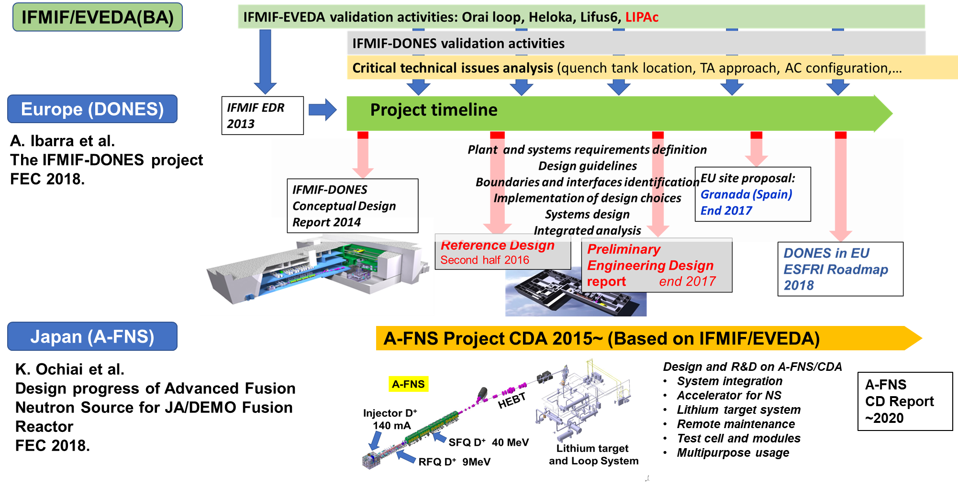
Neutron Source
After success of IFMIF/EVEDA,
EU/JA plan to construct neutron irradiation test facilities:
DONES (EU) and A-FNS (JA)
MPT/2-4 Ibarra
MPT/P3-6 Ochiai
Notes:
Then both EU and JA proposed their plan to construct neutron irradiation test facilities, DONES and A-FNS. This is the outline of the project progress, and now both of them are designing on a basis of achievement by IFMIFEVEDA.

Slide 29
SEE
SEE/3-1Ra Konishi, 3-1Rb Takeda, 3-1Rc Nam
Notes:
SEE had a rapporteur talk on future energy systems study.
They propose 3 application of fusion for future market, electricity, fuel and CCS.
One major point is that outage frequency has a strong impact as a base load electricity. Basically base load electricity requires very low outage for long period.
Instead, another point could be that various application of fusion heat will respond future requirements for sustainable development. They analyzed Biomass fuel production by fusion and Carbon sequestration by Fusion.
Thus results suggest new possibility of fusion energy.

Slide 30
Thank you for all poster presenter
P1: FIP/1-1 M.Nakahira, FIP/1-2Ra Y. Oda, FIP/1-2Rb R. G. Trivedi, FIP/1-2Rc G. Gantenbein, FIP/1-3Ra J. Joshi, FIP/1-3Rb V. Toigo, FIP/1-3Rc A.Kojima, FIP/1-4 A. Litnovsky, FIP/1-5 E. E. Mukhin, FIP/1-6 X.Wang, FIP/P1-1 L. R. Baylor, FIP/P1-2 S. Simrock, FIP/P1-3 Z.Wang, FIP/P1-4 J. Smith, FIP/P1-5 A. G. Razdobarin, FIP/P1-6 S. Imagawa, FIP/P1-7 M. Tanaka, FIP/P1-8 T.Kobayashi, FIP/P1-9 A. K.Verma, FIP/P1-10 H. Tobari, FIP/P1-11 K. Kajiwara, FIP/P1-12 A. Y. Dnestrovsky, FIP/P1-13 A. Kasugai, FIP/P1-14 R. Imazawa, FIP/P1-15 D. L. Brower, FIP/P1-16 S. Clement-Lorenzo, FIP/P1-17 E. Gaio, FIP/P1-18 T. Schwarz-Selinger, FIP/P1-19 N. Bairagi, FIP/P1-20 R. Bright, FIP/P1-21 K. Patel, FIP/P1-22 E. A. Tolman, FIP/P1-24 P. Chaudhuri, FIP/P1-25 R. Sugandhi, FIP/P1-26 V. N.Muvvala, FIP/P1-27 I.Kodeli, FIP/P1-28 R. Anand, FIP/P1-29 P. V. Subhash, FIP/P1-30 S. S. Sandhu,
FIP/P1-31 A. K. Tyagi, FIP/P1-32 R.Kumar, FIP/P1-33 G. L.Vyas, FIP/P1-34 S.Varshney, FIP/P1-35 S. Jha, FIP/P1-36 S.Kumar, FIP/P1-37 M. Manuelraj, FIP/P1-38 L. Cai, FIP/P1-39 N. P. Singh, FIP/P1-40 M. J. Singh, FIP/P1-41 H. Tyagi, FIP/P1-42 A. Maheshwari,
FIP/P1-43 D.Aggarwal, FIP/P1-44 K. K. Gotewal, FIP/P1-45 K. M. Patel, FIP/P1-46 S. Muralidhara, FIP/P1-47 P. Dutta, FIP/P1-48 R. R. K. Tiwari, FIP/P1-49 K. K. Gotewal, FIP/P1-50 S. V.Rogozhkin, FIP/P1-51 R. Lunsford, FIP/P1-52 H. B. Pandya, FIP/P1-53 J. Rapp, FIP/P1-54 K. Ikeda, FIP/P1-55 D. Sharma, FIP/P1-56 T. Kariya, FIP/P1-57 R. N. Panchal, FIP/P1-58 G.Vadolia, FIP/P1-59 A. D. Mankani,
P3: FIP/P3-1 F. Bedoya, FIP/P3-2 K. Gi, FIP/P3-3 H.Noto, FIP/P3-4 M.Kobayashi, FIP/P3-5 P. Kanth, FIP/P3-6 K. Ochiai, FIP/P3-7 G. Stankunas, FIP/P3-8 C. Day, FIP/P3-9 Ž. Štancar, FIP/P3-10 S. P. Smith, FIP/P3-11 Z. Xu, FIP/P3-12 A.Abhishek, FIP/P3-13 S. S.Atchutuni, FIP/P3-14 R. Joshi, FIP/P3-15 S. S. Mukherjee, FIP/P3-16 A. Arumugam, FIP/P3-17 S. C. Tadepalli, FIP/P3-18 K. P. Singh, FIP/P3-19 N. Chauvin, FIP/P3-20 D. Panayotov, FIP/P3-21 I. Ricapito, FIP/P3-22 H. Liao, FIP/P3-23 A. S. Arakcheev, FIP/P3-24 R. T. Khaydarov, FIP/P3-25 M. Coleman, FIP/P3-26 J. M. Park, FIP/P3-27 S. Shah, FIP/P3-28 S. Tiwari, FIP/P3-29 M. Rajput, FIP/P3-30 A. Patel, FIP/P3-31 S. G. Khambholja, FIP/P3-32 K. S. Bhatt, FIP/P3-33 S. S.Vala, FIP/P3-34 D. Dubey, FIP/P3-34 V. Shukla, FIP/P3-36 E. Pajuste, FIP/P3-37 S. S. Khirwadkar, FIP/P3-38 P. Chakraborty, FIP/P3-39 P. A. Rayjada, FIP/P3-40 J. Jiang, FIP/P3-41 V. M. Chernov, FIP/P3-42 C. S. Sasmal, FIP/P3-44 A.Attri, FIP/P3-45 T. Tulenbergenov, FIP/P3-46 H. L.Swami, FIP/P3-47 P. Bharathi, FIP/P3-48 A. Patel, FIP/P3-49 A. J. Deka, FIP/P3-50 S. S. Mukherjee, FIP/P3-51 J. S. Mishra, FIP/P3-52 P. Bhatt, FIP/P3-53 Y. M. Jain, FIP/P3-54 R. Gangradey,
FIP/P3-55 L. Hao, FIP/P3-56 M. R. Jana, FIP/P3-57 S. S. Chauhan, FIP/P3-58 R.Kumar, FIP/P3-59 D.Kumawat, FIP/P3-60 V. Menon, FIP/P3-61 A. K. Pandey, FIP/P3-62 A. Patel, FIP/P3-63 S. P. Gerhardt, FIP/P3-64 K. A. Jadeja, FIP/P3-65 C.Walters
P7: FIP/2-1 J. Chen, FIP/2-2 T. R. Barrett, FIP/2-3 R. Lunsford, FIP/2-4 D. Iglesias, FIP/3-1 G. Federici, FIP/3-2 Y. Sakamoto, FIP/P8-9 G. M.Wallace, FIP/3-4 M. Kikuchi, FIP/3-5Ra R. Maingi, FIP/3-5Rb G. Mazzitelli, FIP/3-6 R. J. Goldston, MPT/1-1 A. Kreter, MPT/2-1 T.Nagasaka, MPT/2-2 R. Ding, MPT/2-3 P. N.Maya, MPT/2-4 A. Ibarra, SEE/1-1 C. Grisolia, SEE/2-1 M. R. Gilbert, SEE/3-1Ra S.Konishi, SEE/3-1Rb S. Takeda, SEE/3-1Rc H.Nam, FIP/P7-1 M. Siccinio, FIP/P7-2 H. Lux, FIP/P7-3 S. S. Ananyev, FIP/P7-4 Y. Takase, FIP/P7-5 L. Zani, FIP/P7-6 B. K. Yadav, FIP/P7-7 Y. S. Shpanskiy, FIP/P7-8 V. L. Tanna, FIP/P7-9 U. Prasad, FIP/P7-10 G. Mahesuria, FIP/P7-12 G. Gantenbein, FIP/P7-13 L. Savoldi, FIP/P7-14 A. Garg, FIP/P7-15 D. B. Gin, FIP/P7-16 R. Sugandhi, FIP/P7-17 V. G. Devi, FIP/P7-19 S. Dutta, FIP/P7-20 D. Christian, FIP/P7-21 A. Tomar, FIP/P7-22 A. Shrivastava, FIP/P7-23 D. Sulaiman, FIP/P7-24 N. Rastogi, FIP/P7-25 B. R. Doshi, FIP/P7-26 S. Roy, FIP/P7-27 H. Chen, FIP/P7-28 P. Prajapati, FIP/P7-29 Q. Huang, FIP/P7-30 J. Mora-Meléndez, FIP/P7-31 A. K. Sahu, FIP/P7-33 O. Crofts, FIP/P7-34 V. B. Minaev, FIP/P7-35 K. Kizu, FIP/P7-36 S. Binwal, FIP/P7-37 Y. Shibama, FIP/P7-38 T. Brown, FIP/P7-39 T. Goto, FIP/P7-40 V. Antoni, FIP/P7-41 J. Yagi, FIP/P7-42 J. Figueiredo,
P8: FIP/P8-1 R. Patel, FIP/P8-2 R. C. O’Neill, FIP/P8-3 C. K. Gupta, FIP/P8-4 J. Patel, FIP/P8-5 K. Mohan, FIP/P8-6 A. Fasoli, FIP/P8-7 J.Kumar, FIP/P8-8 M. Patel, FIP/P8-9 R.Kumar, FIP/P8-10 J. C. Patel, FIP/P8-11 R. Ragona, FIP/P8-12 R. Sharma, FIP/P8-13 P. Y. Li, FIP/P8-14 U. Fischer, FIP/P8-15 M. Ghate, FIP/P8-16 A. Jha, FIP/P8-17 M. Bandyopadhyay, FIP/P8-18 R. K. Buddu, FIP/P8-19 R. Bahl, FIP/P8-20 H. K. Patel, FIP/P8-21 V. K. Panchal, FIP/P8-22 T. K. Sharma, FIP/P8-23 A. Patel, FIP/P8-24 Z. Shaikh, FIP/P8-25 M. Sharma, FIP/P8-26 B. K. Shukla, FIP/P8-28 B. R. Doshi, FIP/P8-29 B. Chektybayev, FIP/P8-30 E. Ušpuras,

Slide 31
Thank you for presenters of India
P1: FIP/1-2Rb R. G. Trivedi, FIP/1-3Ra J. Joshi, FIP/P1-9 A. K.Verma, FIP/P1-19 N. Bairagi, FIP/P1-20 R. Bright, FIP/P1-21 K. Patel, FIP/P1-24 P. Chaudhuri, FIP/P1-25 R. Sugandhi, FIP/P1-26 V. N.Muvvala, FIP/P1-29 P. V. Subhash, FIP/P1-30 S. S. Sandhu, FIP/P1-31 A. K. Tyagi, FIP/P1-32 R.Kumar, FIP/P1-33 G. L.Vyas, FIP/P1-34 S.Varshney, FIP/P1-35 S. Jha, FIP/P1-36 S.Kumar, FIP/P1-37 M. Manuelraj, FIP/P1-39 N. P. Singh, FIP/P1-40 M. J. Singh, FIP/P1-41 H. Tyagi, FIP/P1-42 A. Maheshwari, FIP/P1-43 D.Aggarwal, FIP/P1-44 K. K. Gotewal, FIP/P1-45 K. M. Patel, FIP/P1-46 S. Muralidhara, FIP/P1-47 P. Dutta, FIP/P1-48 R. R. K. Tiwari, FIP/P1-49 K. K. Gotewal, FIP/P1-52 H. B. Pandya, FIP/P1-55 D. Sharma, FIP/P1-57 R. N. Panchal, FIP/P1-58 G.Vadolia, FIP/P1-59 A. D. Mankani,
P3: FIP/P3-5 P. Kanth, FIP/P3-12 A.Abhishek, FIP/P3-13 S. S.Atchutuni, FIP/P3-14 R. Joshi, FIP/P3-15 S. S. Mukherjee, FIP/P3-16 A. Arumugam, FIP/P3-17 S. C. Tadepalli, FIP/P3-18 K. P. Singh, FIP/P3-27 S. Shah, FIP/P3-28 S. Tiwari, FIP/P3-29 M. Rajput, FIP/P3-30 A. Patel, FIP/P3-31 S. G. Khambholja, FIP/P3-32 K. S. Bhatt, FIP/P3-33 S. S.Vala, FIP/P3-34 D. Dubey, FIP/P3-34 V. Shukla, FIP/P3-37 S. S. Khirwadkar, FIP/P3-38 P. Chakraborty, FIP/P3-39 P. A. Rayjada, FIP/P3-42 C. S. Sasmal, FIP/P3-44 A.Attri, FIP/P3-46 H. L.Swami, FIP/P3-47 P. Bharathi, FIP/P3-48 A. Patel, FIP/P3-49 A. J. Deka, FIP/P3-50 S. S. Mukherjee, FIP/P3-51 J. S. Mishra, FIP/P3-52 P. Bhatt, FIP/P3-53 Y. M. Jain, FIP/P3-54 R. Gangradey, FIP/P3-56 M. R. Jana, FIP/P3-57 S. S. Chauhan, FIP/P3-58 R.Kumar, FIP/P3-59 D.Kumawat, FIP/P3-60 V. Menon, FIP/P3-61 A. K. Pandey, FIP/P3-62 A. Patel, FIP/P3-64 K. A. Jadeja,
P7: MPT/2-3 P. N.Maya, FIP/P7-6 B. K. Yadav, FIP/P7-8 V. L. Tanna, FIP/P7-9 U. Prasad, FIP/P7-10 G. Mahesuria, FIP/P7-14 A. Garg, FIP/P7-16 R. Sugandhi, FIP/P7-17 V. G. Devi, FIP/P7-19 S. Dutta, FIP/P7-20 D. Christian, FIP/P7-21 A. Tomar, FIP/P7-22 A. Shrivastava, FIP/P7-23 D. Sulaiman, FIP/P7-24 N. Rastogi, FIP/P7-25 B. R. Doshi, FIP/P7-26 S. Roy, FIP/P7-28 P. Prajapati, FIP/P7-31 A. K. Sahu, FIP/P7-36 S. Binwal,
P8: FIP/P8-1 R. Patel, FIP/P8-3 C. K. Gupta, FIP/P8-4 J. Patel, FIP/P8-5 K. Mohan, FIP/P8-7 J.Kumar, FIP/P8-8 M. Patel, FIP/P8-9 R.Kumar, FIP/P8-10 J. C. Patel, FIP/P8-12 R. Sharma, FIP/P8-15 M. Ghate, FIP/P8-16 A. Jha, FIP/P8-17 M. Bandyopadhyay, FIP/P8-18 R. K. Buddu, FIP/P8-19 R. Bahl, FIP/P8-20 H. K. Patel, FIP/P8-21 V. K. Panchal, FIP/P8-22 T. K. Sharma, FIP/P8-23 A. Patel, FIP/P8-24 Z. Shaikh, FIP/P8-25 M. Sharma, FIP/P8-26 B. K. Shukla, FIP/P8-28 B. R. Doshi,
Very impressive, covering wide range of fusion engineering and technology.
Among these, I would like to highlight the following:
FIP/P1-40 M. J. Singh, R&D status of Indian Test Facility for ITER DNB characterization
RF driven negative ion source, achieved 270 A/m² H⁻ production, close to the ITER requirement: 300 A/m² H⁻.
FIP/P3-56 M. R. Jana, Development of technology for Fabrication of prototype ion extraction grid for fusion research.
R&D on grid manufacturing technique based on electrodeposition. only a few industries are available world wide.
Also note that four out of five remote handling papers have been submitted from India.

Slide 32
Conclusion
ITER on-site construction and manufacturing of components in progress. Some of the 1st ITER component completed such as TF coil structure, ECH.
  JT-60SA and WEST support ITER in various engineering/physics aspect, and for full W divertor, respectively.
DEMO, Advance Technology for In Vessel Components
  EU/JA DEMO design presented from both EU and JA, both still in pre conceptual level.
  Concerns on high heat load, and dust has pointed out toward DEMO. Here some basic researches are still required utilizing existing machines.
Materials Phys. Tech.
  A new strategy based on probability based design method proposed.
Fusion Neutron Source
  IFMIF/EVEDA going on schedule.
  EU/JA plan to construct neutron irradiation test facilities: DONES (EU) and A-FNS (JA).
  Further deep collaboration is desirable among various machines and big projects. For example, experience of material choice, machining, welding, assembly of ITER VV or TF coil should be handed over to the next generation DEMO.

Slide 33
Thank you for your attention.
For all participants of the conference,
thank you for your cooperation.
For local host, DAE and IPR,
thank you for your coordination and hospitality.

Slide 34
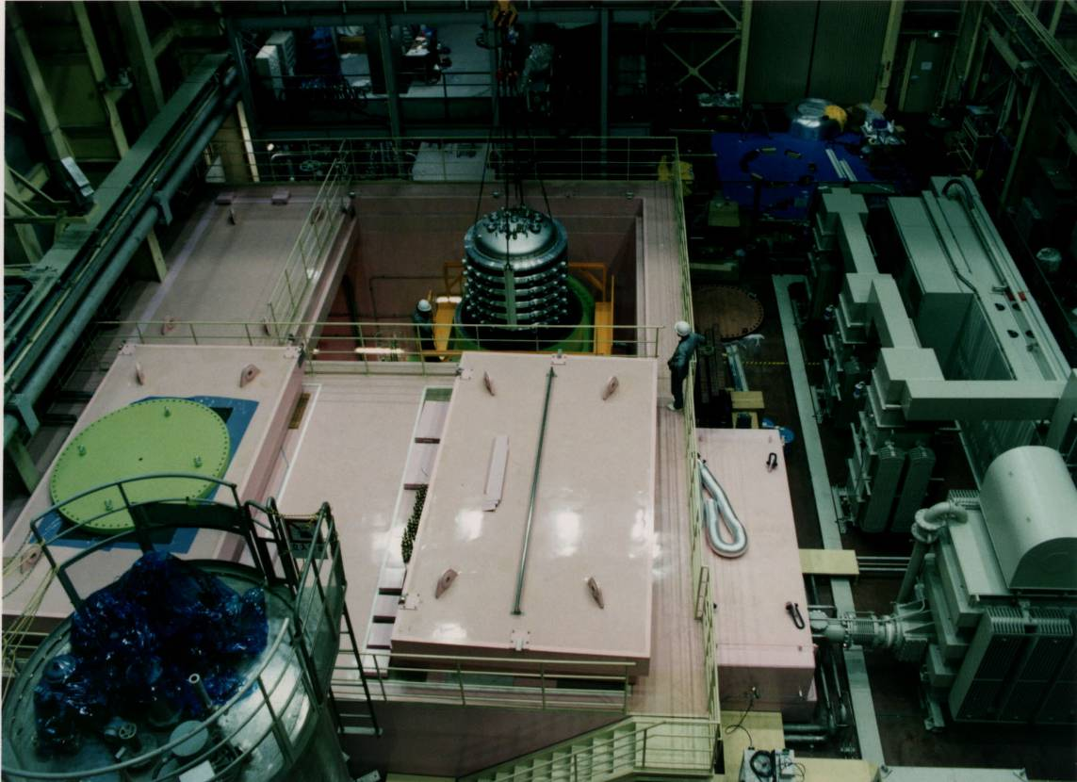
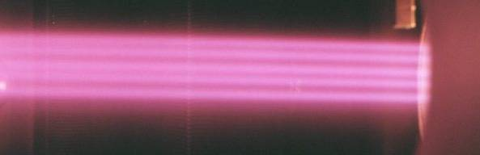
Takashi Inoue
KAMABOKO plasma generator
1MeV Accelerator
Power Supply
Xray Shield
Magnetic Filter
First achievemnet of ITER requirement 300A/m² H⁻@0.2Pa with magnetic filter and KAMABOKO source (1995).
First ITER relevant beam (1MeV, 200A/m² H⁻ with achievement of 1 MV vacuum insulation (2011).
To Diagnostics
From Accelerator
Φ16mm
Multi beamlet

