Slide 1
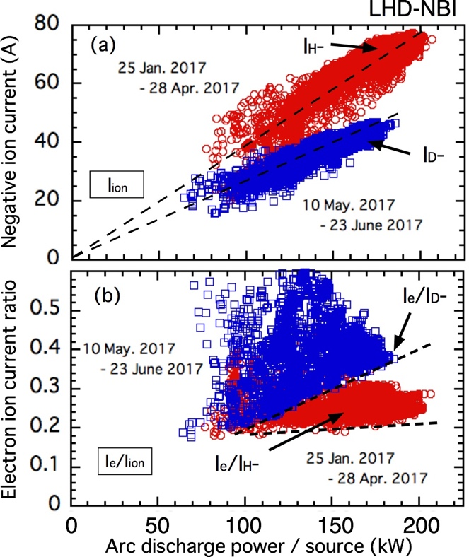
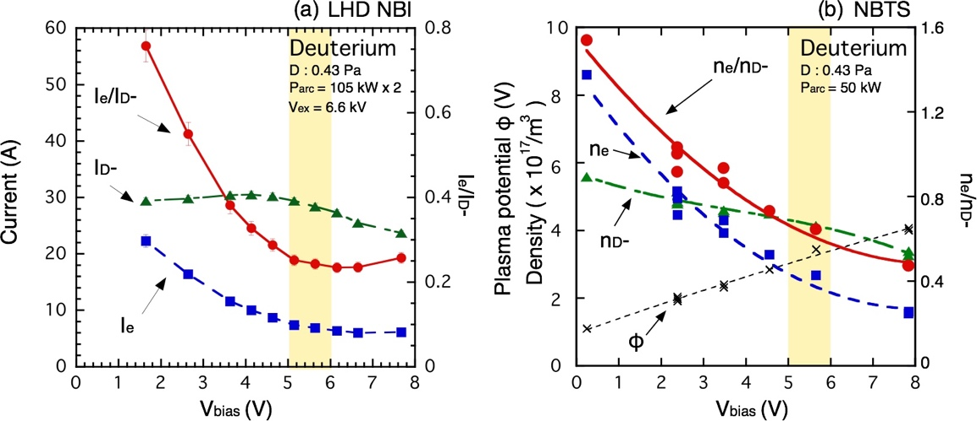
FIP/P1-54
Exploring Deuterium Beam Operation and Behavior of Co-Extracted Electron in Negative-Ion-Based Neutral Beam InjectoR
K. IKEDA and LHD-NBI Team
National Institute for Fusion Science (NIFS), National Institutes of Natural Sciences, Toki, Japan
• First deuterium beam operation was initiated in LHD-NBI in 2017.
•The deuterium negative ion current (I_{D}-) reaches 46.2 A with the averaged current density being 190A/m² , and the electron-ion current ratio (I_{e}/I_{D}-) increases to 0.39 using 5.6 V high bias voltage to reduce electron contamination in the beam.
• Linear dependence of the minimum value of the I_{e}/I_{D}- on the arc-discharge power is found, and is stronger in the D– operation than I_{e}/I_{H}- in the hydrogen operation.
• Increase of electron density in the vicinity of the plasma grid surface is confirmed by half-sized research negative ion source in the test stand in NIFS (NBTS).

