Slide 1
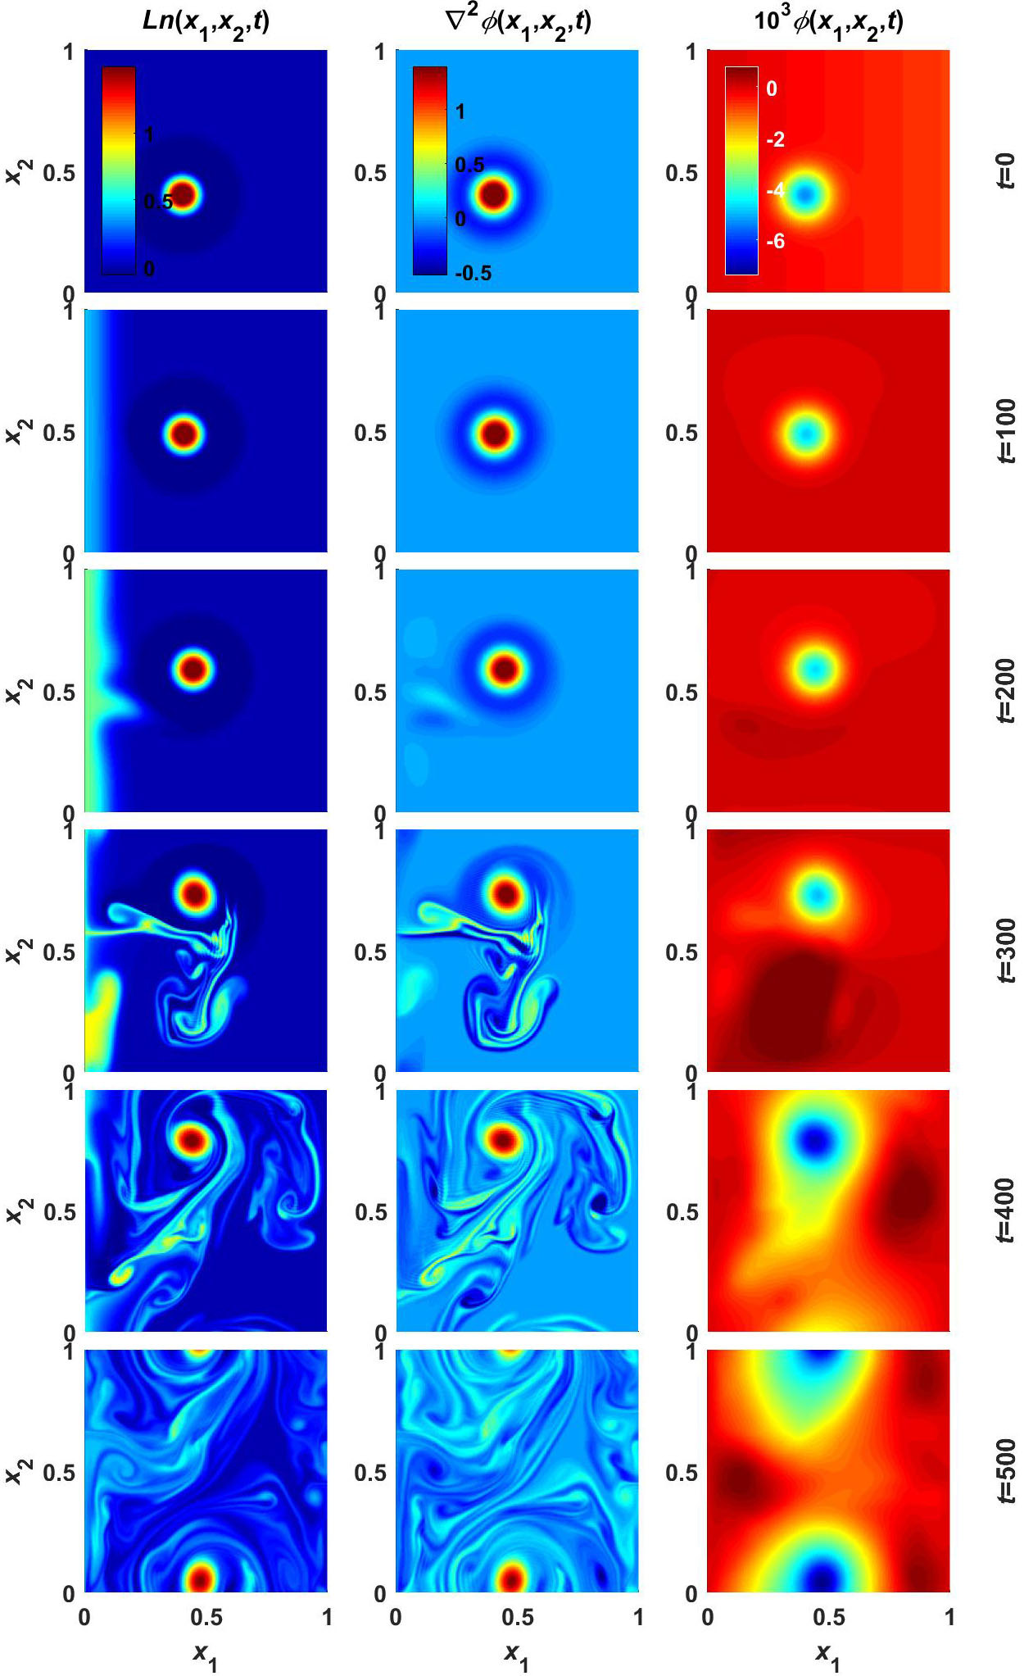
Bizarro, Venâncio and Vilela Mendes (TH/P7-15): Exact conservative solutions of fluid models for the scrape-off layer as the ancestors of blobs?
Analytical solutions of the travelling-wave type have been obtained for the conservative part of a standard two-field (density plus vorticity) 2D model of the SOL.
It is conjectured these might be the conservative ancestors of blobs seen in experiments and simulations.
Numerical simulations of the full model (accounting also for diffusion, parallel losses and sources) seem to support this conjecture, with the conservative, blob-like initial solution being distorted, but surviving the full, non-conservative dynamics.
Snapshots with contour plots of the log density, vorticity and potential

