Slide 1
India’s Quest for Fusion Energy and The Road to ITER
Shishir Deshpande

Slide 2
Currently available resources limited
Quest is global
Among the 17 Sustainable Development Goals, spelt out after an extensive study by the UN, the 7th Goal is about ‘affordable and clean energy’.

Slide 3
We all are in such a situation that requires every conceivable energy source to be:
  tapped (extract-exploit-if-fit-for-purpose)
  improve efficiency (innovative materials, gadgets)
  made cost-effective (re-engineer processes)
  minimize impact on environment (reduce consumables)

Slide 4
Parity of per capita consumption with the world-average - a grand challenge
Capacity has to be almost trebled!
So, an equally challenging problem that emerges is how do we manage to grow on sub-optimal energy supply in the interim period.
Techniques to increase efficiency of various energy-intensive processes needed
For this one needs new tools, materials and research-infrastructure to innovate, improvise bring improvement on a mass-scale.
Scales matter; even a tiny saving/improvement for a nation with billion people is quite impactful.

Slide 5
Advanced technologies like fusion hold the promise but have been traditionally considered too far away for any serious investment so far.
The ‘fear factor’ of failure can be overpowering
However, it’s time to turn it around and ask ourselves: What difference will it make if fusion reactor works as desired?
The ITER Project is a collective expression of this global quest for energy
The task however, is complex and embeds challenges of extreme kind
But then, that is the nature of fusion research. It is all about innovative ways and can continue to provide the world with spin-offs while it graduates from hydrogen plasma to D-T and from there on to power-reactors.

Slide 6
India has come a long way in both fusion-science and technology via its well-conceived indigenous as well as collaborative measures.
India’s journey in magnetic confinement research began in 1982 and it has grown in several areas of plasma and fusion research.
A number of developments has taken place: tokamaks with copper-coils (ADITYA) and with superconducting coils (SST-1) have been built indigenously in the Institute for Plasma Research, Gandhinagar.
The scientists have gained experience in plasma operations of these tokamaks as well as in SINP-tokamak, which is located in the Saha Institute of Nuclear Physics, Kolkata
Now, an upgraded ADITYA-U is in place, exploring experiments with shaped plasma
A host of auxiliary technologies have been developed and tested with the test-beds created in-house

Slide 7
India needs to sustain the momentum of its fusion research to be able to reap the benefits from participation in ITER and to quickly channelize the success of ITER in its vision.
The ITER participation has been followed in India with the blanket and the divertor technology development initiatives.
Industrial applications have begun technology-transfer
The HRD is taking place with a strong academic backbone with a project-oriented approach (NFP)
Some details are being covered in OV-talk

Slide 8
Early Days
1920: Meghnath Saha’s fundamental investigations, Allahabad; ionization equilibrium; 1938 duoplasmatron source for cyclotron, Kolkata
1960 toroidal pinch at TIFR, Mumbai
1970 Space plasma group, Vikram Sarabhai, PRL Ahmedabad
Vision for fusion!
Credits: P.I. John, Universal Journal of Physics and Application 11(1): 33-43, 2017;
DOI: 10.13189/ujpa.2017.110104

Slide 9
Basic Experiments

Slide 10
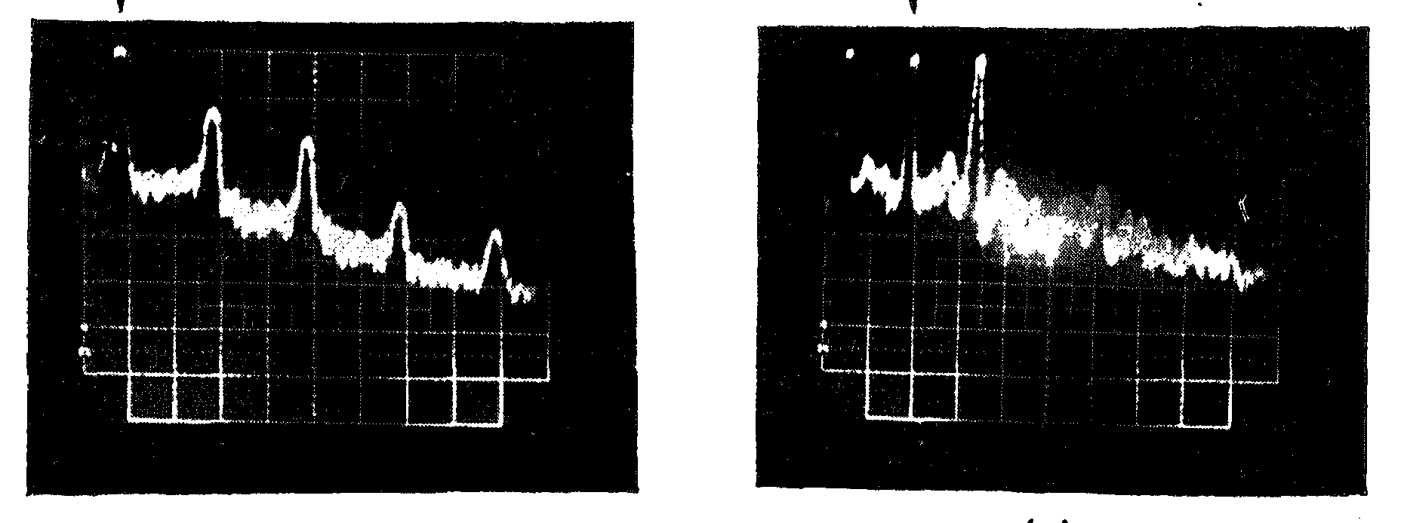
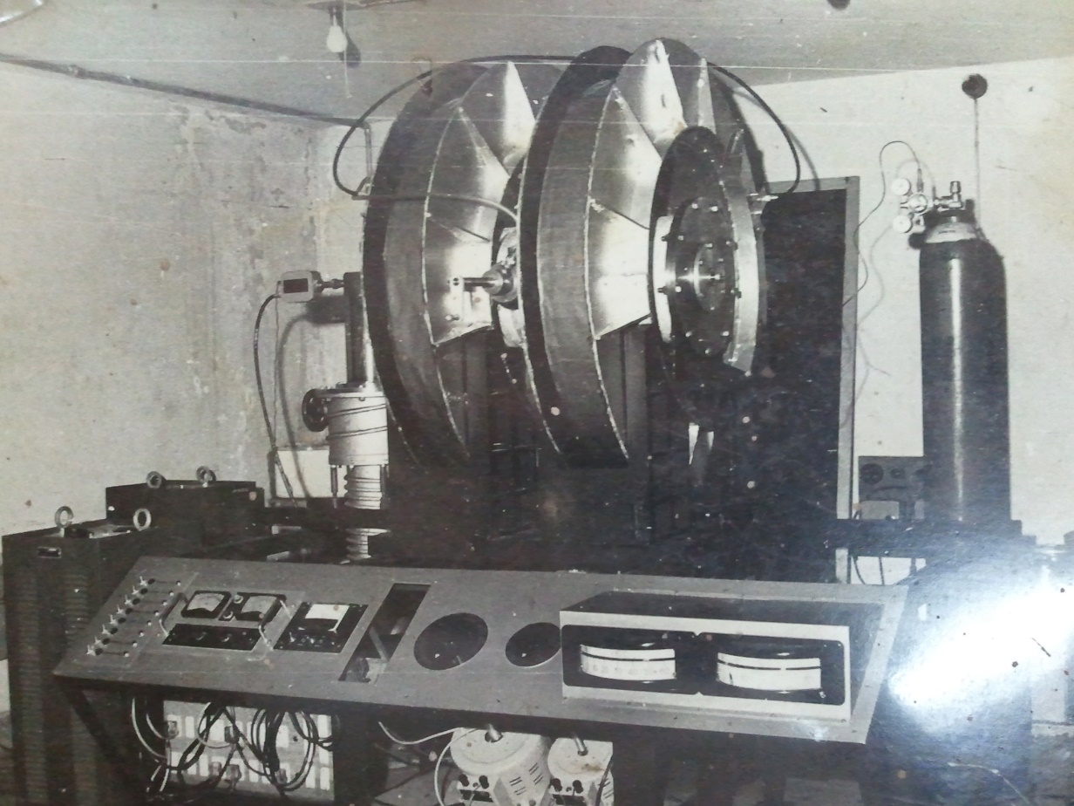
1972 Basic Experiments at Physical Research Lab
Electrojet Simulation
Instability studies for ionospheric plasma
Notes:
power spectra for density fluctuations for diff E fields ~ 1-2 V/cm; V-scale 2kHz/div

Slide 11
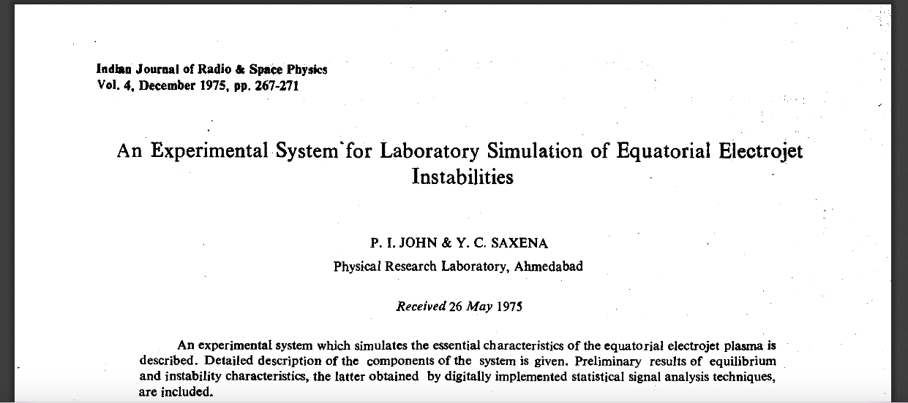

Slide 12
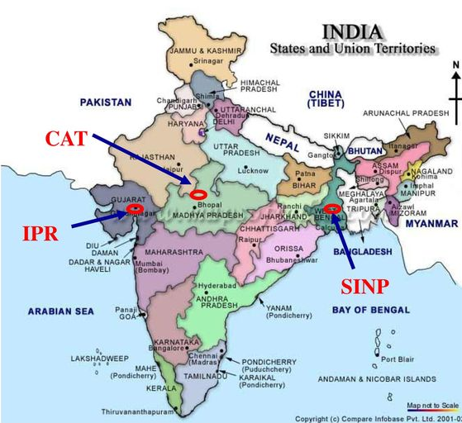
Laser Plasma Interactions
ADITYA tokamak
SINP tokamak
Credits: P. Vasu, Talk: Tokamak & Tokamak Related Diagnostic Experience in India
https://slideplayer.com/slide/13415377/

Slide 13
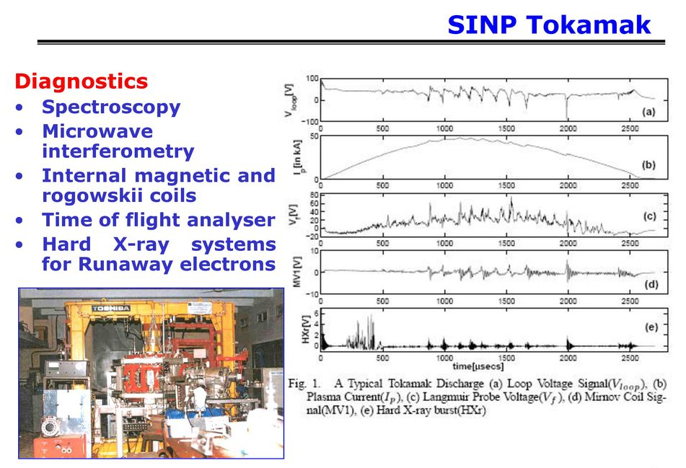
Commissioned in 1987
Credits: P. Vasu, Talk: Tokamak & Tokamak Related Diagnostic Experience in India

Slide 14
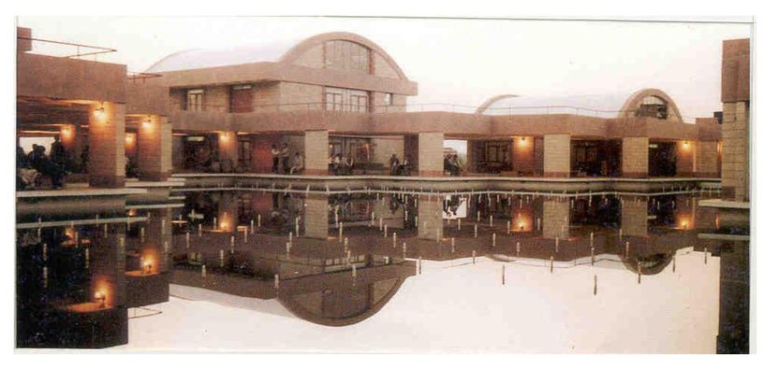
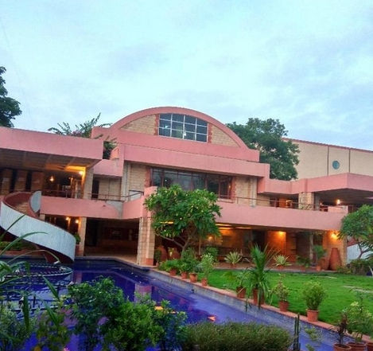
Institute for Plasma Research
Picture Credits: P. Vasu, Talk: Tokamak & Tokamak Related Diagnostic Experience in India

Slide 15
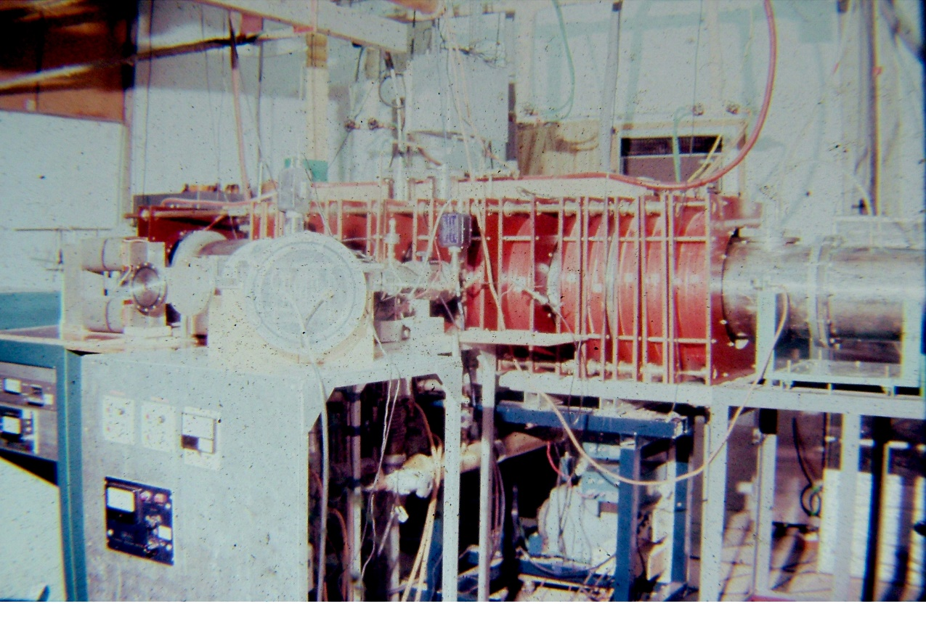
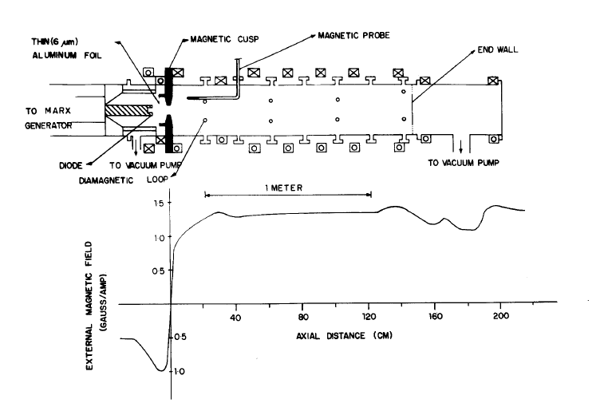

1986 Basic Experiments at IPR

Slide 16
Formation of a compact torus by a rotating relativistic electron beam
Phys. Fluids 29, 3445 (1986)
K. K. Jain and P. I. John
A closed field-reversed configuration has been produced by a long pulse duration ( ~ 500 nsec) intense electron beam injected into hydrogen gas.
The field reversal is created by the beam current during the duration of beam propagation, but is sustained by the beam-induced plasma currents after the exit of the beam.
Reconnection of the anti parallel field lines has been observed

Slide 17
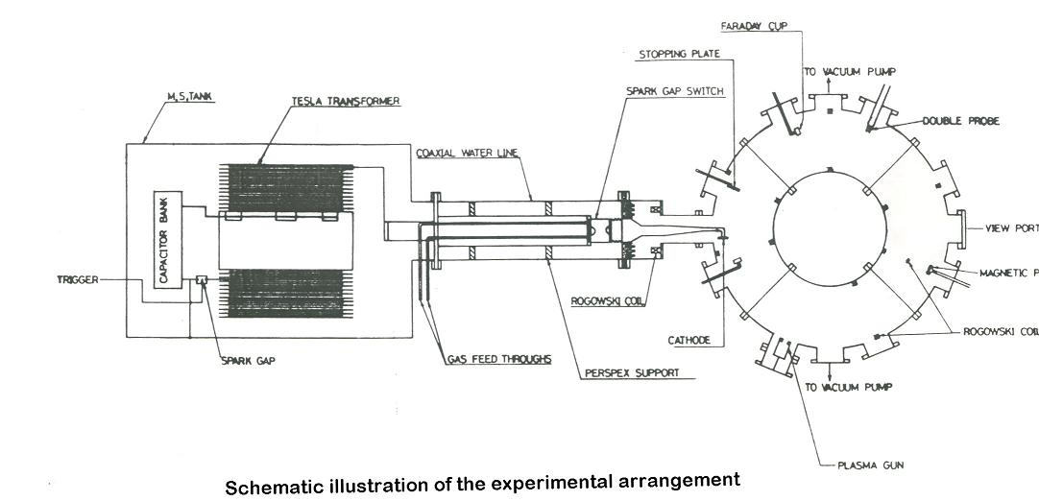
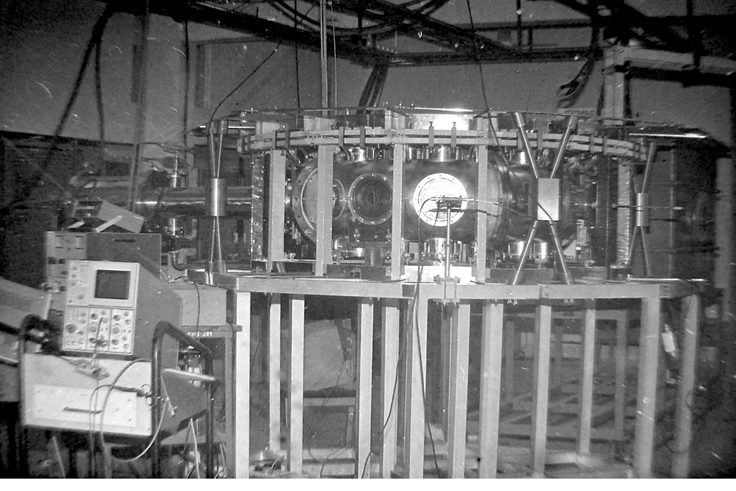
Formation of REB in a toroidal device
ICPP, 1989, D Chenna Reddy & PI John

Slide 18
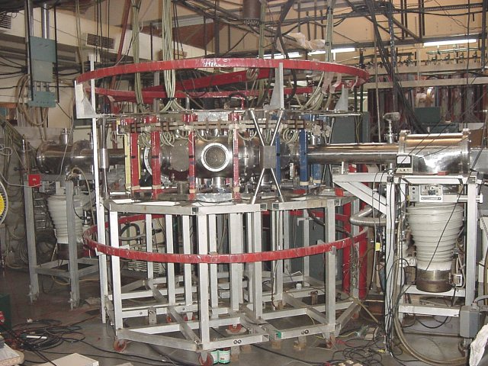
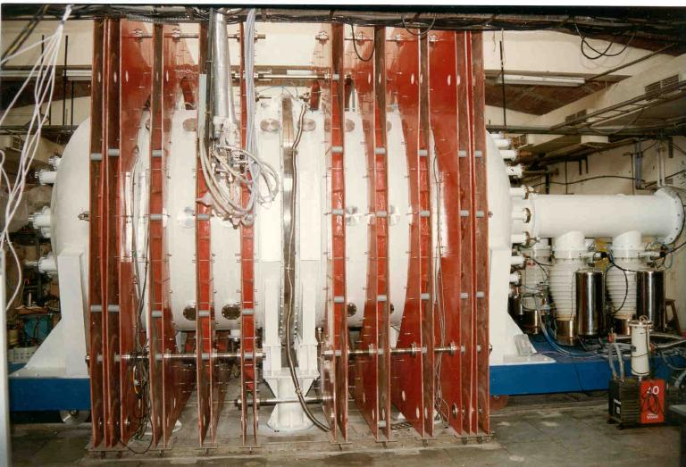
BETA device
LVPD: Large Volume Plasma device
A number of small experiments on double-layers, dusty plasmas, RF plasmas, non-neutral plasmas, diagnostic
developments, other plasma and non-linear physics experiments and almost all of the theory and simulations
has not been mentioned in this talk. These form a continuum for academic stimulation in IPR’s history

Slide 19
ADITYA Tokamak

Slide 20
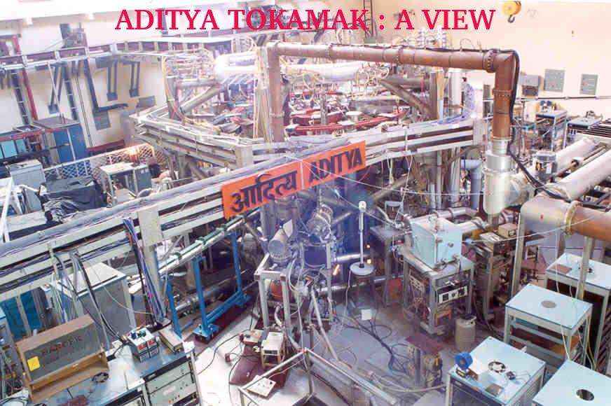
1982 ADITYA tokamak – start of construction
First Indian Tokamak operational
since 1989

Slide 21
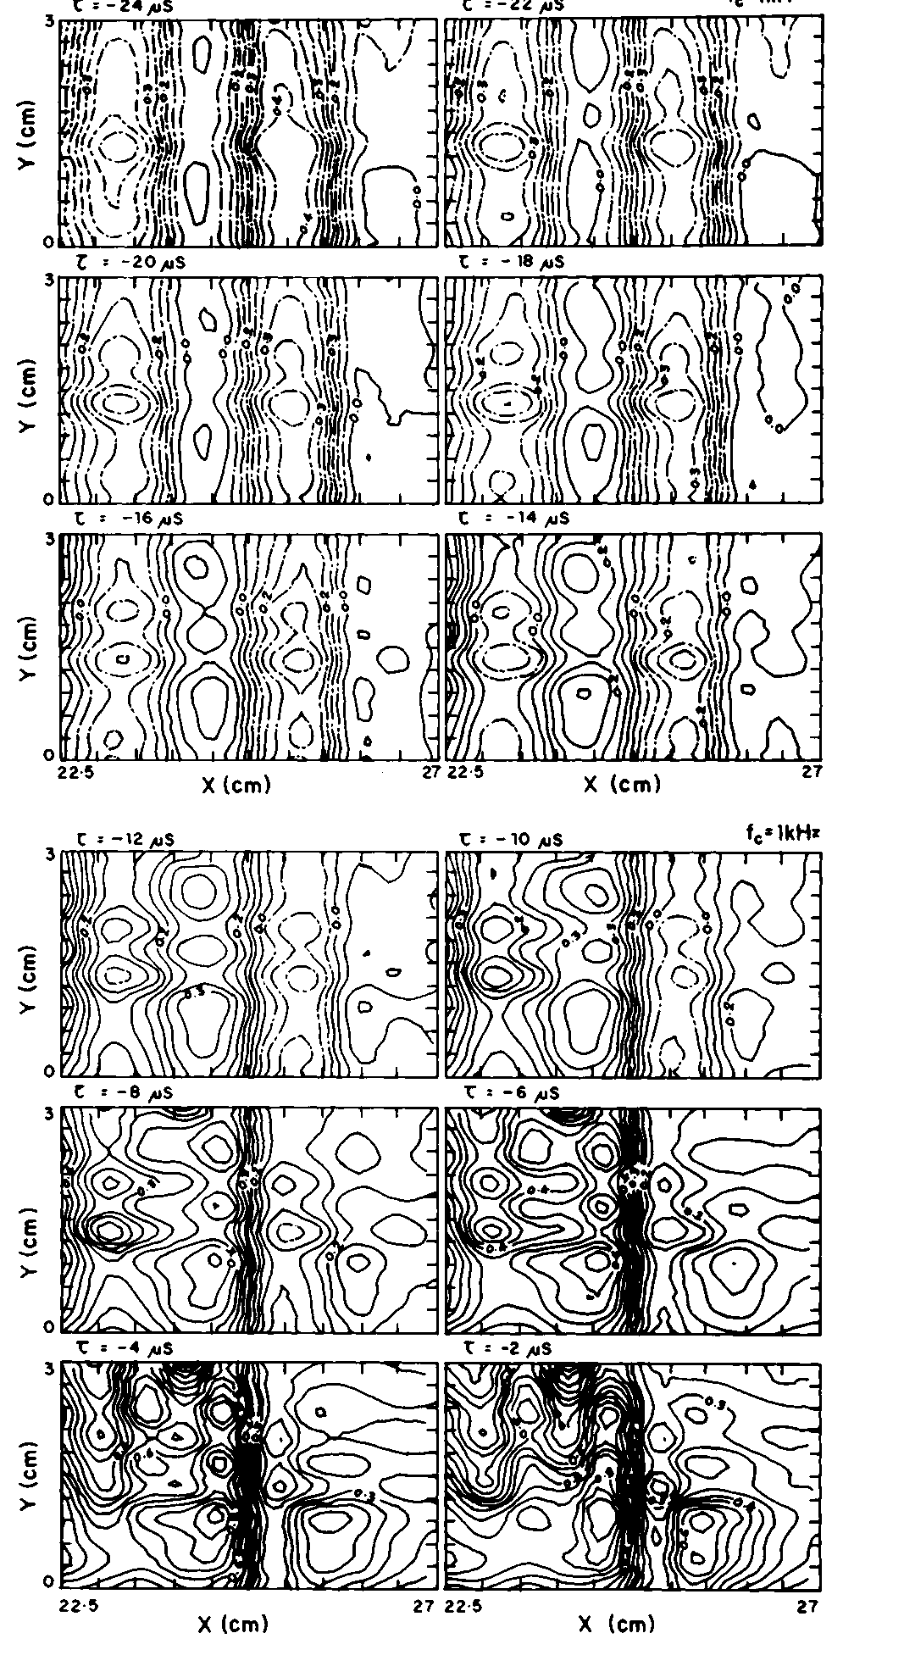
Turbulent Transport
Transport is not a steady ooze but comes out in bursts:Nuclear Fusion 33, (1993) 1201
Frequency resolved particle transport from edge density and potential fluctuations. The transport is inwards at frequencies below 20 kHz and outwards at higher frequencies.

Slide 22
The fusion pursuit generated experience within IPR and in the industries:
  UHV systems
  Copper and Superconducting Magnets
  Cryogenic Systems (LHe & LN₂)
  Large Cryostats for testing at low temperatures
  High Current Pulsed, Shaped, Regulated Power supplies
  Control, Monitoring and Data Acquisition systems
  Plasma Diagnostics
  High power RF Heating & Current Drive Systems
  Neutral Beam System for heating and Current Drive
  Which eventually played a crucial role in international contribution

Slide 23
SST-1Tokamak: A bit of history and status

Slide 24
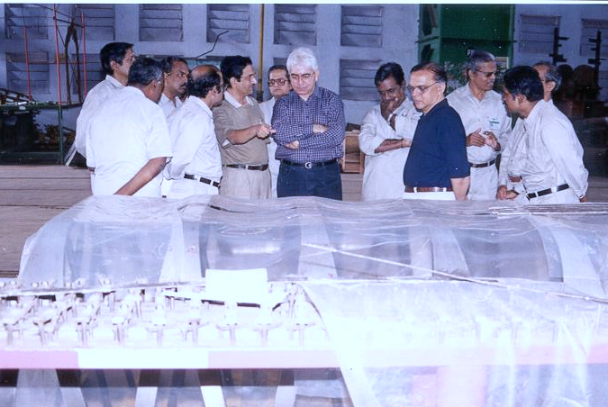
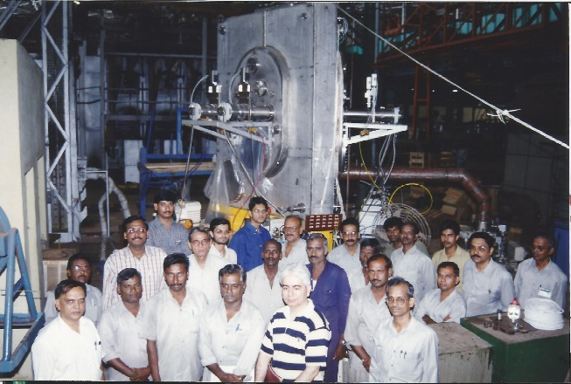
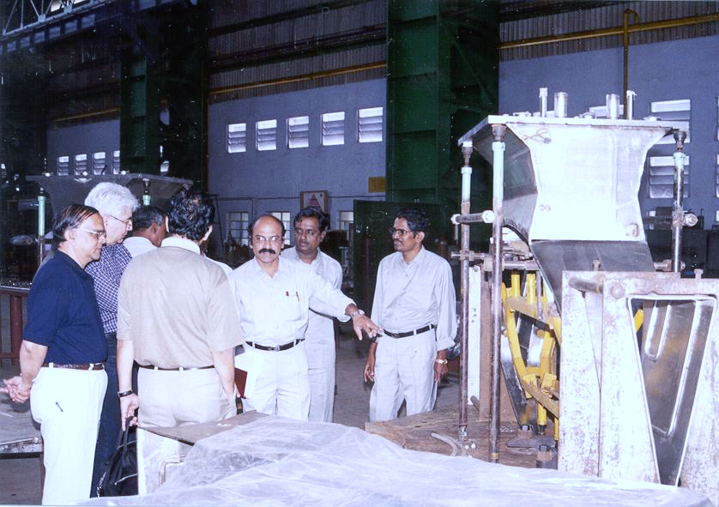
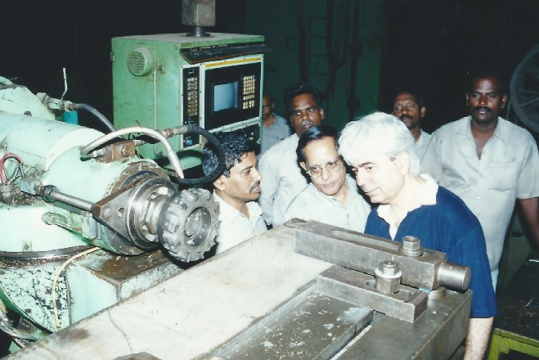
Major fabrication activity at BHEL, Bhopal & Tiruchirappalli
  Vacuum Vessel & Cryostat
  Support structure
  Magnets

Slide 25
Credits: YC Saxena, ITC-12, 2001 talk
http://www.nifs.ac.jp/itc/itc12/Saxena.pdf

Slide 26
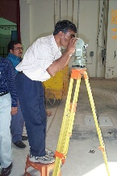
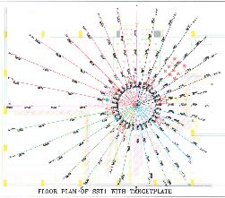
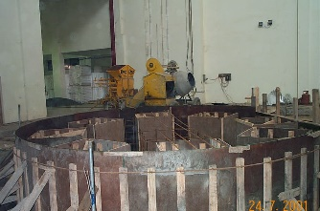
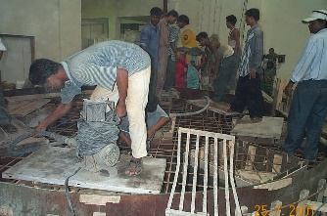
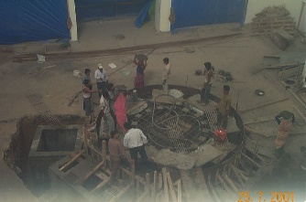
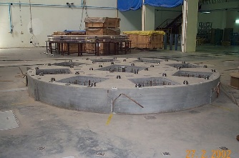
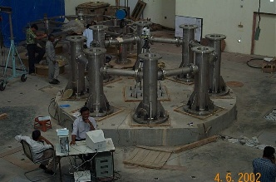
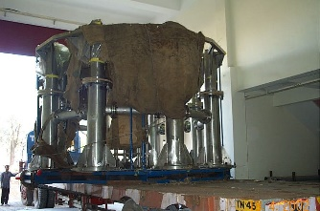
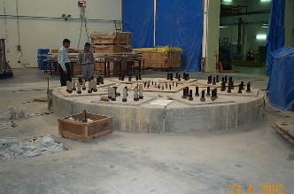
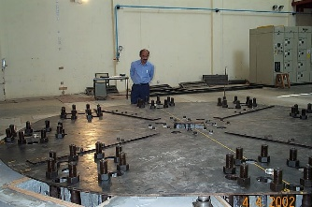
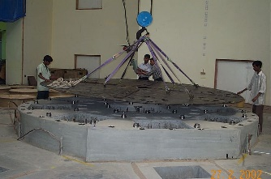
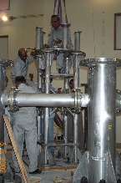
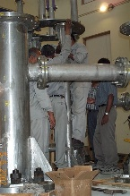
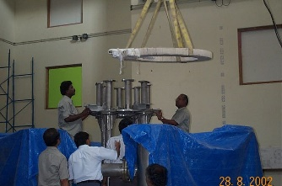
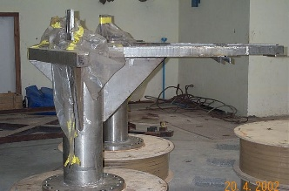
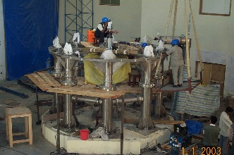
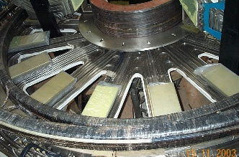
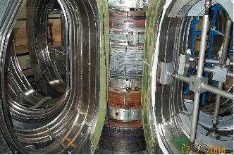
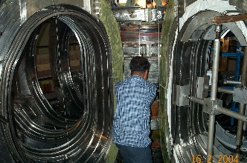
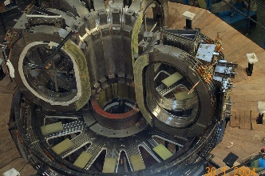
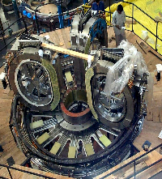
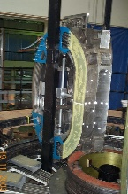
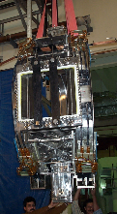
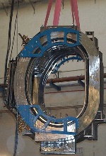
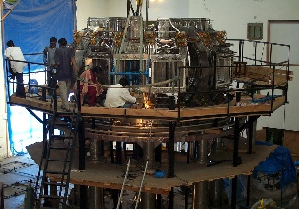
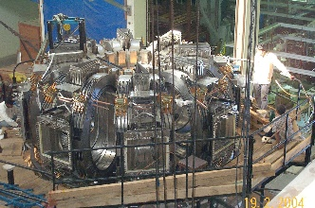
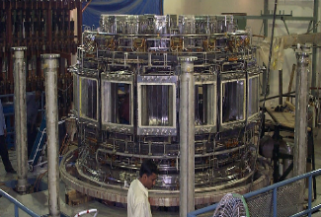
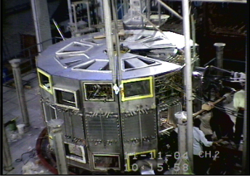
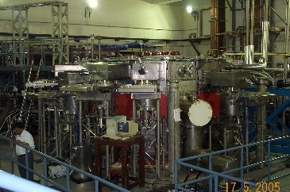
Assembly sequence of SST-1: 2003-2005

Slide 27
Status:
Re-built and commissioned
First stage:
Circular plasma experiments using only superconducting Toroidal Field (TF) coils
Second stage (underway):
Produce shaped plasma using superconducting TF+PF coils

Slide 28
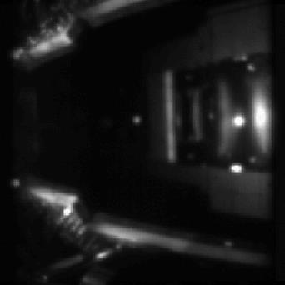
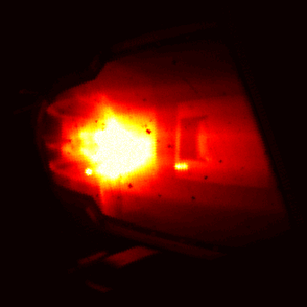

A slew of measures in the offing
Improve PF cooling – for shaped and longer pulse operation
Establishing TF current 80% of design value
Charging trials using TF+PF3-up+dn pair
Low loop-V startup with He to understand burn-through
Field error measurement using e-beam
A reference frame (left) and snap-shot
by visual camera (right) showing SST-1 plasma
Some more details in IPR Overview, press brief

Slide 29






HV & UHV Systems
Vacuum Vessel for SST1
SST1 Cryostat
SS 304L
16 m³
75 m²
4100 kg
10⁻⁸ mbar
39 m³
59 m²
4520 kg
10⁻⁵ mbar
ADITYA Vacuum Vessel
NBI VV
ADITYA-U Vacuum Vessel
1.5 m³; 15 m²; 1.5 x 10⁻⁷ torr
2 m³
20 m²
1.0 m³; 10 m²; 1.0 x 10⁻⁷ torr

Slide 30








SUPERCONDUCTING COILS
Copper Coils
TF COILS
Picture Frame, water cooled, Copper
Length (mm) 1260.0
Width coil (mm) 1030.0
TF COIL
D-Shaped;
X-section:194x144 mm2
Dim: 2.59 m ´ 1.53 m
POLOIDAL COILS

Slide 31



Heating & Current Drive Systems
ICRH Antenna
3.7 GHz Klystron
28 GHz Gyrotron
NBI systems development

Slide 32
ITER !

Slide 33


India’s Participation, background work
“We are watching the recent
developments in the progress
of ITER and would be keen on
opportunities of participation in
this international effort. “
Dr. Anil Kakodkar, 2003
July 2005
For High Technology & Space:
India has expressed its interest in ITER and a
willingness to contribute. The United States
will consult with its partners considering
India’s participation.

Slide 34
2005
“ Professor Predhiman K. Kaw, Chairman, prepared the report on behalf of the IFRC, reflecting members' personal views on the latest achievements in fusion research, including magnetic and inertial confinement scenarios.
The report describes fusion fundamentals and progress in fusion science and technology, with ITER as a possible partner in the realization of self-sustainable burning plasma. The importance of the socio-economic aspects of energy production using fusion power plants is also covered.
Noting that applications of plasma science are of broad interest to the Member States, the report addresses the topic of plasma physics to assist in understanding the achievements of better coatings, cheaper light sources, improved heat-resistant materials and other high-technology materials. ”

Slide 35
The road to ITER has been very challenging
Complexity is the biggest challenge
  The scope keeps expanding at the next level of detail (as the interdependence gets re-discovered, domino-effects are not fully known upfront)
First-of-a-kind
  There are no past references to draw from (so the estimates are uncertain)
  Even the tools and test-facilities don’t exist (Only limited suppliers show interest/qualify)

Slide 36



Project execution encountered many design changes
60 m tall Reactor
Complex;
7 floors, numerous
interfaces

Slide 37







Assembly bldg
B2-slab
09/15
License
08/14
Seismic pad
06/12
Excavations
04/12
Agreement
02/11
Initial (2005) design incomplete + Setback due to Fukushima and extra design changes
11/06

Slide 38
Plasma Applications

Slide 39

FCIPT
Linking Fusion Technology with Industry

Slide 40
Applications will connect fusion to society
Component-life
Bio-compatibility
Waste destruction
Pyrolysis
Institute for Plasma Research
Industry
Healthcare
Space
Agriculture
Atm. pl. jets
nano-powder
Brass+rubber
Aerospace
Thrusters
Re-entry
Source: FCIPT/IPR Overview Brief

Slide 41
HRD

Slide 44
What next?

Slide 45
2013
2018
We must ourselves a number of uncomfortable questions:
Given the investment in ITER, can we justify building separate DEMO reactors? Which critical gap areas can be addressed by less massive but synergistic parallel investment?
How is the infrastructure/ tools / HRD / industry developed for ITER by all partners going to be useful in future?
Knowledge leveraging for future? Which structures need to be built? How to maintain an advanced state of readiness to exploit fusion and spin-offs?
Fusion Research Programme in India, Shishir Deshpande and Predhiman Kaw,
Sadhana Vol. 38, Part 5, October 2013, pp. 839–848.© Indian Academy of Sciences
https://www.ias.ac.in/describe/article/sadh/038/05/0839-0848

Slide 46
Summary
History of fusion research in India is essentially defined by the history of IPR (inclusive of the days of its embryonic stage)
A diverse portfolio has emerged with time due to sheer intensity of efforts by its founder director
We continue his quest ... for he would stop at nothing ...
Thank you

