Slide 1
ELM Control Physics with LHCD and Impurity Seeding in the HL-2A Tokamak
27th IAEA Fusion Energy Conference
EX7-4
Ahmedabad, India,26th Oct. 2018
Presented by: Guoliang XIAO^{1,2}
Collaborators:
X.L. Zou³, Y.P. Zhang¹, D. Mazon³, W.L. Zhong¹, X.Y. Bai¹, Z.Y. Cui¹, L. Delpech³, X.T. Ding¹, J.Q. Dong^{1,4}, A. Ekedahl³, B.B. Feng¹, G. Giruzzi³, J.M. Gao¹, M. Goniche³, G.T. Hoang³, A.D. Liu⁵, B. Lu¹, Y. Peysson³, S.D. Song¹, X.M. Song¹, Z.B. Shi¹, P. Sun¹, D.L.Yu¹, M. Xu¹, X.R. Duan¹, and HL-2A team¹
1. Southwestern Institute of Physics, P.O. Box 432, Chengdu, China
2. Department of Engineering physics, Tsinghua University, Beijing, China
3. CEA, IRFM, F-13108 Saint-Paul-lez-Durance, France
4. Institute for Fusion Theory and Simulation, Zhejiang University, Hangzhou, China
5. KTX Laboratory and Department of Modern Physics, University of Science and Technology of China, Anhui Hefei 230026,China
ACKNOWLEDGEMENTS: Thanks to all the members in HL-2A and IRFM team. Thanks to the financial support from the research foundationes in China and EUROfusion.
Notes:
SWIP/CEA collaboration

Slide 2
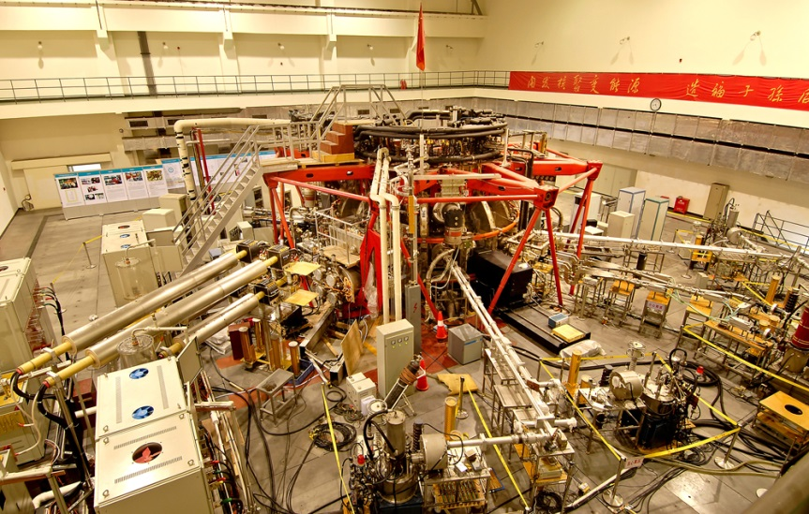
Content：
Background
Experimental results
Theoretical simulation
Summary

Slide 3
Background
Simulations and scaling have predicted that in magnetic fusion reactor as ITER, the divertor heat flux caused by large ELMs are far beyond the material limitation, and can cause severe erosion on plasma facing components.
Effective techniques are highly desirable to achieve external control of the ELM size and the heat load.
ELM and Heat flux control for ITER
Existing mitigation techniques
ELM mitigation techniques :Pellet pacing, SMBI, RMP and other perturbation fields.
Recently lower hybrid current drive (LHCD) has been shown to be a new effective method for ELM mitigation.
Nevertheless, the reliability of these methods still needs to be demonstrated, and the understanding of the mechanism requires further investigation.
ELM mitigation seems to be strongly correlated to pedestal turbulence enhancement from the previous results in HL-2A.

Slide 4
Experimental Results
Ⅱ.
ELM control with LHCD
ELM control with impurity seeding

Slide 5
ELMs control with LHCD on HL-2A -Experimental observations
G.L. Xiao P.o.P., 2017
High
Parameter
zone
ELM and heat load Control
ELM mitigation is clearly observed: $f_{ELM} ↑$ and $A_{ELM} ↓$
No significant degradation of stored energy W_{E} .
Significant reduction of divertor peak heat load.
Parameter dependence
Dependence in $\overline{n_{e}}$ and $P_{LH}$ of the ELM mitigation with LHCD.
Better chance to achieve mitigation with higher power and higher density ($n_{e}≥2.5×{10}^{19} m^{−3}, { P}_{LHCD}≥300kW$).

Slide 6
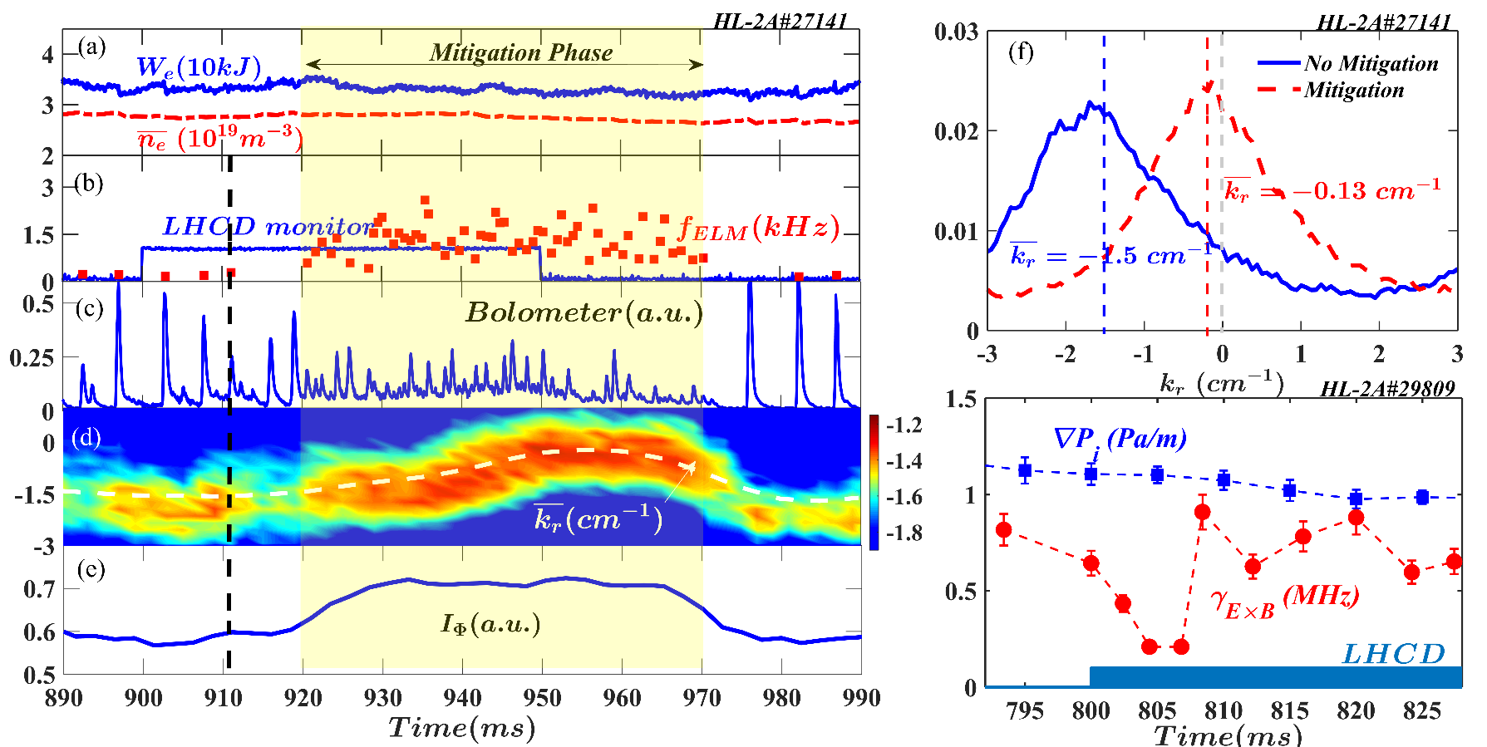
ELMs control with LHCD on HL-2A -Role of Pedestal Turbulence
Turbulence regulation
Synchronization and desynchronization: LHCD>0→a time interval→ ELM mitigation and pedestal turbulence enhancement.
Turbulence enhancement: closely related to the turbulence $k_{r}$-spectrum shift.
k_{r}-spectrum shift: $\overline{k_{r}}≈−1.5 cm^{−1}→ \overline{k_{r}}≈0 cm^{−1}$
Velocity shear: LHCD>0 → $γ_{E×B}$ drops sharply.

Slide 7
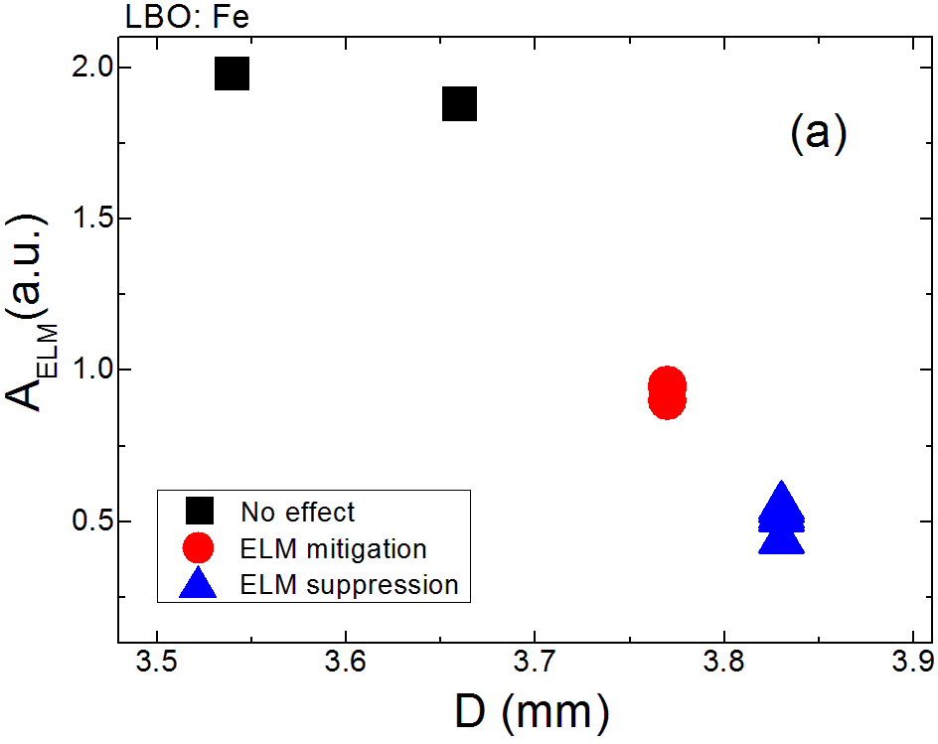
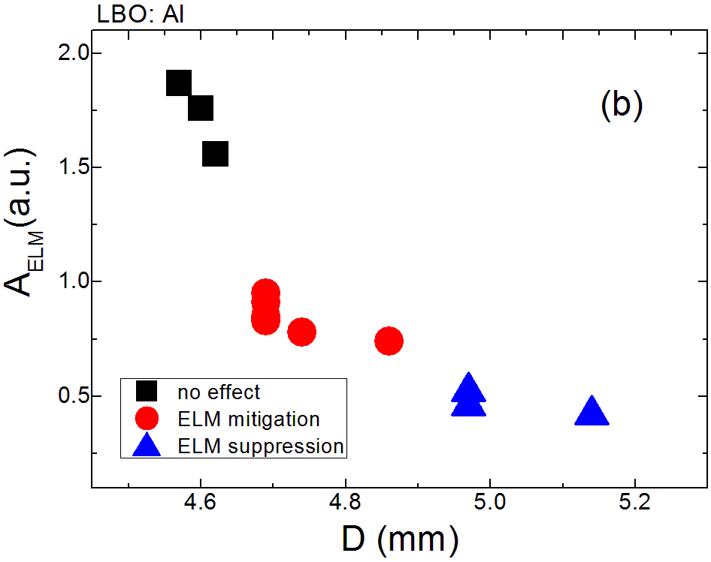
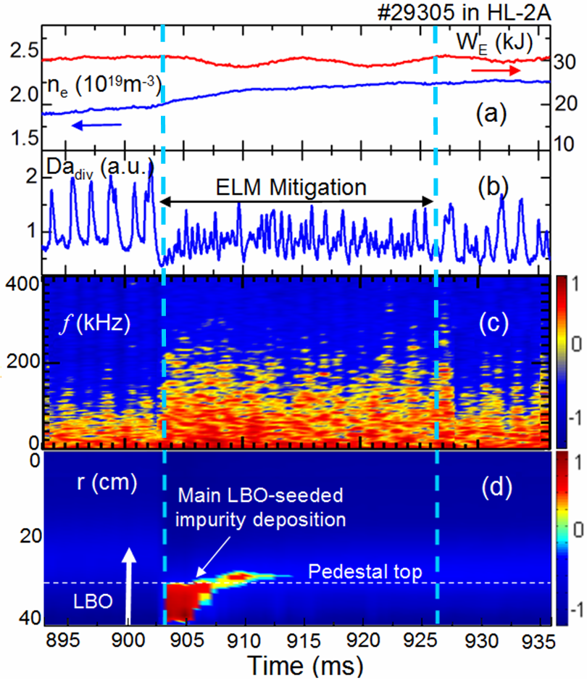
ELMs control with impurity seeding -Experimental observations
ELM amplitude
Quantity of impurity
Y.P.Zhang N.F. 2018
Experimental Observation
Location: The impurity mainly in pedestal area.
ELMs mitigation by impurity seeding with the enhancement of turbulence spectrum.
Parameter Dependence
The efficiency: dependence on the quantity of electron injected with seeded impurity, or Z_{eff} of the impurity.
Notes:
species

Slide 8
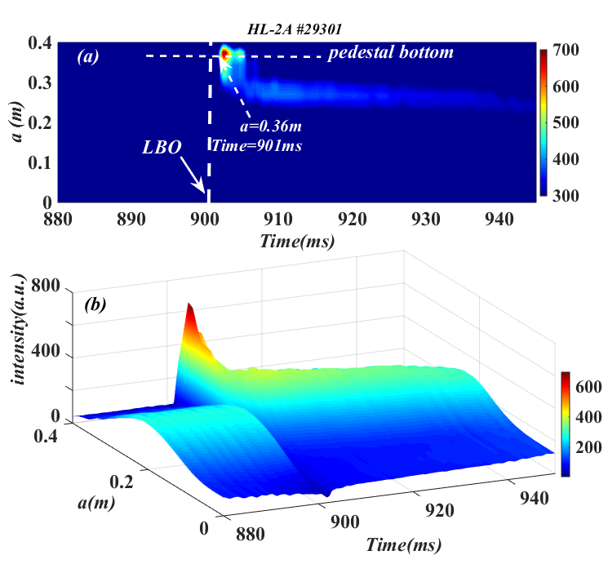
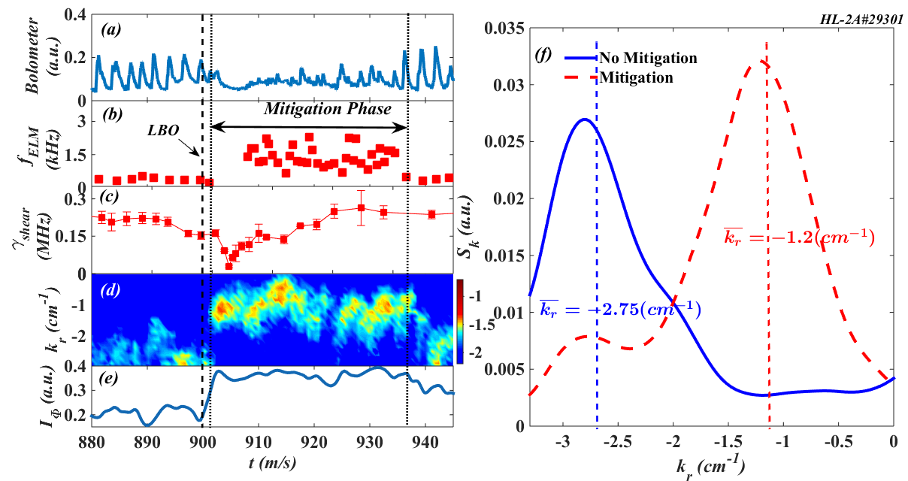
ELMs control with impurity seeding -Similarity on Pedestal Turbulence
Laser Blow-off(LBO) Fe impurity seeding
$\text{E}\text{×}\text{B}$ Velocity shear: Severe reduction after LBO.
$$↓$$
Pedestal turbulence: Intensity enhanced.
radial wavenumber spectral shift.
$$↓$$
ELM Mitigation

Slide 9
Theoretical Simulation
Ⅲ.
Spectral shift model
Typical simulation result
Identification of critical growth rate $γ_{0}$
Comparison

Slide 10
Spectral Shift Model
Model is based on the regulation of the turbulence amplitude by its radial wavenumber spectral shift caused by external velocity shear:
Velocity shear induced convection term
Linear growth rate
Diffusion in k_{x} space
$$∂ɸ/∂t=γ_{k_{y}}ɸ+γ_{E×B}k_{y}∂ɸ/∂k_{x}−\left(c_{y}k_{y}^{2}+c_{x}k_{x}^{2}\right)ɸ^{2}+D(∂^{2}ɸ)/(∂k_{x}^{2} ) (1)$$
$$k_{x}:radial;$$
$$k_{y}:poloidal.$$
$$∂|∇p|/∂t=Q−(χ+χ_{0} )|∇P| (2)$$
Dissipation term
$$γ_{E×B}=α\left|∇P\right|+U_{0}−U \left(3\right)$$
(1) Nonlinear evolution of turbulence amplitude.
(2) Thermal transport equation.
(3) Velocity shear equation
U: Reduction value of the $γ_{E×B}$from the external source input.

Slide 11
Typical Simulation Result
Q: heat source
U: reduction value of velocity shear
$\overline{k_{x}}:$Averaged Radial
wavenumber
$I_{Φ}:$Turbulence
intensity
U>0, $γ_{E×B}$ drops sharply.
Time delay: $U>0,$ $\overline{k_{x}}$ $→0$with a time delay $∆t_{k}$, then turbulence intensity $I_{Φ}↑$.
Turbulence enhancement: turbulence spectral shift $\overline{k_{x}}→0$, the turbulence dissipation term($\sim$ $k_{x}^{2}$) $↓$, pedestal turbulence intensity $I_{Φ}↑.$

Slide 12
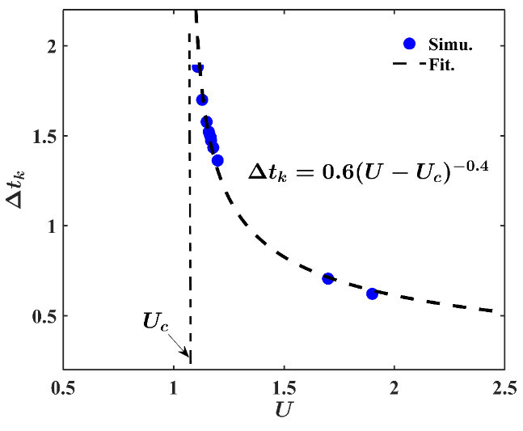
Identification of Critical Growth Rate $γ_{0}$
critical value U_{c} : U<U_{c} no effect on turbulence.
U>U_{c} triggering the variation of turbulence.
Identification of $γ_{0}: Y=\int_{0}^{∆t_{k}}{γ_{E×B}dt ∝}∆t_{k}$, $Y=γ_{0}∆t_{k}−b$.
Linear relation between $γ_{0}$ and U_{c}.
Role of $γ_{0}$: key role for regulation of the turbulence amplitude by the radial wavenumber shift.

Slide 13
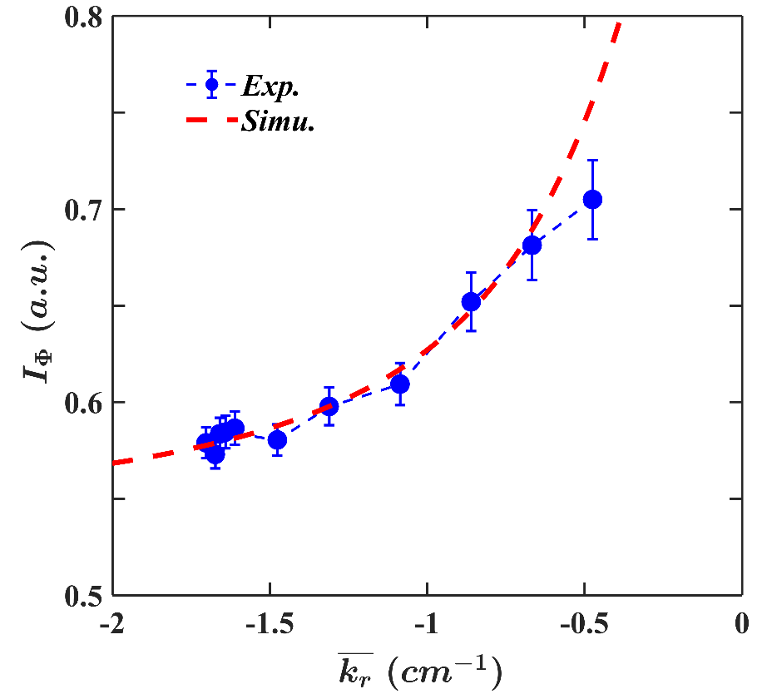
Comparison
The radial wavenumber $k_{x}→0$, the turbulence dissipation term($\sim$ $k_{x}^{2}$) $↓$, pedestal turbulence intensity $I_{Φ}↑.$
Good agreement on turbulence behavior between experimental and simulation result.

Slide 14
Summary
Ⅳ.
Mitigation effect
Turbulence behavior
Theoretical modeling

Slide 15
Summary
1
Mitigation Effect
ELM mitigation with LHCD and impurity seeding is successfully achieved.
Parameter dependence: LHCD($n_{e}≥2.5×{10}^{19} m^{−3}, P_{LHCD}≥300kW$)
Impurity seeding: Z_{eff} of the impurity
2
Turbulence behavior
LHCD/impurity seeding could reduce the plasma velocity shear.
The close relation between pedestal turbulence enhancement and its radial wavenumber spectrum shifting to origin.
3
Theoretical modeling
Theoretical model shows turbulence could be regulated by U_{c} or critical growth rate $γ_{0}$.
Good agreement on turbulence regulation between experiment and theory.
Plausible mechanism for ELM mitigation: External source input(such as LHCD and impurity seeding) → Edge velocity shear decrease → Turbulence radial spectral shift → Turbulence enhancement → ELM mitigation.
Notes:
kx<0 inwards

Slide 16
THANK YOU for your attention！

