Slide 1
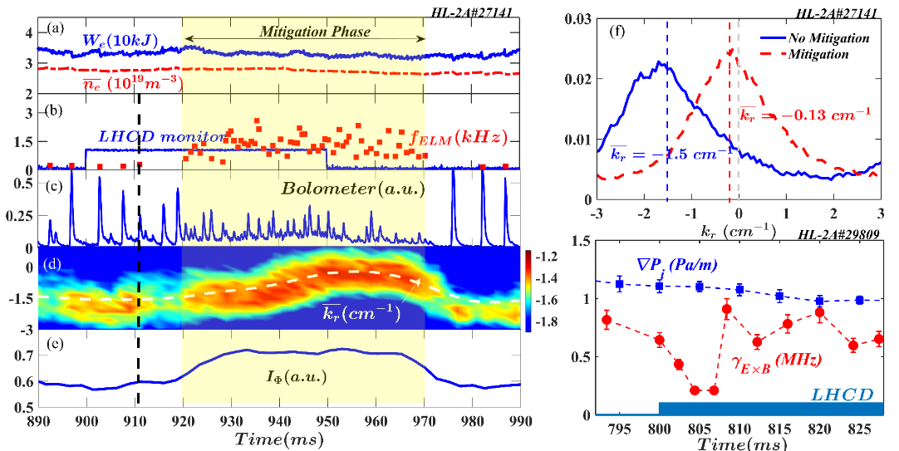
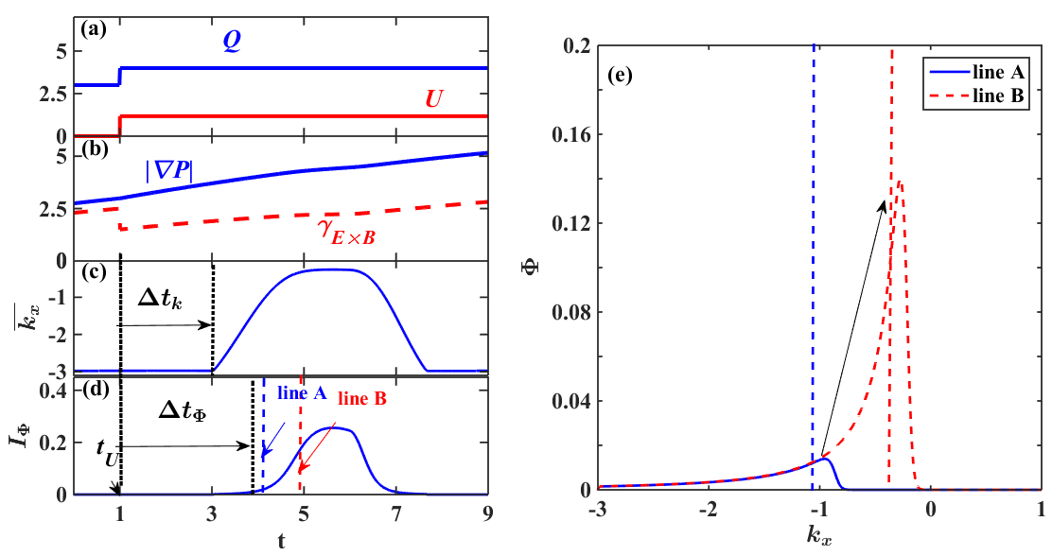
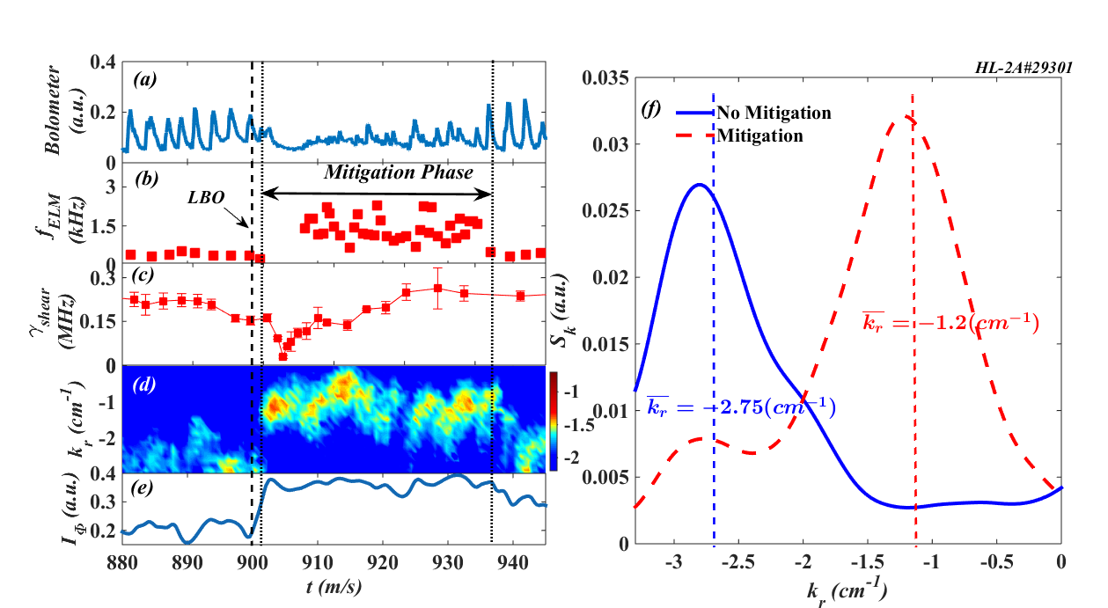
EX7-4 G.L. Xiao ELM control with LHCD and impurity seeding
ELM Control with LHCD and impurity seeding have been successfully achieved on HL-2A
Experimental analysis and theoretical simulation shows plausible mechanism: External source input(LHCD, impurity seeding, SMBI) → Edge velocity shear decrease → Turbulence radial spectral shift → Turbulence intensity enhancement → ELM mitigation

