Slide 1
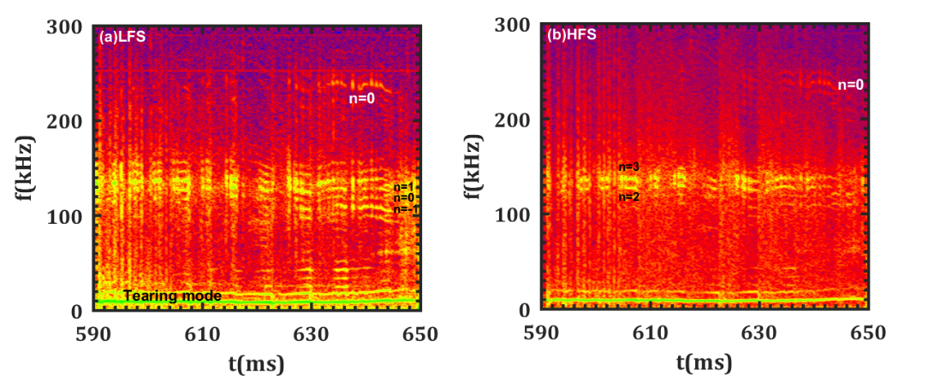
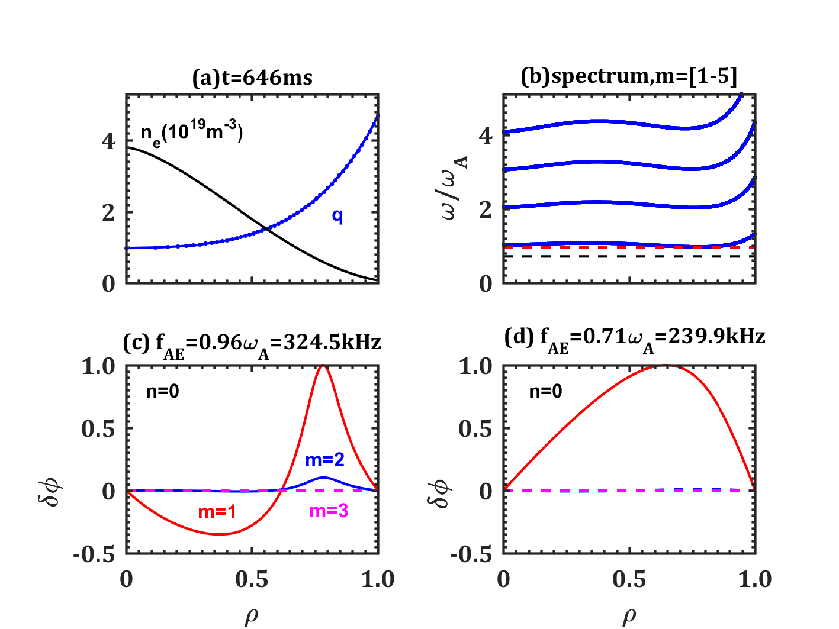
The global Alfven eigenmode (GAE) driven by nonlinear coupling between toroidal Alfven eigenmode (TAE) and tearing mode is found for the first time on HL-2A.
TAE modes nonlinearly couple with low frequency tearing mode and
lead to generation of Alfvenic sidebands with n_{AMs}= 0, ±1, ±2…
GAE driven by two AMs couple ：
f_{AMa}+ f_{AMb}= f_{HFM} ≈ 240kHz
n_{AMa}+ n_{AMb}= n_{HFM}= 0
Alfven mode code (AMC) calculation:
The frequency is around 240kHz, which agree with experimental observation. The mode structures display global feature and cover fully normalized radius of ρ = 0−1.

