Slide 1

IAEA-FEC 2018 EXC/5-1
Transport Characteristics of Deuterium and Hydrogen Plasmas with Ion ITB in LHD
K. Nagaoka^{1,2}
H. Takahashi^{1,3}, M. Nakata^{1,3}, K. Tanaka^{1,4}, K. Mukai^{1,3}, M. Yokoyama^{1,3},
H. Nakano^{1,3}, S. Murakami⁵, K. Ida^{1,3}, M. Yoshinuma^{1,3}, S. Ohdachi^{1,3}, T. Bando⁶, M. Nunami^{1,3}, S. Satake^{1,3}, R. Seki^{1,3}, C. Suzuki^{1,3}, H. Yamaguchi¹, M. Osakabe^{1,3},
T. Morisaki^{1,3} and the LHD Experiment Group
¹National Institute for Fusion Science, National Institutes of Natural Sciences
²Nagoya University, Graduate School of Science
³SOKENDAI, Department of Fusion Science
⁴Kyushu University, Interdisciplinary Graduate School of Engineering Sciences
⁵Kyoto University, Graduate School of Engineering
⁶National Institutes for Quantum and Radiological Science and Technology

Slide 2
Contents
Introduction
Transport characteristics and improvement
- T_{e}/T_{i} dependence
- R/L_{Ti} dependence
Isotope effects
- Lower χ_{i} in deuterium plasma
- Nonlinear transport simulation (GKV)
Summary

Slide 3
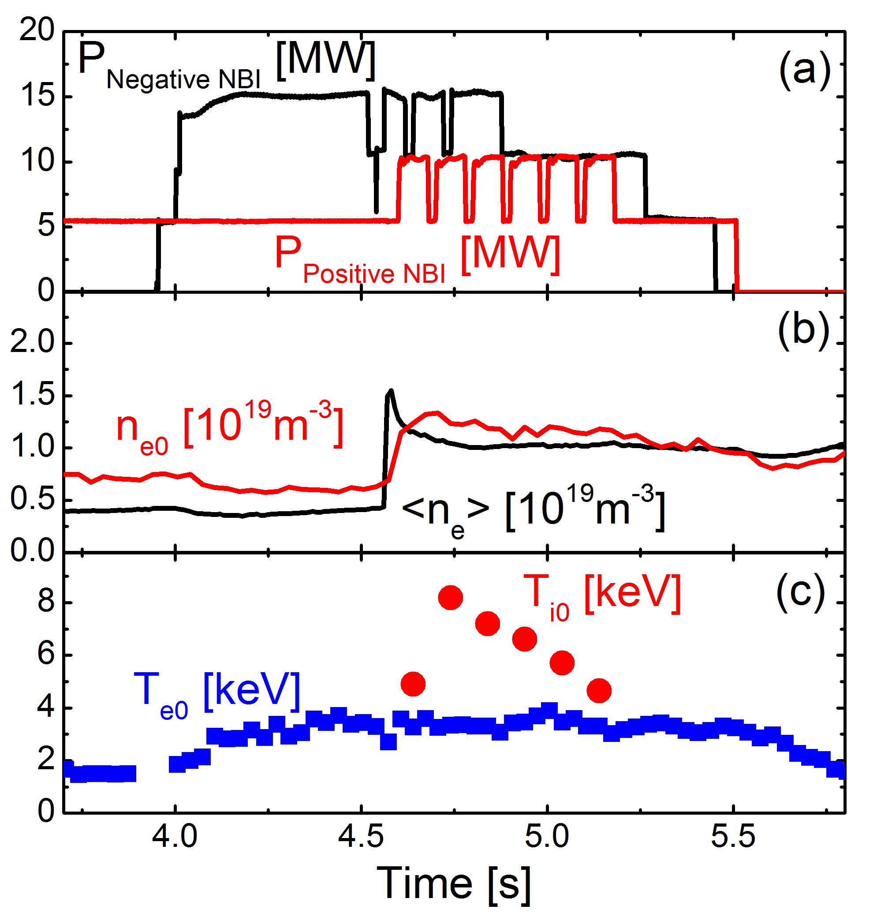
Ion ITB formation in helical plasmas
Nagaoka, NF2015
ion ITB
C pellet
impurity hole
The T_{i} is higher than the T_{e} in the core of NBI heated plasma.
The peaked T_{i} profile with steep gradient (ion ITB) formed, and no ITB was observed in the T_{e} and density profiles.
Significant reduction of anomalous ion heat transport with E_{r}<0 (ion-root).
Carbon impurity was expelled from the core (Impurity hole formation)

Slide 4
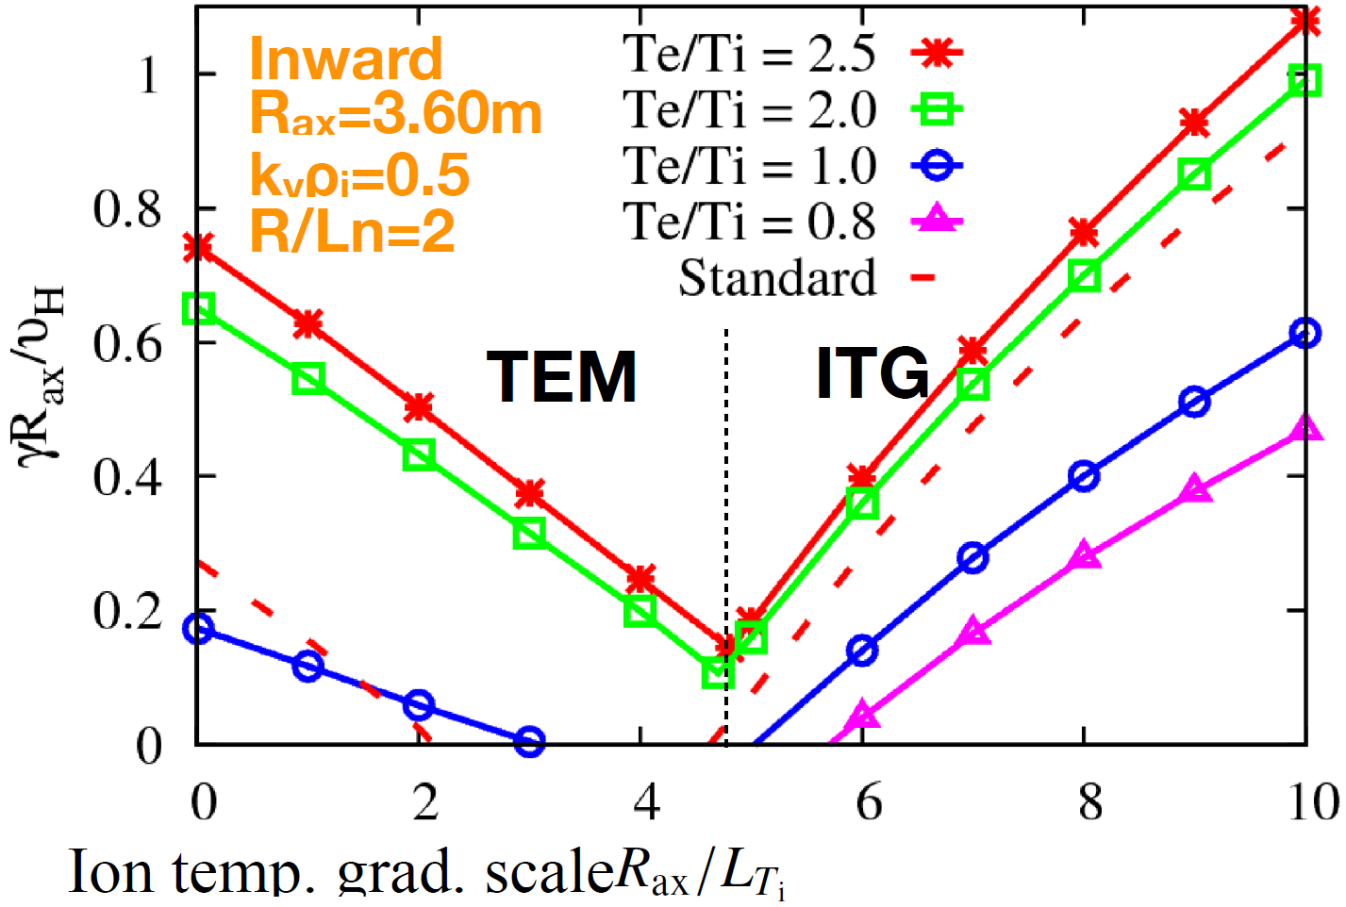
ITG is dominated in high-T_{i} plasmas in LHD
Gyrokinetic Vlasov code（GKV）
- 5 dimensions in phase space
local flux tube
Inward shifted LHD plasmas
Nakata PPCF2016
In high-T_{i} regime（R/L_{Ti}∼10）, ITG mode is the most unstable
Growth rate increases with R/L_{Ti}（= -(R/T_{i})(dT_{i}/dr)）
Growth rate increases with T_{e}/T_{i} as well
＝＞Therefore, we focus on R/L_{Ti} andT_{e}/T_{i} dependence

Slide 5
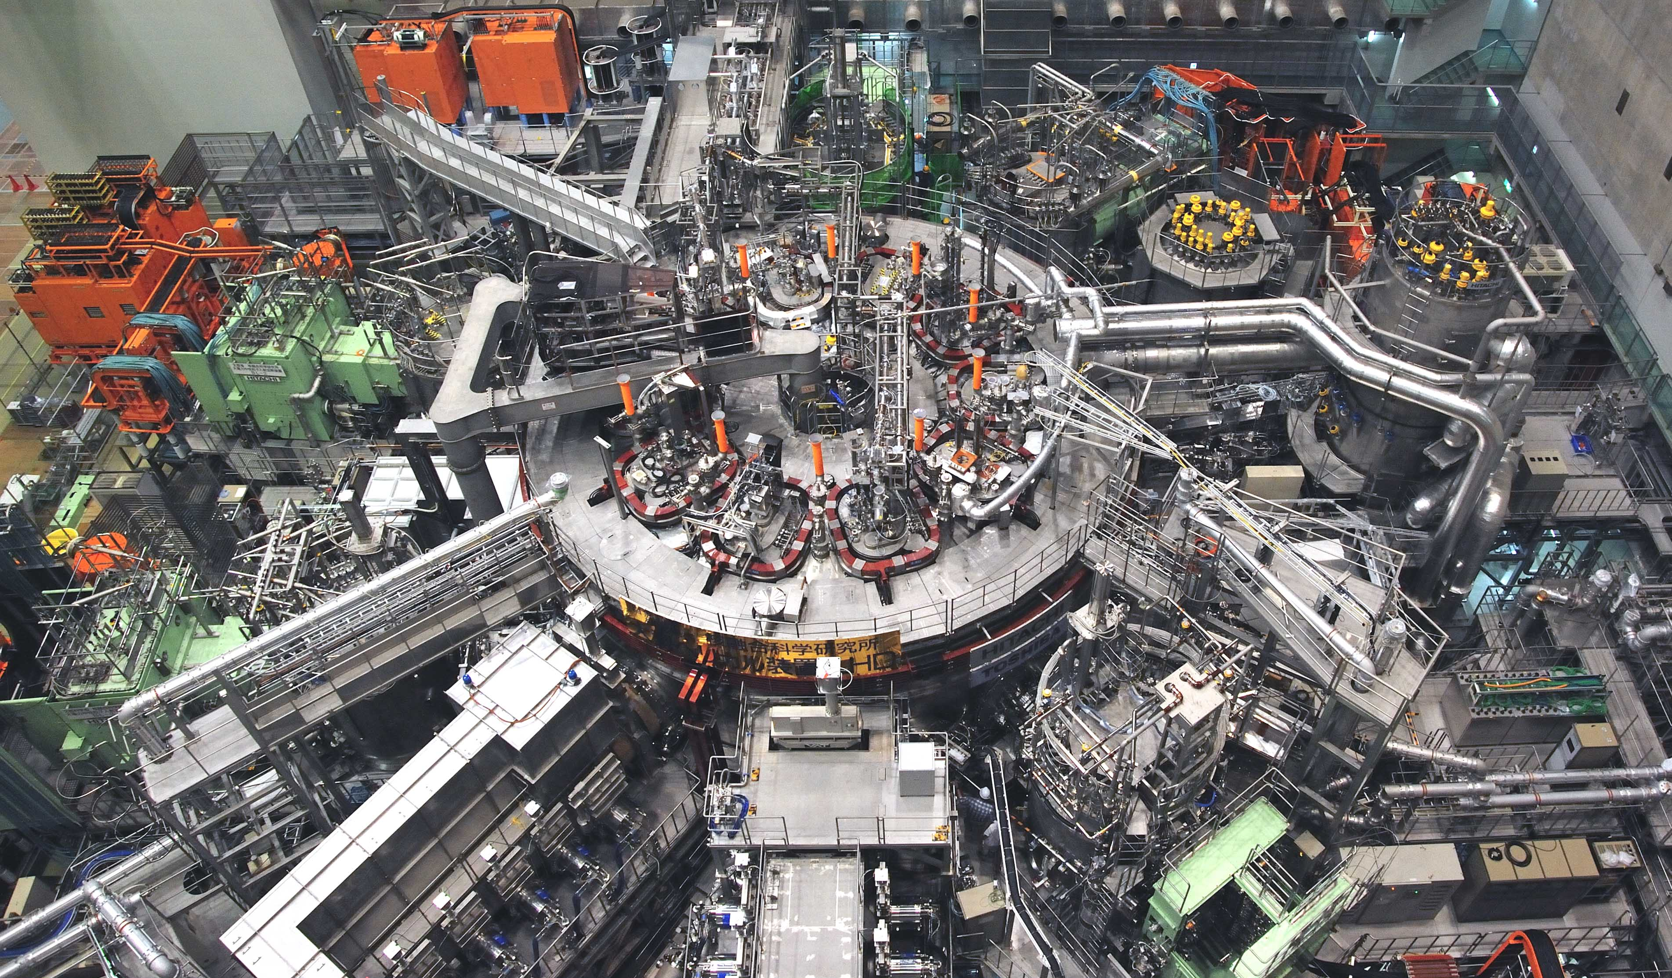
Deuterium experiment in LHD

Slide 6
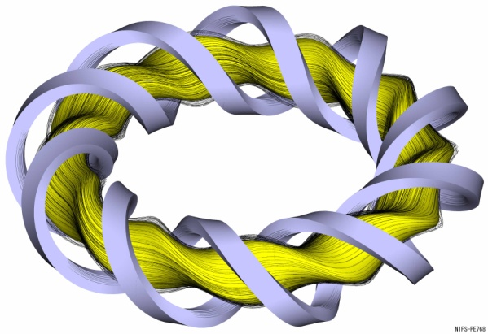
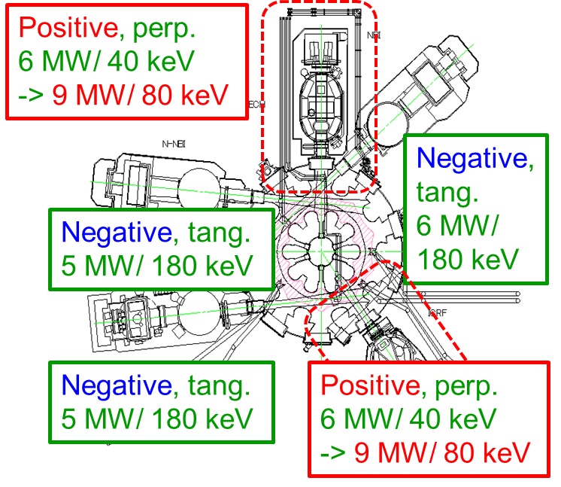
Deuterium experiment in LHD
Specifications
• Helical mode numbers: l/m=2/10
• All superconducting coil system
• Plasma major radius: 3.42-4.1 m
• Plasma minor radius: 0.63 m
• Plasma volume: 30 m³
• Toroidal field strength: 3 T
• 20 RMP coils

Slide 7
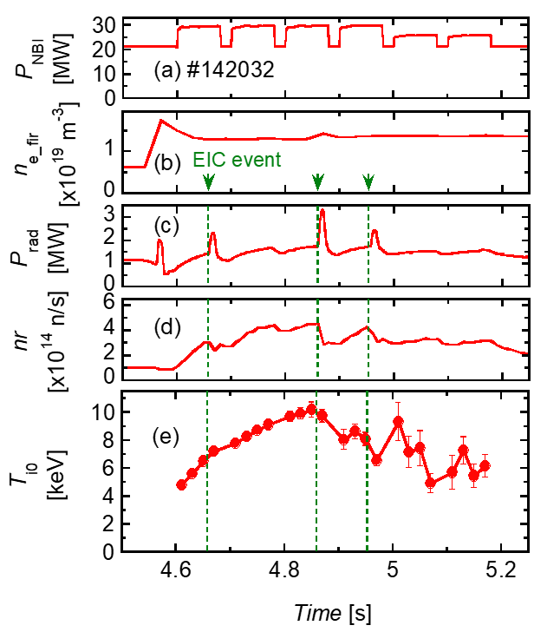
Extension of high-T_{i} regime （T_{i0}=10keV）
Ohdachi EX/1-3Rb,EX/1-TH/1
T_{i0}=10keV ±0.2keV （Z_{eff}=~2） was achieved
C pellet + He gas puff
D beams（p-NBI） + H beams (n-NBI)
MHD bursts (EIC) degraded the neutron rate and T_{i0}
The ion heat transport with D is improved, although the D ion ratio is roughly 30% of ion density.

Slide 8
Extension of high-T_{i} regime （T_{i0}=10keV）
In order to evaluate the transport in more detail and discuss isotope effect, pure H plasmas and pure D plasmas are analyzed in this study.

Slide 9
Introduction
Transport characteristics and improvement
- T_{e}/T_{i} dependence
- R/L_{Ti} dependence
Isotope effects
- Lower χ_{i} in deuterium plasma
- Nonlinear transport simulation (GKV)
Summary

Slide 10
Pure Hydrogen and Pure Deuterium plasmas
Target plasmas analyzed in this study are High Purity of ion species
H plasma： ${n_{H}}/{n_{e}}>0.80$ with H gas puff + H beams
D plasma： ${n_{D}}/{n_{e}}>0.80$ with D gas puff + D beams

Slide 11

ITG like T_{e}/T_{i} dependence
Significant increase of heat transport depending on T_{e}/T_{i}
＝＞ consistent with ITG turbulence
No significant difference in T_{e}/T_{i} dependence between H and D plasmas

Slide 12
Transport suppression with (R/L_{Ti})
Reduction of heat transport with R/L_{Ti}, inconsistent with ITG nature
＝＞ion ITB formation
Transport suppression in D plasmas
＝＞another mechanism of transport suppression depending on ion mass

Slide 13
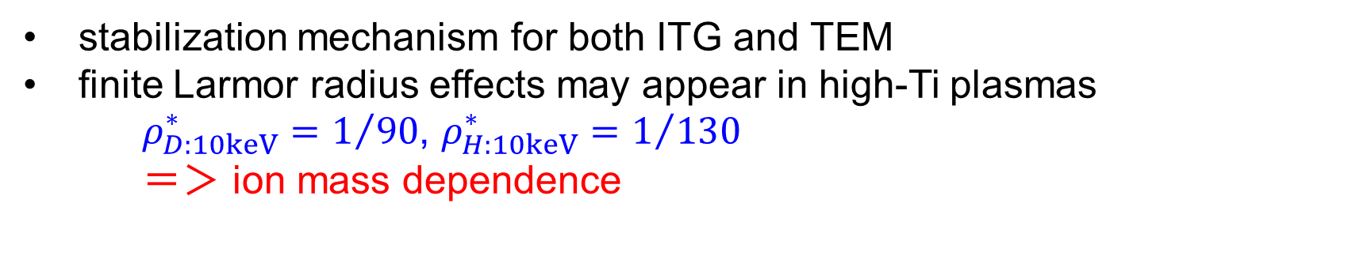
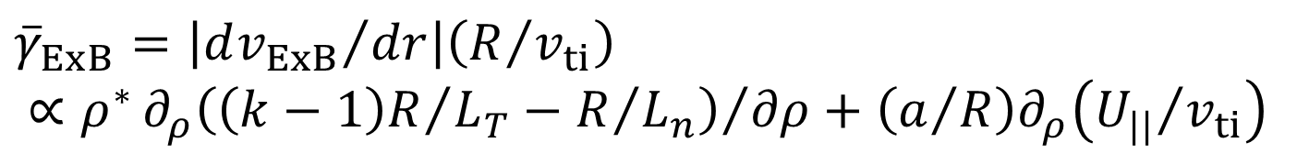
Turbulent suppression depending on ion mass and R/L_{Ti}
Radial electric field shear（EｘB poloidal rotation）
${\overline{γ}}_{ExB}=\left|{dv_{ExB}}/{dr}\right|\left(R/{v_{ti}}\right)$
$$∝ρ^{∗}{∂_{ρ}\left({\left(k−1\right)R}/{L_{T}−R/{L_{n}}}\right)}/{∂ρ}+\left(a/R\right)∂_{ρ}\left({U_{||}}/{v_{ti}}\right)$$
Burrell PoP1997, Jolliet NF2012
stabilization mechanism for both ITG and TEM
finite Larmor radius effects may appear in high-Ti plasmas
$ρ_{D:10keV}^{∗}=1/{90}$, $ρ_{H:10keV}^{∗}=1/{130}$
＝$＞$ ion mass dependence
The ExB shear is a potential candidate of physics mechanism of turbulent suppression, although it should be confirmed by further experiments and global transport simulations in near future.

Slide 14
Introduction
Transport characteristics and improvement
- T_{e}/T_{i} dependence
- R/L_{Ti} dependence
Isotope effects
- Lower χ_{i} in deuterium plasma
- Nonlinear transport simulation (GKV)
Summary

Slide 15
Pure Hydrogen and Pure Deuterium plasmas
Target plasmas analyzed in this study are High Purity of ion species
H plasma： ${n_{H}}/{n_{e}}>0.80$ with H gas puff + H beam
D plasma： ${n_{D}}/{n_{e}}>0.80$ with D gas puff + D beam
Comparison with the same n_{e} and P_{i_tot}

Slide 16
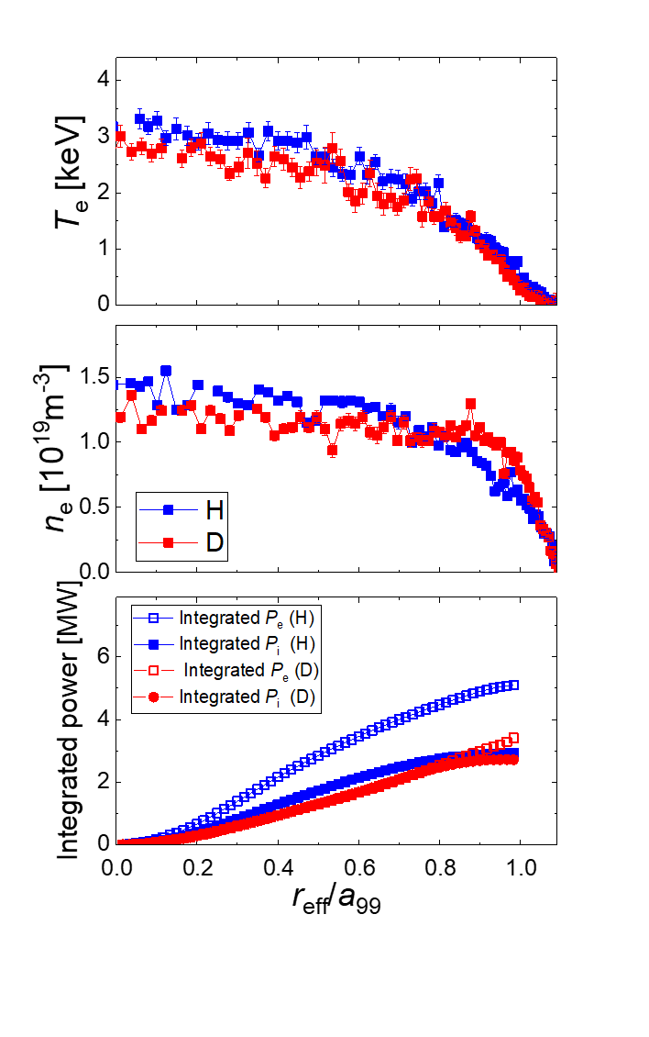
Comparison between H plasma and D plasma
Higher T_{i} in D plasma
Steeper density gradient in the edge of D plasma
Larger electron heating power in H plasma with a factor of 1.5
＝＞higher T_{e} (20-30%)

Slide 17
Transport analysis
Ion
Electron
Significant reduction of the ion heat transport in the core of both plasmas
＝＞Ion ITB formations
Smaller heat transport in D plasma
Density fluctuation (PCI) is smaller in D plasma
＝＞correlating with heat transport

Slide 18
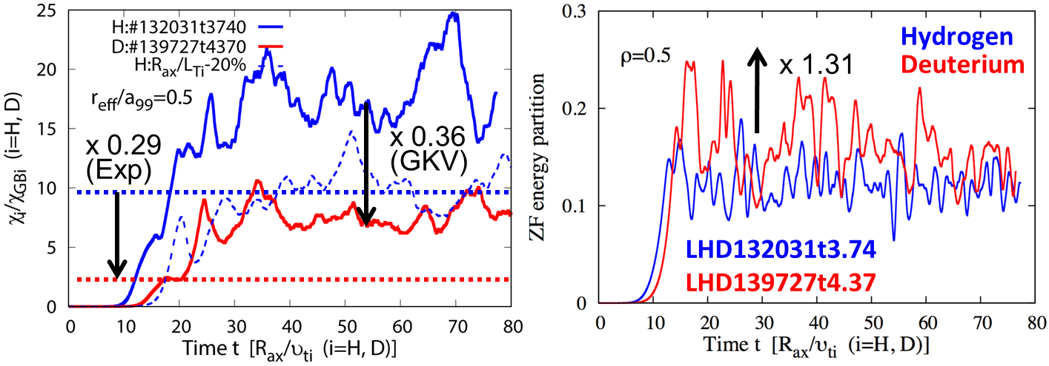
Nonlinear GK simulations under Exp. conditions
Nakata EPS2018 &PPCF2018
Nonlinear gyrokinetic simulation （GKV） with plasma profiles obtained in experiment
    Destabilization of ITG mode and nonlinear saturation
    Transport level is reproduced with the accuracy of 20% in T_{i} gradient
    => Global effects such as Er-shearing will improve the discrepancy
    Reproduce the reduction of ion heat transport in D plasma

Slide 19
Nonlinear GK simulations under Exp. conditions
Nakata EPS2018 &PPCF2018
Nonlinear gyrokinetic simulation （GKV） with plasma profiles obtained in experiment
    ZF energy partition is larger in D plasma with factor of 1.3
    => ZF enhancement may contribute the transport reduction in D plasmas

Slide 20
Summary
In D experiments in LHD, T_{i0}=10keV was achieved, and transport analyses of Ion ITB plasmas and isotope effect were discussed.
On Ion ITB formation
  T_{e}/T_{i} dependence is ITG-like
  Transport reduction with R/L_{Ti}
  ＝＞ ion ITB
  ＝＞ suggesting the improvement with ExB shear
On isotope effect
  Ion heat transport reduction in D plasma
  Nonlinear sim.（GKV） reproduced the reduction of χ_{i} in D plasma, and observed the increase of ZF
These mechanisms contribute to the achievement of T_{i0}=10 keV in the helical plasma

Slide 21
Thank you for your attention!

Slide 22
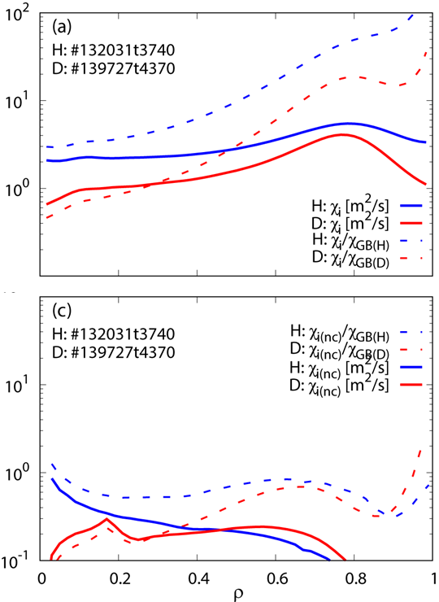
Neoclassical transport
Neoclassical transport calculation with FORTEC3D
The solution with Er > 0 was obtained, and should be checked experimentally
The NC transport is smaller than experimental evaluation
=> turbulent dominates the transport
The difference of NC transport between H and D plasma is smaller and cannot explain the experimental observation

Slide 23

Strategy of evaluation of isotope effects in LHD
Global confinement
Global
Scaling of confinement time
$$τ\sim A^{x_{1}}{∙ρ}_{∗}^{x_{2}}∙ν_{∗}^{x_{3}}∙β^{x_{4}}$$
- wide parameter regime
Local transport
Local
Dependence on local parameters, their gradients
$$χ\sim A^{x_{1}}{∙ρ}_{∗}^{x_{2}}∙ν_{∗}^{x_{3}}∙β^{x_{4}}∙{\left({T_{e}}/{T_{i}}\right)}^{x_{5}}∙{\left(R/{T_{T}}\right)}^{x_{6}}∙{\left(R/{T_{n}}\right)}^{x_{7}}∙∙∙∙$$
underlying physics
excellent profile measurement

Slide 24
Nonlinear GK simulations under Exp. conditions
Nakata EPS2018 &PPCF2018
Nonlinear gyrokinetic simulation （GKV） with plasma profiles obtained in experiment
    => Destabilization of ITG mode and nonlinear saturation
    => Reduction rate of heat transport reproduced the experiment
    => ZF energy partition is larger in D plasma with factor of 1.3
Global effects such as Er-shear effect will improve the discrepancy in the heat transport

