Slide 1
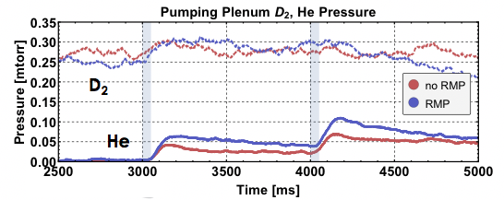
Enhancement of global helium exhaust observed over a range of scenarios during RMP vs ELMy H-mode cases
Increase of partial pressure and concentration in pump duct during RMP
Reduced 𝛕_{p}*_{,He} observed in core, edge, SOL, and pump plenum
𝛕_{p}*_{,He}/𝛕_{E} reduced by ~2 over a range of cases during RMP
Supports enhanced He exhaust as an additional, critically important feature of the RMP ELM control
𝛒=0.81
𝛒=0.20

