Slide 1
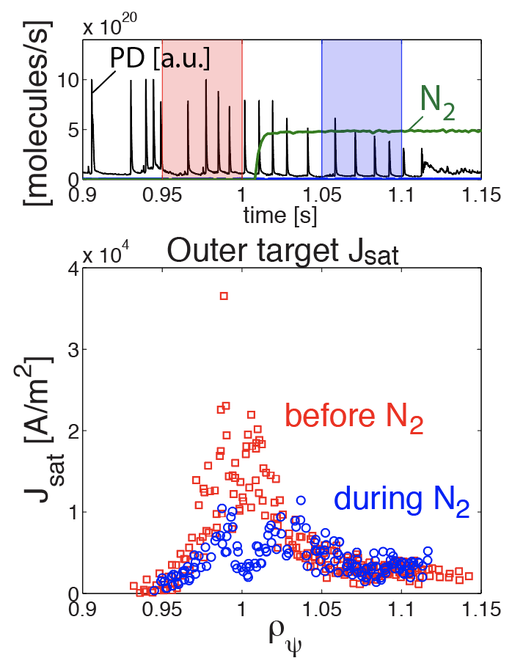
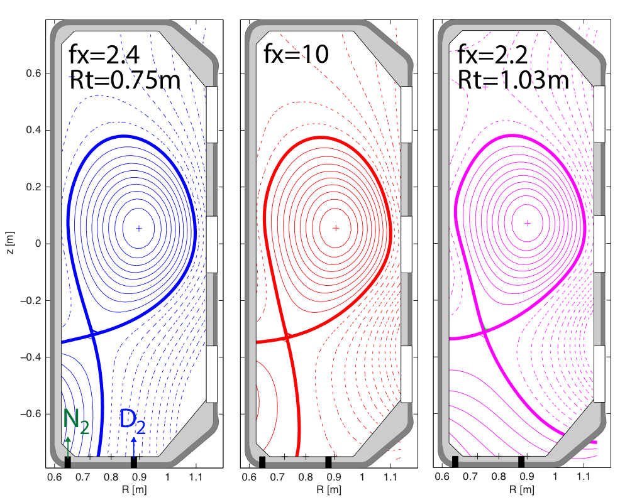
Alternative divertor detachment studies extended to ELMy H-mode on TCV
H-mode power threshold on TCV weakly dependent on geometry for Standard, X-, Super-X, and Snowflake
Partial detachment achieved using N₂ seeding
ELMy H-mode detachment extended to X-, and Super-X
Movement of impurity radiation front 20% slower in Super-X case
Stronger drop in target j_{sat} for X-Divertor
As in L-mode, radiation in outer leg increases by ≈50% in X-Divertor, but absolute level is low
Extend studies next to higher P_{sol} and baffled configurations
[1] C. Theiler et al.,
IAEA - EX/P1-19
[2] J. Harrison et al.,
ready to submit

